Slide 1
Personal Website Workshop
R Ladies DC - June 2017

Slide 2
Install Blogdown
install.packages('devtools')
library(devtools)
devtools::install_github('rstudio/blogdown')

Slide 3
Install Hugo
library(blogdown)
blogdown::install_hugo()

Slide 4
Build a New Site
blogdown::new_site()

Slide 5
Hugo Themes!
https://themes.gohugo.io/

Slide 6
Markdown and R Markdown Resources
Blogdown Book: R Markdown vs. Markdown
R Studio: R Markdown Cheat Sheet
Read the Docs: Markdown Guide

Slide 7
Publishing/Deployment Options

Slide 8
Manual Deployment
| Netlify

Slide 9
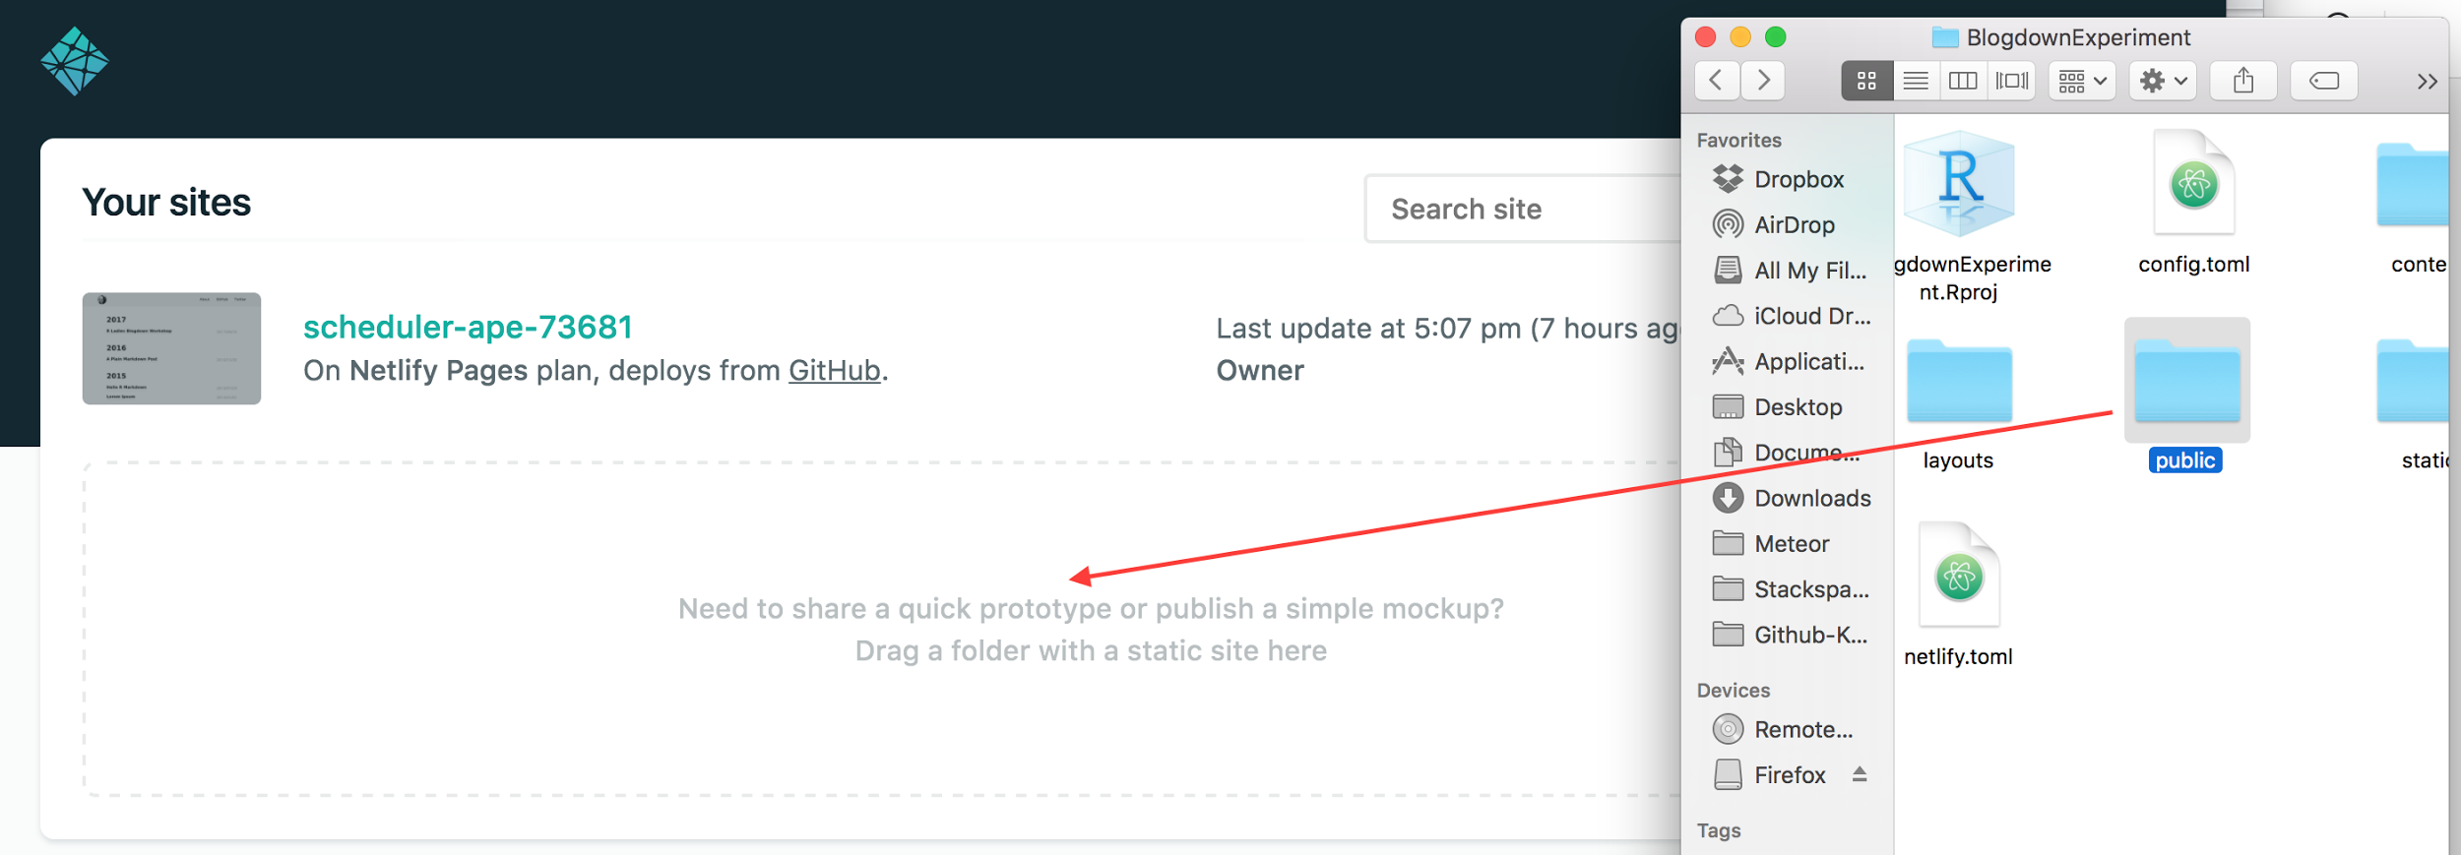
Manual Deployment through Netlify

Slide 10
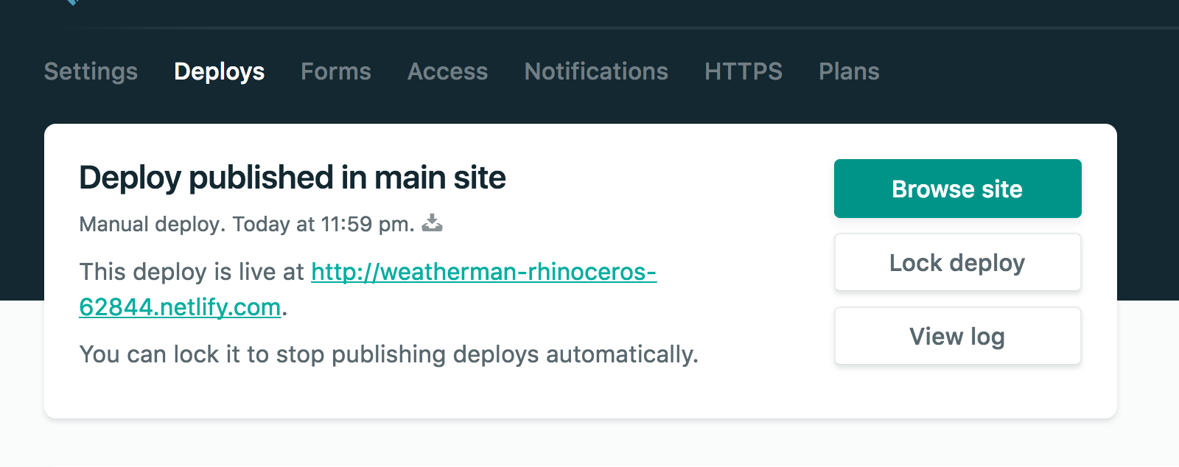
Manual Deployment through Netlify

Slide 11
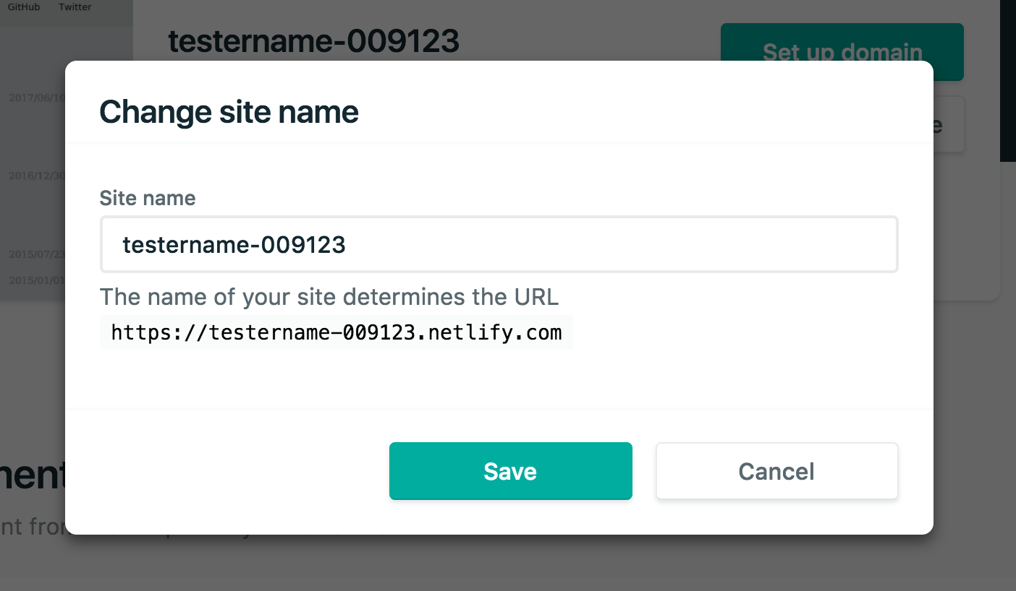
Manual Deployment through Netlify
Notes:
Google Domains!

Slide 12
Continuous Deployment
| Netlify & Github

Slide 13
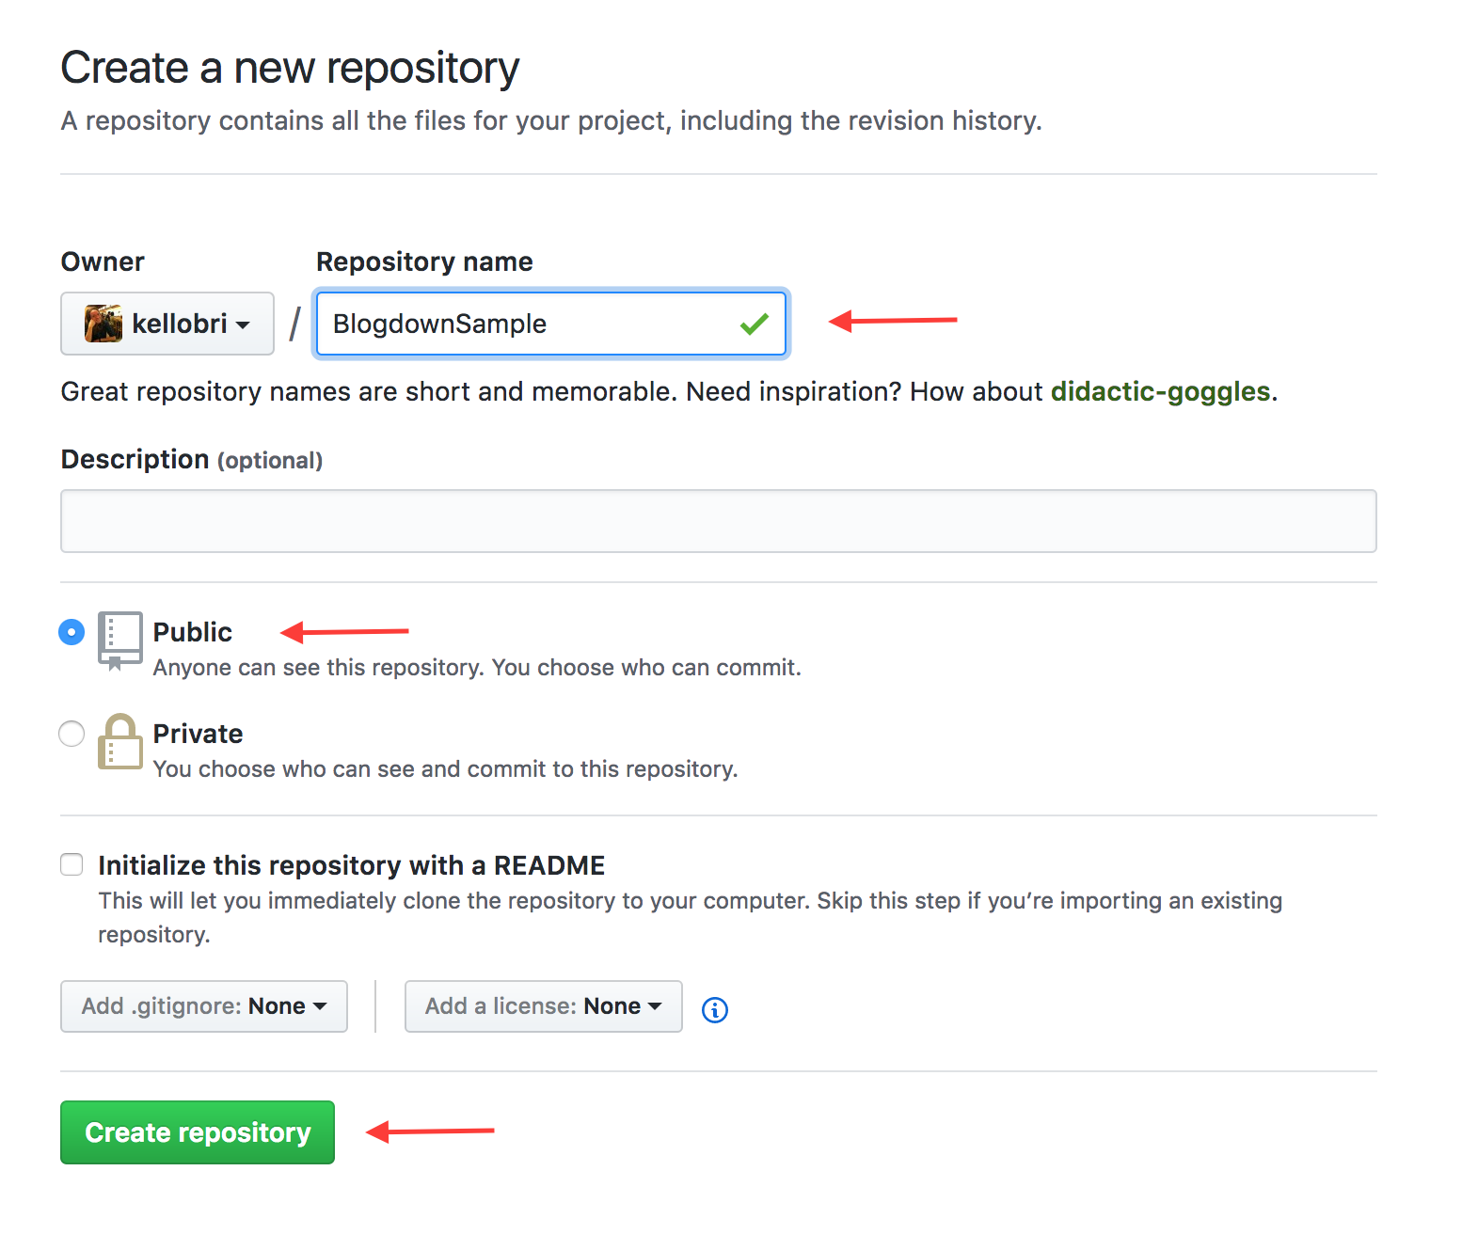
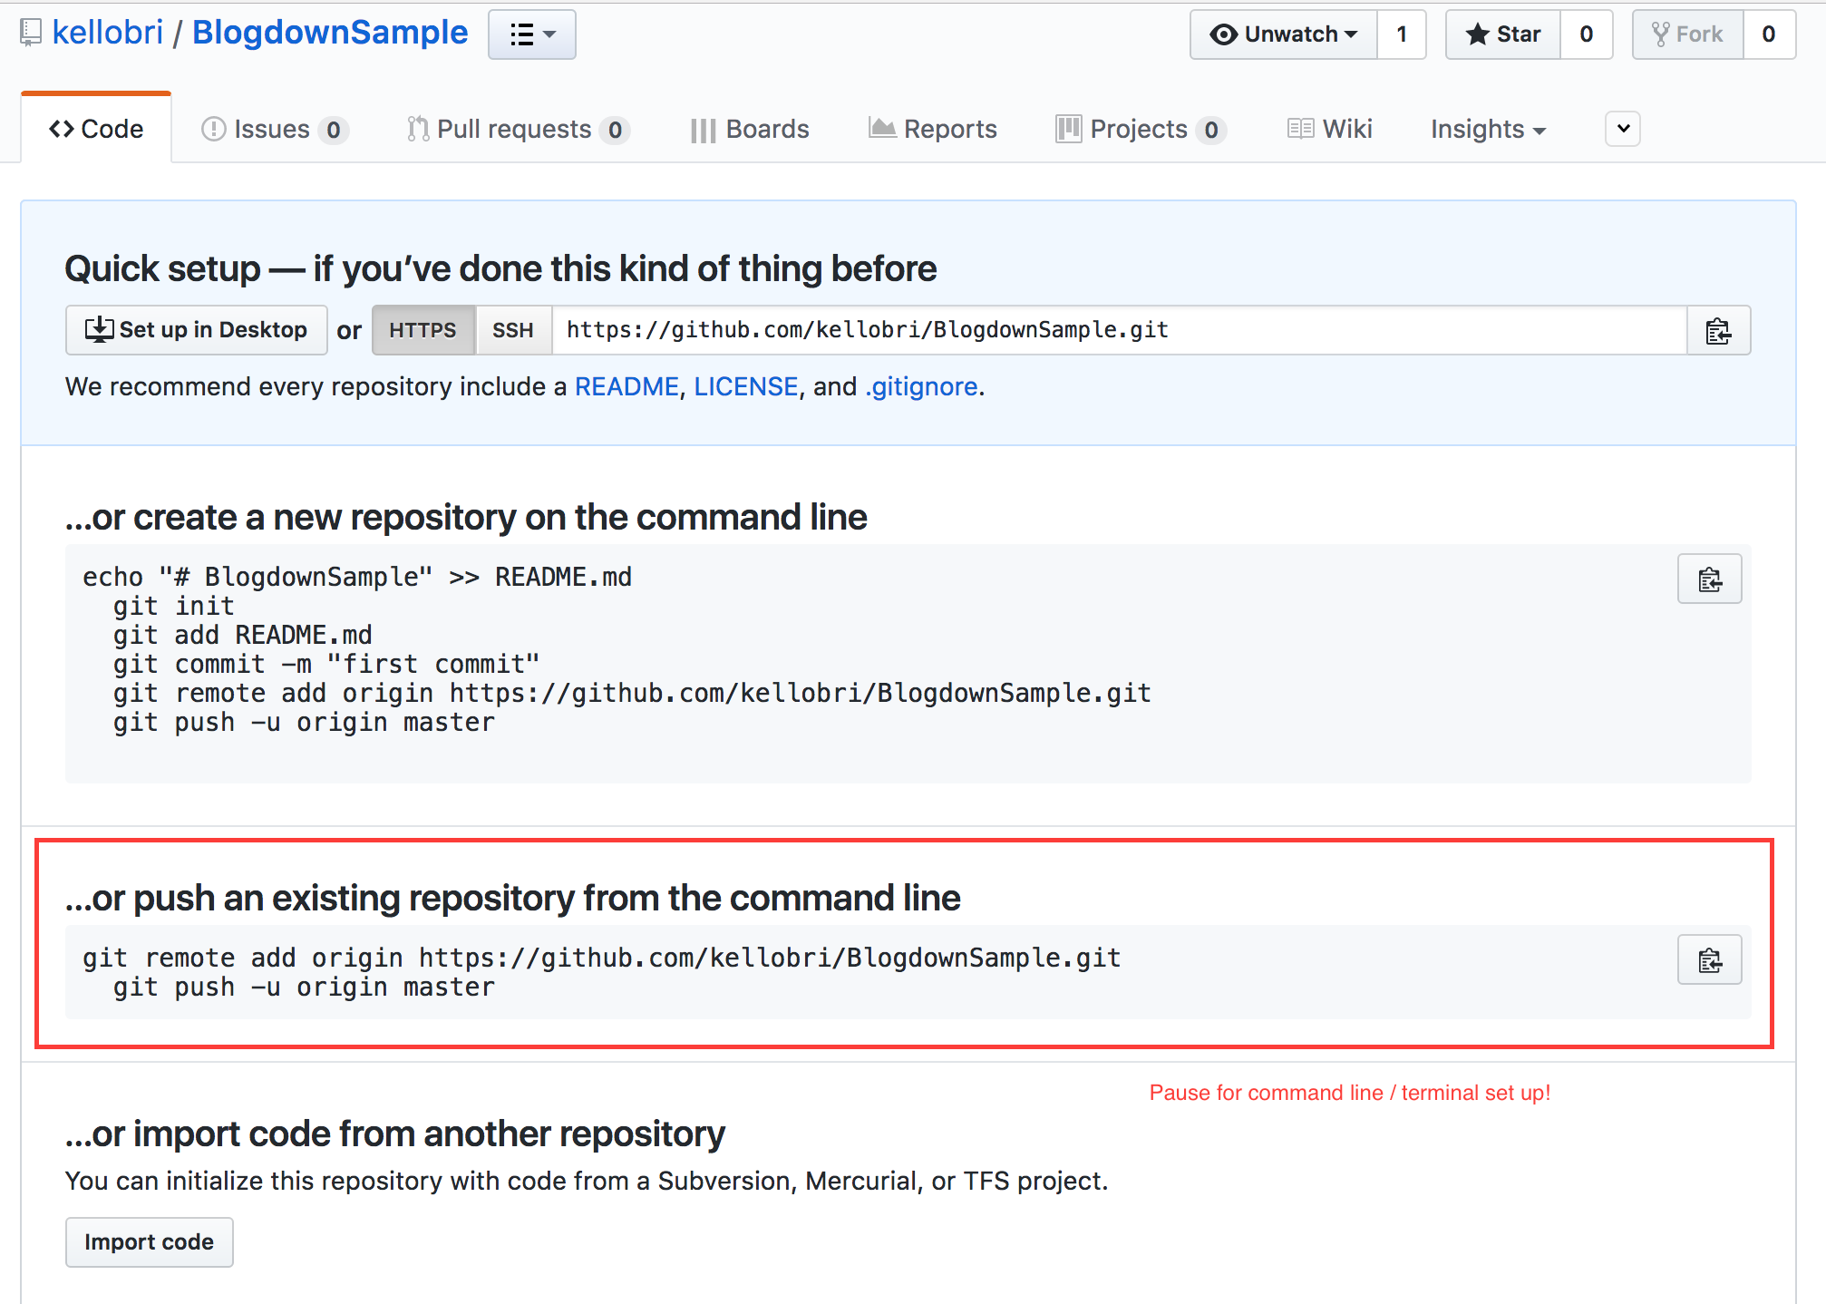
Continuous Deployment through Github & Netlify

Slide 14
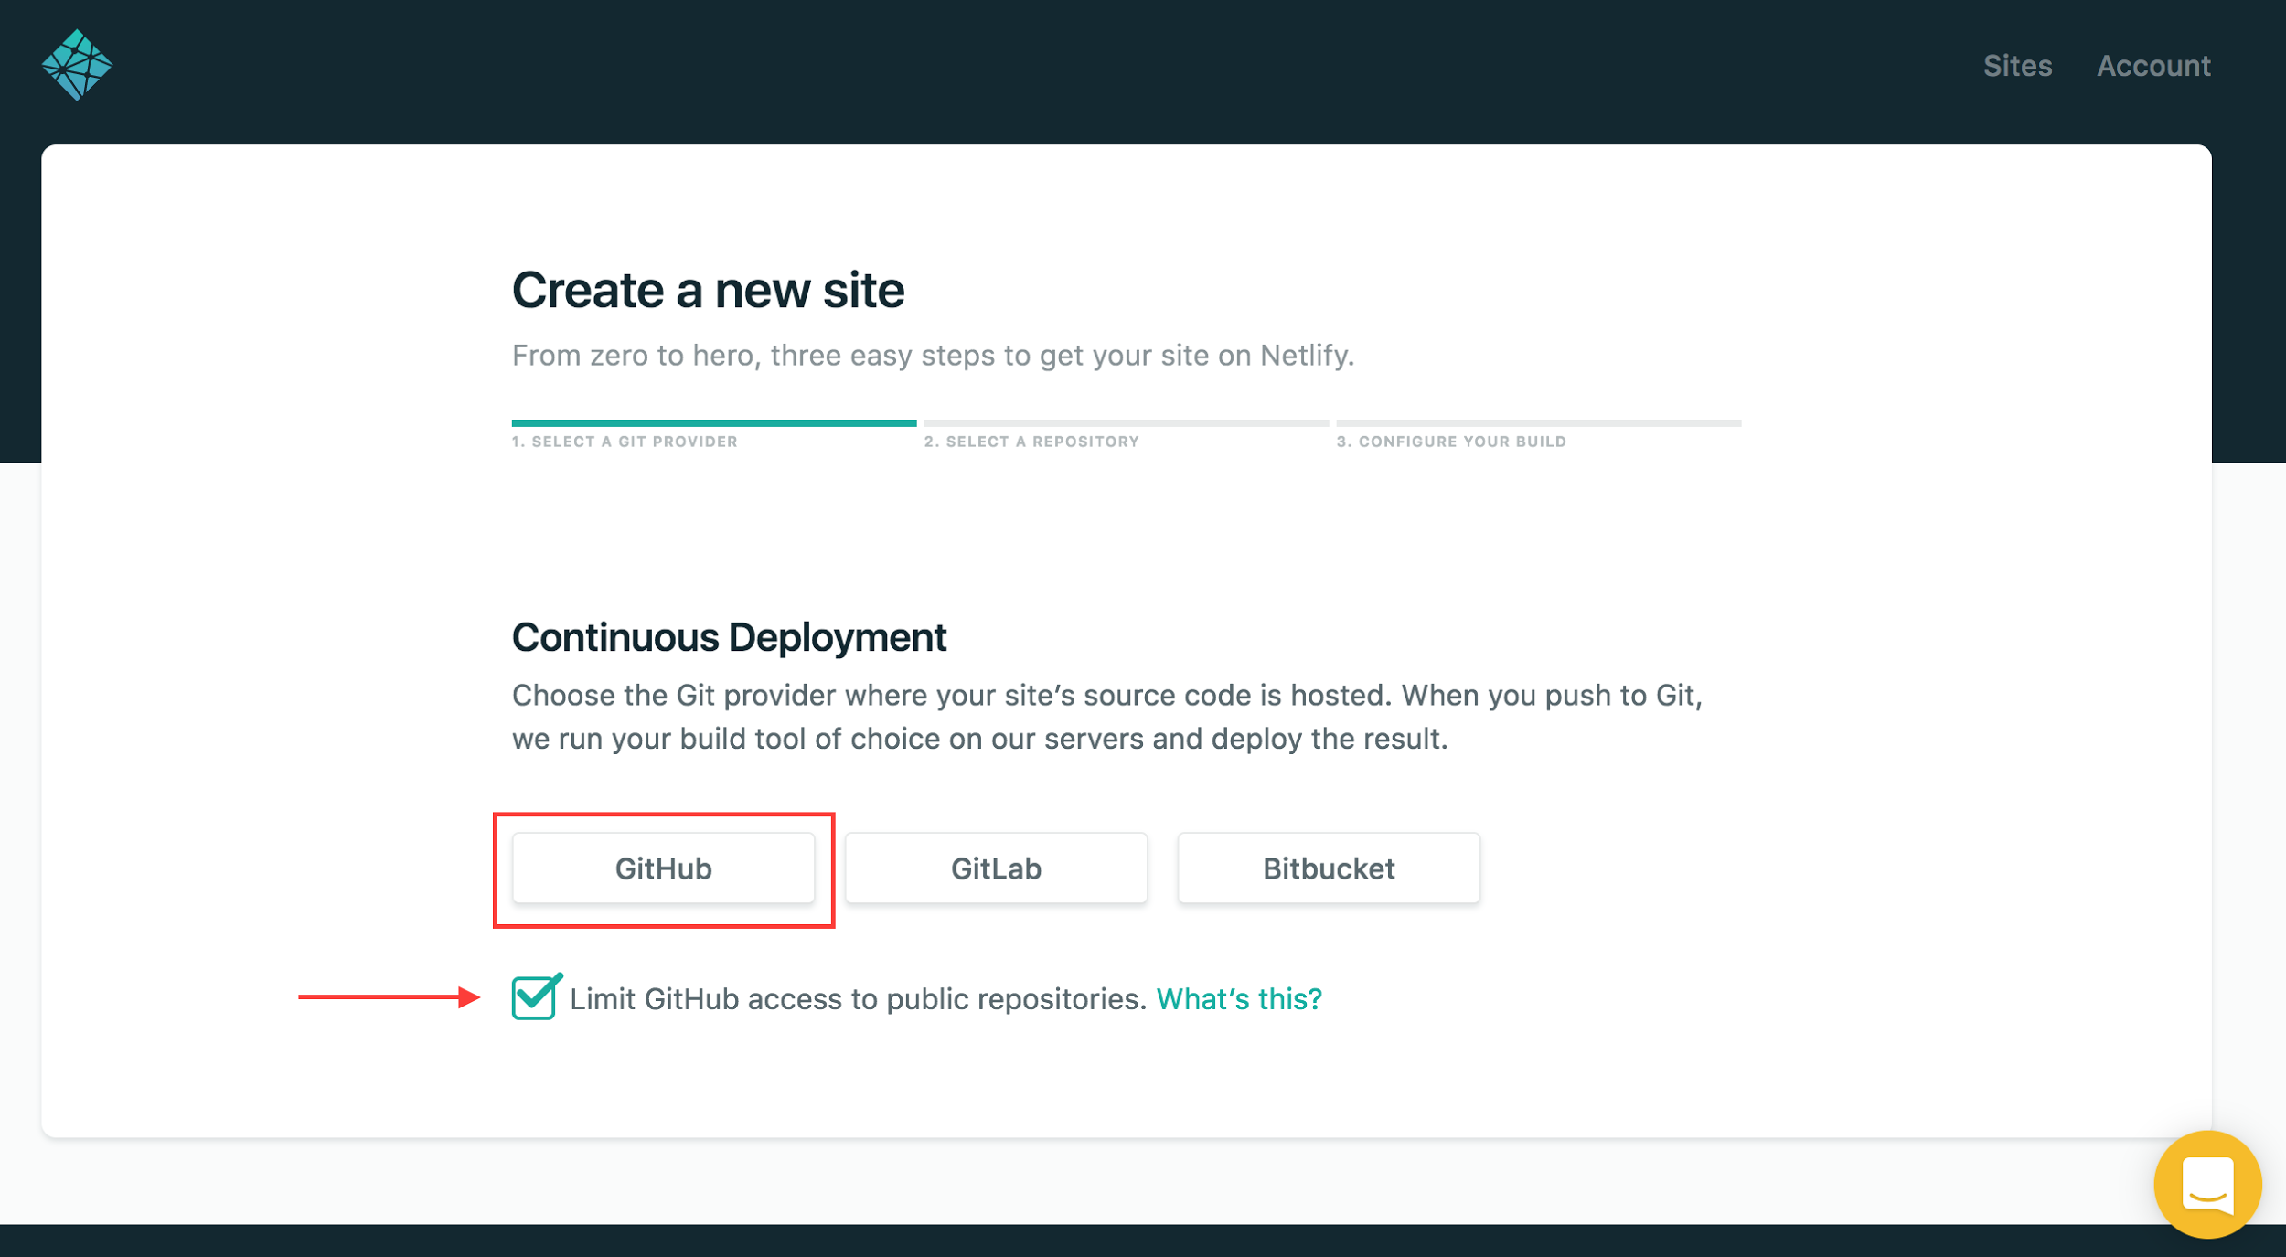
Continuous Deployment through Github & Netlify

Slide 15
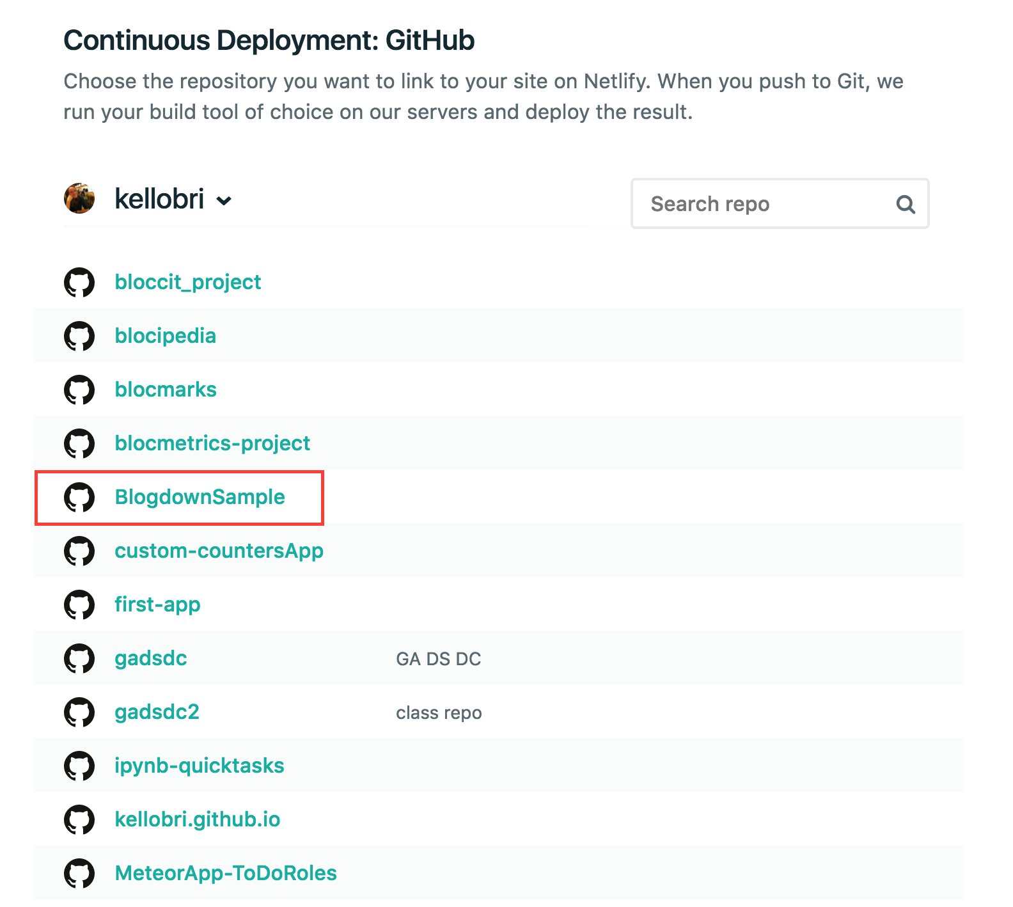
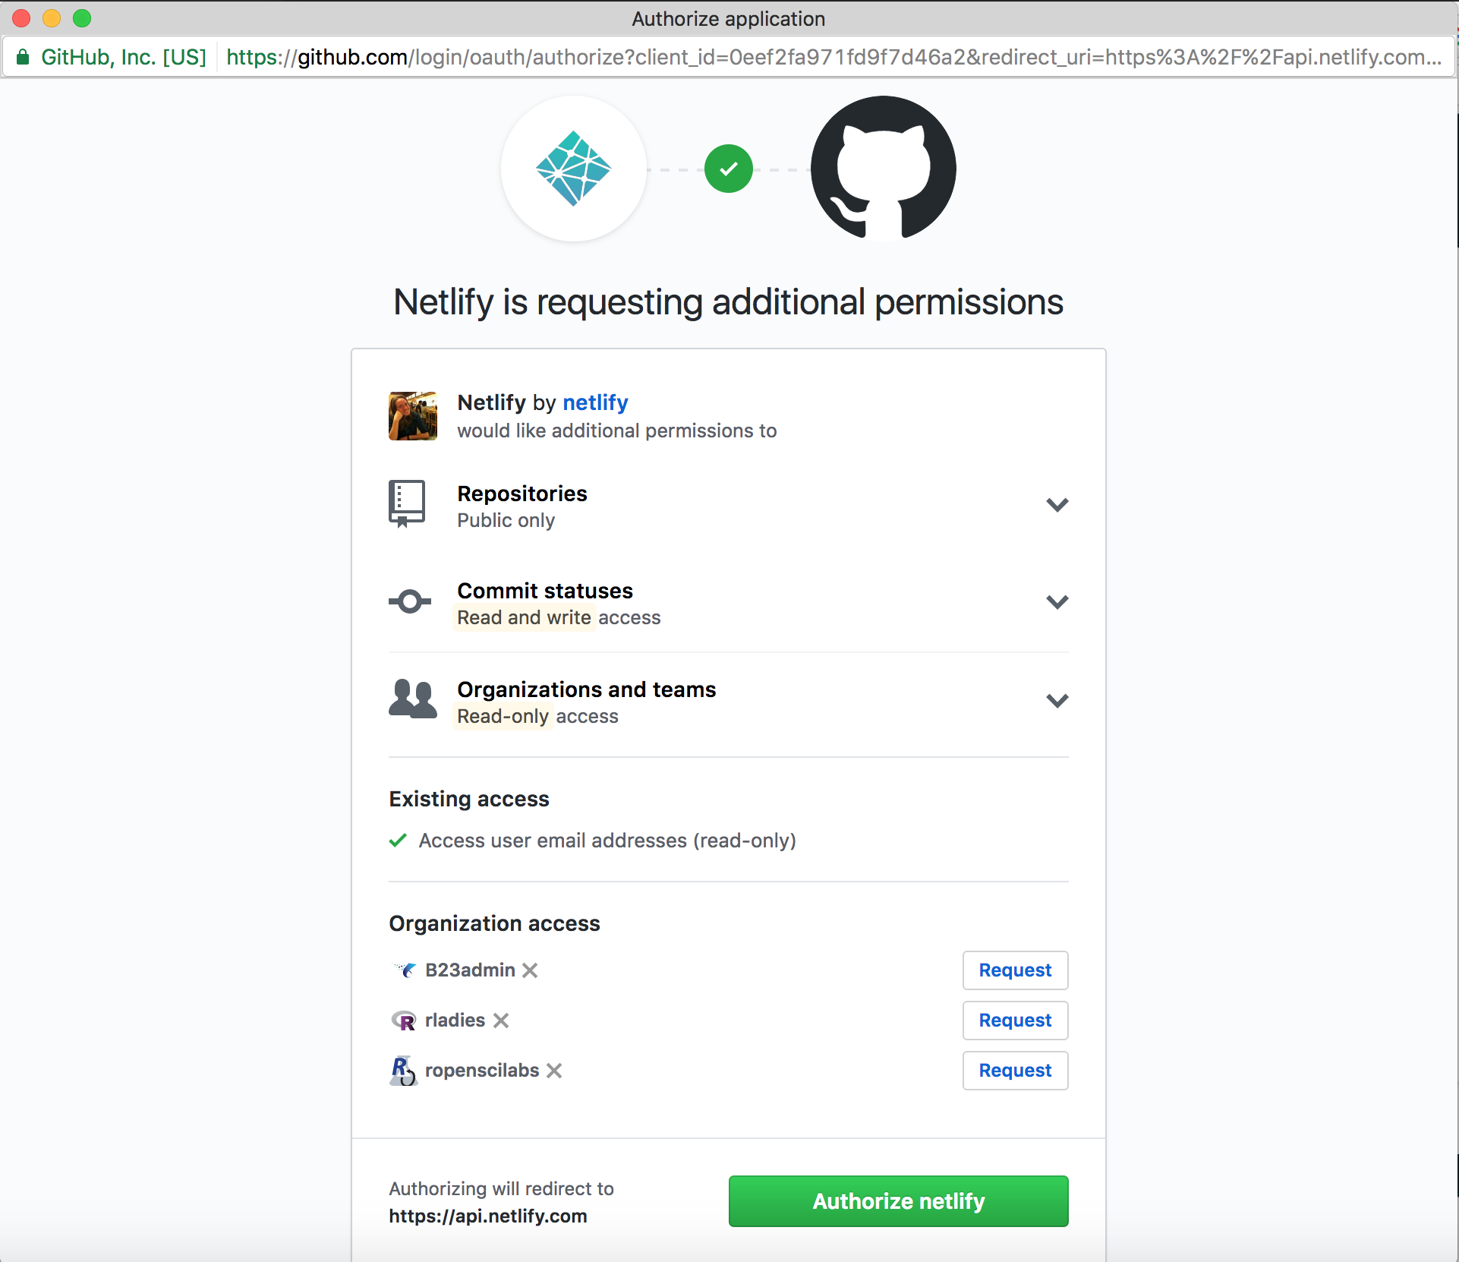
Continuous Deployment through Github & Netlify

Slide 16
(Pause) Github Setup?
Github Account
Git Basics
Basic Terminal (Command Line) Commands

Slide 17
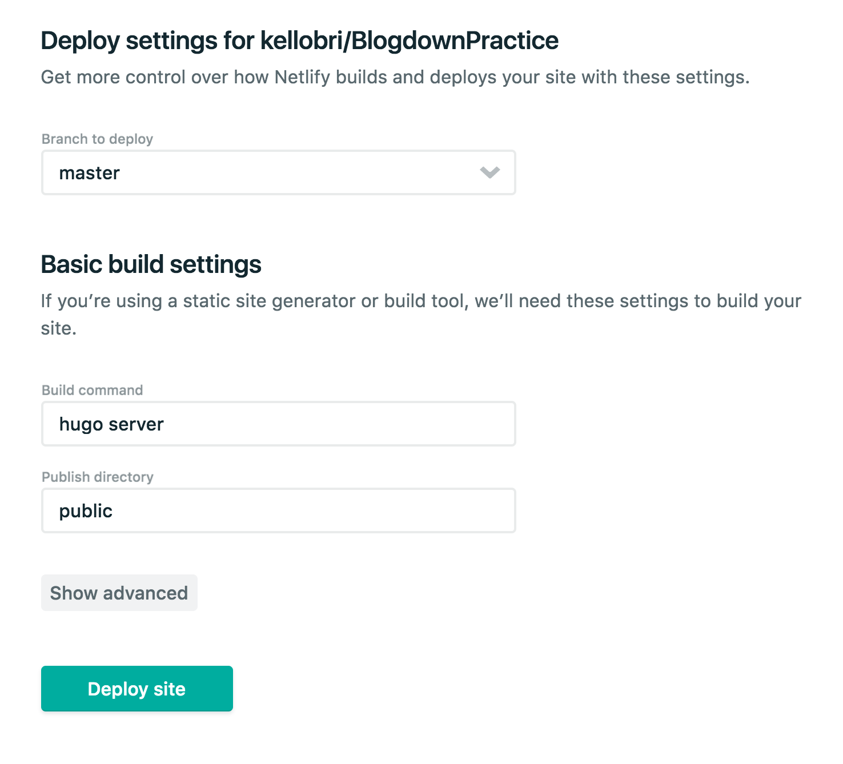
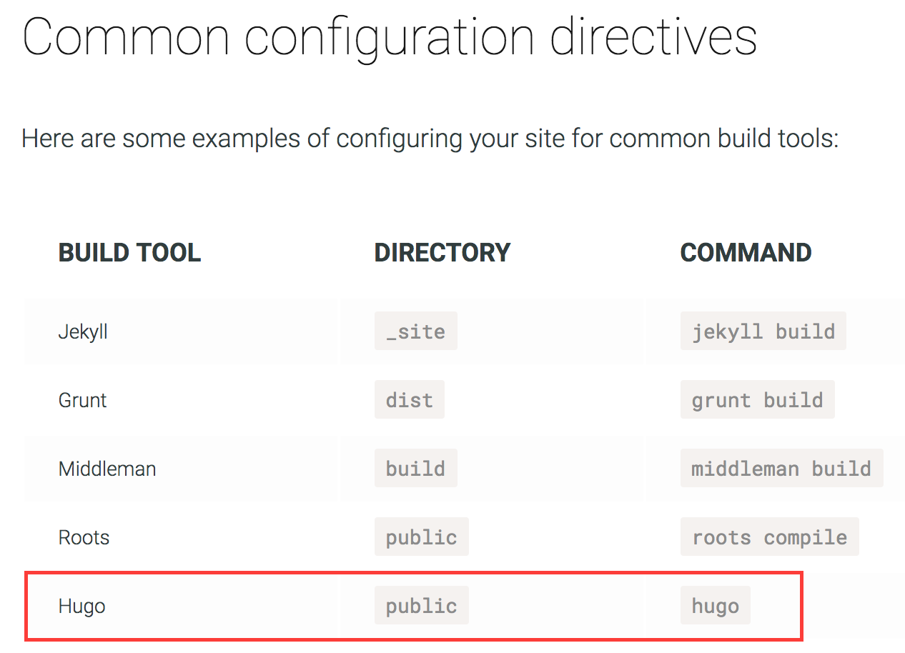
Continuous Deployment through Github & Netlify

Slide 18
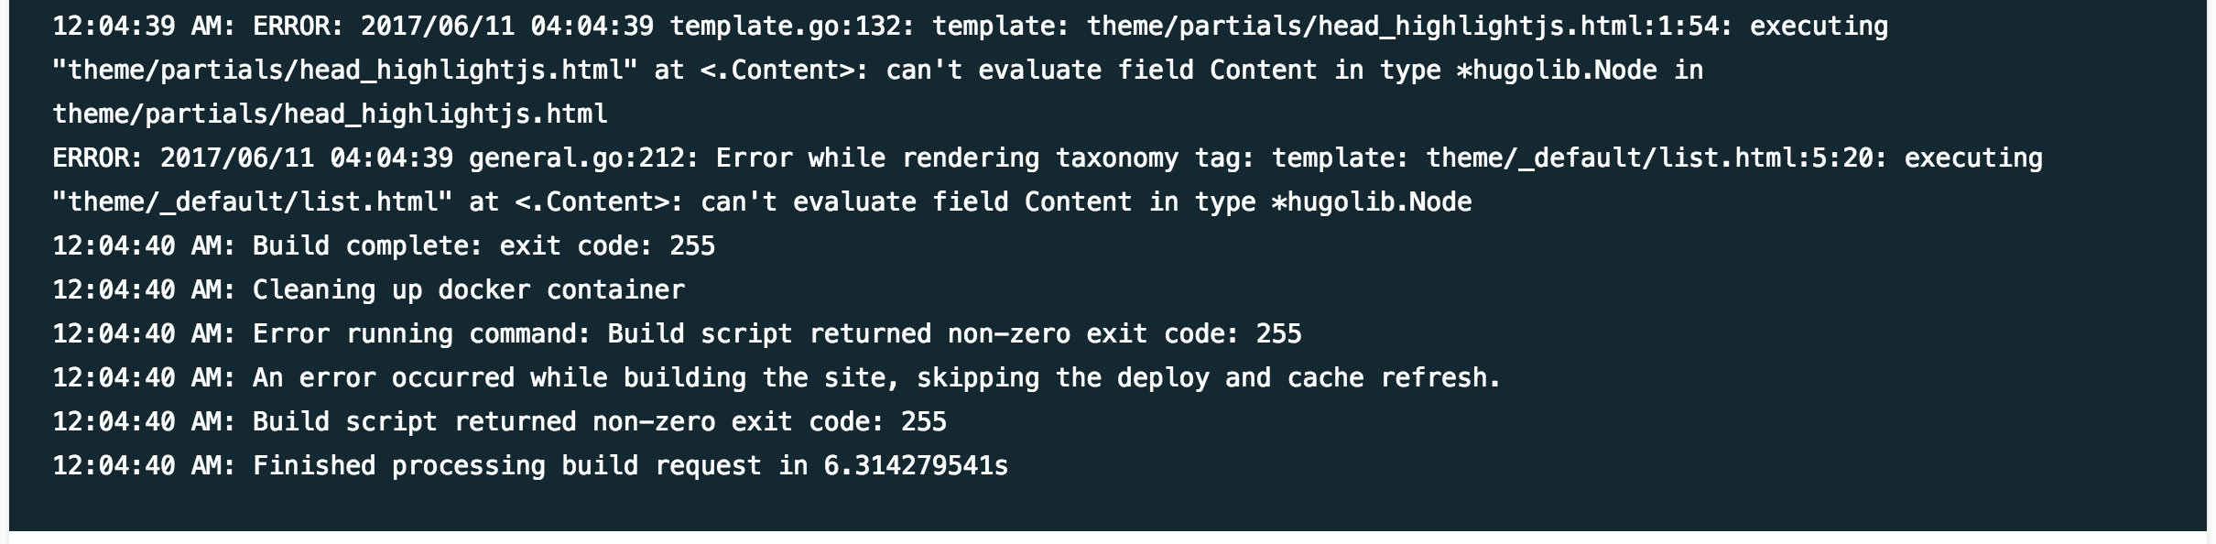
Continuous Deployment through Github & Netlify
Errors!

Slide 19
Continuous?? Deployment
| Github Pages

Slide 20
Github Pages
Github Pages + Blogdown Tutorial
My Personal Attempt

Slide 21
More Blogdown Resources

Slide 22
RStudio Blogdown/Hugo Resources
RStudio Webinar “Introducing Blogdown”
Blogdown Github Readme
Book about Blogdown (Warning - Under Development)

