Slide 1
Overview of Amazon Laptop Market Analysis
Market OverView
Analysis of 60 laptop products from Amazon's catalog
Focus on brands, pricing distribution, specifications, and consumer preferences
Data includes products across various price points ($123.99 - $2,599.00)
Primary brands include HP, Lenovo, ASUS, Acer, Dell, and LG
Most products feature Windows 11 or Chrome OS
Screen sizes range from 11.6" to 17.3

Slide 2
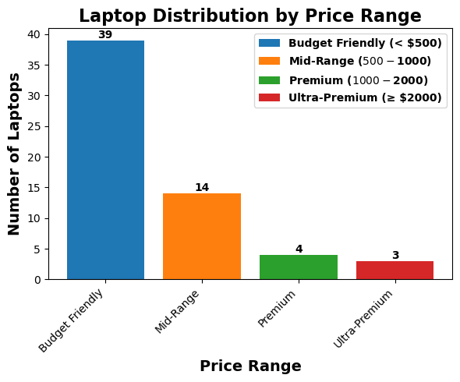
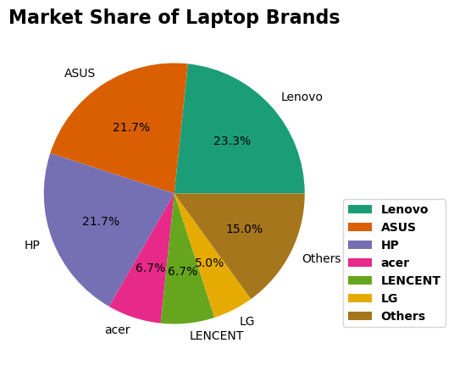
Insight: The market is dominated by budget and mid-range offerings, with HP, ASUS, and Lenovo controlling over 60% of the products in this dataset.

Slide 3
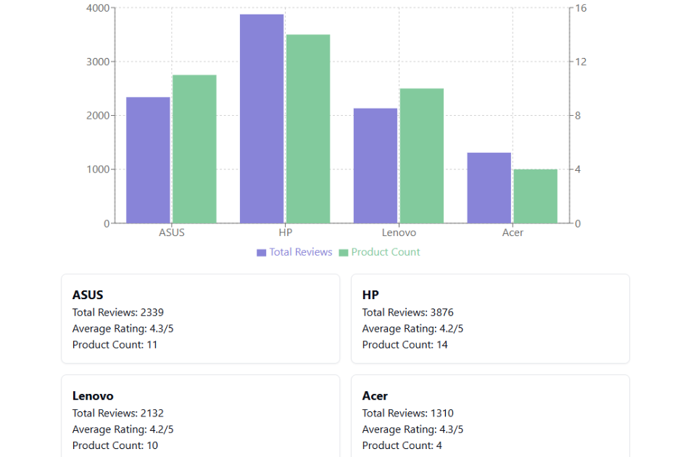
Review Analysis Breakdown
Total Review
Highest Rated Products:
ASUS ROG Strix G16 (4.5/5, 1,650 reviews)
ASUS Vivobook 16 (4.9/5, 19 reviews)
Intel AX210 Network Card (4.7/5, 705 reviews)
Notes:
“Welcome to this data-driven presentation, where we analyze sales performance and product selection across divisions. Our goal is to provide meaningful insights that each division can use to optimize its strategy. We’ll look at sales trends, product choices, and competitive positioning. Through visualizations, we will identify which brands and products are performing well and help shape future decisions. Let’s start by looking at the key insights.”

Slide 4
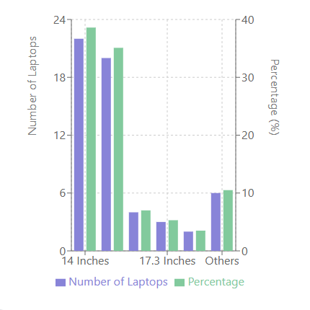
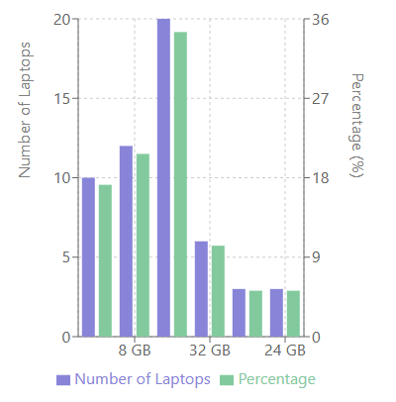
Screen Size Distribution (Dual-Axis Bar Chart) RAM Configuration Analysis (Dual-Axis Bar Chart)

Slide 5
Actionable Recommendations
Recommendations:
For Brands:
It shows lots of competition in the mid-range. Focus on this range with more features and branding
Explore opportunities in Ultra-premium if underserved
Place the popular devices in the recommended section like ASUS Vivo Book
For Retailers:
Highlight the premium features for premium and Ultra Premium laptops to attract high-end buyers
Stock more Budget friendly and Mid-range segments as these are likely to drive higher sales Volume
For Marketers:
Use the data to identify trends and align product offerings with customer preferences
Explore the Niche products: Budget Chromebook and Lightweight Models
Target Gaming enthusiasts with popular brands like, Acer Nitro, ASUS ROG Strix

