Slide 1

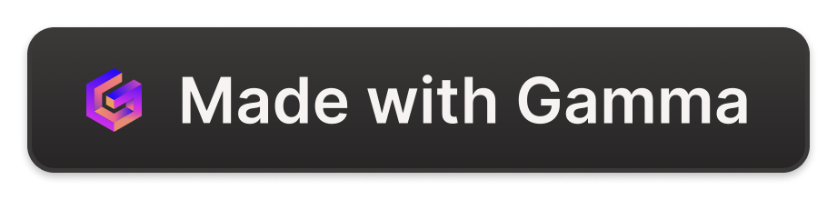
Introduction to CRM Fusion Labs
Revolutionizing customer relationship management with cutting-edge solutions.
Ca
by Cindy Karathe

Slide 2
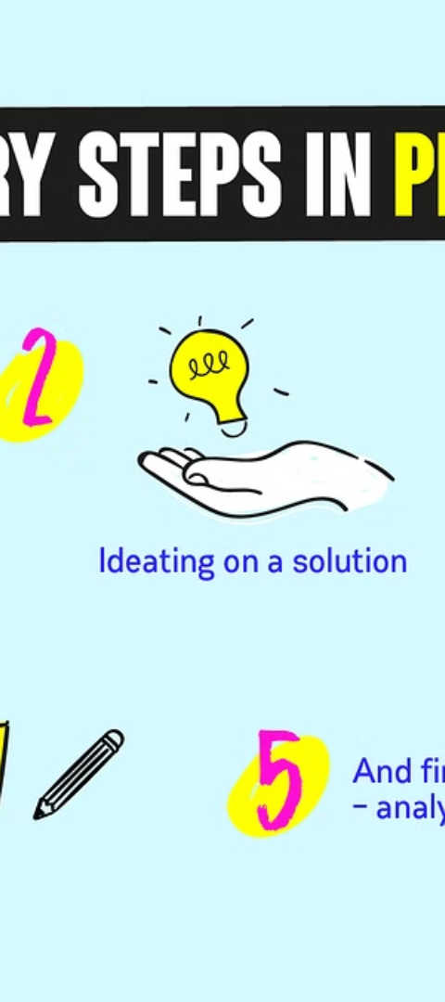
The problem we solve
1
Data Silos
2
Lack of Insights
End the challenge of disconnected customer data.
Unlock hidden patterns and trends in customer behavior.
3
Inefficient Processes
Streamline workflows for better productivity.

Slide 3



Our solution
Data Integration
AI Insights
Automation
Connect customer data from all sources.
Derive meaningful, actionable insights from data.
Efficiently automate repetitive tasks.

Slide 4



Key features of our product
Customization
Scalability
Security
Create tailor-made solutions for specific business needs.
Grow effortlessly as your business expands.
Protect sensitive customer data with advanced measures.

Slide 5
Market opportunity
75M
40%
2023
Customer base
Growth rate
Projection
Untapped potential for CRM software solutions.
Rapidly expanding market with huge opportunities.
Anticipated market growth by the end of 2023.

Slide 6
Business model
Subscription-based
Payment flexibility
Enterprise solutions
Custom pricing options
Value-added services
Enhanced customer support

Slide 7

Our team
Expertise
Collaboration
A diverse team with extensive experience.
Work with a dedicated and passionate team.
Innovation
Driven by creativity and forward-thinking.

Slide 8



Call to action
Contact Us
Partnership
Explore Solutions
Reach out to discover how we can help your business.
Explore collaboration opportunities with us.
Find the perfect CRM solution for your business.

