Slide 1
Software Architecture
Chiel Peters, Cindy Berghuizen, Mary Gouseti, Omar Pakker
Team: The B.O.M. (Ball of Mud)

Slide 2
Important Questions
How much resources need to be allocated in order to keep our system up to date with the external resources?
What kind of (temporary) storage for the rapidly changing data is needed?
How will our system access the external data-sources?
The B.O.M.

Slide 3
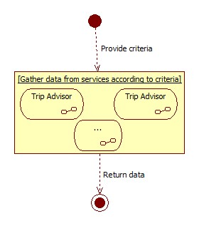
Architecture Options
Forward all requests to the external data-sources?
(see Image)
Poll every data-source and store results in a database?
Poll every data-source independently and store results in a database?
Use a cache to store request results?
The B.O.M.

Slide 4
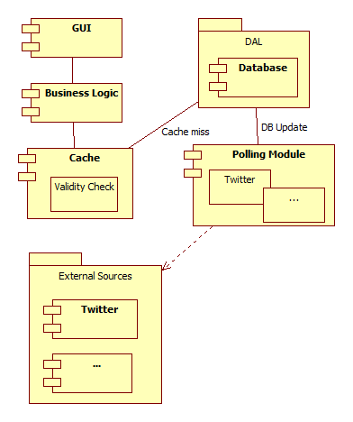
Proposed Solution
Seperate layers for GUI and logic.
Use a caching system.
Poll data-sources independently.
The B.O.M.

Slide 5

Questions?
Ball of Mud is a reference to the Software Architecture
“Big Ball of Mud”.
This is an architecture without a clear structure.
The B.O.M.

