Slide 1
Requirements Engineering
Software Engineering
Omar Pakker, Mary Gouseti, Cindy Berghuizen, Fabien Tesselaar & Chiel Peters

Slide 2
Outline
The source of the idea
Experiment 1 : Anchoring
Experiment 2 : Group Dynamics
Application to Prototyping
Requirements Engineering
Notes:
General Introduction -> Outline of the presentation

Slide 3
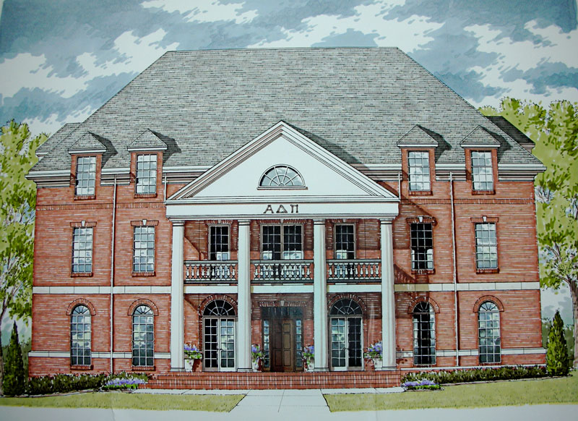
Student House
Requirements Engineering
Notes:
Tell the puking story -> How everyone follows up on what the first people say

Slide 4
Group Dynamics theory
“Group members put the value of being part of the group higher than anything else. They will strive for unanimity on issues the group has to deal with. The group members will follow the opinion of others especially the one that takes the lead.”
- Irving L. Janis
Requirements Engineering

Slide 5
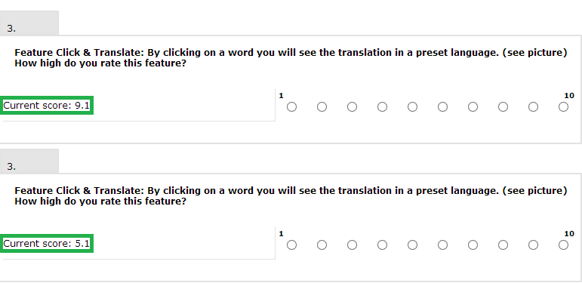
Anchoring Experiment
Show a (fake) mean of an earlier survey
Requirements Engineering
Notes:
Six Features -> One general evaluation

Slide 6
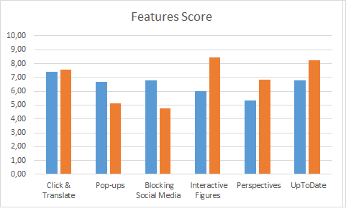
Anchoring Experiment: Results
Requirements Engineering
Notes:
Don’t explain every feature in detail. Just note why we think some are high and some are not

Slide 7
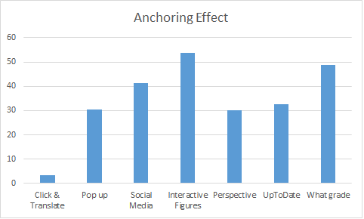
Anchoring Experiment: Results
Requirements Engineering
Notes:
Calculated Anchoring effect

Slide 8
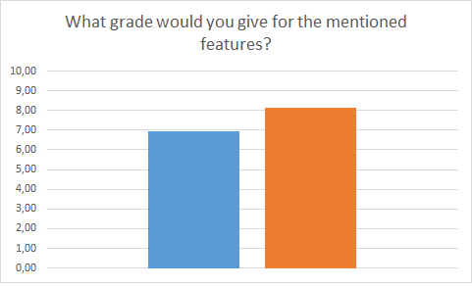
Anchoring Experiment: Results
Requirements Engineering
Notes:
Availability bias

Slide 9
Group Dynamics Experiment
Group versus Individuals
How does a group prototype session differ from one performed on individuals?
Requirements Engineering

Slide 10
Group Dynamics Experiment:
Observations
Follow the opinion of the first most outspoken
Individuals broader viewpoints
Power of discussion
Requirements Engineering

Slide 11
Application to prototyping
No clear better results
Start individually work towards the group
Requirements Engineering

