Slide 1
Glucose
G6P
Gluconate
Glycolysis/
Gluconeogenesis
F6P
KDG
F1,6P
KDPG
Glycerol
Glycerol-3P
DHAP
GAP
1,3BPG
PEP
Pyruvate
TCA cycle to make NADH and FADH₂!
Modified from R. Hackley presentation
Notes:
spED pathway in archaea and some clostridium sps
PFK enzyme is particularly interesting as there are marked difference between the two characterized PFKs in Hvol (70kDA homodimer) and Har. Vallismortis (70kDa monomer, gene not identified)
Halophiles are only archaea that use GADPH and PGK in catabolisis (allows for same amt of energy generation as classical bacterial ED)
FBPA appears to be HGT from bacteria. Relies on Mn or Fe to catalyze
KHK not homologous to eukaryotic khk
enzyme activity studies (Rawal et al. 1988) have confirmed gluconeogenesis in H. salinarum. Furthermore, saccharide units are attached to surface proteins of H. salinarum such as the S-layer protein and flagellins (Sumper 1987). Sugar moieties of lipids and proteins are likely synthesized via nucleotide sugars. In accordance with this, several nucleotide sugar enzymes such as UDP-glucose 4- epimerase (EC 5.1.3.2, e.g. NP4662A) and UDP-glucose 6- dehydrogenase (EC 1.1.1.22, e.g. NP2322A, NP4668A) are present in haloarchaeal genomes
Under anaerobic conditions, it has been shown for H. salinarum that pyruvate is primarily converted to alanine, presumably by an aspartate transaminase, and to a larger extent to lactate and acetate (Bhaumik and Sonawat 1994; Ghosh and Sonawat 1998). In spite of proven lactate dehydrogenase activity in H. salinarum cell extracts (Bhaumik and Sonawat 1994), no clear lactate dehydrogenase homolog has been identified in haloarchaeal genomes

Slide 2
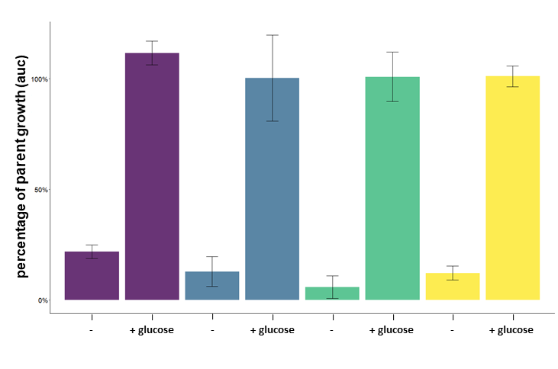
∆trmB phenotypes confirm conserved function
Halobacterium salinarum
Haloarcula hispanica
Haloferax mediterranei
Haloferax volcanii
Percent growth of WT (auc)
Modified from R. Hackley presentation
AK Schmid, Jake Herb, MMP, RH, 2019 NCSSM miniterm

Slide 3
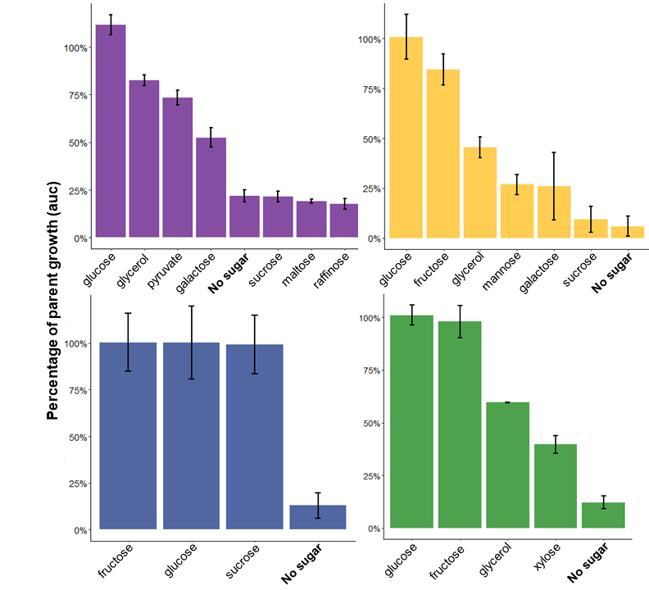
∆trmB phenotypes agree with known metabolic differences
Halobacterium salinarum
Haloferax volcanii
Haloarcula hispanica
Haloferax mediterraneii
AK Schmid, Jake Herb, MMP, RH, 2019 NCSSM miniterm
Modified from R. Hackley presentation

Slide 4
Starch
AMY123 enzymes
Glucose
G6P
Gluconate
F6P
KDG
Fructose
F1P
F1,6P
KDPG
Acetate
Glycerol
Glycerol-3P
DHAP
G3P
1,3BPG
TCA cycle to make NADH and FADH₂!
PEP
Pyruvate
Modified from R. Hackley presentation
Notes:
spED pathway in archaea and some clostridium sps
PFK enzyme is particularly interesting as there are marked difference between the two characterized PFKs in Hvol (70kDA homodimer) and Har. Vallismortis (70kDa monomer, gene not identified)
Halophiles are only archaea that use GADPH and PGK in catabolisis (allows for same amt of energy generation as classical bacterial ED)
FBPA appears to be HGT from bacteria. Relies on Mn or Fe to catalyze
KHK not homologous to eukaryotic khk
enzyme activity studies (Rawal et al. 1988) have confirmed gluconeogenesis in H. salinarum. Furthermore, saccharide units are attached to surface proteins of H. salinarum such as the S-layer protein and flagellins (Sumper 1987). Sugar moieties of lipids and proteins are likely synthesized via nucleotide sugars. In accordance with this, several nucleotide sugar enzymes such as UDP-glucose 4- epimerase (EC 5.1.3.2, e.g. NP4662A) and UDP-glucose 6- dehydrogenase (EC 1.1.1.22, e.g. NP2322A, NP4668A) are present in haloarchaeal genomes
Under anaerobic conditions, it has been shown for H. salinarum that pyruvate is primarily converted to alanine, presumably by an aspartate transaminase, and to a larger extent to lactate and acetate (Bhaumik and Sonawat 1994; Ghosh and Sonawat 1998). In spite of proven lactate dehydrogenase activity in H. salinarum cell extracts (Bhaumik and Sonawat 1994), no clear lactate dehydrogenase homolog has been identified in haloarchaeal genomes

