Slide 1
Chicago Property Valuation Analysis
Justin Cox, Will Dibb, Taylor Rasley, Taylor Williams, Zhongyi Zhang

Slide 2

Overview
Model development for property value comparison of Chicago areas given various livability considerations to identify areas where property values might be under/overvalued. Identifying these areas where property is out of alignment with livability provides potential opportunities for investment (real estate purchases).

Slide 3
Data Sources
City of Chicago
Chicago Zip Geospatial Map
Active Business Licenses
Crime
Community Assets:
Grocery Stores
Libraries
Zillow API
Property Values
American Community Survey
Population (Zip)

Slide 4




Data Pipeline Tools
OpenRefine
API integration and data cleaning
MySQL
Database modeling and data centralization
R Studio
Data transformation and analysis
Tableau
Data visualization

Slide 5
Design Considerations
Zip code used as the geographic region by which value scores are estimated
All data sets contain lat/long and/or zip code values
Data sets that do not contain zip code are mapped to zip code via mapping table
Livability scores for each category (i.e. education, crime, business) of zip code regions determined by aggregating key features in individual data-sets and normalizing per population as needed

Slide 6
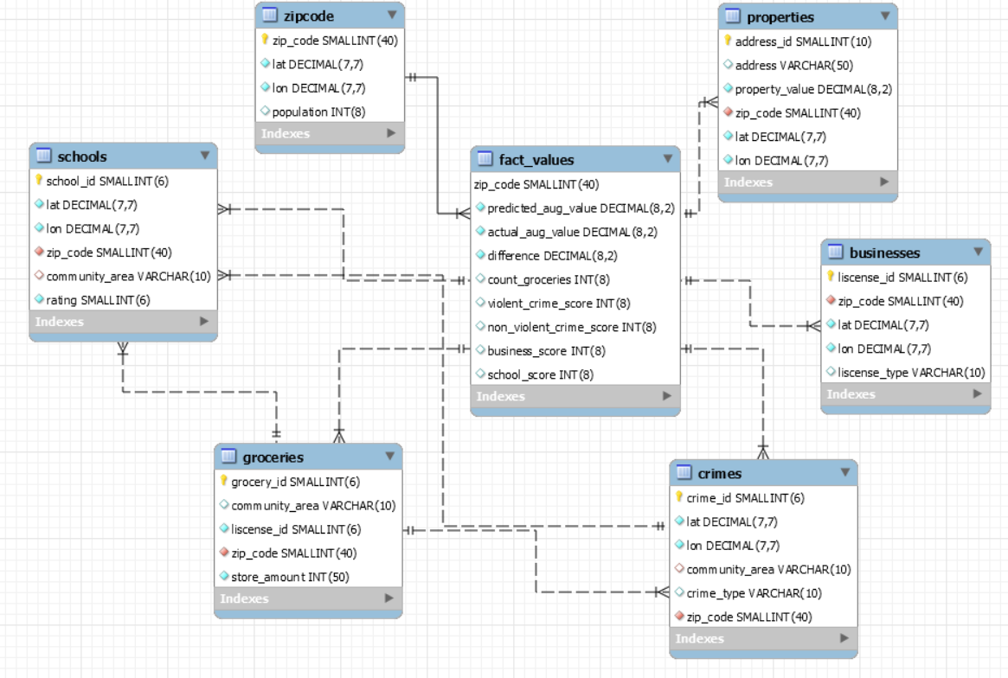
EER Diagram

