Slide 1
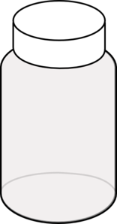
layer_id =
100_1
sample_id =
100_2
100
100_3
100_4
specimen_id = 52
151_1
151_2
151
151_3
151_4
151_5

