Slide 1
15637 Sprint presentations #1
Xingyao Wei
&Jing Li

Slide 2
Summary
An e-commerce web application
Using Django MTV Framework
A shopping website that mainly sells home decorations
Using the admin interface to auto generate the admin page
Buyers can search the product by category and check where is the nearest location to pick up
Buyers can post the comments and the satisfied products

Slide 3
Original goals
Log In and Register Page
Homepage
Admin page
Item page

Slide 4
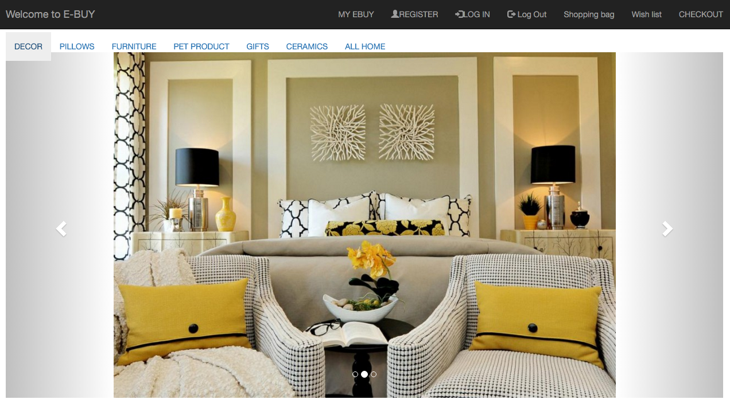
Progress Homepage

Slide 5
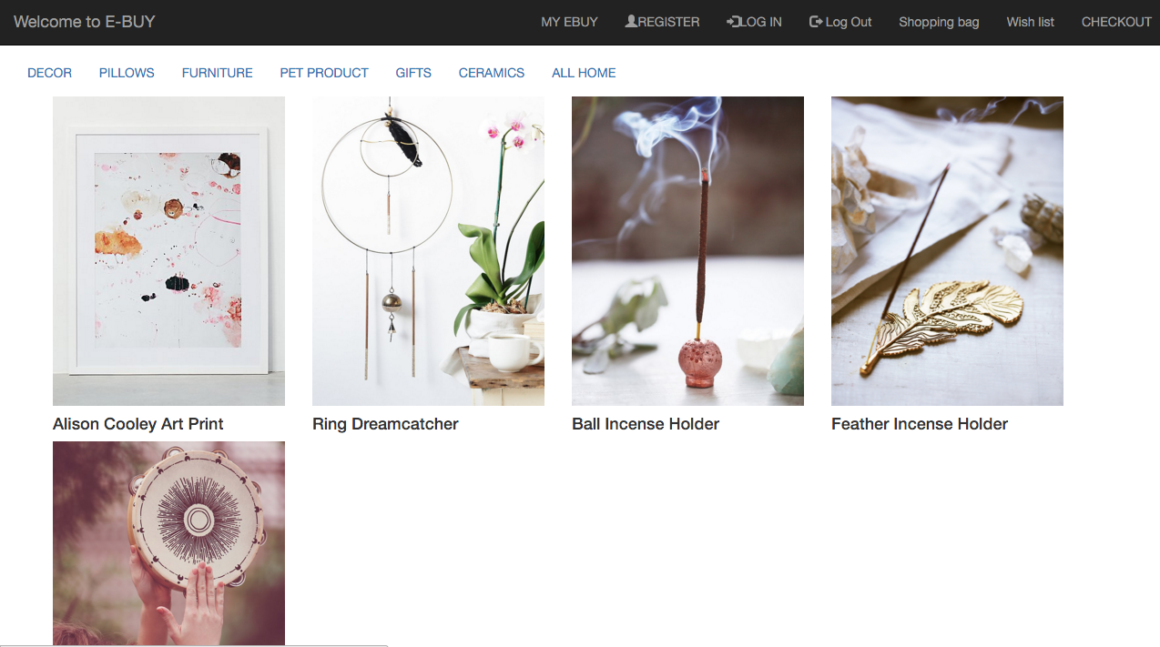
Progress display by category

Slide 6
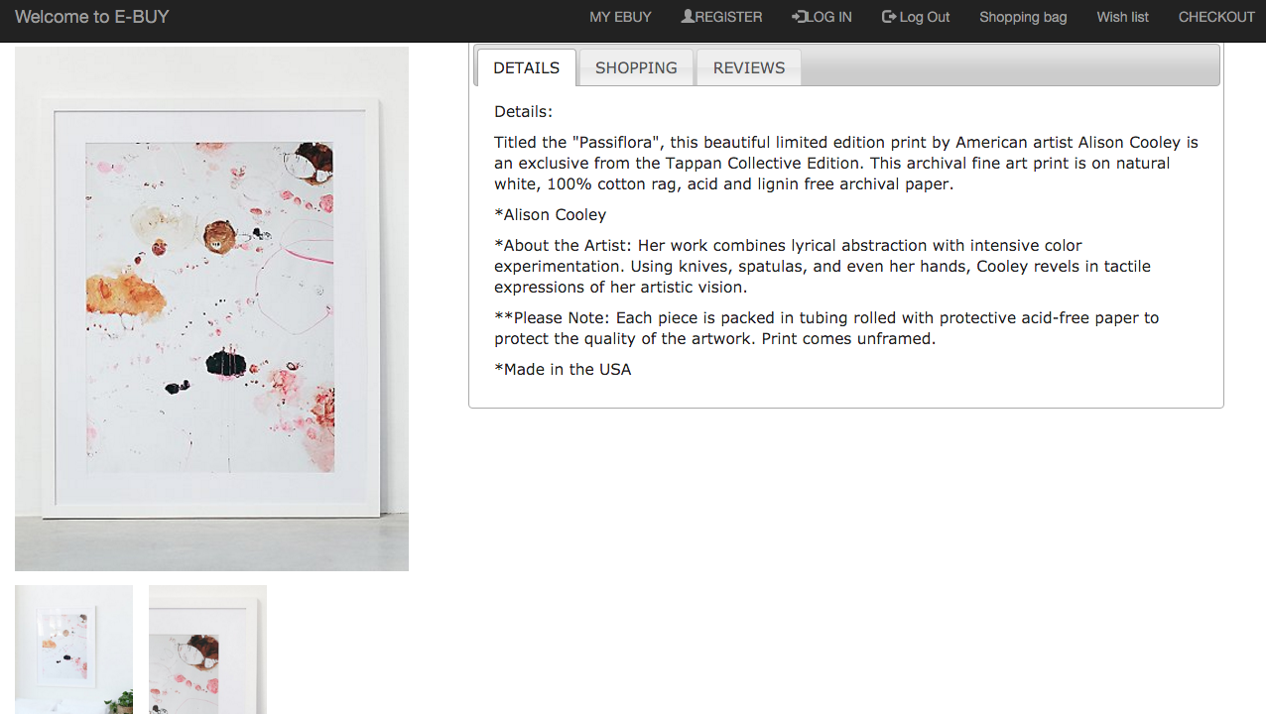
Progress Item page

Slide 7
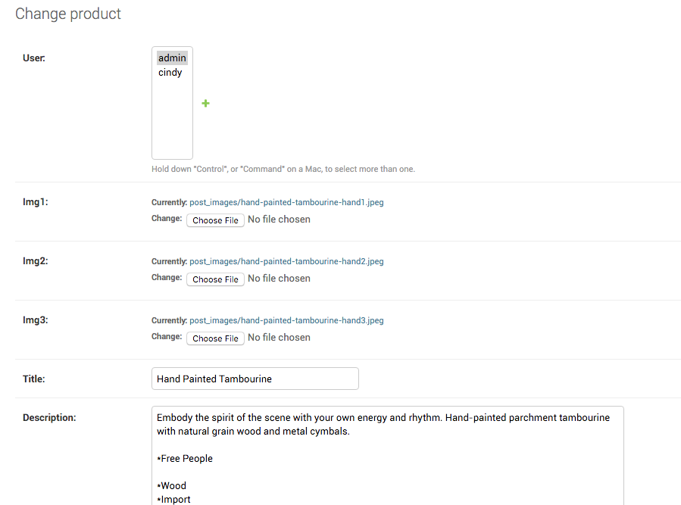
Progress Admin

Slide 8
Next sprint goal
Shopping bag
Modify product item page
User Profile page
Modify the homepage
Wishlist

