Slide 1
15637 Sprint presentations #2
Xingyao Wei
&Jing Li

Slide 2
Update
A shopping website that mainly sells home decorations
Using Jquery and Ajax to do some client-side function
(1)Partly enlarge the picture (2)change the amount of the product
(3)Search for the product
Buyers can post the comments and the satisfied products
Adding profile page

Slide 3
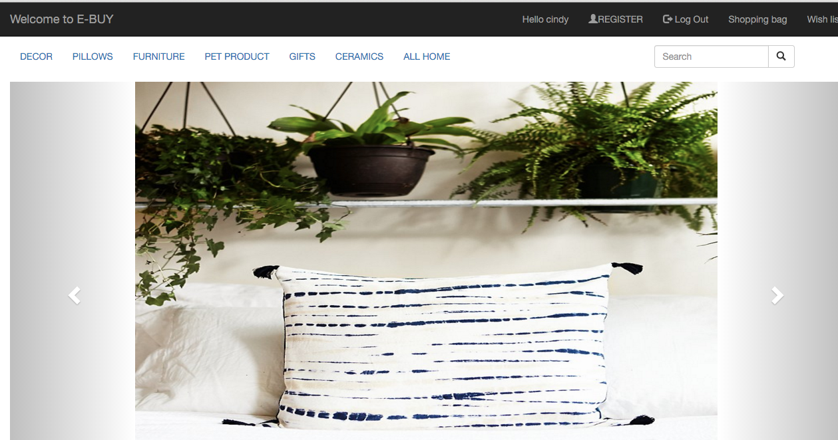
Progress Homepage
Display the latest products instead of hard coding
Fix the login and logout problem

Slide 4
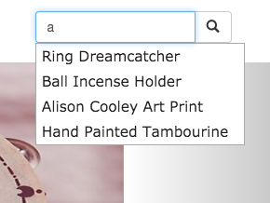
Progress Search function
Using jquery to autocomplete search by the titles

Slide 5
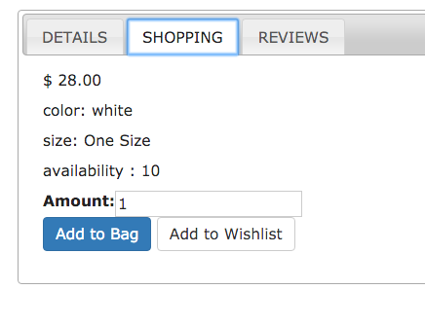
Progress Item page

Slide 6
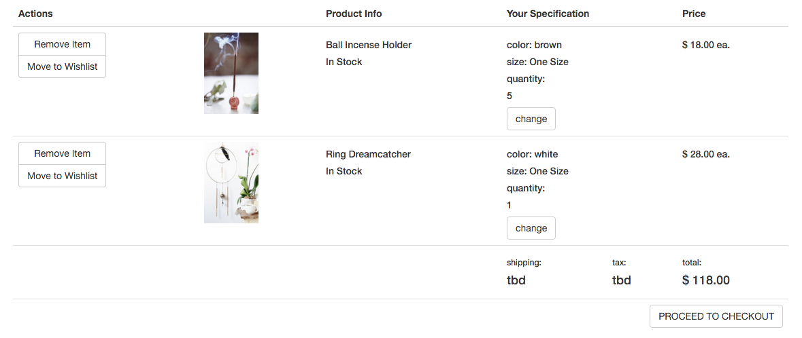
Progress Shopping bag page

Slide 7
Progress Shopping bag and Wishlist
Add the product to the shopping bag or wishlist
Change quantity of the prodcut
Remove the product
See total price

Slide 8
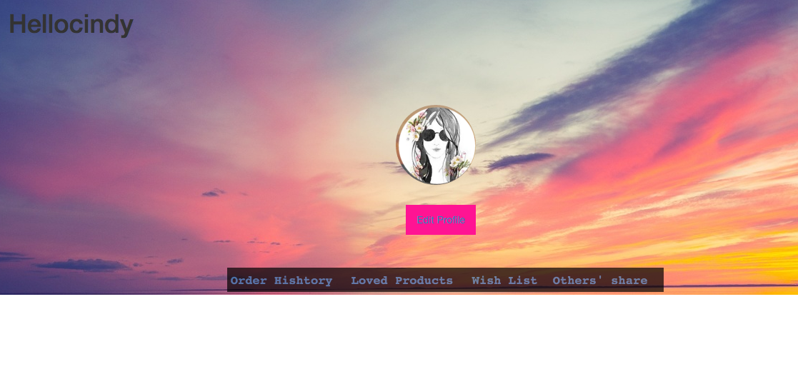
Progress profile page
Edit the profile
See the wish list
Share your order

Slide 9
Next step
Add google API to show some nearby shops for buyers to pickup product
Add payment function
Add previous orders page
Fix errors

