Slide 1
Binary Adder Circuit

Slide 2
Binary Adder
Addition is the most elementary arithmetic operation.
Four possible outputs:
0 + 0 = 0
1 + 0 = 1
0 + 1 = 1
1 + 1 = 10
The last operation produces two digits. We must carry the left-digit (Most-significant-digit).

Slide 3


Half Adder
A half adder adds two input bits and produces two output bits:
SUM (S) is the sum of the two digits.
CARRY (C) is the carry bit.
A | B | S | C
0 | 0 | 0 | 0
0 | 1 | 1 | 0
1 | 0 | 1 | 0
1 | 1 | 0 | 1
$$S=\left(¬A∧B\right)∨\left(A∧¬B\right) \\ C=A∧B$$
Notes:
In half adder, input is only 2 bits. The sum and the carry is output. From the truth table, the equation of the sum and carry was derived. C is only 1 when both values are 1. Also, S is only 1 when either of input is 1.

Slide 4
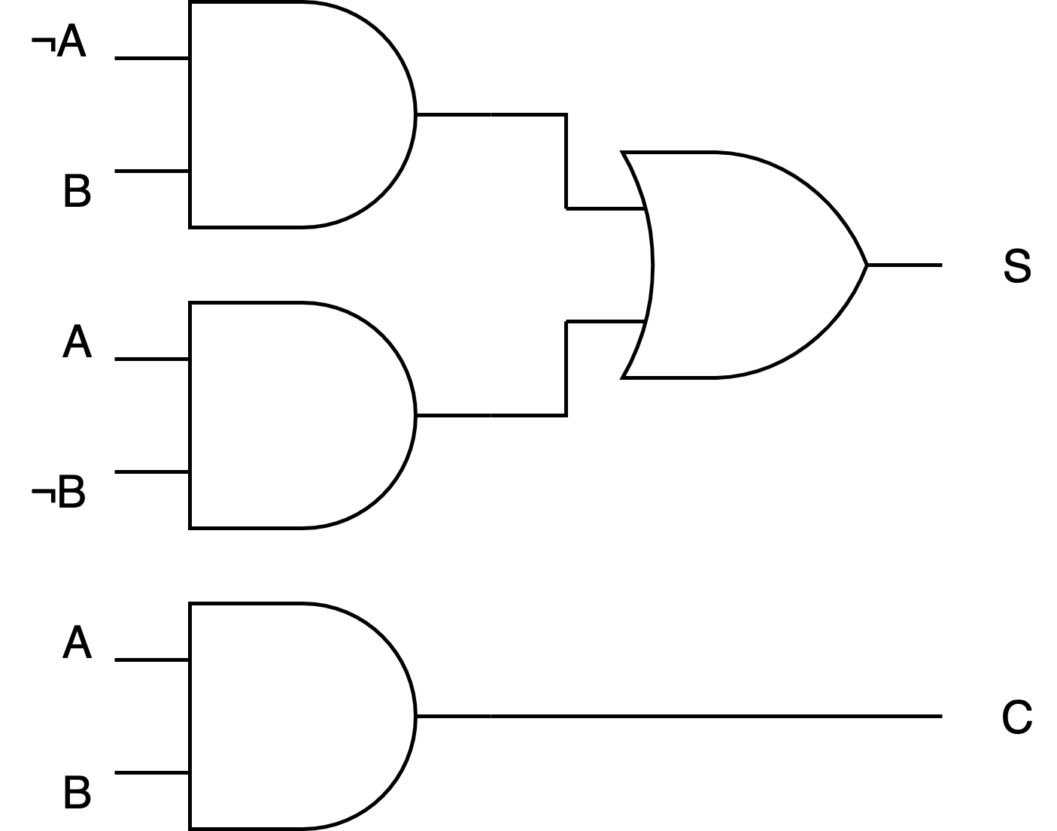
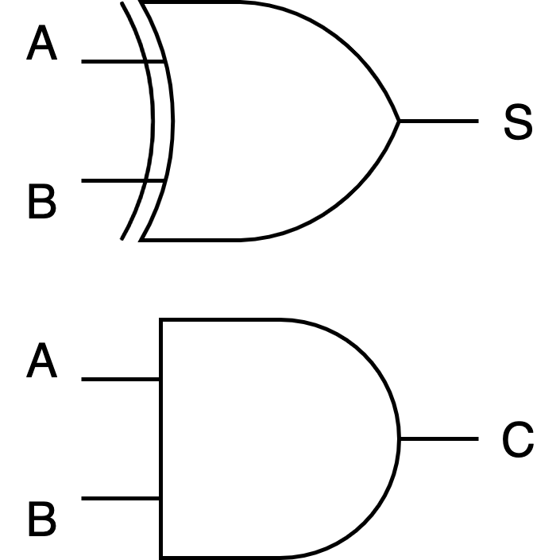
Half Adder Logic Circuit
Notes:
The first diagram illustrated independently the Sum and the Carry based on the equation. However, combining both showed that Sum is actually the Xor value of the relationship between the two input. Hence, one Xor gate is sufficient while the AND gate will produce the Carry.

Slide 5
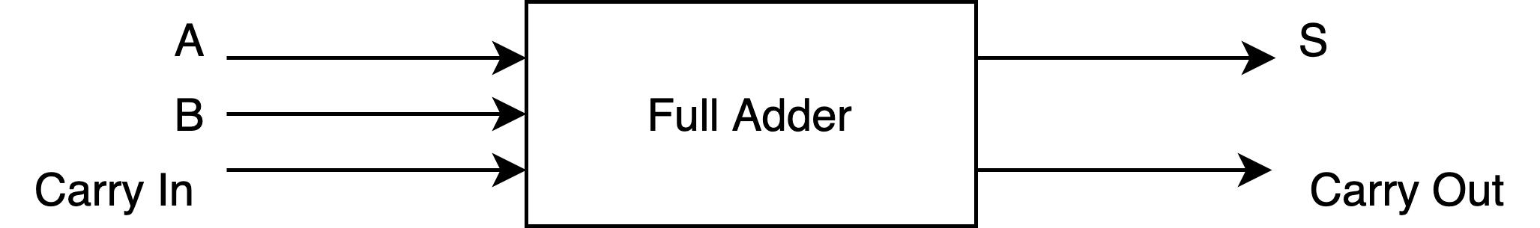
Full Adder
The full adder accounts for an incoming carry bit.
It also produces a sum and carry.
A | B | Carry In | Sum | Carry Out
0 | 0 | 0 | 0 | 0
0 | 0 | 1 | 1 | 0
0 | 1 | 0 | 1 | 0
0 | 1 | 1 | 0 | 1
1 | 0 | 0 | 1 | 0
1 | 0 | 1 | 0 | 1
1 | 1 | 0 | 0 | 1
1 | 1 | 1 | 1 | 1

Slide 6


K-Maps
AB
AB
 | 00 | 01 | 11 | 10
0 | 0 | 1 | 0 | 1
1 | 1 | 0 | 1 | 0
 | 00 | 01 | 11 | 10
0 | 0 | 0 | 1 | 0
1 | 0 | 1 | 1 | 1
C
C
$$S=\left(¬A∧¬B∧C\right)∨$$ $\left(¬A∧B∧¬C\right)∨$ $\left(A∧¬B∧¬C\right)∨$ $$(A∧B∧C)$$
$$C=\left(A∧B\right)∨$$ $\left(¬A∧B∧C\right)∨$ $(A∧¬B∧C)$

Slide 7
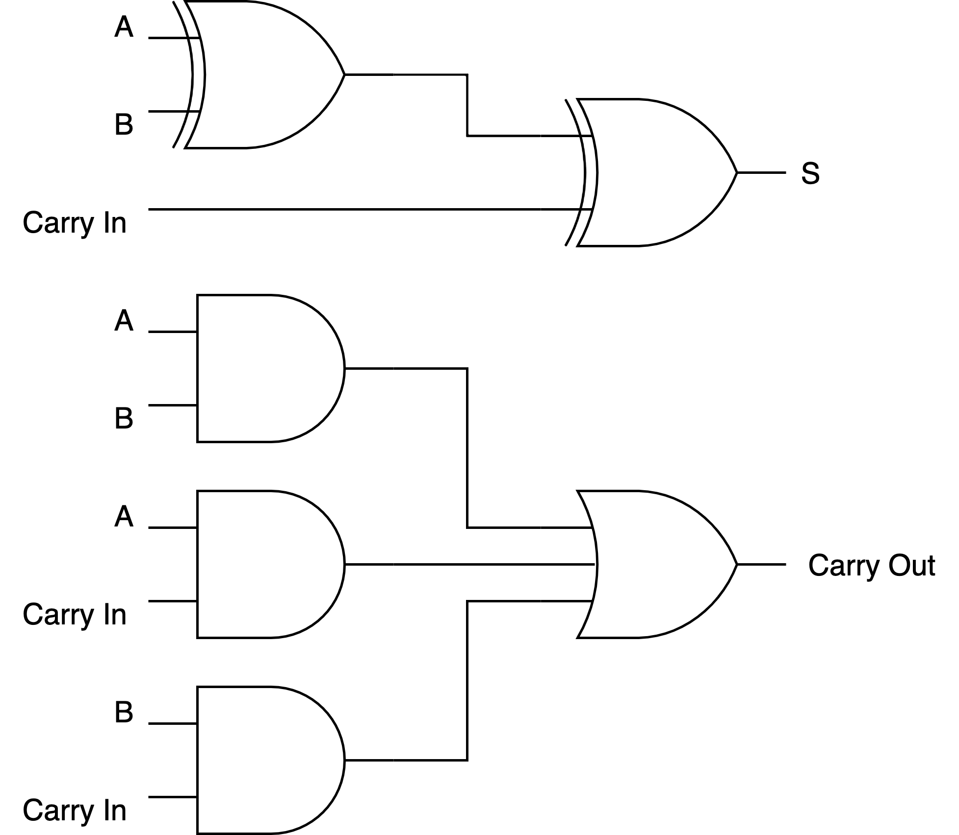

Full Adder Logic
$$S=A⊕B⊕C_{in}$$
$$C_{out}=\left(A∧B\right)∨\left(A∧C_{in}\right)∨(B∧C_{in})$$

Slide 8
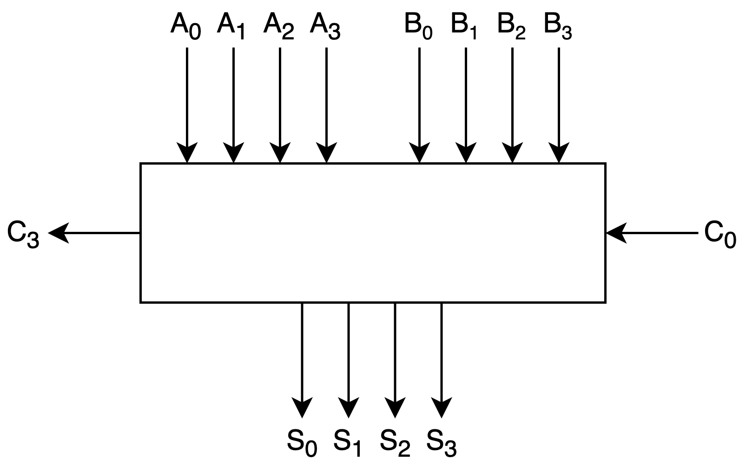
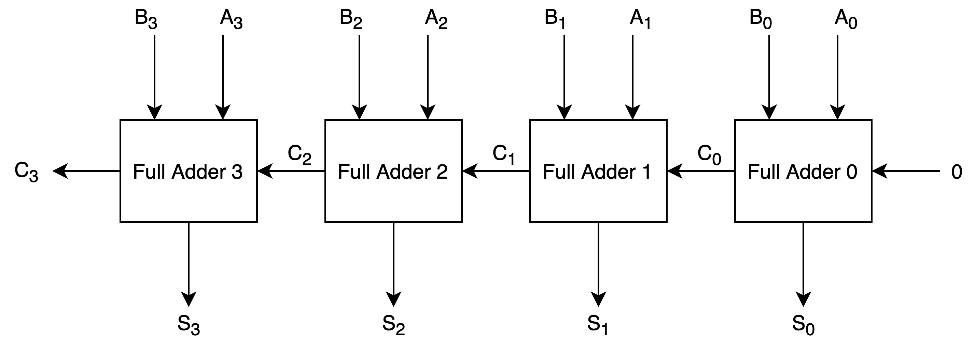
Four Bit Parallel Adder

Slide 9
Binary Addition
Outputs require all inputs.
There is a delay in the parallel adder while waiting for carry digits
Delay = number of gate levels * delay in gate
Carry propagation time determines the speed
of addition.
Notes:
Logic gates are implemented using electronic components which have a finite switching speed.
There is a finite delay before the output of a gate responds to a change in its inputs – propagation delay.
The cumulative delay owing to a number of gates in cascade can increase the time before the output of a combinational logic
circuit becomes valid.

Slide 10
A half-adder adds two bits and provides the output – sum and carry.
A full-adder combines two or more half-adders to add binary numbers.
We use a full-adder to build four, eight, sixteen, etc. bit adders.
There is an inherent delay while carry digits are propagated through the circuit.
Original Slides By Pelumi Apantaku.
Updated Slides by Kevin Chalmers.
Video By Kevin Chalmers.

