Slide 1
Genetwork
When Caches GO AwrY

Slide 2
What Even is GENETWORK?

Slide 3
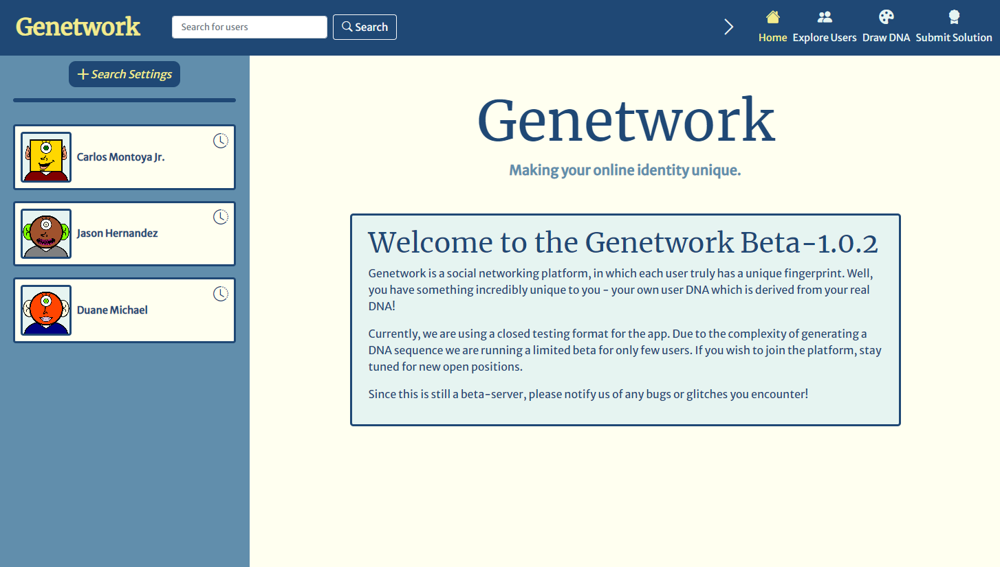

Slide 4

What Even is GENETWORK?
Social media web-app
Each user has a DNA sequence based on their real DNA
DNA sequence dictates the user’s avatars
During Closed Beta

Slide 5
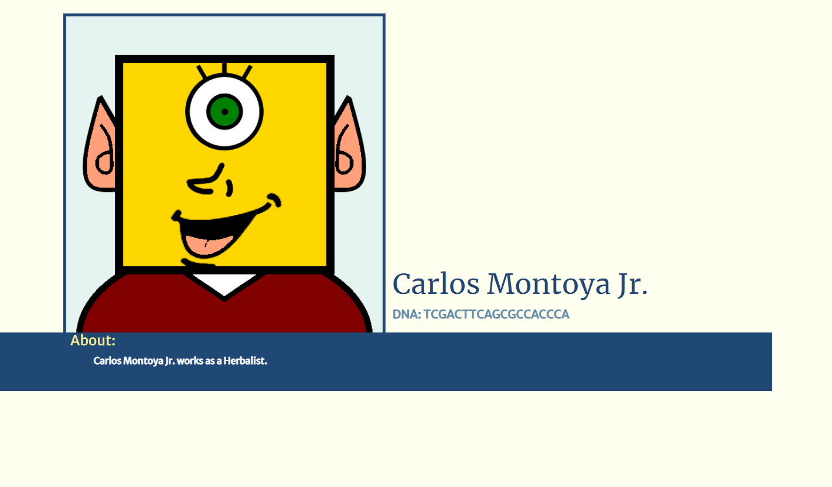
DNA = 19 characters of C,G,A,T Collection of part Encodings

Slide 6

This is Raven Darkhölme (Don’t Sue ME Marvel)
Evil
Shapeshifter
Apparently, in the Genetwork Beta

Slide 7
Let’s Bring Her To Justice!
Step 1
Get her virtual DNA
Step 2
Use the virtual DNA to out how she looks
Step 3
???
Step 4
Profit

Slide 8
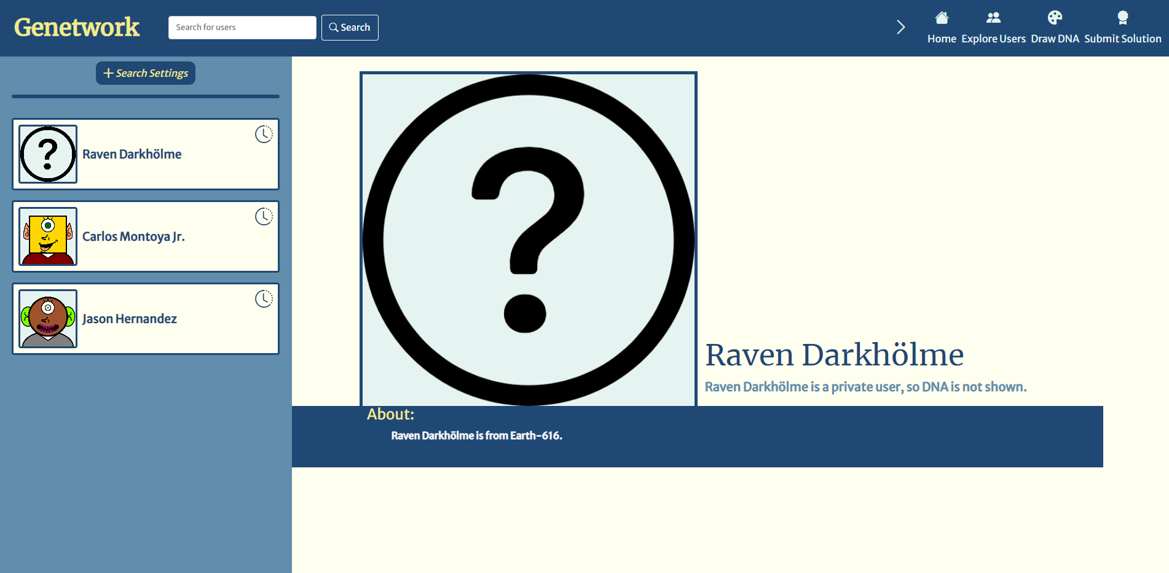
NOPE

Slide 9
Problems
Raven’s DNA is Hidden, since she is a private user.
Raven is a shapeshifter, if we draw her attention she will shapeshift and disappear
Can’t catch the wrong guy (can’t submit wrong DNA solution)
Can’t ask too many questions about her – Up to 256 ☹

Slide 10
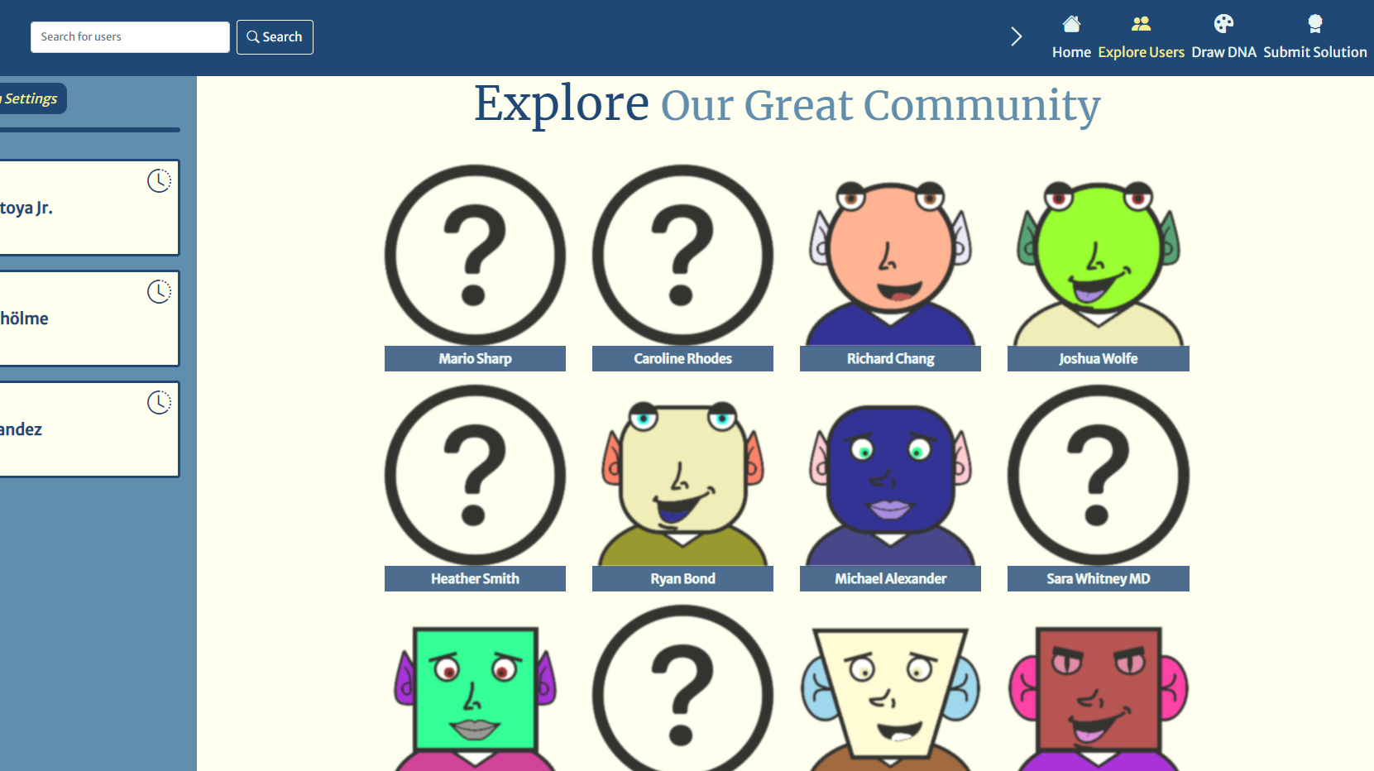
Looking Around
Explore page loads users dynamically?
It uses an API!

Slide 11
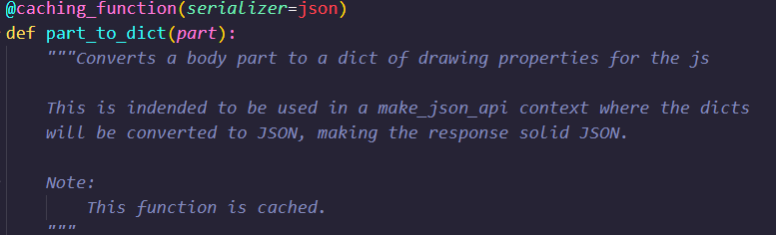
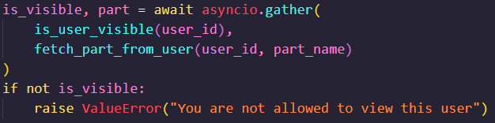
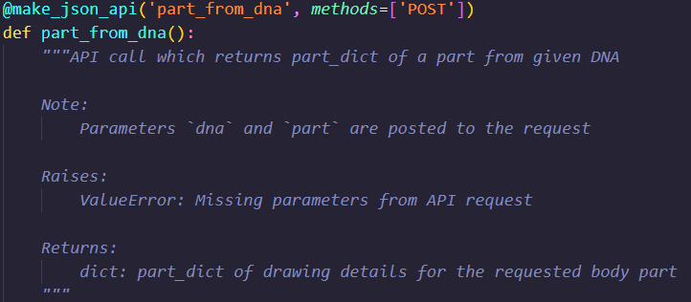
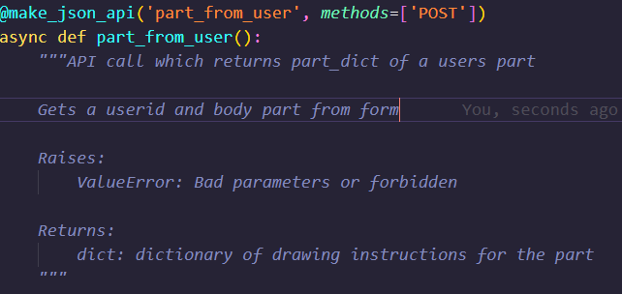
the api

Slide 12

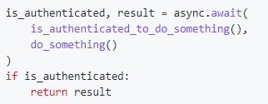
What in the Async?
Speculative
Optimistic
Execution

Slide 13


Leakage!
NOPE
is_user_visible
NOPE
part_from_user
May I get Raven’s head?
part_to_dict
Raven’s Head - Secret
cache

Slide 14
Half The story
cache
?

Slide 15
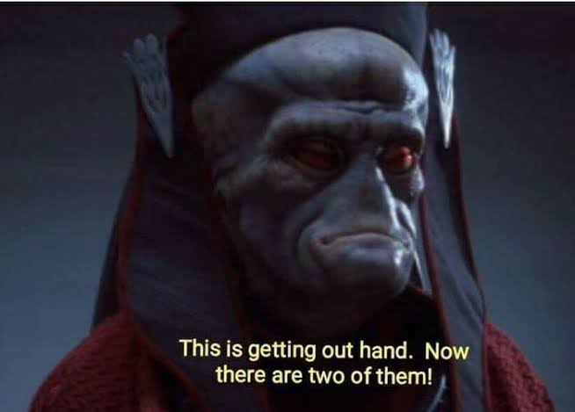
Three Little Caches
Three cache implementations, with rising difficulty.
Simple Cookie-Session Cache
Encrypted Cookie-Session Cache
Server-Side SQL-Based Cache
3

Slide 16
Simple Cookie-Session Cache
Easy Mode:
Data is stored using Flask-Sessions (like JWT)
Data can be accessed in the cookie
Data is signed but not encrypted
Reading Comprehension

Slide 17
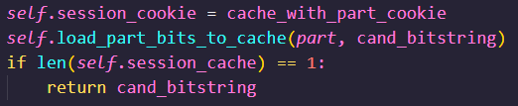
Encrypted Cookie-Session Cache
Medium Mode:
Data is stored using Flask-Sessions but inputs/outputs are encrypted!
Data can be accessed in the cookie
Size still visible!

Slide 18
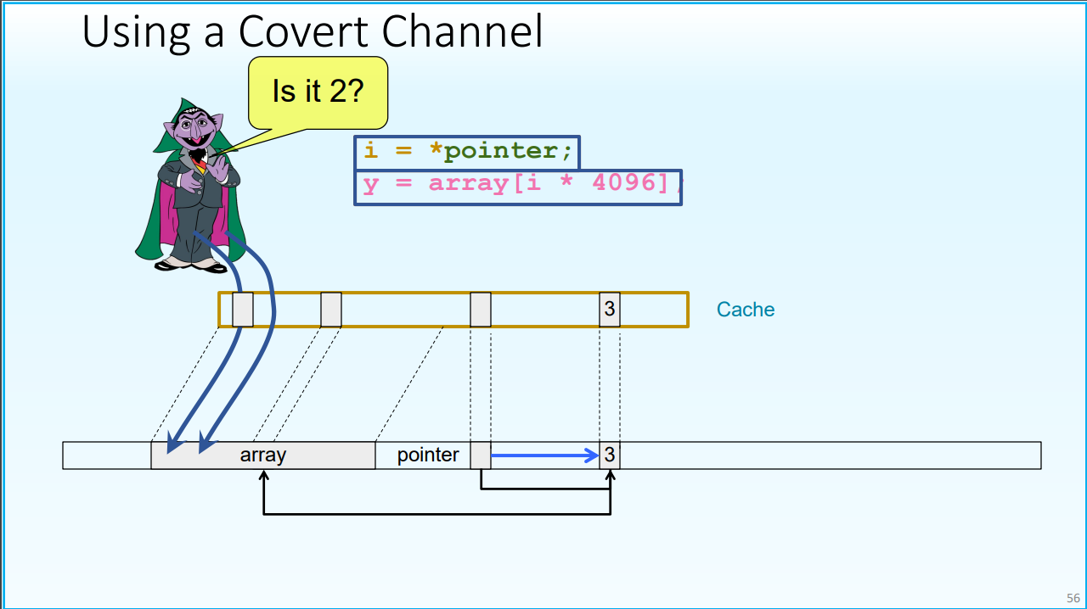
Server-Side SQL-Based Cache
Hard Mode:
Data is stored in the server in an SQL database.
User sees can access no data
What can we do?
Great Artists Steal (Slide from Yuval Yarom)

Slide 19
What genetwork actually is
Higher level, accessible version of Spectre
Three cache implementations, with rising difficulty.
Simple Cookie-Session Cache – Understanding The Leak
Encrypted Cookie-Session Cache – Side Channel Attack Using Metadata
Server-Side SQL-Based Cache – Full-On Cache Attack Simulation

Slide 20
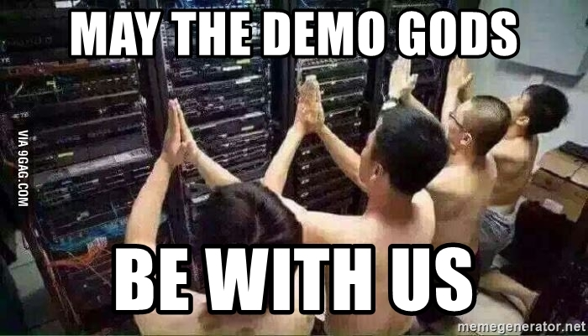
Time for a DEMO?

