Slide 1
Decaf 实验四
4.代码生成

Slide 2
Decaf 实验四
代码生成
Code generation includes several steps:
  1) Intermediate code generation
  2) Generate some form of assembly code instead of actual executable code
  3) Optimization: To improve the speed and size of the target code

Slide 3
Decaf 实验四
中间代码生成
  The need for intermediate code
  Abstract syntax tree does not resemble target code, particularly in its representation of control flow constructs
  Intermediate code
  Representation of the syntax tree in sequential form that more closely resembles target code
  Popular forms of intermediate code:
  Three-address code

Slide 4
Decaf 实验四
三地址码
  The most basic instruction of three address code has the general form x=y op z
  x,y,z are names, constants or compiler-generated temporary names
  op stands for any arithmetic or logical operator, such as + ,’and’
  “Three-address code” comes from this form of instruction, in general each of x,y and z represents an address in memory

Slide 5
Decaf 实验四
三地址码
  赋值语句
  a = 5 + 2 * b;
  三地址码
  _t0 = 5;
  _t1 = 2 * b;
  a = _t0 + _t1;

Slide 6
Decaf 实验四
三地址码
  if语句
    if( x < y )
    z = x;
    else
    z = y;
    z = z + z;
  三地址码
    _t0 = x < y;
    If_false _t0 Goto _L0;
    z = x;
    Goto _L1;
    _L0:
    z = y;
    _L1:
    z = z * z;

Slide 7
Decaf 实验四
中间代码生成
主要在包inter中
每个类的gen, jumping
  将while，do等语句翻译成if x goto L1等形式的三地址码

Slide 8
Decaf 实验四
if x goto L1等形式的三地址码实现
  public void emitjumps(String test, int t, int f){
  if(t!=0&&f!=0){
  emit("if "+test+" goto L"+t);
  emit("goto L"+f);
  }
  else if(t!=0) emit("if "+test+" goto L"+t);
  else if(f!=0) emit("iffalse "+test+" goto L"+f);
  else ;
  }

Slide 9
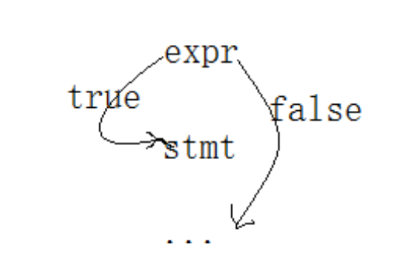
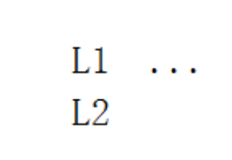
Decaf 实验四
if (expr) { stmt; }
  public void gen(int b, int a) {
  int label = newlabel(); // label for the code for stmt
  expr.jumping(0, a); // fall through on true, goto a on false
  emitlabel(label); stmt.gen(label, a);
  }

Slide 10
Decaf 实验四
例子
  if(a<b)
  {
  min=a;
  }
  while(min+a<c)
  {
  a=a+1;
  }

Slide 11
Decaf 实验四
例子-输出
  L1: if_false a < b goto L3
  L4: min = a
  L3: t1 = min + a
  if_false t1 < c goto L2
  L5: a = a + 1
  goto L3
  L2:

Slide 12
Decaf 实验四
实验内容：
  1. 理解源码，添加注释
  2. 添加for语句的中间代码生成
  3.
  进阶要求， 从词法开始，一直到TAC到生产，增加Switch语句

Slide 13
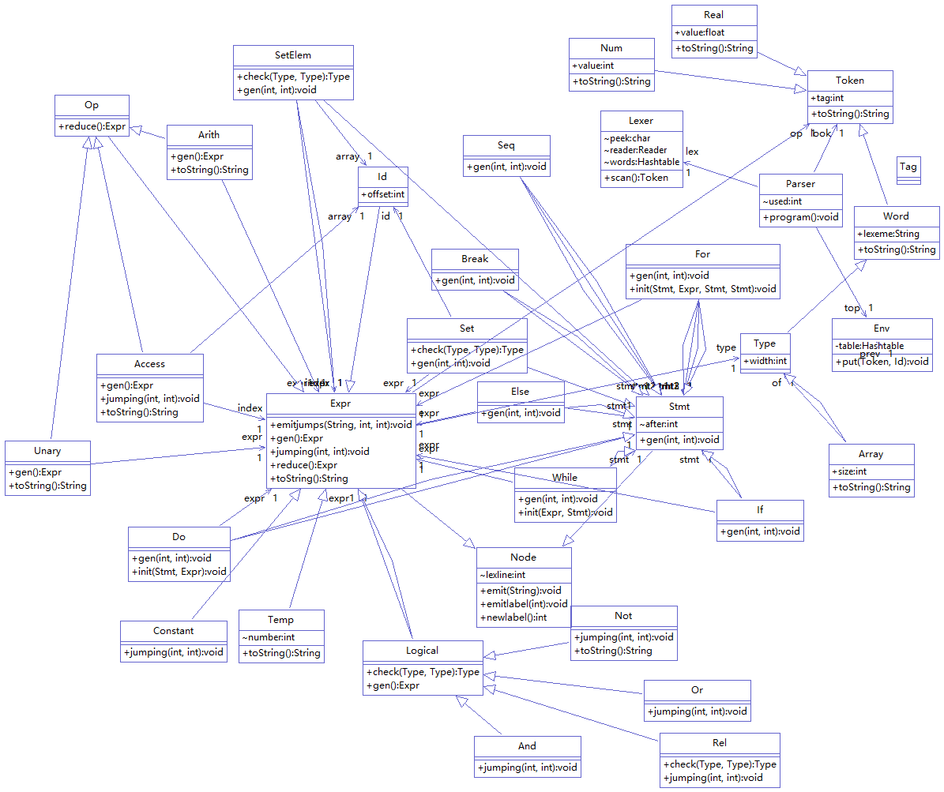

Slide 14
Another Version of decaf
Decaf C++ version
  Running with Flex and Bison
.\decaf configuration guide.docx
  .\decaf-master\doc\020_Decaf_Specification.pdf
  ..\050_Assignment_1.pdf
  ..\130_Assignment_2.pdf
  ..\190_Assignment_3.pdf

Slide 15
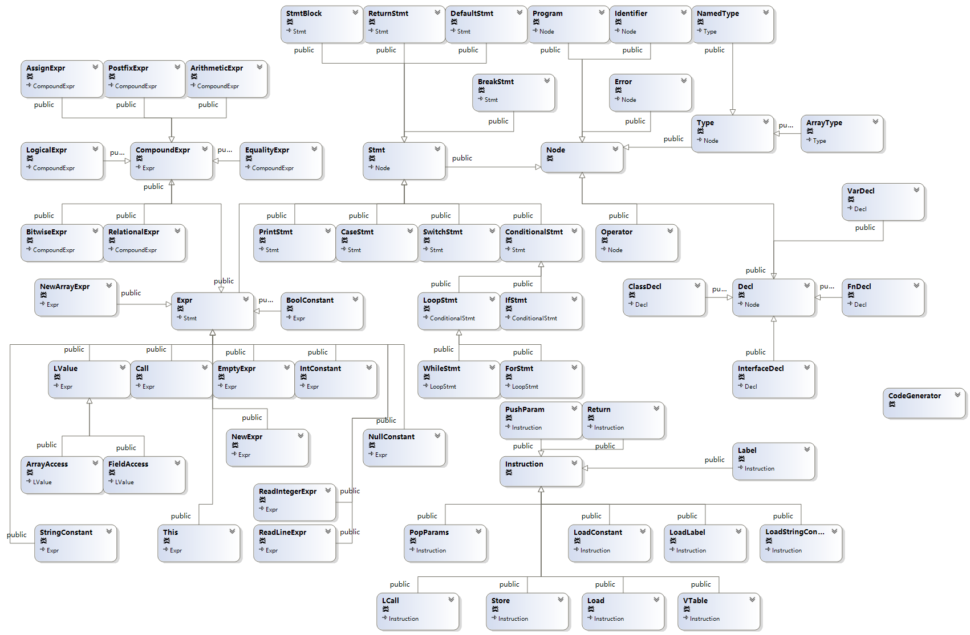

Slide 16
Pay attention to:
  .\ast\ast.h 语法树基础结构
  .\ast\stmt.cc 语义分析、代码生成入口
  .\arch\x86 三地址码
  .\dcc\errors.h 错误处理

