Slide 1
Intro to Cryptocurrency
By noah Montero

Slide 2
Outline
Cryptocurrency
Bitcoin
Ethereum
Altcoin
Tweak coins
Volatile coins
Stable Coin
Takeaways
sources

Slide 3
Cryptocurrency
Essentially, digital money
It is decentralized (not government-regulated)

Slide 4
Bitcoin
Bitcoin (along with blockchain) first came to existence in 2008 invented by Satoshi Nakamoto and was then released and tested along with open source code in 2009.
The idea of bitcoin is to make secure peer-to-peer transactions trading bitcoin without any involvement from the government, financial institution, or banks (Smigel)

Slide 5
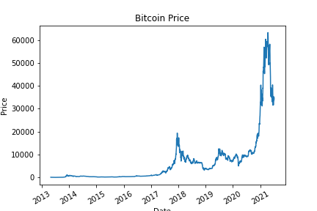
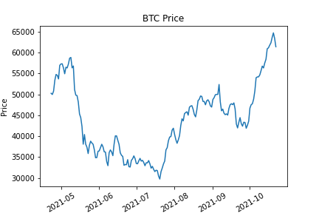
Bitcoin prices
price history
Recent Prices

Slide 6
Ethereum
The cryptocurrency that introduced smart contracts in the blockchain
It is also decentralized
Proposed by Vitalik Buterin in 2013
Got developed in 2014, and went live in 2015
More work went to it and the Ethereum team upgraded Ethereum to Ethereum 2.0 to fix the following
Clogged Network (to fix slow transaction speeds and high costs)
Large energy consumption due to proof of work

Slide 7
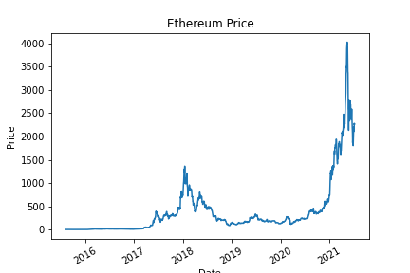
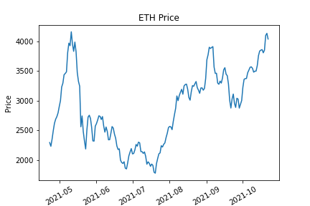
Ethereum Prices
Price History
Recent Prices

Slide 8
Altcoin
Simply put anything other than Bitcoin
Most of these coins are built on top of Ethereum (including Ethereum itself)
types of Altcoin
Tweak Coins
Coins that are Volatile
Stable coins

Slide 9
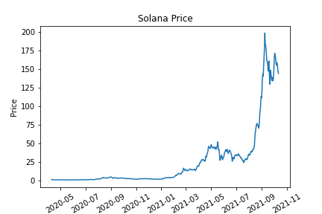
Tweak Coins
Tweak Coins are coins that work to improve transaction speeds, transaction security, etc.
Solana
Founded in 2017 by Anatoly Yakovenko, a former contributor to Qualcomm and Dropbox.
Solana targets problems found in traditional protocols from Bitcoin and Ethereum by making the network faster and cheaper
https://solana.com/

Slide 10
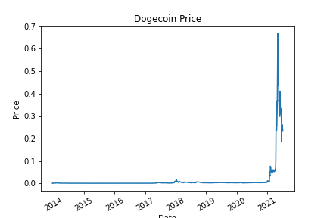
Volatile coins
Coins that spike up and down quickly and suddenly
DogeCoin
A community based cryptocurrency founded by Billy Markus and Jackson Palmer December 6th 2013
This coin was the fun coin based off a popular meme found in internet culture

Slide 11
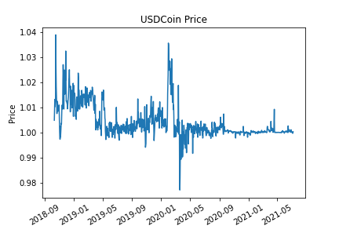
Stable coins
Crypto currency that is relative to an existing currency in the physical world (such as US Dollar, or Japanese Yen)
USDC is based on the US Dollar

Slide 12
Takeaways
Bitcoin and Ethereum are your best bets
Do your research
Be mindful of volatile coins

Slide 13
Sources
References
https://learn.bybitglobal.com/altcoins/a-beginners-guide-what-is-usd-coin-and-how-does-it-work/
https://www.ecb.europa.eu/pub/pdf/scpops/ecb.op230~d57946be3b.en.pdf?321f6bf14960e6f604725be5a466957b
https://learn.huobi.com/en-us/the-history-of-ethereum/
https://analyzingalpha.com/bitcoin-history
https://beincrypto.com/learn/what-is-solana/
https://www.chime.com/blog/a-beginners-guide-to-cryptocurrency/

Slide 14
Sources
Data
https://www.kaggle.com/sudalairajkumar/cryptocurrencypricehistory?select=coin_Solana.csv
https://www.kaggle.com/varpit94/solana-data
https://www.nasdaq.com/market-activity/cryptocurrency/eth/historical
https://www.nasdaq.com/market-activity/cryptocurrency/btc/historical

