Slide 1
CBD Calla Housing Automatic assembly line---
Automatic Product Collecting Machine
2026/01/22

Slide 2
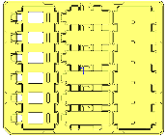






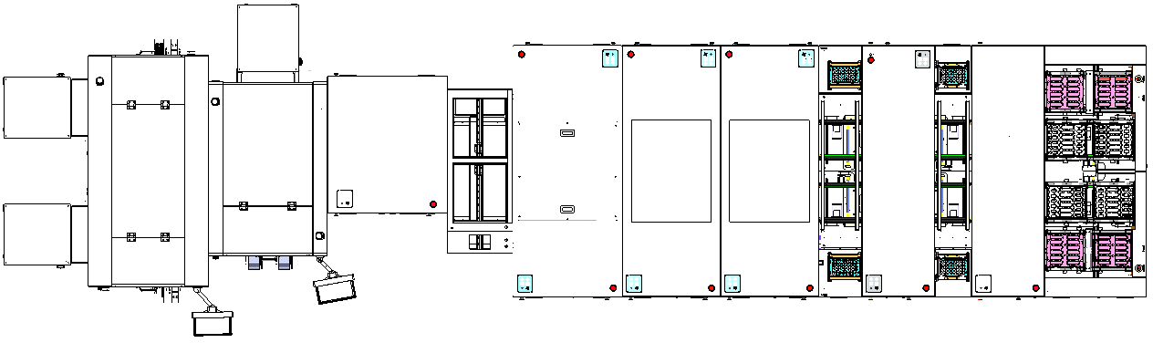
Upper and Lower Cover Automatic Assembly Line – LH-Cony Existing Machine Retrofit ）
整體Layout示意Overall Layout Diagram
Unit單位:mm
Line Direction
1870
1100
1100
600
1000
900
900
1400
1600
Item | 1 | 2 | 3 | 4 | 5 | 7 | 8 | 9 | 10
Station No. | 1 | 2 | 3 | 4 | 5 | 7 | 8 | 9 | 10
Station Name | Automatic Upper Cover Metal Fitting | Automatic Lower Cover Metal Fitting | Metal Sleeve Press-Fit & Upper Cover Flip | Transfer Unit | PCB Automatic Assembly Machine | Upper Cover Automatic Assembly & Press-Fit | Upper Cover Automatic Assembly & Press-Fit | USB Sub-Assembly Machine | Automatic Unloading Machine
New Build / Retrofit | Customer Supplied | Customer Supplied | Retrofit | Customer Supplied | Retrofit | Retrofit | Retrofit | Retrofit | Retrofit
CT (s) | – | – | 3.25 | – | 5 | 10 | 10 | 3.5 | 3
Feeding Method | – | – | Tray | – | Tray | Tray | Tray | Tray | Tray
Automatic Assembly Line UPH ：900PCS/H
Automatic Line Dimensions ： L 10500mm * W 2600mm * H 1700mm (供參考，依實際為準)
New Build
Retrofit
2
Customer Supplied

Slide 3

Contents
Item | Description | DRI
1 | Historical versions | ChengHaoZhe
2 | Machine performance design | ChengHaoZhe
3 | Machine layout | ChengHaoZhe
4 | Key component | ChengHaoZhe
5 | Action flow design | ChengHaoZhe
6 | Sequence chart | ChengHaoZhe

Slide 4
1.Historical version
Version | Description | Date | DRI | Remark
V01 | Design modification version | 2026/1/22 | ChengHaoZhe

Slide 5
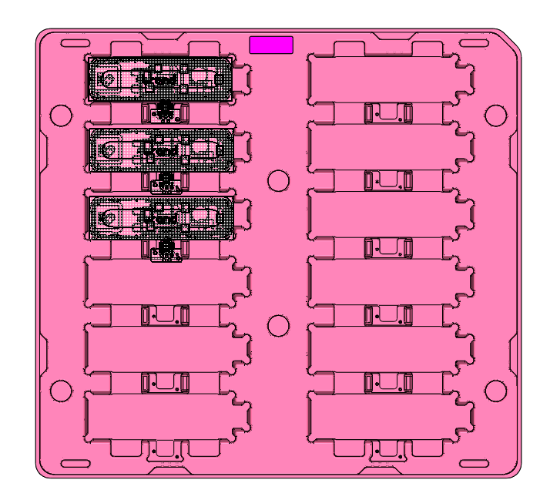
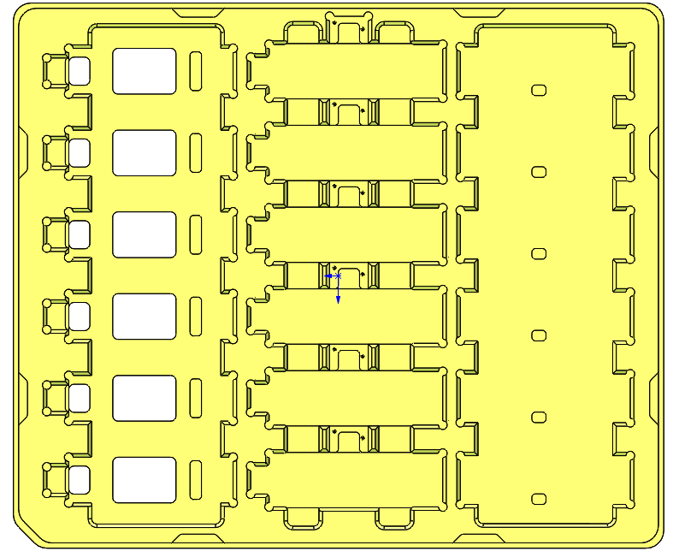
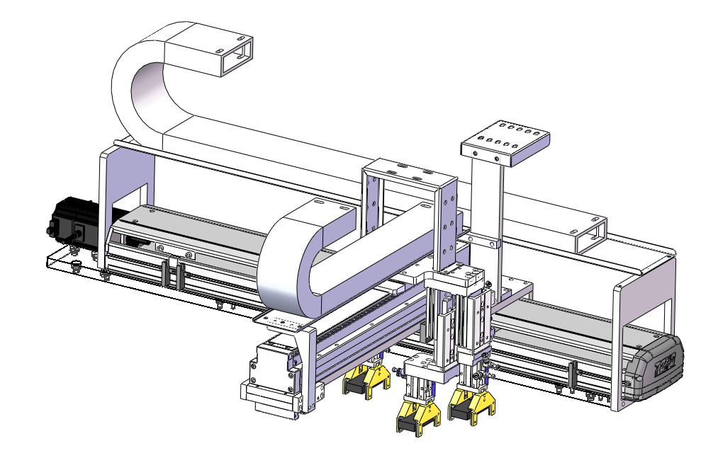
2.Machine performance design
Feature：
Tray
table Load transfer component
Tray
Aim | Collect the products in the incoming Tray
Tray | 370*310*23.7mm，335*310*17
Tool | table Load transfer component
Course | Take the material, put the material
UPH requirements | 900PCS

Slide 6
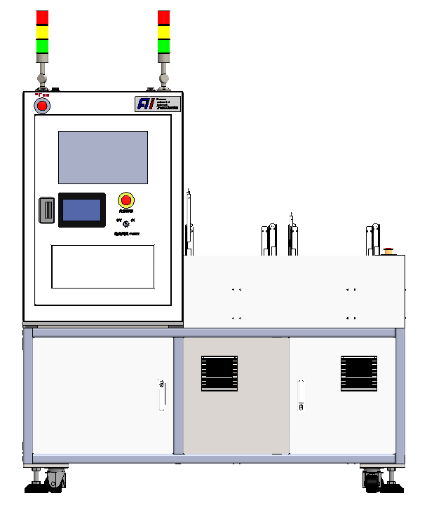
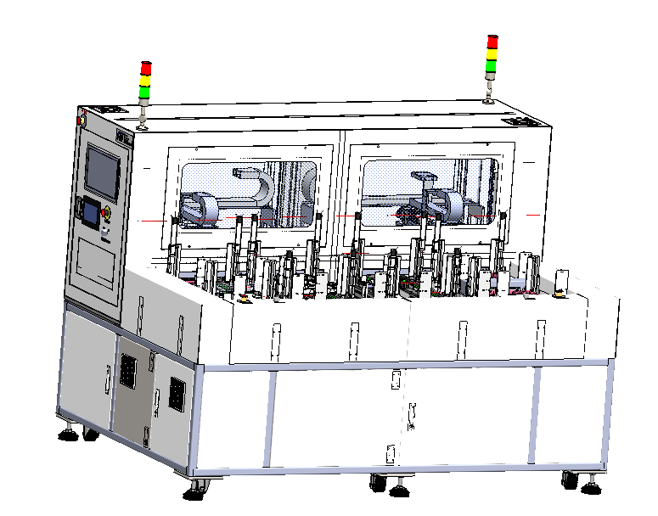
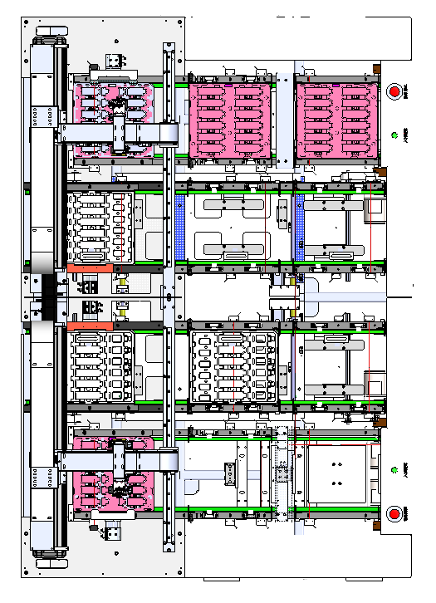
3.Machine layout
Tricolour light
1684mm
Touch screen
1600mm
2300mm

Slide 7
3.Machine layout
2
3
Tray Flow into
Trayoutflow
Item number | Process flow
1 | Empty Tray switch components
2 | Table Load transfer component
3 | Receiving Tray Switch components
1
1
2
3
Key position

Slide 8
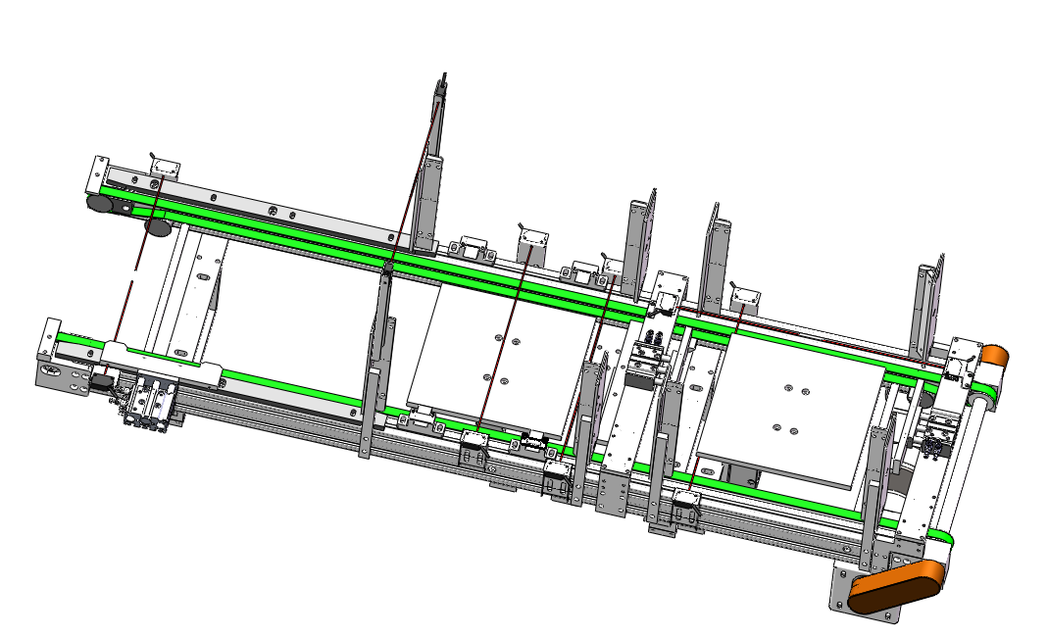
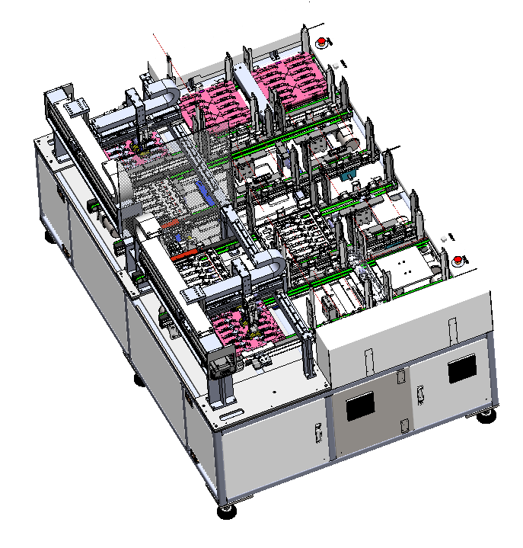
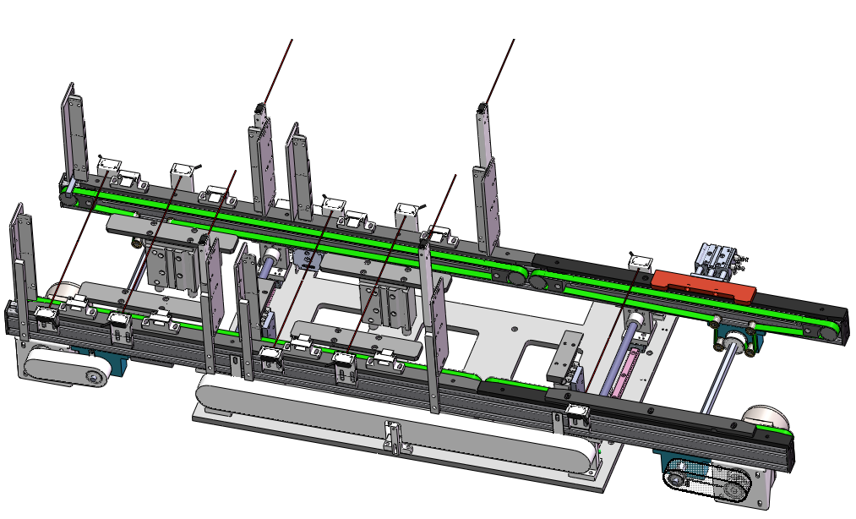
3.Machine layout
Table Load transfer component
3
Receiving Tray Switch components
2
1
Empty Tray switch components

Slide 9
4.Key component
4.1Empty Tray switch components
1
Tray area 1
1.Tray positioning process ：
①Tray flows into the conveyor line, Tray sensing Sensor4 sensing after the conveyor line deceleration, blocking cylinder block Tray .
②Tray side positioning cylinder push out to position Tray.
2.Empty Tray process：
① After the product is clamped, the empty Tray flows into Tray area 1, Tray sensing Sensor1 sensing after the transmission line slows down, the blocking cylinder blocks the Tray .
②Tray ejector cylinder ejector empty Tray away。
③Tray area 1Tray sensor Sensor3 indicates that the Tray is full after sensing the Tray. This time Tray will enter Tray area 2. After sensing the Tray sensor Sensor7, the conveyor line will slow down and the blocking cylinder will block the tray .
④ Tray ejector cylinder ejector empty Tray away。
Tray ejector cylinder
Tray area 2
Tray block cylinder
Tray side positioning cylinder
Belt
Electric machine
Electric machine
Tray receiving support seat
Tray Sensor1
Belt
Tray Sensor2
Tray Sensor3
Tray Sensor4
Tray Sensor5
Tray Sensor6
Tray Sensor7
The maximum load of a single transmission line is about 20Kg

Slide 10
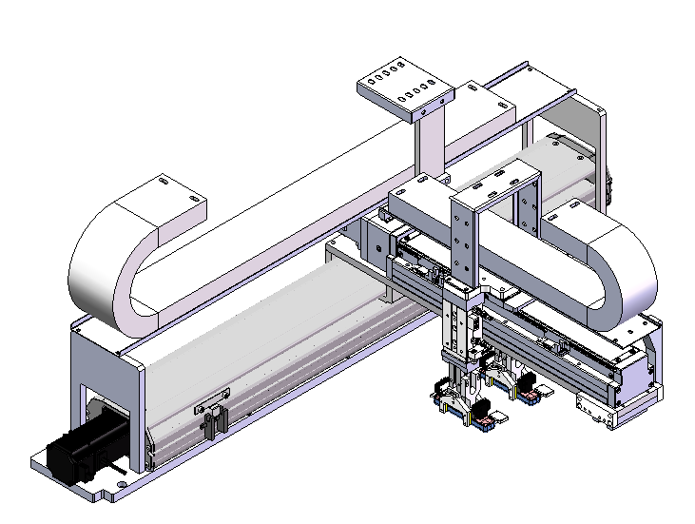
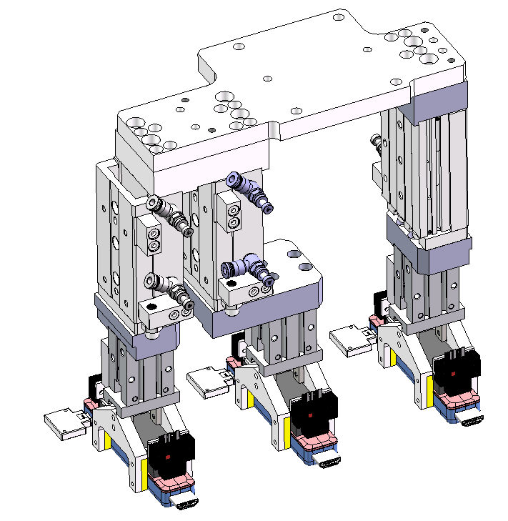
4.Key component
4.2 table Load transfer component
2
X-axis transfer
Type | GTH8-L20-250-BC-S40-C4
Brand | TOYO
repeatability | ±0.01mm
Travel distance | 400mm
Max speed | 1000mm/s
Work speed | 800mm/s
Rate load | 18kg
Work load | kg
X-axis transfer
Y-axis transfer
Type | ETH14-L32-700-BC-S40-B2
Brand | TOYO
repeatability | ±0.01mm
Travel distance | 700mm
Max speed | 1600mm/s
Work speed | 800mm/s
Rate load | 30kg
Work load | kg
Y-axis transfer
Slide cylinder
HLSL12*40SAS
Gripper cylinder
HFZ16

Slide 11
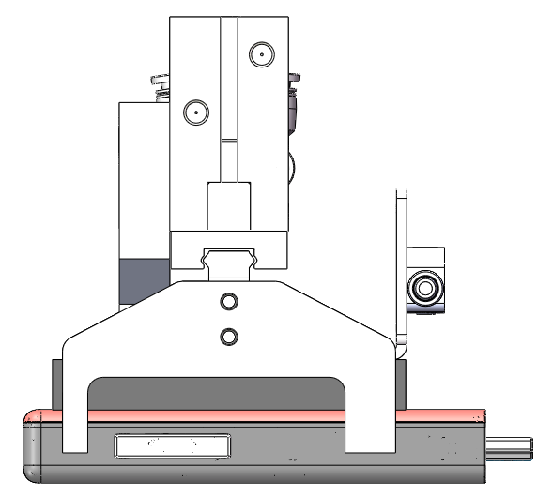
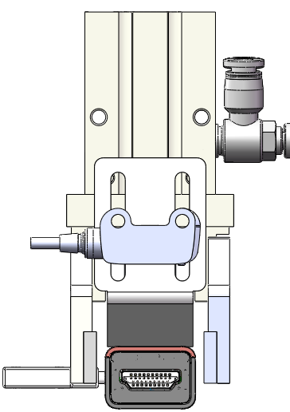
4.Key component
4.2.2Receiving jaw mechanism
5
10
Anti-static Urethane Rubber
7.8
5.25
22.75
27.06

Slide 12
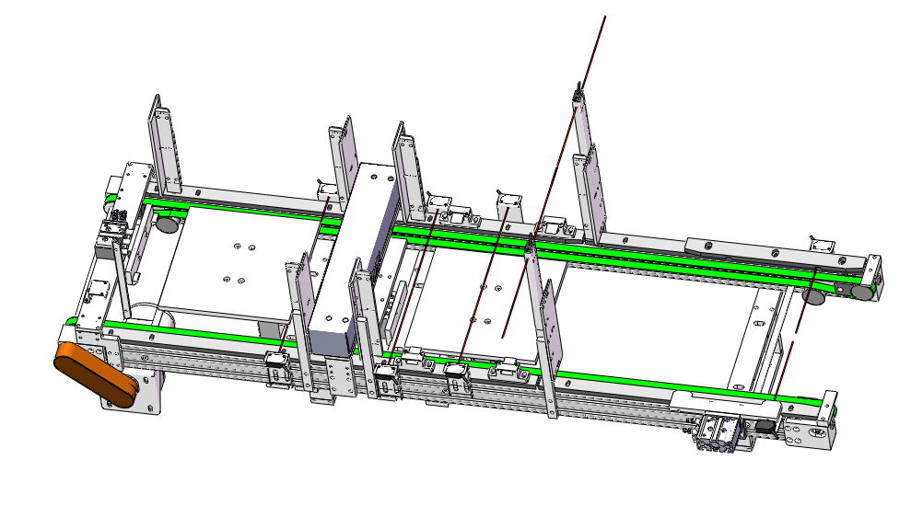
4.Key component
4.3Receiving Tray Switch components
1.Tray positioning process：
①Tray flows into the product area, Tray sensing Sensor4 sensing after the transmission line deceleration, blocking block block Tray .
②Tray side positioning cylinder push out to position Tray.
2.Receiving process：
① After filling the Tray, the product flows into the receiving area. The Tray sensor Sensor2 sensing conveyor line slows down, and the Tray blocking cylinder blocks the Tray .
②Tray Ejector lifts Tray full of product
3.Feeding process：
①After the products in the receiving area are put away, the charging mechanism in the feeding area raises two cylinders, the Tray dividing mechanism is put away, and then the Tray charging mechanism drops a cylinder, the dividing mechanism extends, and the charging mechanism completely drops。
②Tray induction Sensor1 induction line accelerates Tray delivery to the product area
3
Tray Charging mechanism
Input area
Receiving area
Tray block cylinder
Tray side positioning cylinder
Belt
Tray dividing mechanism
Tray block
Electric machine
Tray Sensor1
Tray Sensor2
Tray Sensor3
Tray Sensor4
Tray Sensor5
Product area
The maximum load of a single transmission line is about 20Kg

Slide 13
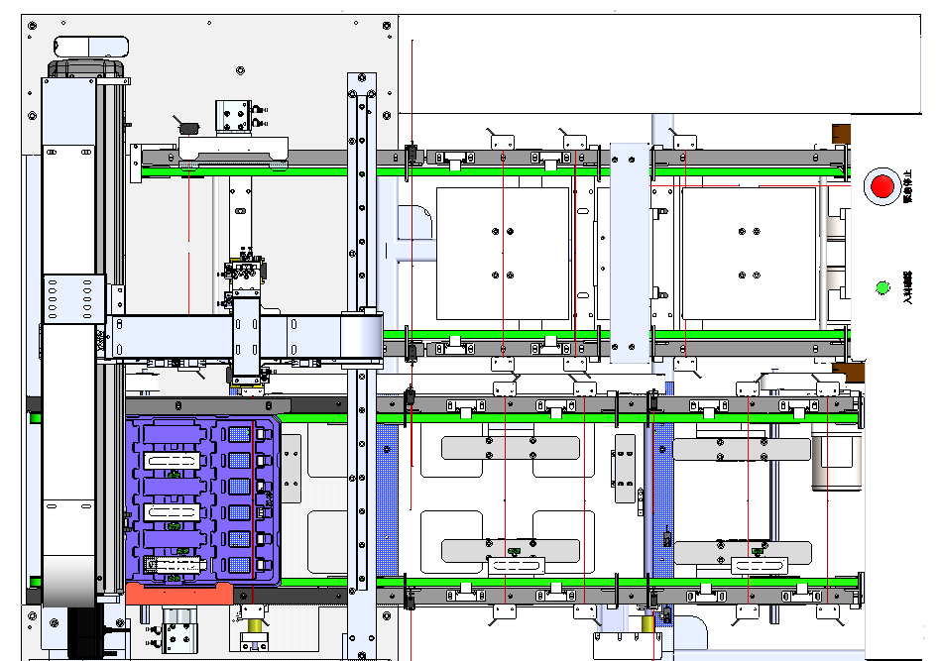
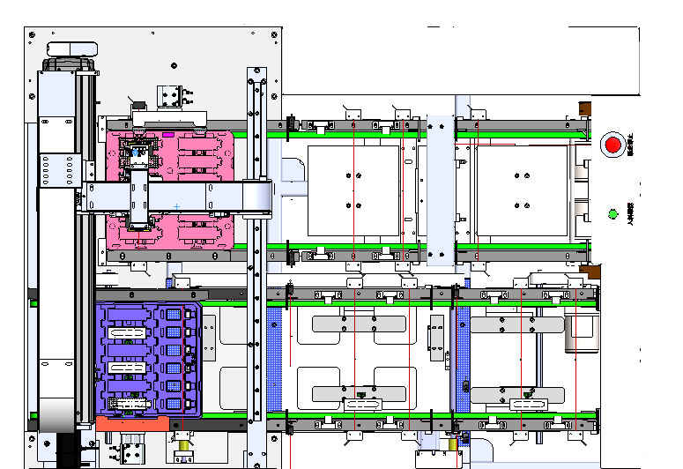
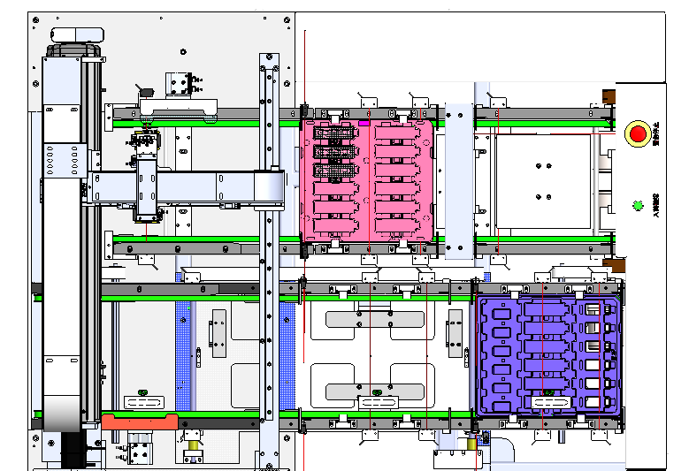
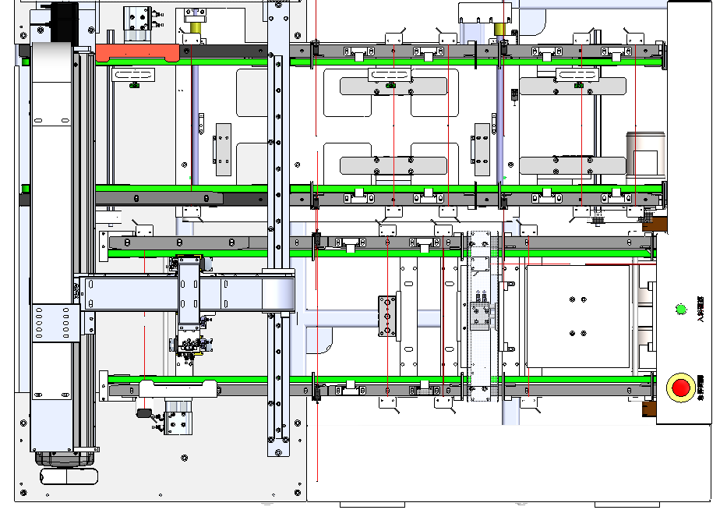
5.Action flow design
Step1: Tray feed into the work area vehicle positioning fixed.（
Step2: table Transfer assembly places product into receiving Tray.
Step3:The product Tray enters the receiving area, and the empty Tray enters the receiving area.

Slide 14
6.Sequence chart
上下蓋自動組裝線---翻面機0.5s/格
Tray盤入料 | 輸送線運轉時間2.0S | 2.5 |  |  |  |  |  |  |  |  |  |  |  |  | 1.5 | 1.5 |  |  |  |  |  |  |  |  |  |  |  |  |  |  |  |  |  |  |  |  |  |  |  |  | 2.5 |  |  |  |  |  |  |  |  |  |  |  |  | 1.5 | 1.5
 | 側頂氣缸伸出0.5S
取料 | 氣缸下降0.5S |  |  |  |  |  | 2 |  |  |  |  |  |  |  |  |  |  |  |  |  |  |  |  |  |  |  |  |  |  |  |  |  |  |  |  |  |  |  |  |  |  |  |  |  |  | 2
 | 真空打開0.5S
 | 氣缸升起0.5S
 | 去翻面位置0.5S
翻面 | 氣缸下降0.5S |  |  |  |  |  |  |  |  |  | 2.5 |  |  |  |  |  |  |  |  |  |  |  |  |  |  |  |  |  |  |  |  |  |  |  |  |  |  |  |  |  |  |  |  |  |  |  |  |  |  | 2.5
 | 夾爪夾緊0.5S
 | 氣缸上升0.5S
 | 翻面1.0S
放料 | 氣缸下降0.5S |  |  |  |  |  |  |  |  |  |  |  |  |  |  | 3 |  |  |  |  |  |  |  |  |  |  |  |  |  |  |  |  |  |  |  |  |  |  |  |  |  |  |  |  |  |  |  |  |  |  |  |  |  |  | 3
 | 夾爪鬆開0.5S
 | 氣缸上升0.5S
 | 去放料位置0.5S
 | 氣缸下降0.5S
 | 氣缸上升0.5S
取料 | 氣缸下降0.5S |  |  |  |  |  |  |  |  |  |  |  |  |  |  |  |  |  |  |  |  | 2 |  |  |  |  |  |  |  |  |  |  |  |  |  |  |  |  |  |  |  |  |  |  |  |  |  |  |  |  |  |  |  |  |  |  |  |  |  |  | 2
 | 真空打開0.5S
 | 氣缸升起0.5S
 | 去翻面位置0.5S
翻面 | 氣缸下降0.5S |  |  |  |  |  |  |  |  |  |  |  |  |  |  |  |  |  |  |  |  |  |  |  |  | 2.5 |  |  |  |  |  |  |  |  |  |  |  |  |  |  |  |  |  |  |  |  |  |  |  |  |  |  |  |  |  |  |  |  |  |  |  |  |  |  | 2.5
 | 夾爪夾緊0.5S
 | 氣缸上升0.5S
 | 翻面1.0S
放料 | 氣缸下降0.5S |  |  |  |  |  |  |  |  |  |  |  |  |  |  |  |  |  |  |  |  |  |  |  |  |  |  |  |  |  | 3 |  |  |  |  |  |  |  |  |  |  |  |  |  |  |  |  |  |  |  |  |  |  |  |  |  |  |  |  |  |  |  |  |  |  |  |  |  |  | 3
 | 夾爪鬆開0.5S
 | 氣缸上升0.5S
 | 去放料位置0.5S
 | 氣缸下降0.5S
 | 氣缸上升0.5S
Tray盤流出 | 側頂氣缸縮回0.5S |  |  |  |  |  |  |  |  |  |  |  |  |  |  |  |  |  |  |  |  |  |  |  |  |  |  |  |  |  |  |  |  |  |  |  | 2 |  |  |  |  |  |  |  |  |  |  |  |  |  |  |  |  |  |  |  |  |  |  |  |  |  |  |  |  |  |  |  |  |  |  |  |  |  |  | 2
 | 載具流出1.5
 |  | 1 | 2 | 3 | 4 | 5 | 6 | 7 | 8 | 9 | 10 | 11 | 12 | 13 | 14 | 15 | 16 | 17 | 18 | 19 | 20 | 21 | 22 | 23 | 24 | 25 | 26 | 27 | 28 | 29 | 30 | 31 | 32 | 33 | 34 | 35 | 36 | 37 | 38 | 39 | 40 | 41 | 42 | 43 | 44 | 45 | 46 | 47 | 48 | 49 | 50 | 51 | 52 | 53 | 54 | 55 | 56 | 57 | 58 | 59 | 60 | 61 | 62 | 63 | 64 | 65 | 66 | 67 | 68 | 69 | 70 | 71 | 72 | 73 | 74 | 75 | 76 | 77 | 78 | 79 | 80 | 81
Cycle time/s | 19.5S
UPH≈3600÷19.5×90%≈166PCSx2x6=1992PCS
Note：90% is estimated OEE, only for UPH calculation. not real product data

Slide 15

THANK YOU ! !

