Slide 1
Dispensing bot thermal gel fixture Ver2.0
CNT
2025.07.11

Slide 2
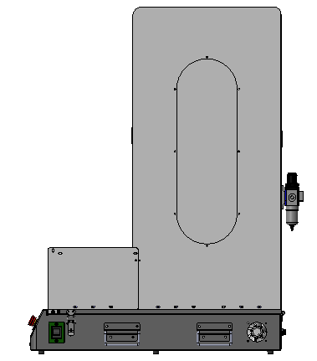
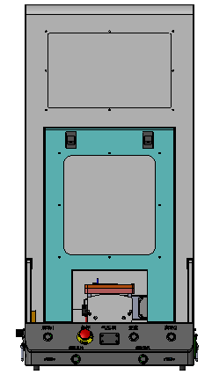
Dispensing bot thermal gel fixture
Fixture overview
975mm
767mm
360mm
Summary: The fixture size is L*W*H=360mm*767mm*975mm.

Slide 3
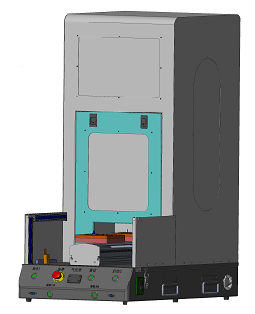
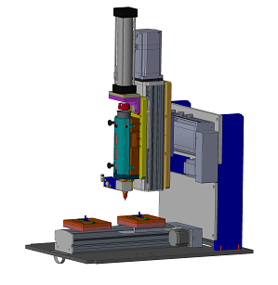
Dispensing bot thermal gel fixture
Fixture parts
Protect
Extrude cylinder
Z axis motor
Light curtain
X axis
Putty bottle fix structure
Control button
Vacuum value
Dispensing nozzle
Emergency stop
Power button
Y axis
holder
Y axis motor

Slide 4
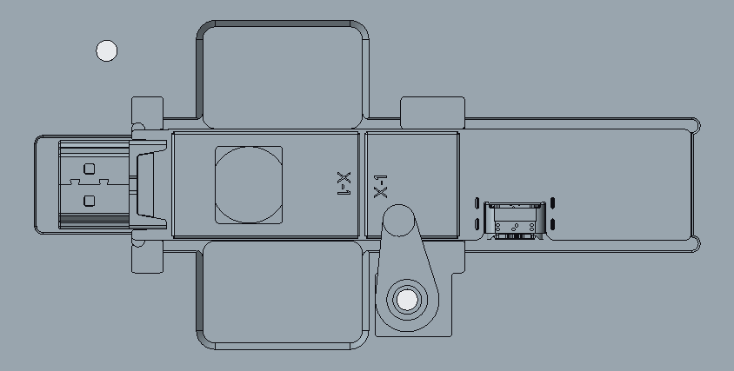
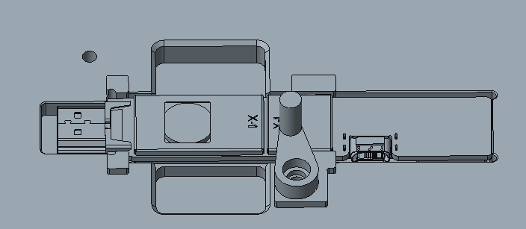
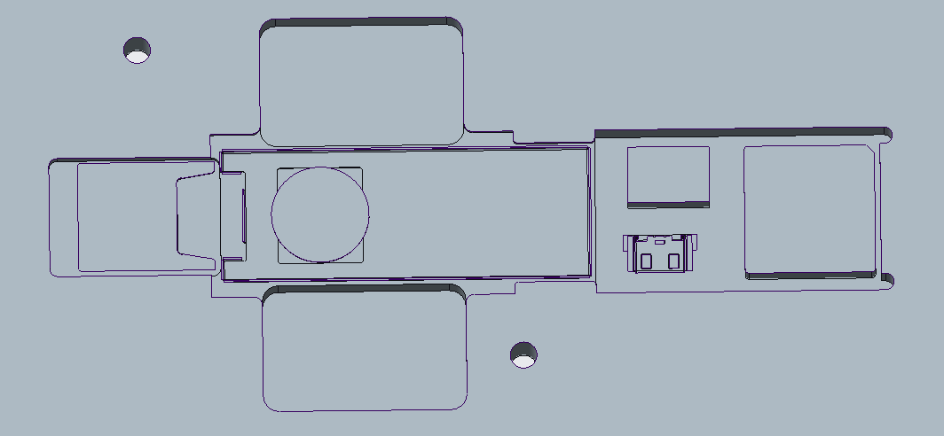
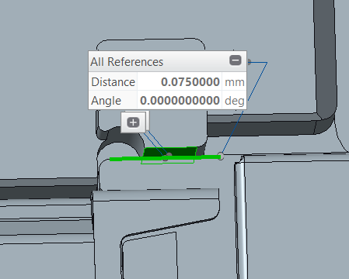
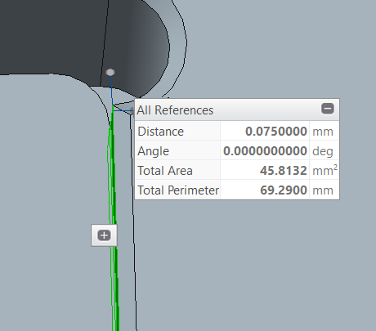
Dispensing bot thermal gel fixture
Holder design
Material: AL7075
Added a buckle to press PCBA
The gap between PCBA and holder is 0.075mm.
No interference between PCBA and holder

Slide 5
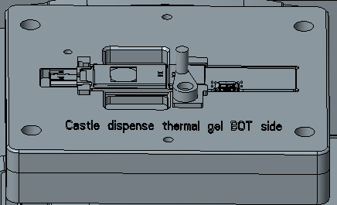
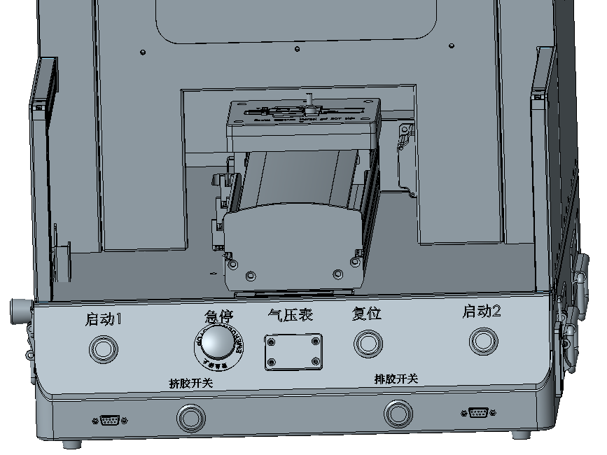
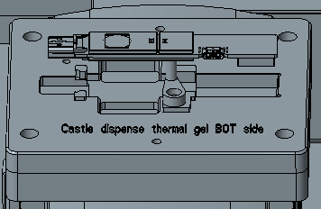
Dispensing bot thermal gel fixture
Work procedures
1.Put PCBA to holder and using buckle to press PCBA
2.Press start button to start dispensing
3.Take out PCBA

