Slide 1
CBD Calla Housing Automatic assembly line---
Back housing assembly Machine
2026/01/22

Slide 2
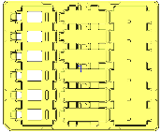






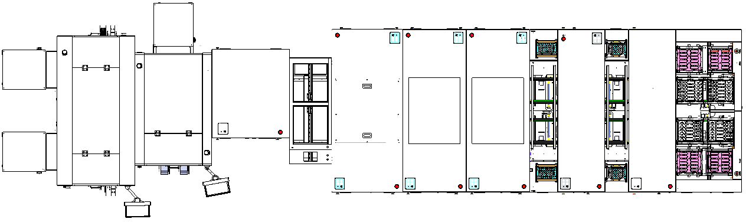
Upper and Lower Cover Automatic Assembly Line – LH-Cony Existing Machine Retrofit ）
整體Layout示意Overall Layout Diagram
Unit單位:mm
Line Direction
1870
1100
1100
600
1000
900
900
1400
1600
Item | 1 | 2 | 3 | 4 | 5 | 7 | 8 | 9 | 10
Station No. | 1 | 2 | 3 | 4 | 5 | 7 | 8 | 9 | 10
Station Name | Automatic Upper Cover Metal Fitting | Automatic Lower Cover Metal Fitting | Metal Sleeve Press-Fit & Upper Cover Flip | Transfer Unit | PCB Automatic Assembly Machine | Upper Cover Automatic Assembly & Press-Fit | Upper Cover Automatic Assembly & Press-Fit | USB Sub-Assembly Machine | Automatic Unloading Machine
New / Retrofit | Customer Supplied | Customer Supplied | Retrofit | Customer Supplied | Retrofit | Retrofit | Retrofit | Retrofit | Retrofit
CT (s) | / | / | 3.25 | / | 5 | 10 | 10 | 3.5 | 3
Feeding Method | / | / | Tray | / | Tray | Tray | Tray | Tray | Tray
Automatic Assembly Line UPH ：900PCS/H
Automatic Line Dimensions ： L 10500mm * W 2600mm * H 1700mm (供參考，依實際為準)
New Build
Retrofit
1
Customer Supplied

Slide 3
Contents
unit：mm
Item | Description | DRI
1 | Historical version | ChengHaoZhe
2 | Machine performance design | ChengHaoZhe
3 | Equipment Layout | ChengHaoZhe
4 | The key components | ChengHaoZhe
5 | Key Fixture Design | ChengHaoZhe
6 | Action flow design | ChengHaoZhe
7 | Timing diagram | ChengHaoZhe
2

Slide 4
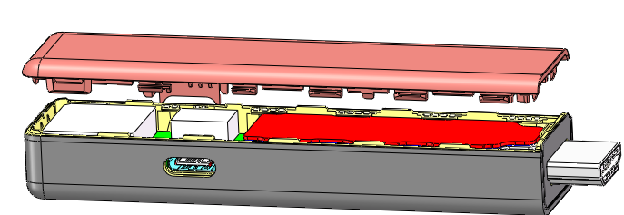
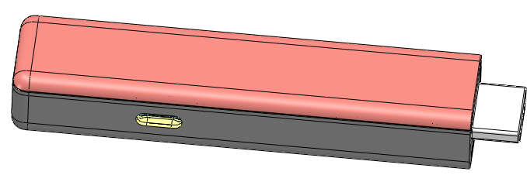
2.Machine Performance Design
Function (Change) ：
unit：mm
Alignment
Pressing
Purpose | Align the upper cover with the top of the lower cover and use a cylinder to press down to make it fit snugly
Product | 100.85*21.1mm
Tool | TABLE Load transfer component，Compression assembly，Material retrieval component，Suction nozzle，CCD，Actuator
Process | CCD calibration
Process requirements | Alignment tolerance +/- 0.2mm
UPH requirements | 900PCS
3

Slide 5
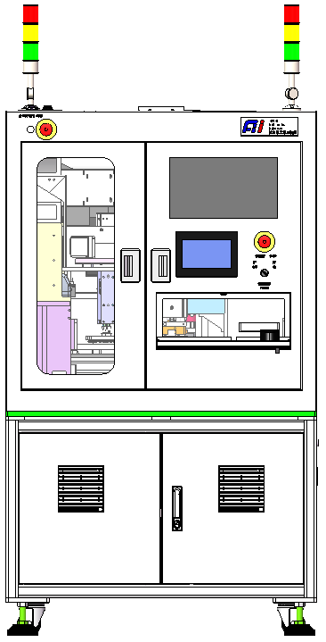
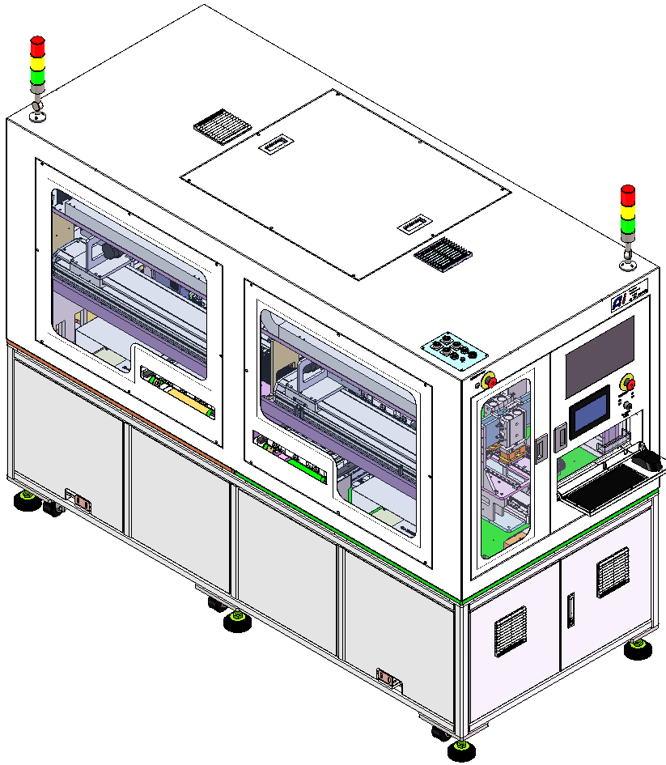
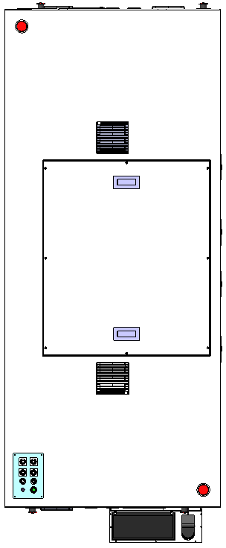
3.Equipment Layout
unit：mm
Tricolor lamp
Tricolor lamp
1680mm
PC
Touch screen
2300mm
 | automatic
Alignment accuracy | ±0.08
CT | 3S
UPH | 900PCS
There are two machines in this station
1000mm
4

Slide 6
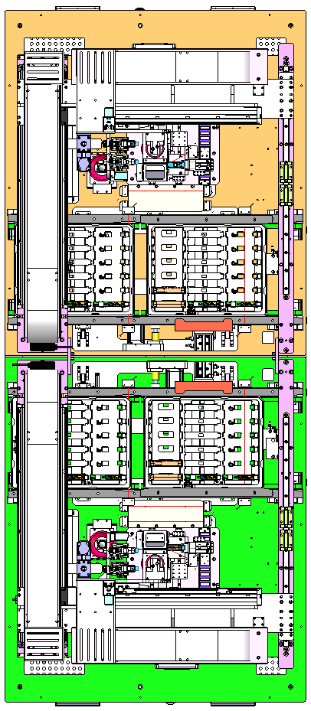
3.Equipment Layout
unit：mm
X/Y TABLE Transfer Component (Material Retrieval) -2
1
4
CCD&Material Retrieval Components (Product Positioning) -1
Item | Components
Front side
1 | X/Y TABLE Transfer Component (Material Retrieval) -1
2 | Lower CCD Component (Label Supplement) -1
3 | Widening the feeding conveyor line (front buffer) -1
4 | CCD&Material Retrieval Components (Product Positioning) -1
5 | Pressing zone (pressing upper and lower covers) -1
6 | Feeding Conveyor Line (Work Area) -1
Rear side
1 | X/Y TABLE Transfer Component (Material Retrieval) -2
2 | Lower CCD Component (Label Supplement) -2
3 | Widening the feeding conveyor line (front buffer) -2
4 | CCD&Material Retrieval Components (Product Positioning) -2
5 | Pressing zone (pressing upper and lower covers) -2
6 | Feeding Conveyor Line (Work Area) -2
Lower CCD Component (Label Supplement) -2
2
5
Pressing zone (pressing upper and lower covers) -1
Widening the feeding conveyor line (front buffer) -1
3
6
Feeding Conveyor Line (Work Area) -1
Rear side
Rear side
Front side
Front side
Widening the feeding conveyor line (front buffer) -1
3
6
CCD&Material Retrieval Components (Product Positioning) -1
Lower CCD Component (Label Supplement) -1
2
5
Pressing zone (pressing upper and lower covers) -1
X/Y TABLE Transfer Component (Material Retrieval) -1
1
4
Feeding Conveyor Line (Work Area) -1
5

Slide 7
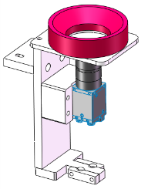
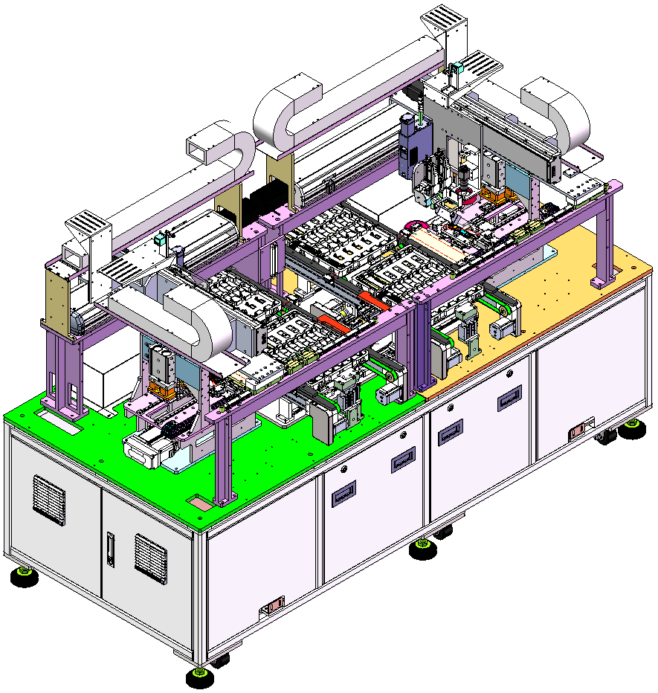
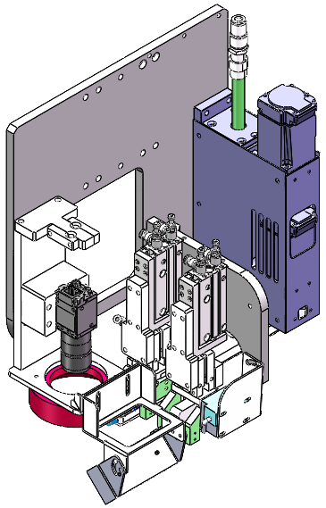
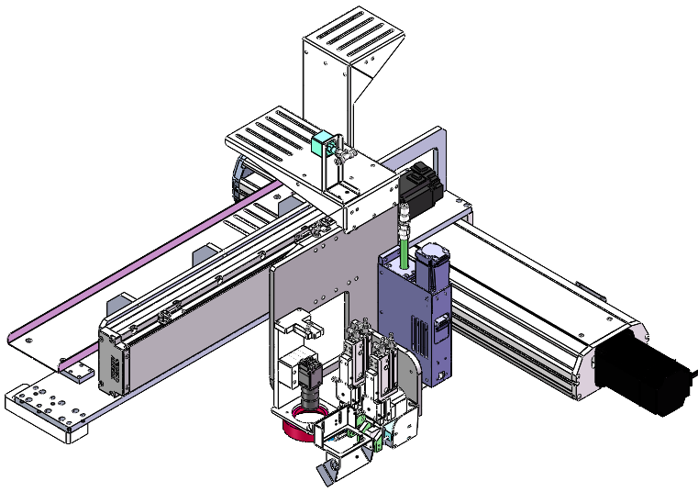
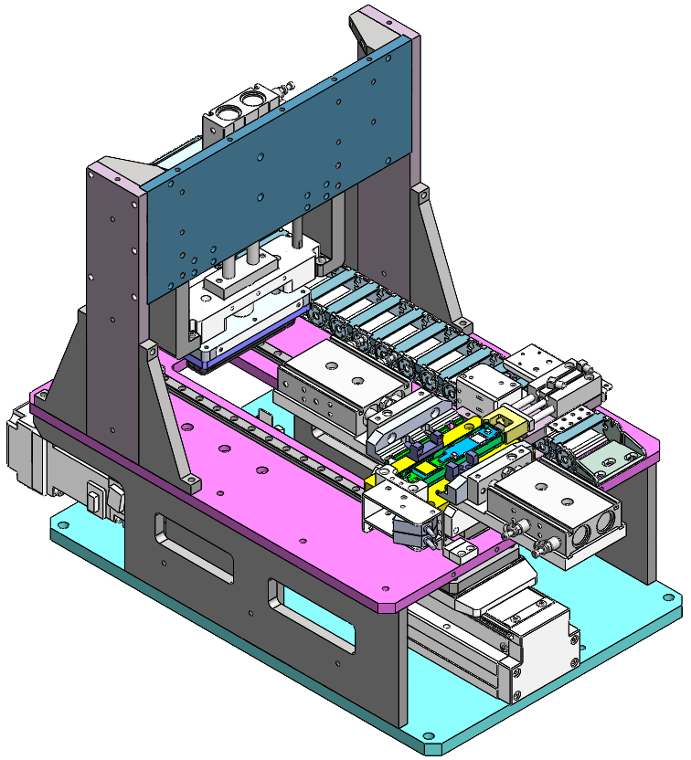
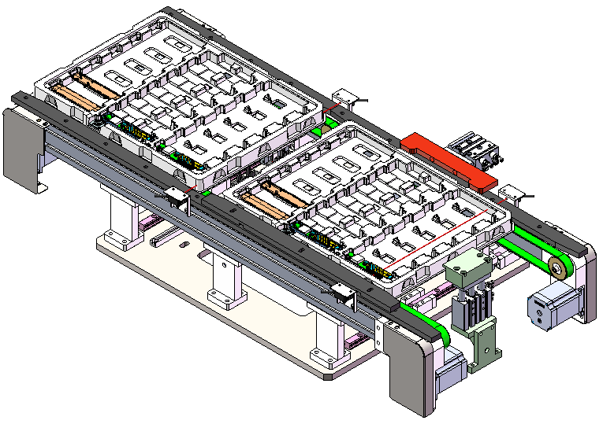
3.Equipment Layout
unit：mm
Lower CCD Component (Label Supplement)
2
4
CCD&Material Retrieval Components (Product Positioning)
X/Y TABLE Transfer Component (Material Retrieval)
1
Pressing zone (pressing upper and lower covers) -1
5
3&6
Widening the feeding conveyor line
6

Slide 8
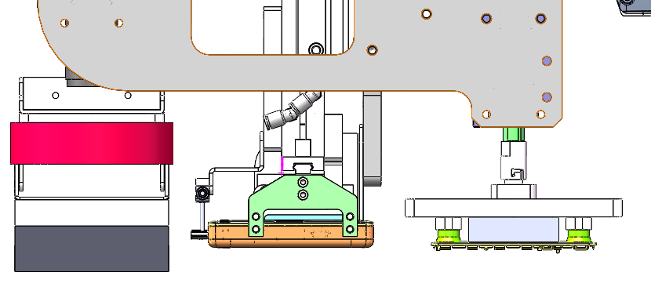
4.The key components
4.1 X/Y TABLE Transfer Component
1
unit：mm
X-axis transfer
Type | GTH12-L32-350-BC-S40-C4
Brand | TOYO
repeatability | ±0.005mm
Position accuracy | ±0.01mm
Travel distance | 350mm
Max speed | 1600mm/s
Work speed | 1280mm/s
Rate load | 30Kg
Work load | 15kg
Vacuum negative pressure gauge
X-axis sliding table
Y-axis sliding table
QR code scanner
Servo actuator
Suction nozzle
On CCD
Material retrieval component
Suction nozzle
QR code scanner
Z-axis transfer
Type | ZRBSS12-P10-S50-P100-B
Brand | SCAUTO
repeatability | ±0.01mm
Position accuracy | ±0.01mm
Travel distance | 50mm
Max speed | 500mm/s
Work speed | 300mm/s
Rate load | 1kg
Work load | 0.3kg
Y-axis transfer
Type | ETH17-L40-550-BC-M75-B2
Brand | TOYO
repeatability | ±0.005mm
Position accuracy | ±0.01mm
Travel distance | 550mm
Max speed | 2000mm/s
Work speed | 1600mm/s
Rate load | 43kg
Work load | 26kg
Main structure: slide table, servo actuator,
material retrieval component,CCD,
suction nozzle, scanner
7

Slide 9
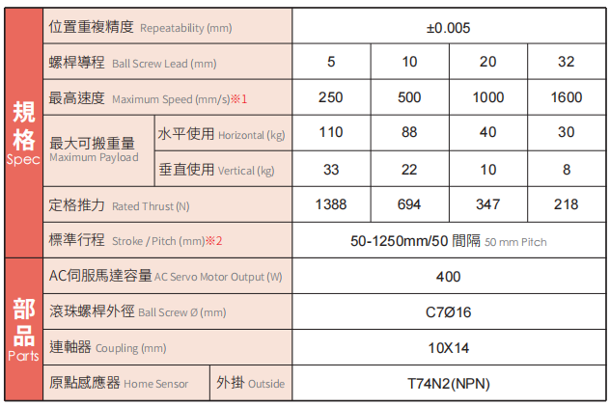
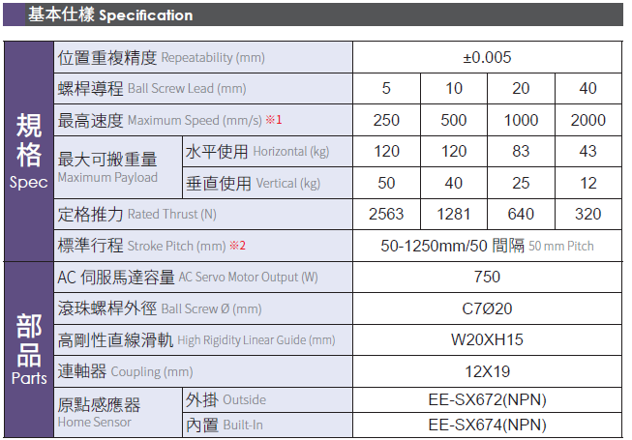
4.The key components
1
4.1 X/Y TABLE Transfer Component
unit：mm
X-axis GTH12-L32-350-BC-S40-C4
Y-axis ETH17-L40-550-BC-M75-B2
8

Slide 10
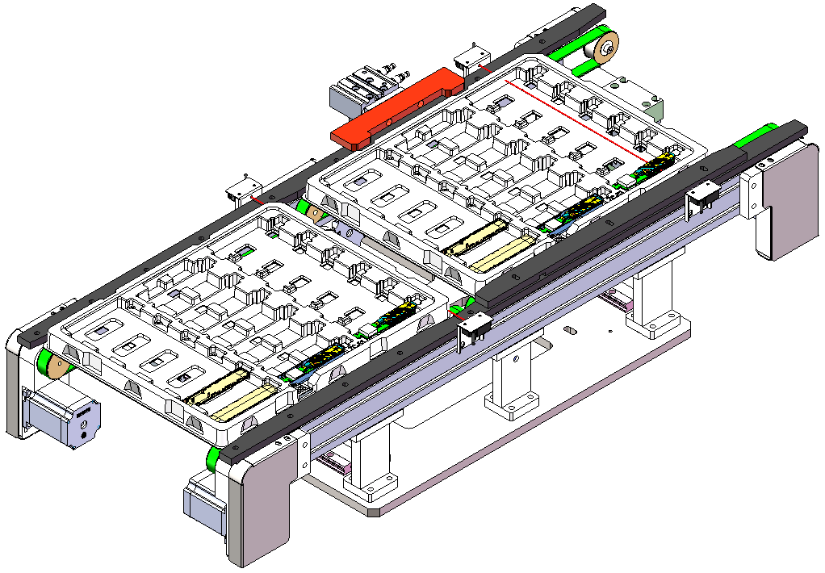
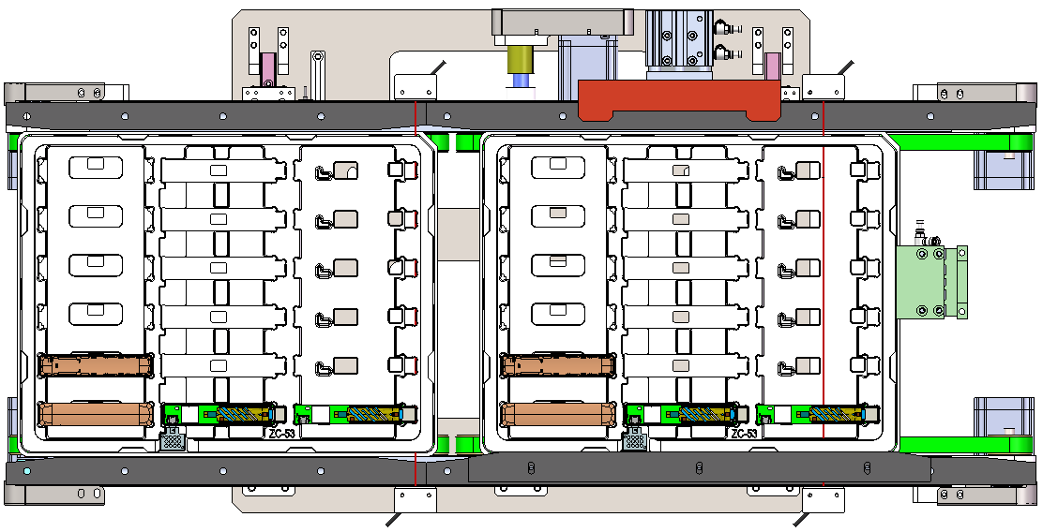
4.The key components
4.2 Widening the feeding conveyor line
3&6
unit：mm
Load tray in place deceleration sensor
Load blocking cylinder
sensor
CX-411
Side positioning cylinder
Thrust 100N
Front Buffer
Widening range 230~320
Blocking block
Work area
Motor
Front Buffer
Work area
Disk positioning process：
The load tray flows into the conveyor line, and CX-411 senses the deceleration of the conveyor line, blocking the cylinder to block the load tray.
Side positioning cylinder push plate .
9

Slide 11
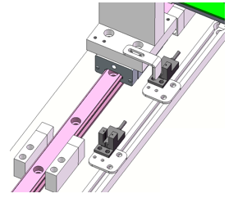
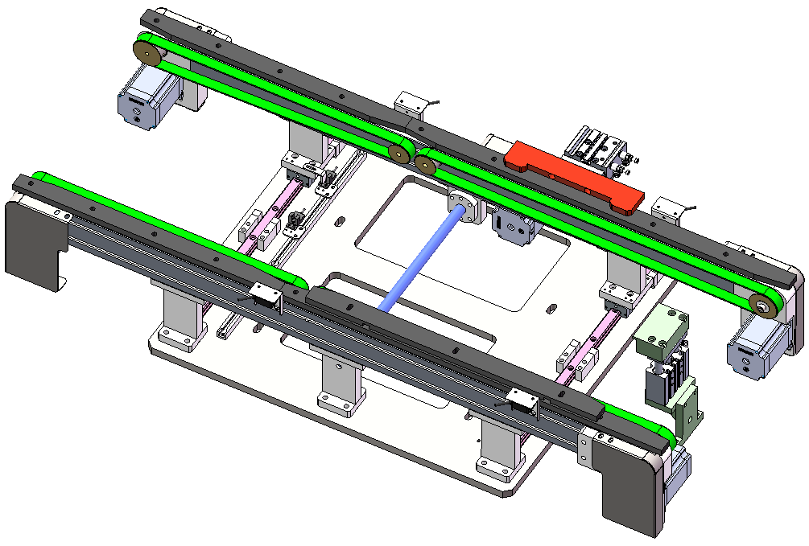
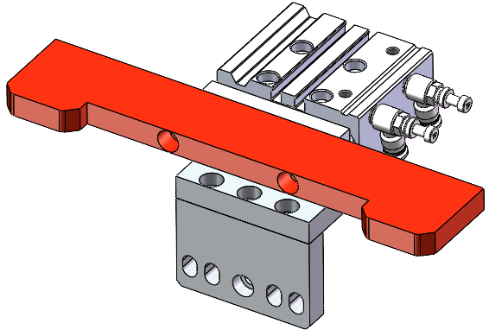
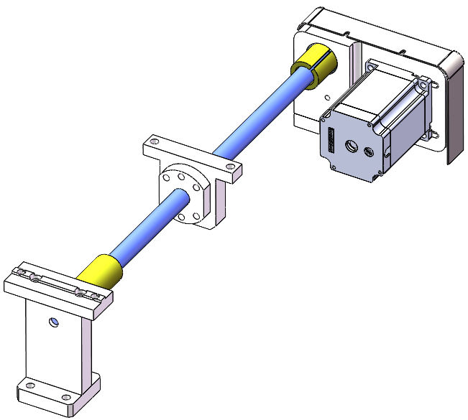
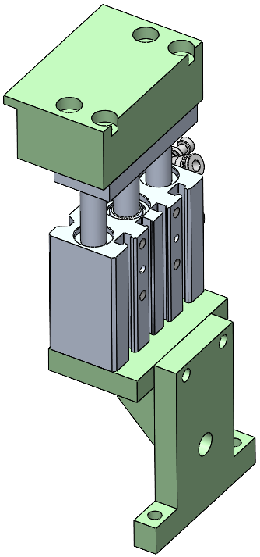
4.The key components
4.2 Widening the feeding conveyor line
3&6
unit：mm
Anti static belt:
Width 15, Thickness 2
Side positioning
AIRTAC：TCM16*20S
Thrust 100N
Conveyor line activity edge
Adjusted soft limit&
origin
Soft limit before adjustment
Hard limit
Widening motor：leadshine:57CM23
Load blocking
AIRTAC：TCM16*20S
Fixed edge of conveyor line
Conveyor line width adjustment process：
When the machine is turned on, it will automatically adjust the width of the conveyor line once (no width adjustment is required for subsequent production).
When adjusting the width, the moving edge of the conveyor line returns to the original point towards the rear soft limit.
After reaching the origin, the moving edge automatically reaches the required width of the loading plate .
10

Slide 12
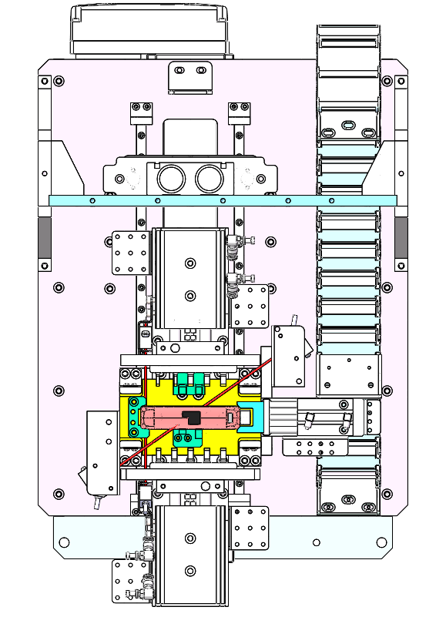

4.The key components
4.3 Compression zone
5
unit：mm
3
2
Module | Process Flow
1 | Secondary positioning
2 | Compression position
3 | Sliding table conveying structure
1
11

Slide 13
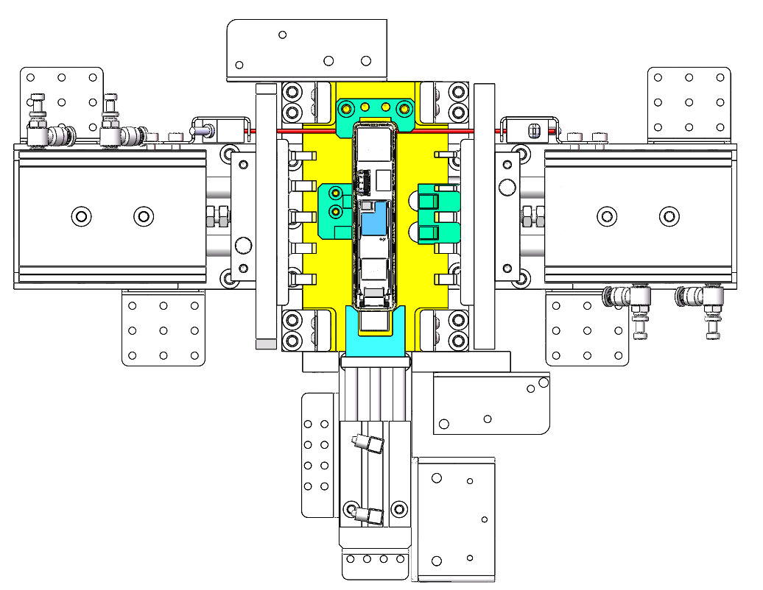
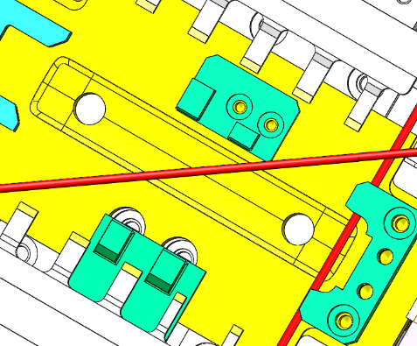
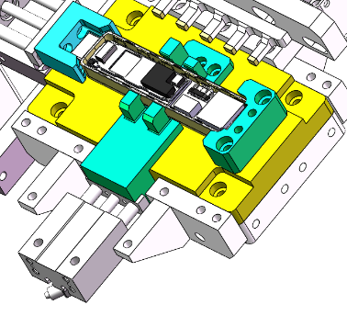
4.The key components
4.3-1 Secondary positioning
Limits datum
(And products obligate clearance 0 mm)
Limits datum
(And products obligate clearance 0 mm)
unit：mm
3
Compression force
62.8~377 N
2
Limits datum
(And products obligate clearance 0mm)
Compression force
62.8~377 N
Limits datum
(And products obligate clearance 0/-0.1mm)
Limits datum
(And products obligate clearance 0/-0.1mm)
Lower side positioning
Limits datum
(And products obligate clearance 0/-0.1mm)
1
Front pusher force 38 N
Profiling holder:
Locating pin hole
Push force 38 N
Alignment features with tolerance
12

Slide 14
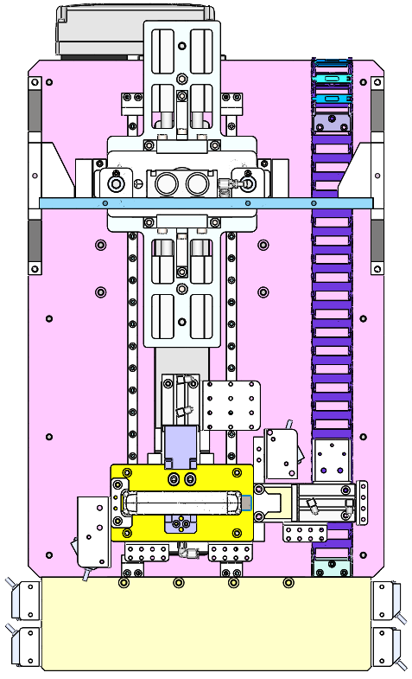
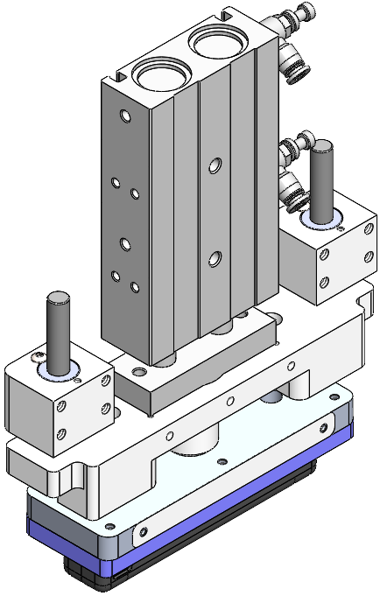
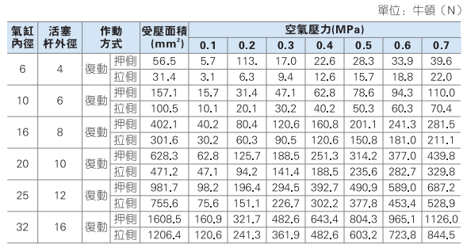
4.The key components
4.3-2 Pressing positions-1
unit：mm
3
TR25X40S
2
Pressing cylinder
Type | TR20X30S | TR25X40S
Brand | AIRTAC | AIRTAC
repeatability | ±0.005mm | ±0.005mm
Position accuracy | ±0.01mm | ±0.01mm
Travel distance | 30mm | 40mm
Max momentum | 377N | 589N
Work momentum | 200N | 300N
1
Pressure check
0~100kg
Anti static electricity
Tetrafluorone
13

Slide 15
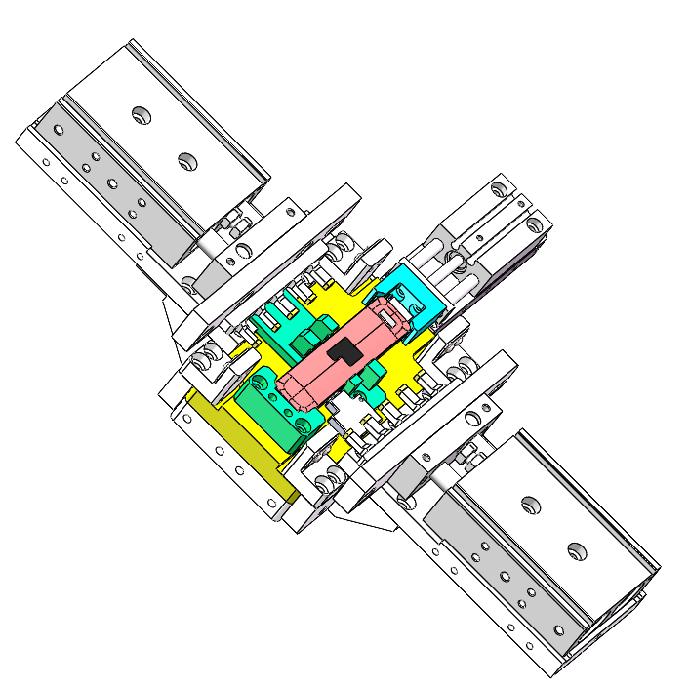
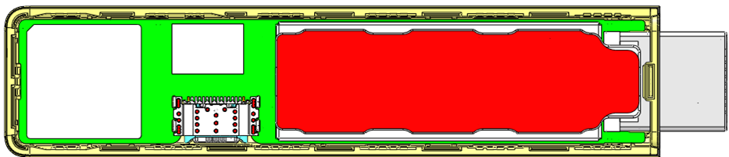
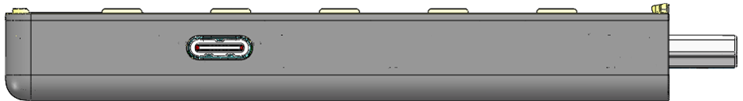
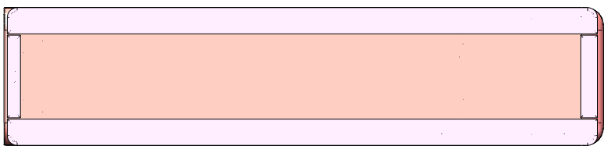
4.The key components
4.3-2 Pressing positions-2 Side pressure head&Upper pressure head
unit：mm
2.7
2.7
5.0
5.0
5.0
TR20X20S
14.53
10.0
12.98
13.6
10.0
10.0
TR10X25S
TR10X25S
14.53
10.0
12.98
10.0
10.0
10.0
5.0
4.0
5.0
5.0
5.0
Anti static electricity
Tetrafluorone
Position of lateral pressure head
TR20X20S
Upper pressure head position
14

Slide 16
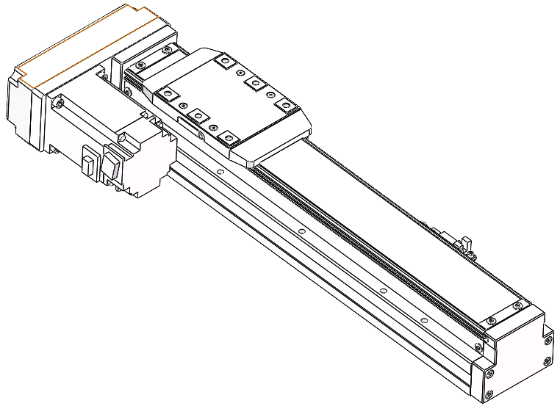
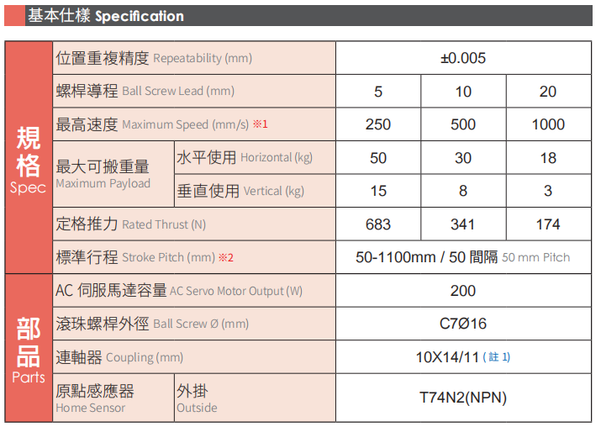
4.The key components
4.3-3 Sliding table conveying structure
X-axis transfer
Type | GTH8-L20-300-BL-S40-D4
Brand | TOYO
repeatability | ±0.005mm
Position accuracy | ±0.01mm
Travel distance | 300mm
Max speed | 1000mm/s
Work speed | 700mm/s
Rate load | 18Kg
Work load | 8kg
unit：mm
3
2
1
15

Slide 17
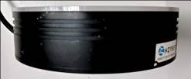
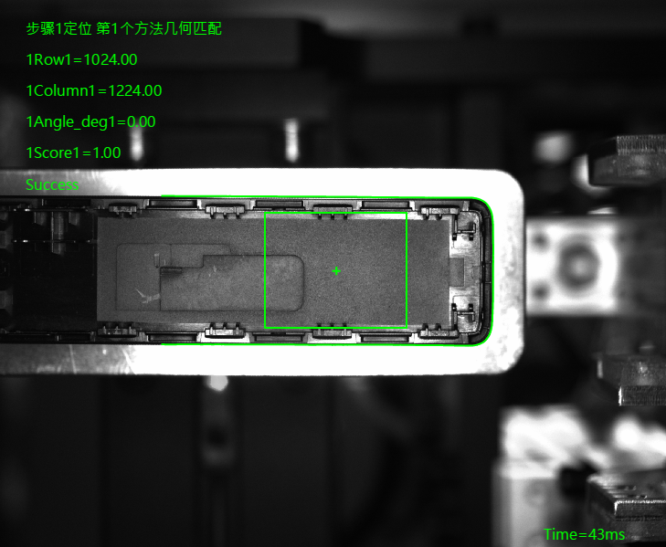
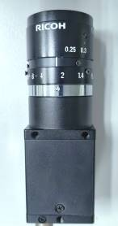
4.The key components
4.4 Lower CCD component (CCD hardware configuration)
Hardware layout diagram：
2
Hardware name | model | quantity
camera | MV-14GF25500C | 1
camera lens | FL-CC1614A-2M | 1
light source | LRS-90W30 | 1
Light source controller | DKZ2-24V-4-AC | 1
pixel | 500W | /
Vision | 58X40mm | /
resolving power | 2592x1944
Pixel size | 58mm/2592≈0.0223mm 40mm/1944≈0.0205mm
unit：mm
light source：LRS-90W30
Using the template matching method, the real object is first photographed to create a template that identifies the center point and initial Angle. Then take a picture with ccd, find the contour, find the same contour through the template to determine the center, and then calculate the deviation and Angle of the x axis and y axis with the template.
120mm
view:40mm*58mm
190mm
camera lens：FL-CC1614A-2M
camera：MV-14GF25500C
CCD accuracy
58mm/2592≈0.0223mm
0.0223*3≈0.067
product
16

Slide 18
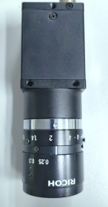
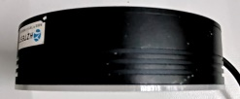
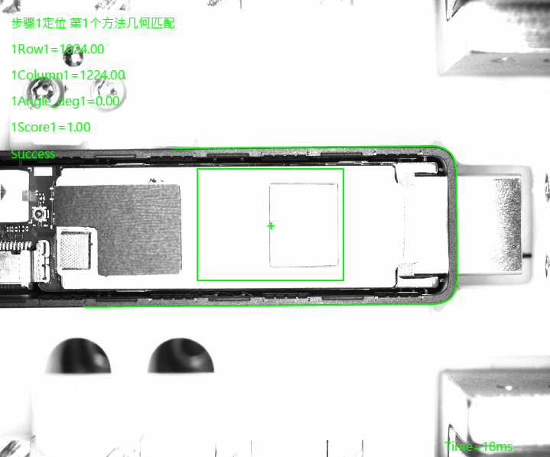
4.The key components
4.5 CCD&material retrieval component (CCD hardware configuration)
Hardware layout diagram：
4
Hardware name | model | quantity
camera | MV-14GF25500C | 1
camera lens | FL-CC1614A-2M | 1
light source | LRS-90W30 | 1
Light source controller | DKZ2-24V-4-AC | 1
pixel | 500W | /
Vision | 58X40mm | /
resolving power | 2592x1944
Pixel size | 58mm/2592≈0.0223mm 40mm/1944≈0.0205mm
camera：MV-14GF25500C
190mm
camera lens：FL-CC1614A-2M
light source：LRS-90W30
Using the template matching method, a real object is first photographed to create a template that identifies the center point and the initial Angle. Then take a picture with ccd, find the outline, find the same outline through the template to determine the center and Angle.
120mm
Vision
:40mm*58mm
CCD accuracy
58mm/2592≈0.0223mm
0.0223*3≈0.067
product
17

Slide 19
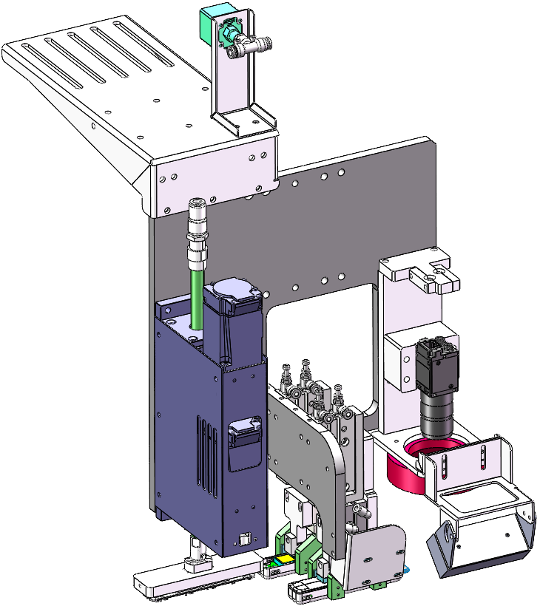
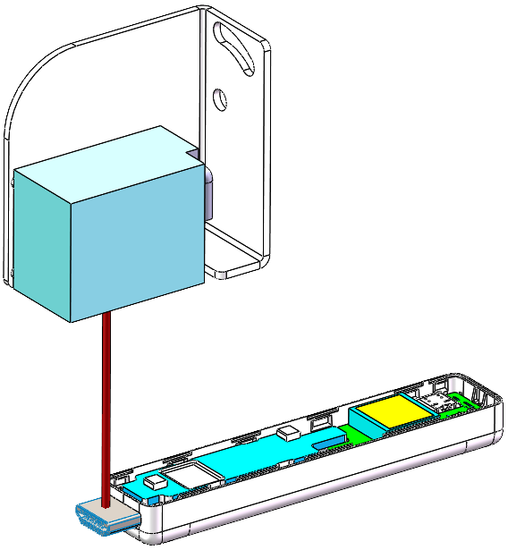
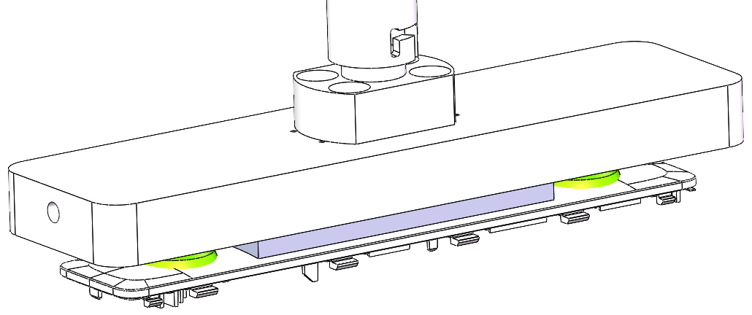
5.Key fixture design
5.1 CCD&material retrieval component (material retrieval component)
Negative pressure gauge
Nozzle assembly
Actuator
UP CCD
Code scanner
Take-up module
50~80mm
Silicone suction cup
Diameter:15mm
Code scanner
Scanning range
Nozzle assembly
18

Slide 20
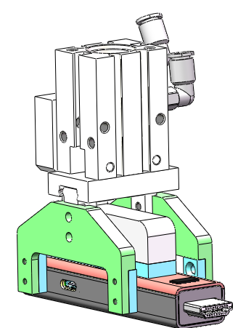
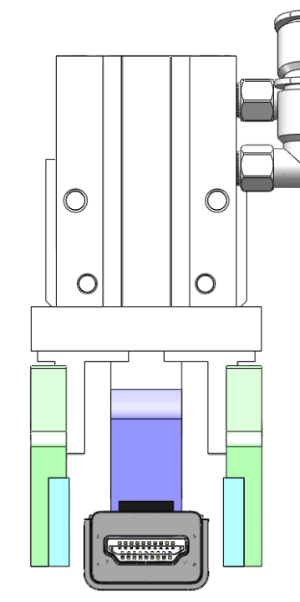
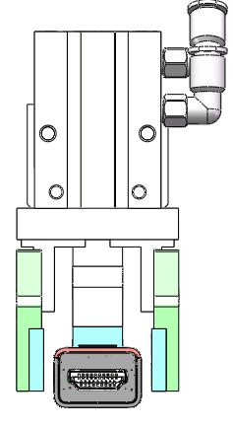
5.Key fixture design
5.2 CCD&material retrieval component (product retrieval)
Clamping force：34N
HFZ16
Check product sensors
Height limiting block
Aluminum parts
2mm
2mm
Silicon rubber
Silicon rubber
Open
Close
Contact surface：
Silicon rubber
Height limiting block
19

Slide 21
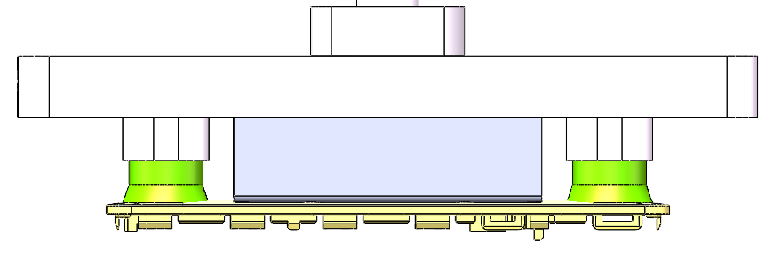


5.Key fixture design
5.3 CCD&material retrieval component (product retrieval)
Height limiting block
6.5
72
91.5
Silicone suction cup
Diameter:15mm
15
21.1
20

Slide 22








6.Action flow design
6.1 Action process
Pressing zone 1
Pressing zone 2
unit：mm
Step1
Step2
Step3
Step4
Upload QR verification code validation information of
the scanner is completed?Legally,after QR passed，
The sliding table of clamping jaw takes the product out
of the tray and puts it into the pressing mechanism for
positioning. Meanwhile, the CCD locates the QR code of
the back housing after the back housing QR code is passed
Put the back housing on
the product.
press the product after
the Link is completed,
press the product, and
put the product into the Tray
The above
action loops
three times
and flows into
the next station
Two trays flow to back
housing station from
the previous station
The device locates the tray
after sensing the signal from
the trays that flows into the
work area
Explain ：1. If the NG product fails to Link rfid or the QR code does not conform, it will not be pressed, put the product back in the original Tray position, and transfer the
NG information to the next station.
2. Each time the CCD takes a picture, it will store the picture, which can be searched later. The picture storage time is 1 month. After 1 month, the picture before
one month will be automatically deleted
The assembly steps
21

Slide 23












6.Action flow design
6.2 Detailed action process
step 2 滑臺移至產品一
進行掃碼并進行上傳資料
Slide table moved to Product 1 scan PSN code and upload data
step 3 夾爪夾取產品一同時吸取上蓋
The claw takes the product and craws the back housing at the same time
Step 4 上蓋移至下相機處進行定位
并掃二維碼綁定PCB資料
Move back housing to the lower camera for positioning and scan the two-dimensional code binding PCB data.
step 5 將產品一放入二次定位區進行定位
Place product one into the secondary positioning area make a position
step 1 輸送線工作區流入
一盤產品
Conveyor line work area inflow A plate of product
step 6 上相機拍照進行產品定位
Camera take pictures for product positioning
Step 7 放置上蓋在產品上
Place the back housing onto the product
Step 8 底部真空吸住產品After the bottom vacuum suction, product
retraction of cylinder
Step 9 產品流入壓合位置進行壓合
The product flows into the pressing position for pressing
Step 10 側面氣缸推拉產品
Side cylinder push-pull product
Step 11 產品壓合完成
移動至二次定位處取料
Product pressing is complete
Move to the secondary location to pick up material
22

Slide 24



6.Action flow design
6.3 Detailed action process
step 12 夾爪將產品夾起
The claw picks up the product
step 13 將產品放入Tray盤
Place the product into a Tray
step 14 以上流程重複3次，XY轴移动，Tray流走
The above process is repeated 3 times, XY axis moves, Tray flows away
機台重復以上流程3次，將剩下3個產品流入下一台同樣的機台做另外3個，完成后流入插卡機
The machine repeats the above process for 3 times, and the remaining 3 products will flow into the
next machine with the same machine to make another 3 products. After completion, the products will
flow into the card insertion machine
23

Slide 25

7.Timing diagram
unit：mm
單機器 UPH≈3600/5.9*0.9=549
Note：90% is estimated OEE, only for UPH calculation. not real product data
24

Slide 26
Thank you
25

