Slide 1
Calgary Press Bot Copper Foil Fixture DFM
Ver 2.0
CNT
2025.06.30

Slide 2
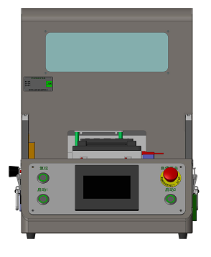
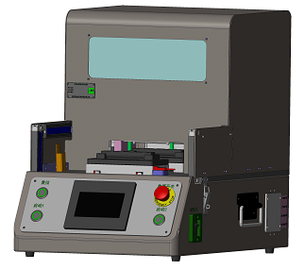
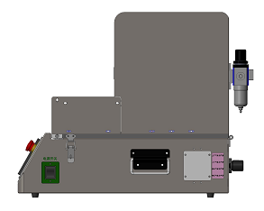
Calgary Press Bot Copper Foil Fixture
471mm
overview
350mm
573mm
Summary: The dimension of this fixture is L*W*H=350mm*573mm*471mm.

Slide 3
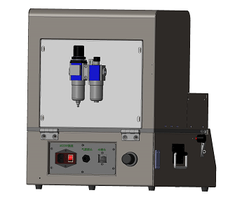
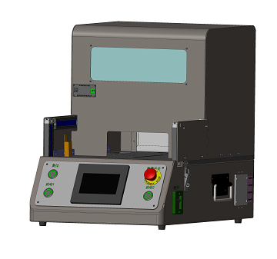
Calgary Press Bot Copper Foil Fixture
Electric control module
Air structure
Protect
Electric control box
Light curtain
Power outlet
Control button
Air connector
Touch screen
Air pressure control valve
Internet connector
Power button
Regulator
Barometer

Slide 4
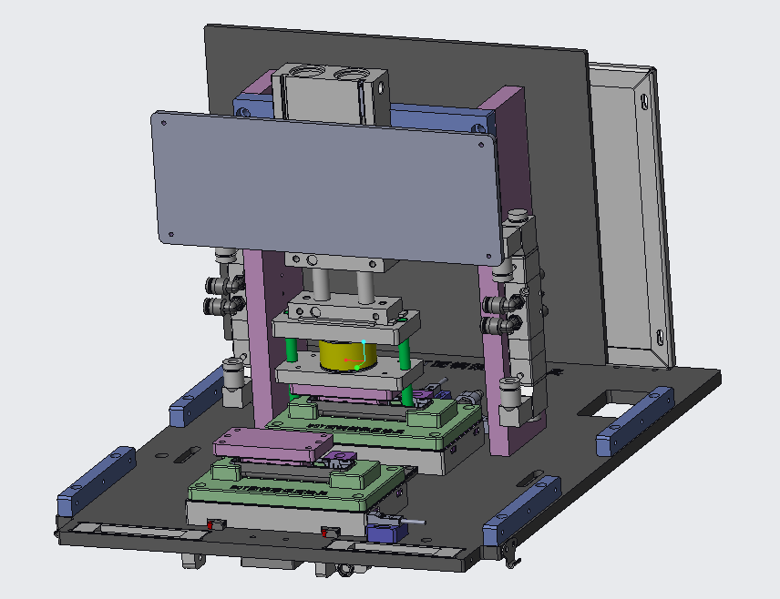
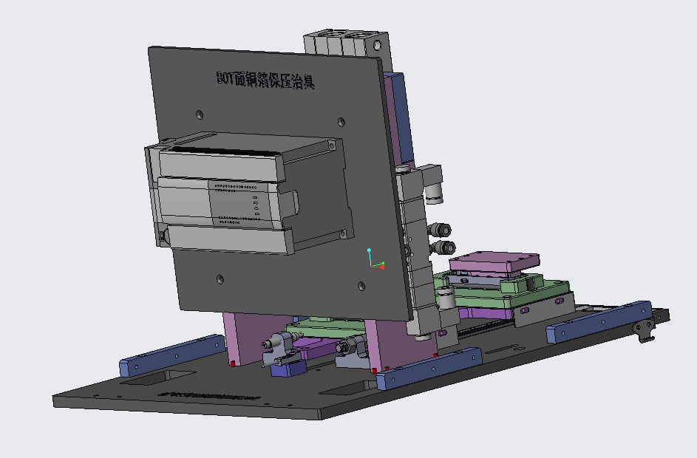
Calgary Press Bot Copper Foil Fixture
Press module
Press cylinder
PLC
Backplane（A7075）
Electric control plate
Vertical plate（A7075）
Bottom plate
(A7075)
Pressure sensor
Cylinder
Solenoid valve
Limitation module
Location sensor
Linear guide

Slide 5
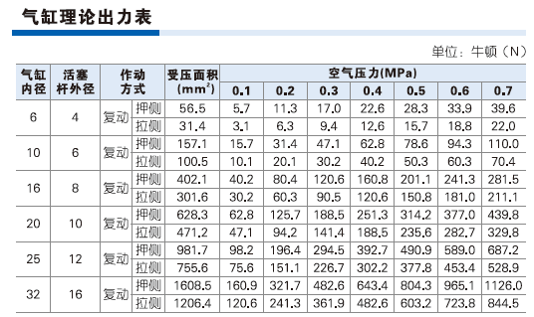
Calgary Press Bot Copper Foil Fixture
Press cylinder size(TR25x50s)
Air pressure | 0.38Mpa
Press force | 37kg

Slide 6
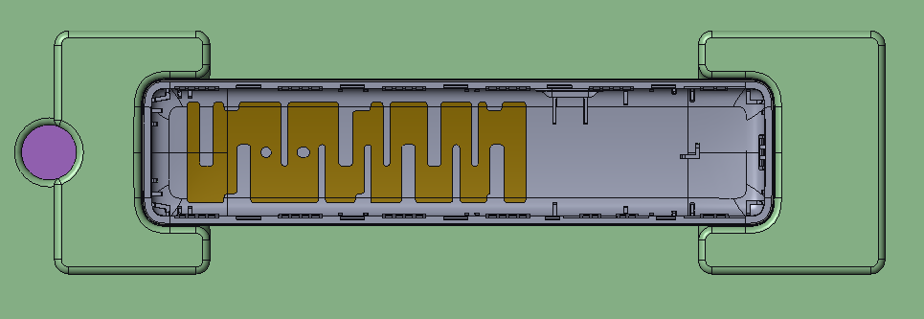
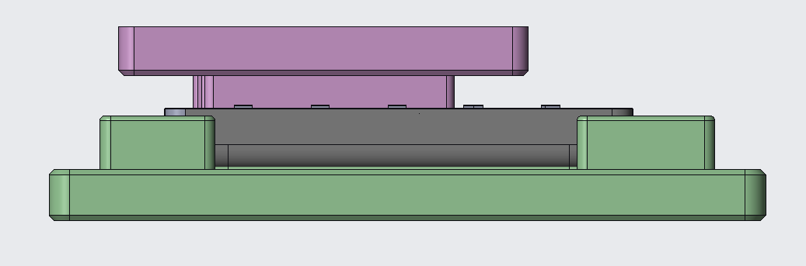
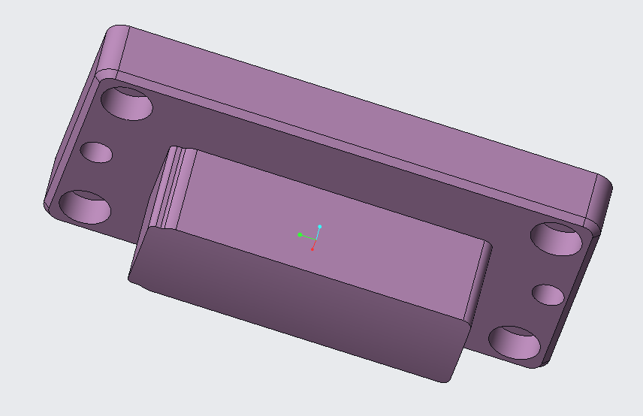
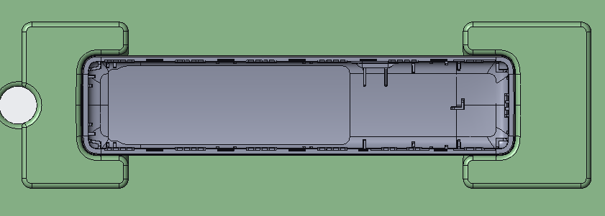
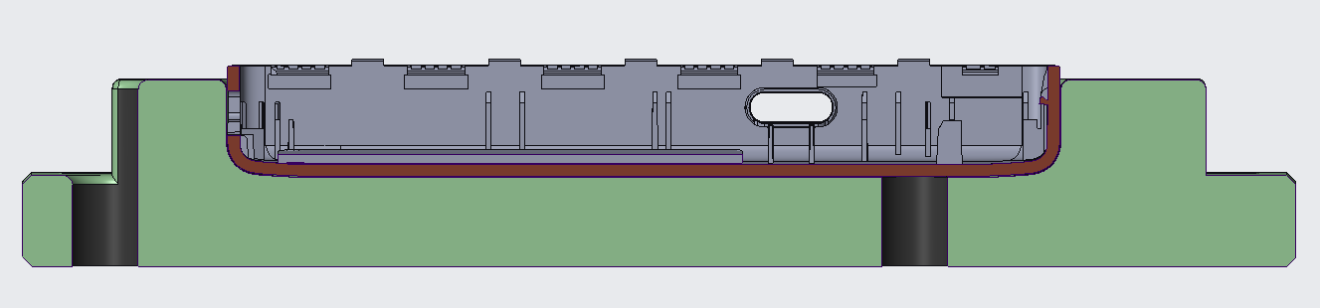
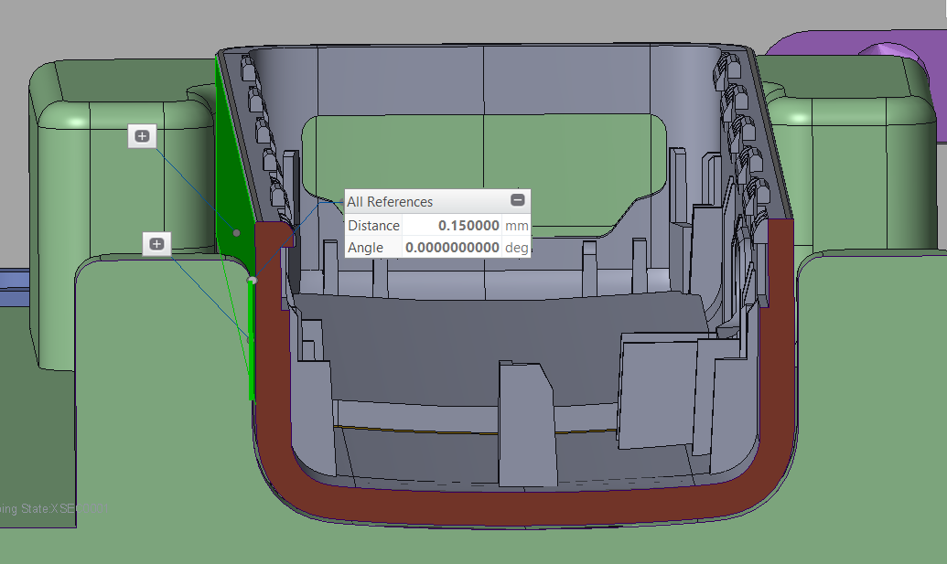
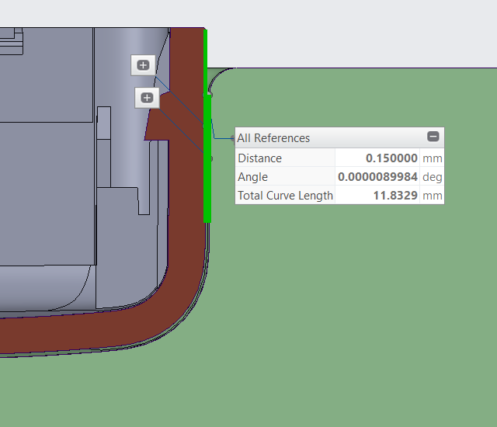
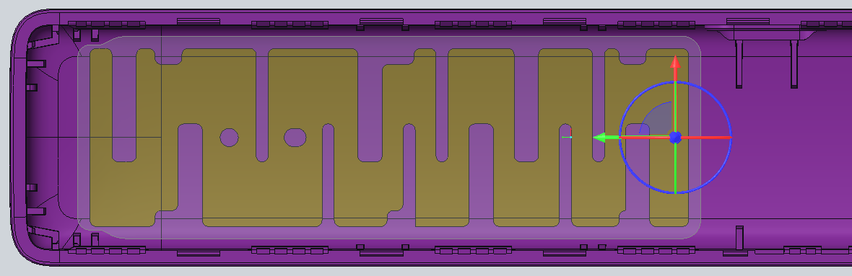
Calgary Press Bot Copper Foil Fixture
Holder design
Press head design
Al+1mm rubber, 70A
X direction
Y direction
No interference with housing
The gap between housing and holder is 0.15mm.
Press head is 0.5mm larger then copper foil.

Slide 7
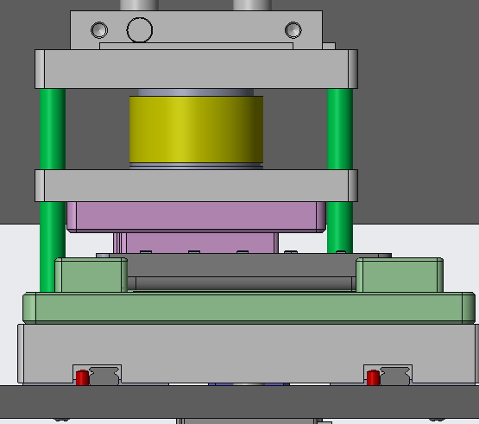
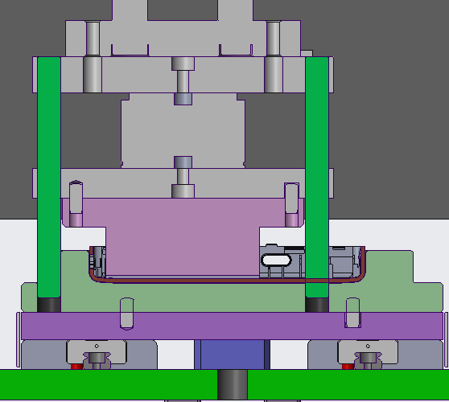
Calgary Press Bot Copper Foil Fixture
Holder and press head alignment
Press head plate
Press head
pin
Alignment pin.
The press head is aligned with press head plate by pin, then we use alignment pin to do alignment during fixture adjustment.

Slide 8
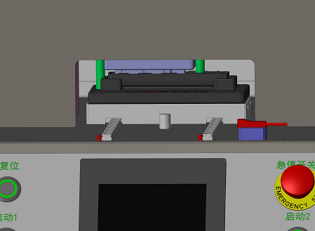
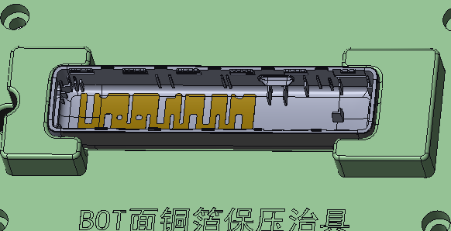
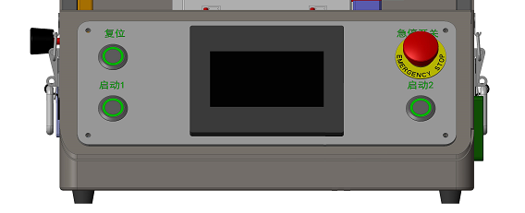
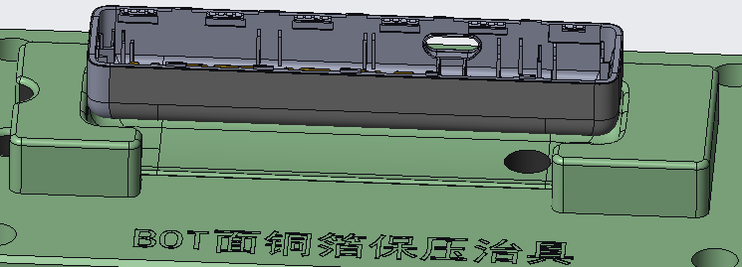
Calgary Press Bot Copper Foil Fixture
Work procedures
1.Put housing on holder
2.Press start button to start fixture
3.Press copper foil
4.Take out device

