Slide 1
Project kettle
A new, in-house developed grade and attendance system

Slide 2
Splash screen
Built using Bootstrap 4
Quick, responsive
Can recover the user’s login information if forgotten
Compatible with mobile technology such as phones and tablets

Slide 3
Navigation bar
Features useful tools such as access to the College calendar (with real-time updates) , a calculator, and a GPA calculator
Students can quickly view their grades by clicking the “Grades” button in the top of the navigation bar
The Calendar will list all major holidays, the OTC student academic calendar, and personal events that the student can create and will link directly to their account
In the navigation bar features quick access to a DuckDuckGo search, allowing Users to search the web directly from kettle

Slide 4
sidebar
The sidebar is the easiest way for the students to access their classes/gradebook for their current courses
Underneath the “Home” button, students can upload/access files using the “Files” tab
Also underneath the “Home” button the user can logout of their account or access the settings page for their account
To the right of the sidebar there is a toggle button to show/hide the sidebar

Slide 5
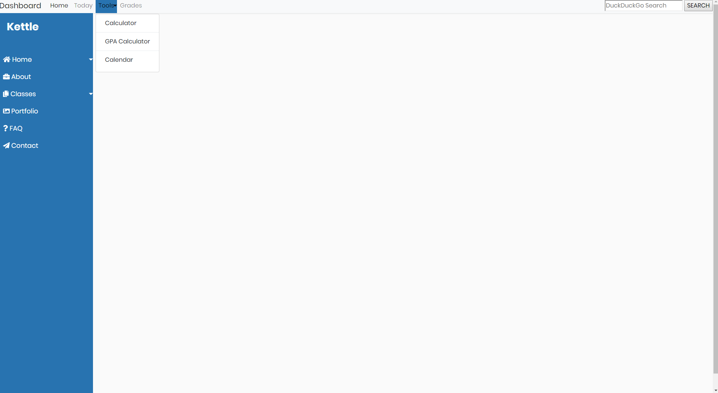

Slide 6
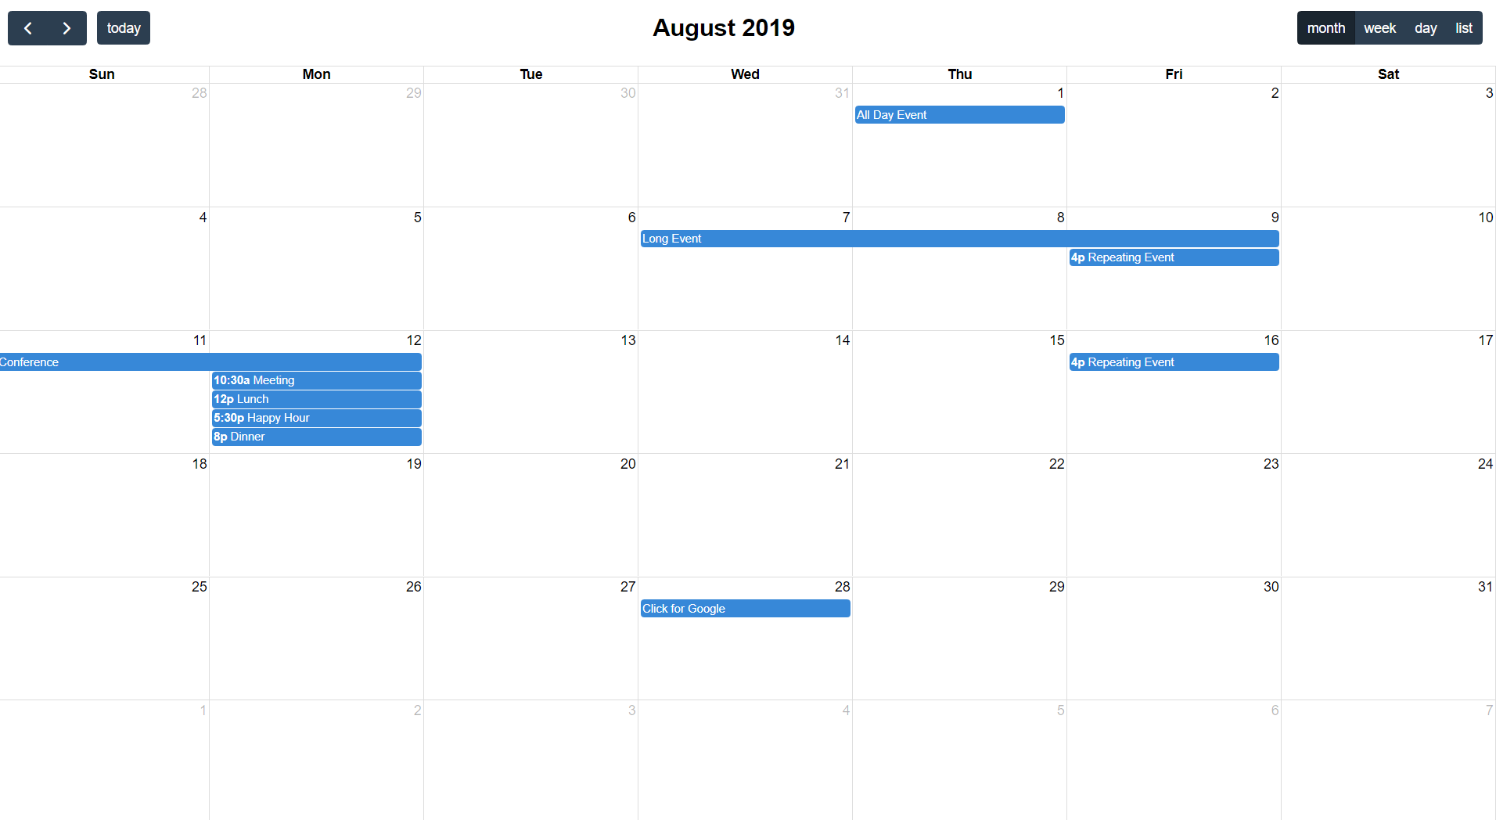

Slide 7
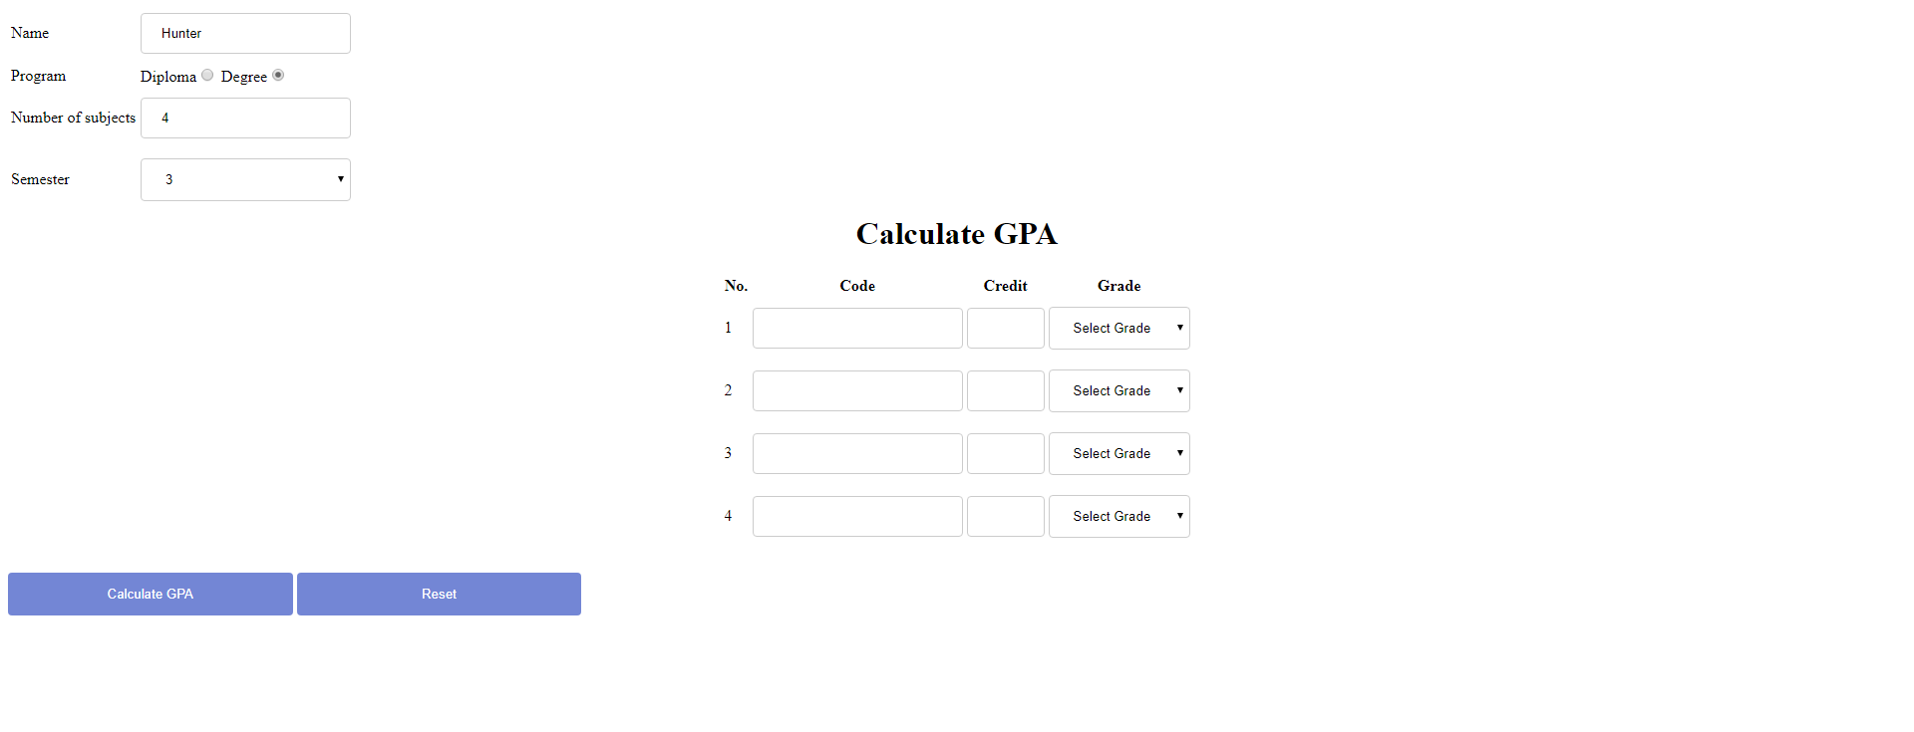

Slide 8
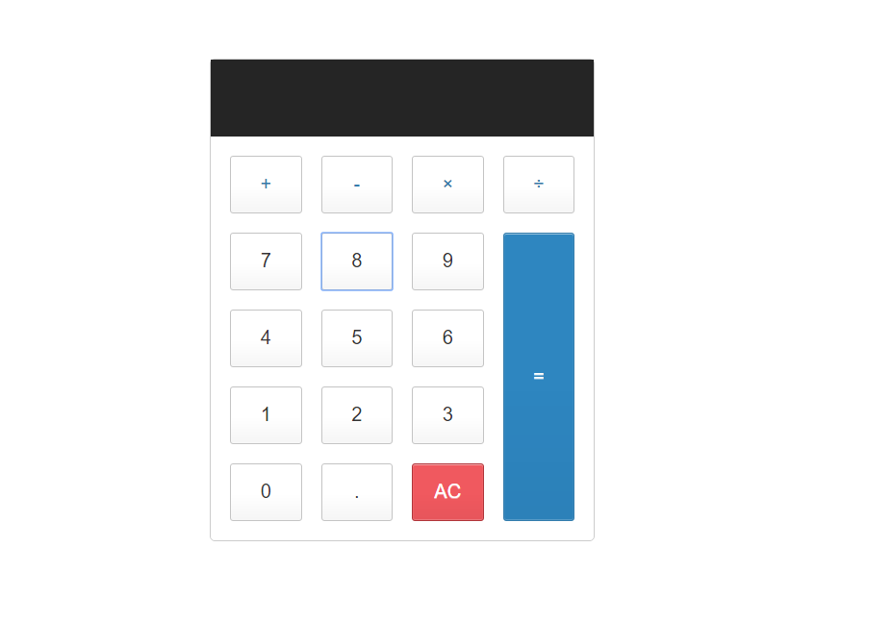

Slide 9
Quick Attendance
Single day, check-box style, attendance with expandable comment box
Goals:
Simple “Click and Submit” design
Comment box for absence notations
Updates Database on submission

Slide 10
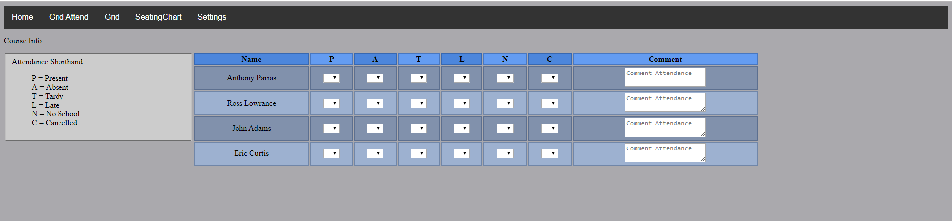

Slide 11
Grid Attendance
Multi-day table created from database with drop-down selection
Also tracks total number of Presences, Absences, and Tardies
Goals
Understandable drop-down selection for each day displayed
Updates Database automatically
Clean, no clutter design
Tracks and automatically emails students when they reach three consecutive absences in order to avoid “surprise” administrative withdraws

Slide 12
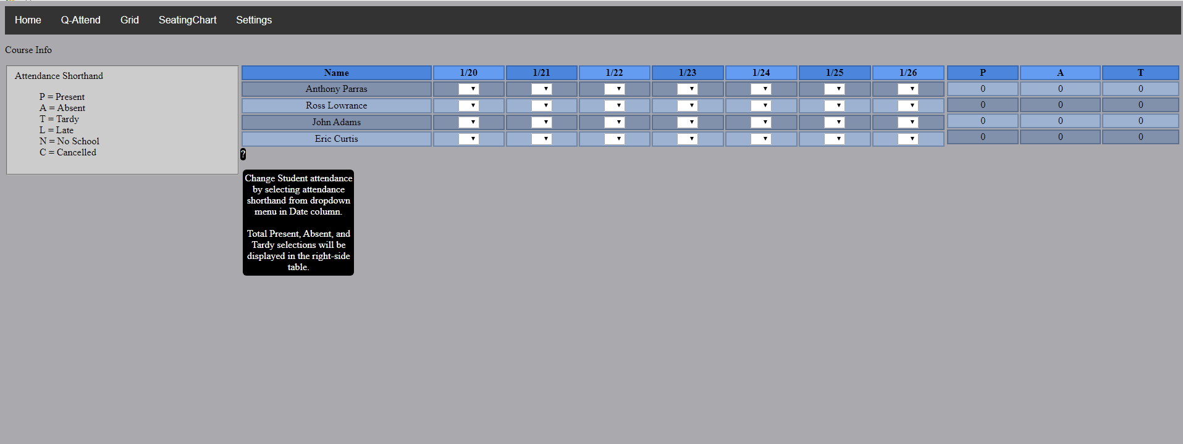

Slide 13
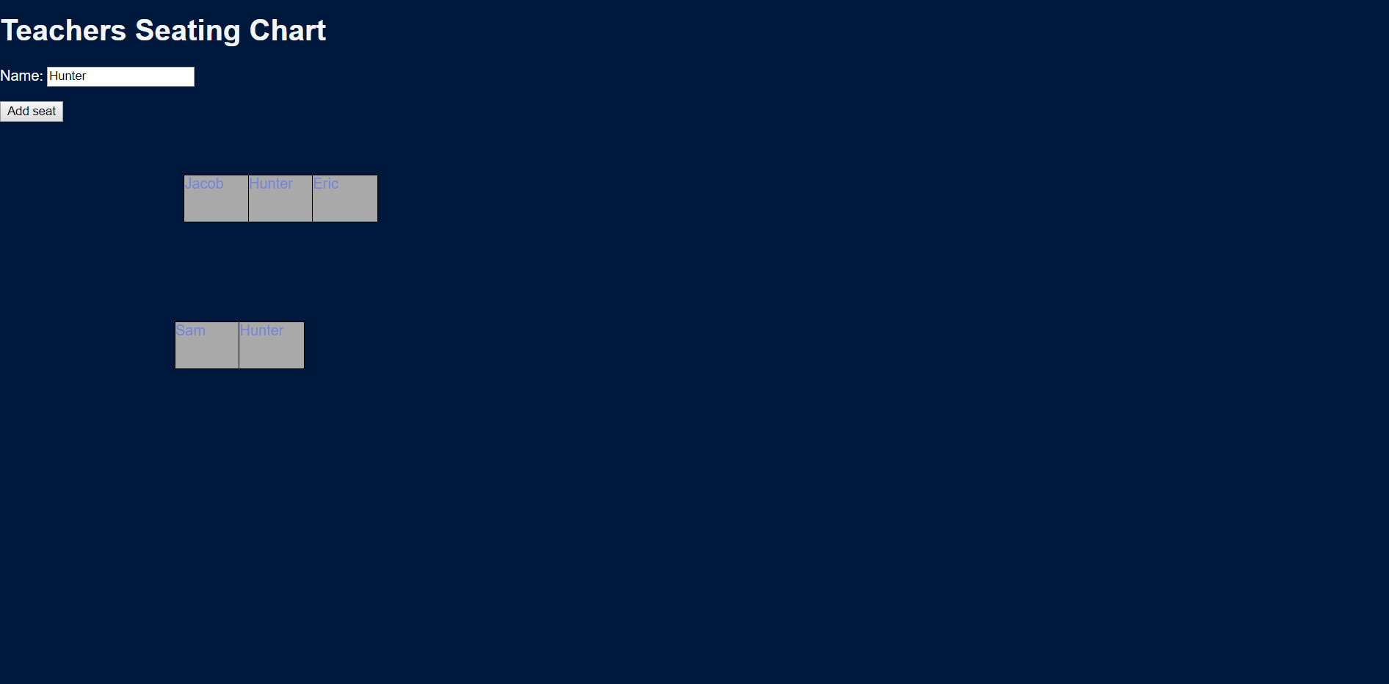
Seating chart
For each class, the student list will populate automatically
Students are listed alphabetically:
LAST NAME, PREFERED NAME
Select a student from the drop-down list, and click “Add Seat” to create a new seat

Slide 14
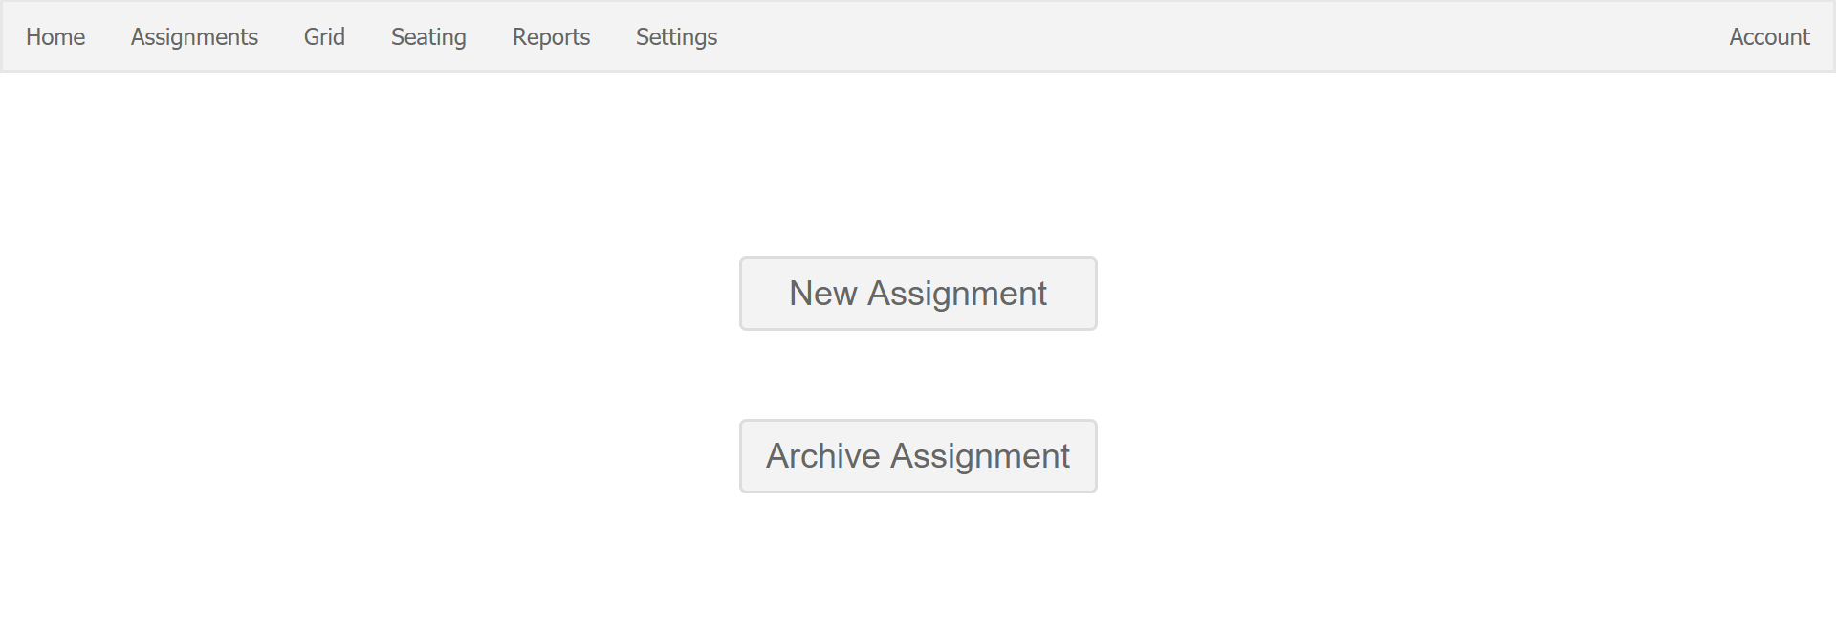
Assignments
Easily move between forms
Remove tabular system

Slide 15
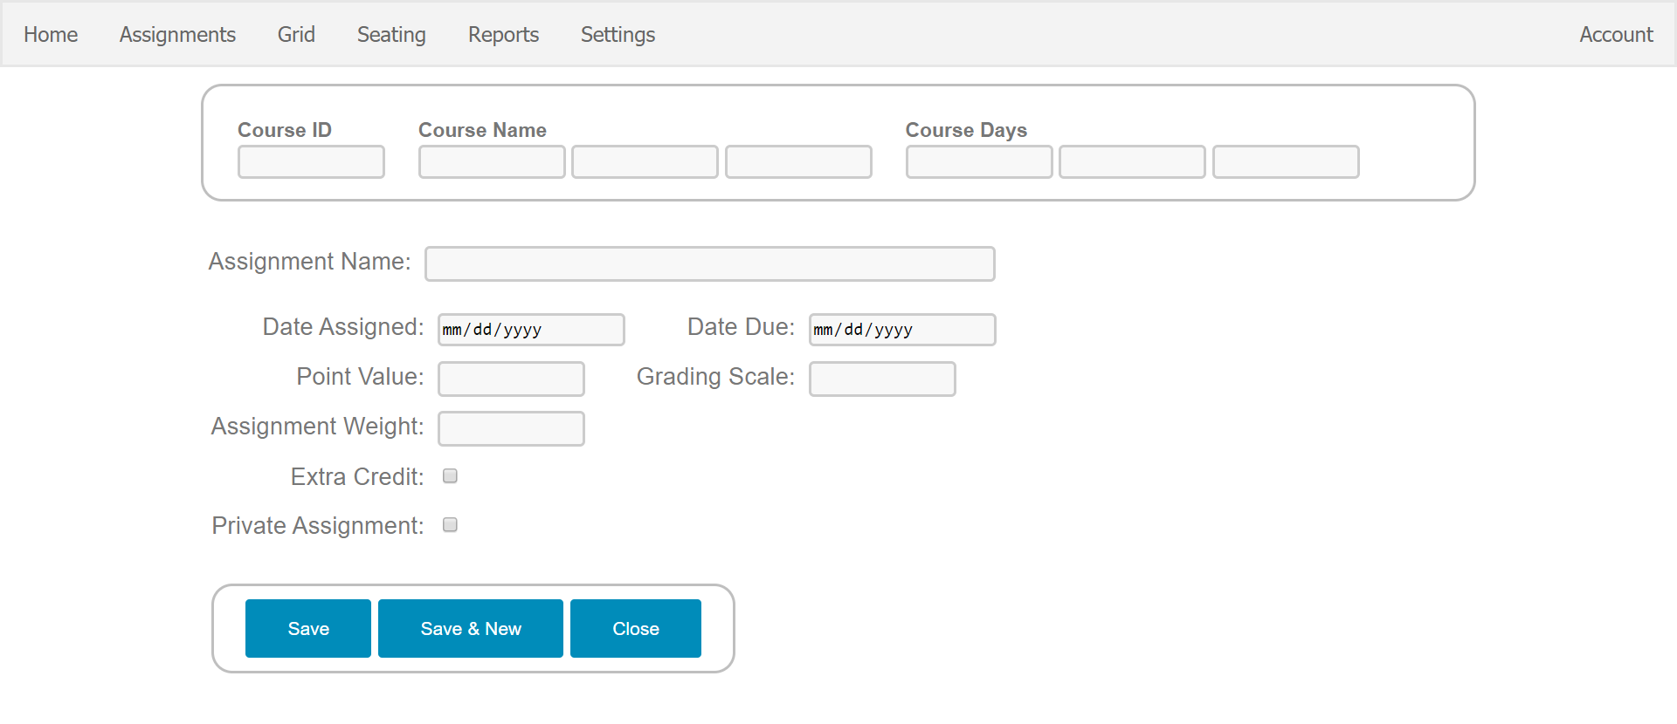
New Assignment
Condense Form to remove scrolling
Remove long input areas

Slide 16
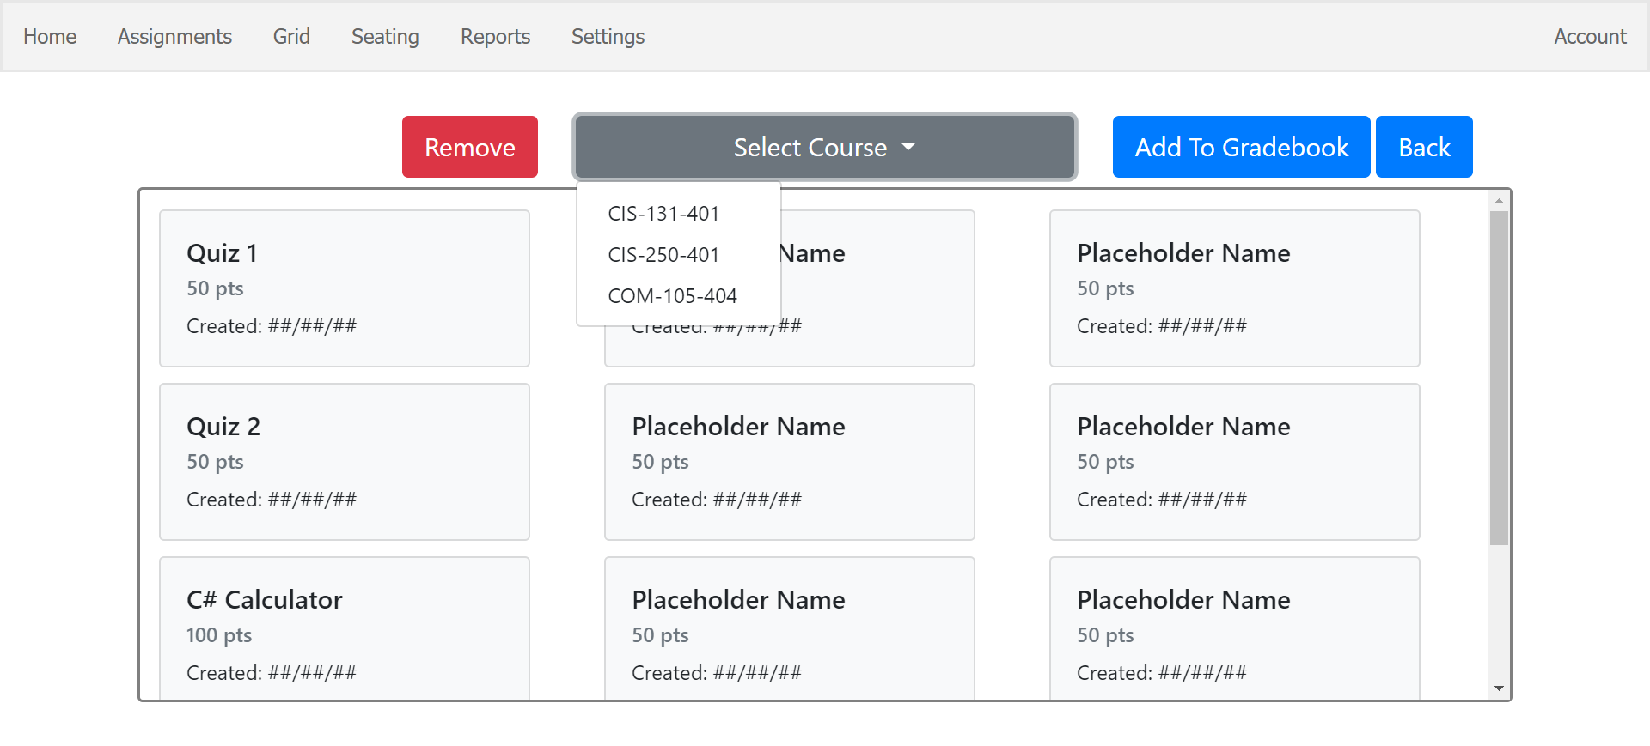
Archived Assignment
Cleanup UI - New Card Layout
Add removal feature

Slide 17
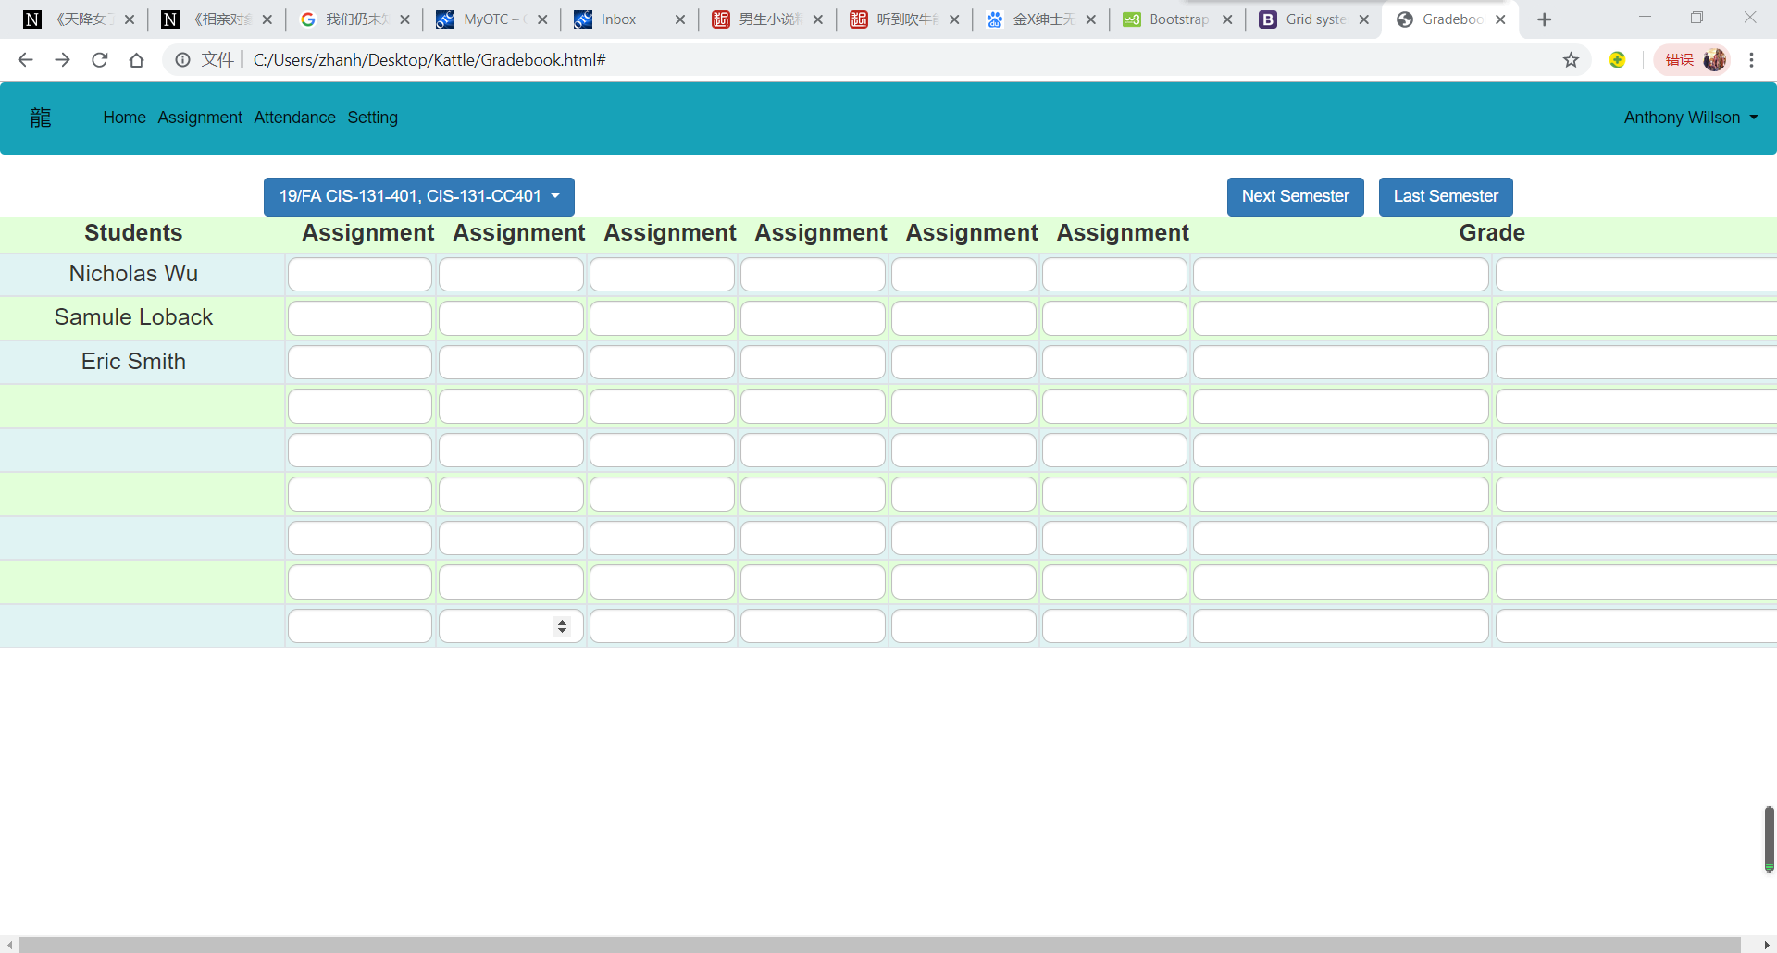
Gradebook
Built using Bootstrap
Clean, intuative UI
Navbar to link other pages
All classes in dropdown menu
Easy to fix and change grades
Automatically emails students when overall grade drops below 65%

Slide 18
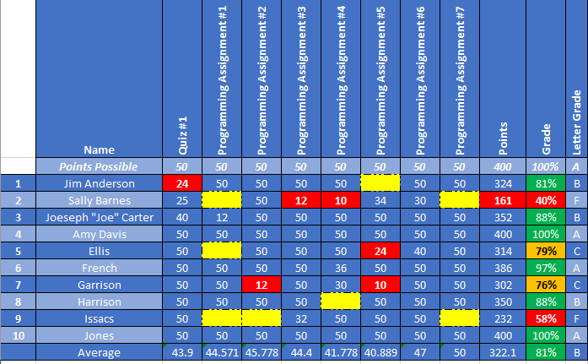
Gradebook

Slide 19
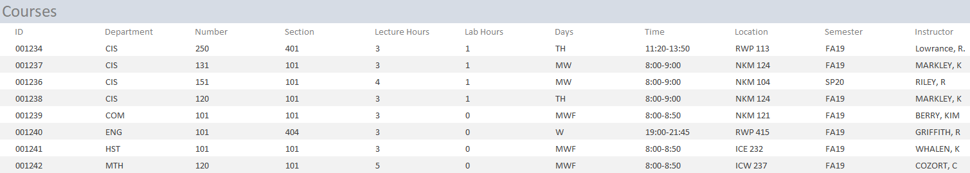
Search the Database (Queries)

Slide 20
What if we only wanted courses taught by a specific Instructor?

Slide 21
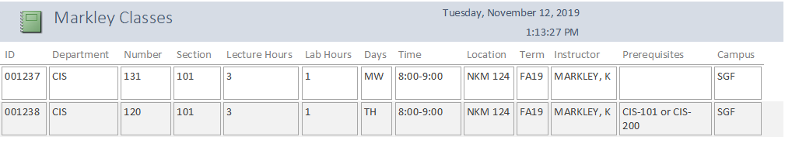
What if we only wanted courses taught by a specific Instructor?

Slide 22
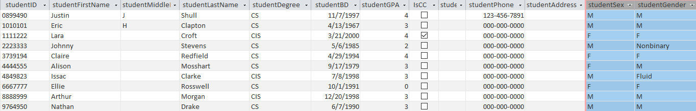
Title IX
Includes a separate fields for gender and sex to comply with Title IX

Slide 23
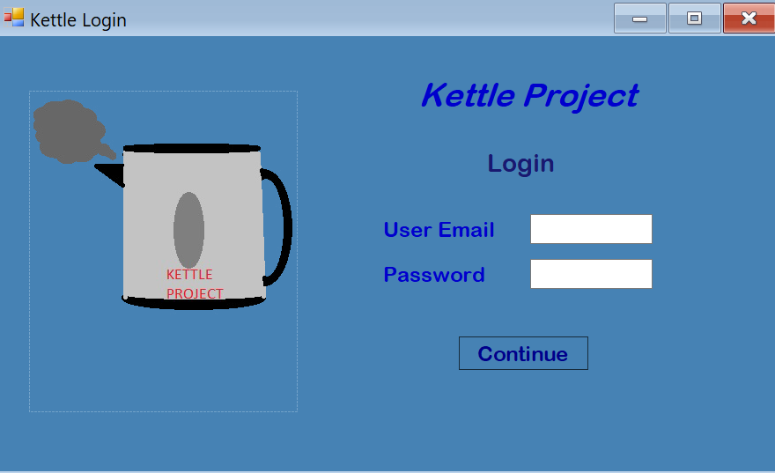
Desktop Version

Slide 24
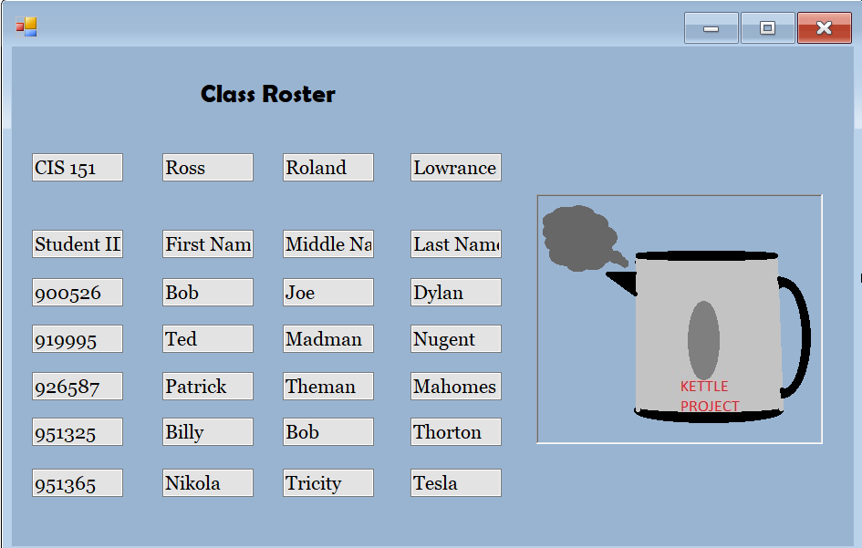
Desktop Version
Notes:
Example of what a class roster search may look like using c# and to search SQL

Slide 25
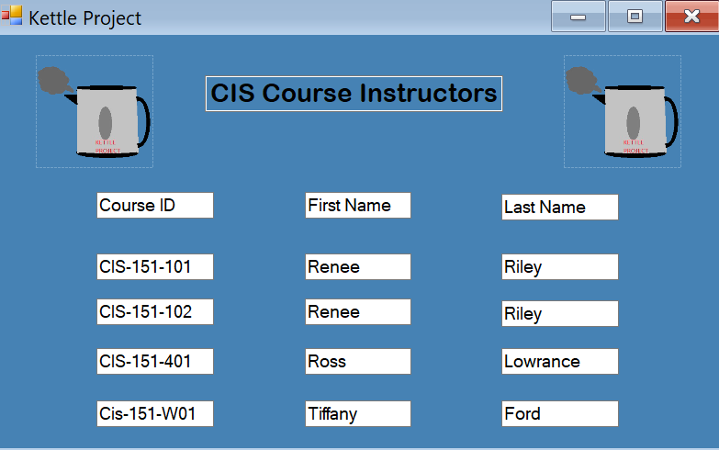
Desktop Version
Notes:
Example of what a SQL search might look like using C#

Slide 26
Credits
Mr. Ross Lowrance – Instructor
Mr. Quintin Guitar – Desktop Version
Mr. Eric Haden – Web-Based Navigation and Toolbox
Mr. Chester “Chet” Hietman – Desktop Version
Mr. Hunter Holderfield – Web-Based Navigation and Toolbox
Mr. Samuel “Sam” Lohbeck – Web-Based Assignments & Grades
Mr. Ryan Mackey – Lead Web Developer
Mr. Anthony “Tony” Parras – Web-Based Attendance
Mr. Justin Shull – Database Design and Administration
Mr. Jacob Ternes – Web-Based Seating Chart
Mr. Nicholas “Nick” Wu – Web-Based Grades

