Slide 1

MusicMind
EAR TRAINING, BUT FUNNIER!

Slide 2


THE CONCEPT
What do we want?
GAMIFICATION

Slide 3
THE CONCEPT
What do we want?
We want to develop an application for ear training.
GAMIFICATION

Slide 4
THE CONCEPT
What do we want?
We want to develop an application for ear training.
GAMIFICATION
How do we want to get our result?

Slide 5
THE CONCEPT
What do we want?
We want to develop an application for ear training.
GAMIFICATION
How do we want to get our result?
Via developing a web game which allows us to get to our goal in a way that is fun for the user.

Slide 6
PROJECTUAL PHILOSOPHY
«NON FUNZIONA NIENTE NON E’ POSSIBILE»
-Marco Porcella
«MA COME SI FA?»
-Andrea Crisafulli
«CHIEDIAMO A CHAT GPT.»
-Filippo Longhi
«SECONDO ME POTREMMO CAMBIARE IL COLORE DELLO SFONDO»
-Giacomo De Toni

Slide 7




THE PIPELINE
DRUM MACHINE MINIGAMES
SINGLEPLAYER
GROUP DIVISION
COMMON GAME LOGIC
KEYBOARD MINIGAMES

Slide 8



THE PIPELINE
MULTIPLAYER
USER AUTHENTICATION
DATABASE IMPLEMENTATION
GAME LOGIC ADAPTATION

Slide 9
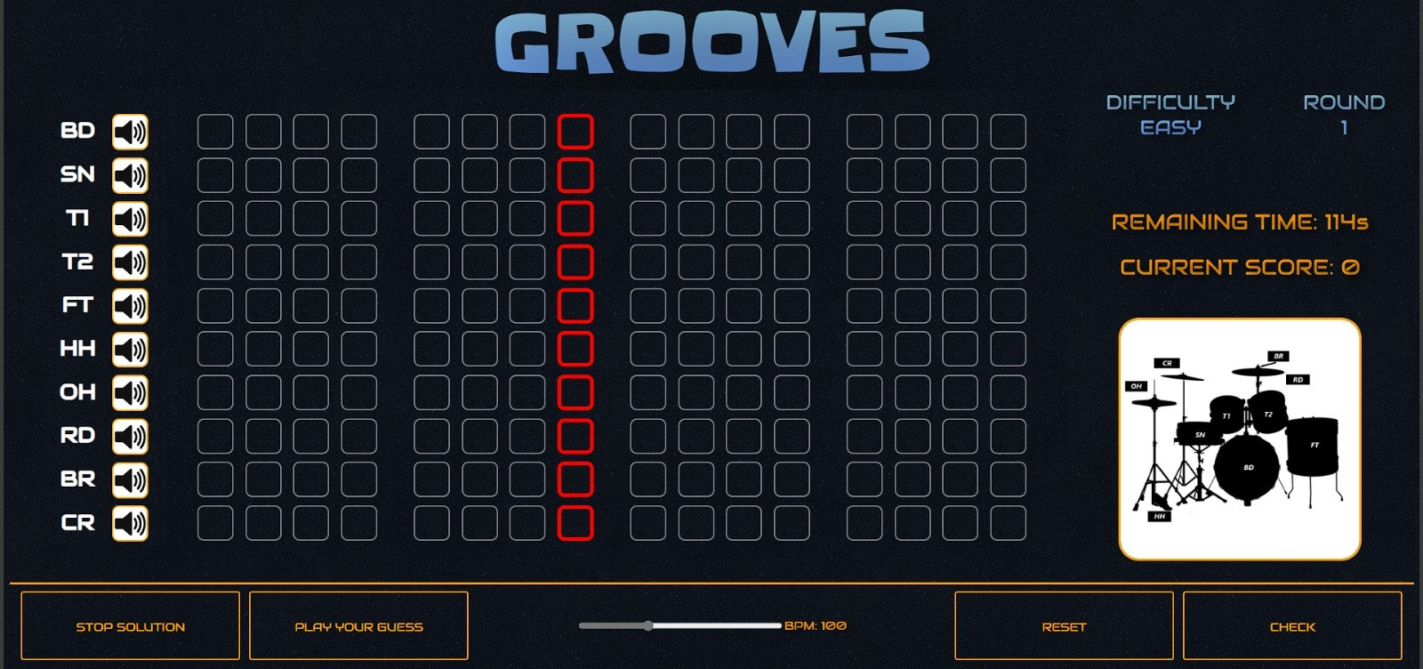
DRUM MACHINE

Slide 10
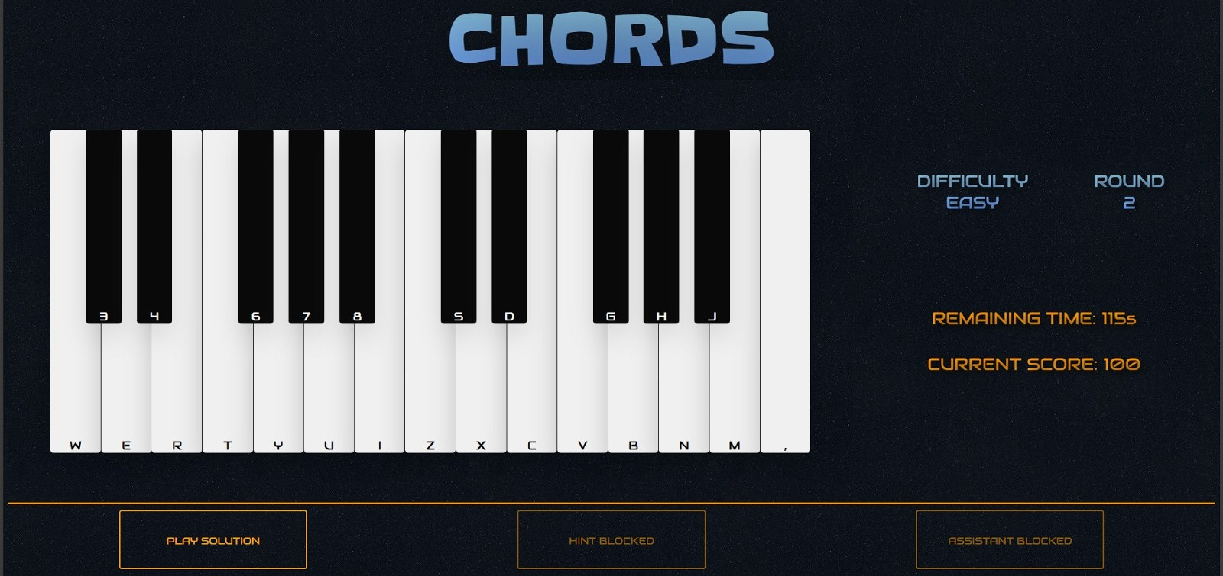
KEYBOARD

Slide 11

BACKEND IMPLEMENTATION

Slide 12


BACKEND IMPLEMENTATION
ANONYMOUS AUTHENTICATION
DATA CONDIVISION

Slide 13



LOGIN SYSTEM
AWAIT USER SIGNIN FUNCTION
DATABASE CREATES USER
CLIENT GETS AND SAVES HIS DATA

Slide 14

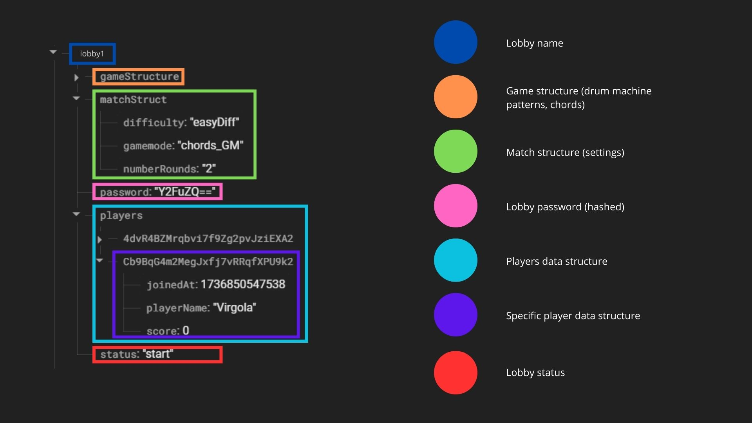

MULTIPLAYER SHARED DATA
UPLOAD PLAYER DATA
DOWNLOAD ALL PLAYERS DATA

Slide 15
LOGIN SYSTEM
AWAIT USER SIGNIN FUNCTION
DATABASE CREATES USER
CLIENT GETS AND SAVES HIS DATA

Slide 16
THE TEAM

Slide 17
MusicMind
THANKS FOR THE ATTENTION

