Slide 1

Generative Audio via Interaction with Ambient
CMLS Final Project 2024/25

Slide 2





What is GAIA?
GAIA (Generative Audio via Interaction with Ambient) is an ambient generative system that transforms real-time enviromental conditions and user interaction into immersive audiovisual experience.

Slide 3




What is GAIA?
It captures ambient data – temperature, light and humidity – using Arduino-based sensors and…

Slide 4

What is GAIA?
… converts them with algorithmic composition to produce evolving, meditative ambient music, visually enhanced by a responsive particle system.

Slide 5
Projectual philosophy
‘’Wow, se metto la mano sul il sensore le palline cambiano.’’
– Andrea Crisafulli, has problems keeping up his focus. –
‘’Ho provato con VCable, Jack e ReaRouter, ma non funziona niente.’’
– Giacomo De Toni, lost his faith in audio softwares. –
‘’Ma non possiamo mandare tutto tramite OSC?’’
– Filippo Longhi, still does not know how OSC works. –
‘’Ragazzi, ho fixato e pushato tutto JUCE.’’
– Marco Porcella, he didn’t fix anything. –

Slide 6








Workflow
OSC
OSC

Slide 7
Arduino
Data collection – OSC protocol transmission

Slide 8




Data collection
Arduino reads temperature and humidity (DHT22) and Ambient light (LDR).

Slide 9



Musical Timing & Triggers
Arduino generates musical rhythm impulses: steady pulses define the bar, while random accents create spontaneous melodic gestures.

Slide 10

Data transmission
Sensor and timing data are formatted and transmitted via Open Sound Control (OSC) over Wi-Fi to SuperCollider and Processing.

Slide 11
SuperCollider
Sound generation

Slide 12




Variables initialization
SuperCollider first needs to be initialized with all the variables that are needed in order to guarantee the correct execution.

Slide 13


Data reception
In order to work, it is mandatory to retrieve the data from the GAIA totem. OSC receivers are so declared to achieve this.

Slide 14

Synth definition
The GAIA synth is defined to compute music with the ambient values retrieved from the GAIA totem.

Slide 15

Alternative execution
There are two possible options to execute GAIA: one which involves the GAIA totem, the other that is based on a random data generation function.

Slide 16
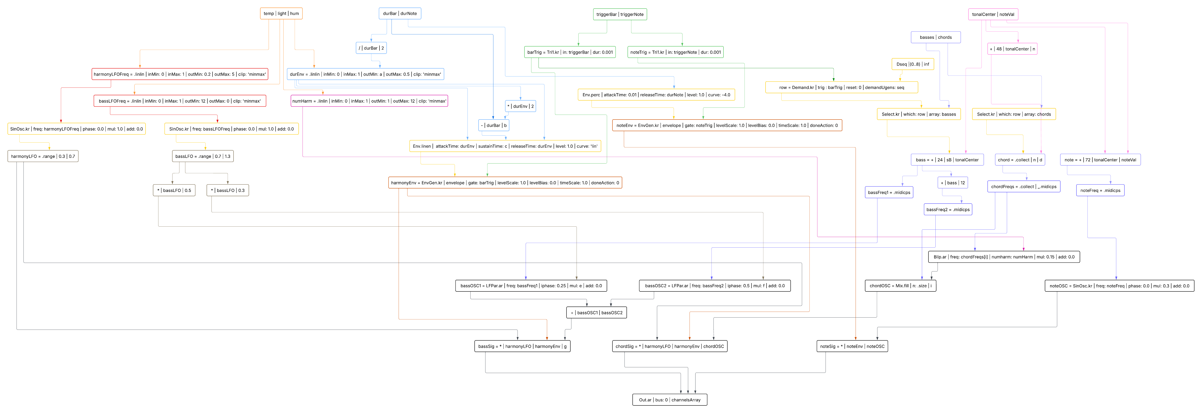
UGen graphs

Slide 17
Reaper
DAW

Slide 18



Input signal format
Reaper DAW receives the input from Supercollider,
that consists of three couples of L/R stereo inputs
(Bass, Chors and Notes).

Slide 19


Plugin execution
Reaper allows the user to interact with the JUCE plugin’s UI, letting the user manipulate each one of the three signals.

Slide 20

Output
The three stereo signals are then combined into a single output thanks to the DAW integrated mixer.

Slide 21
JUCE
User interaction – Signal manipulation

Slide 22




Input signal reception
The JUCE plugin receives the L/R signal from Reaper. It can be one of three possible components: bass line, notes or chords.

Slide 23

User interaction via GUI
The user interacts with a GUI with different handles.
Each of them allows to vary a parameter of a specific effect.

Slide 24

Signal manipulation
It is possible to manipulate the parameters of the three implemented audio effects: reverberation, distortion and delay.
The user can also turn off those effects if needed.

Slide 25

Output
The output signal is sent back to Reaper, which will create a mixed output with the others signals.

Slide 26
Processing
Visual generation

Slide 27


OSC receiver
Processing receives via OSC protocol the parameters from Arduino. This allows the proper functioning of the particle system.

Slide 28

Particle system
The particle system creates a visual interface that varies
with respect to external real-world data collected.

Slide 29
Thanks for your attention
Marco Porcella
Andrea Crisafulli
Giacomo De Toni
Filippo Longhi

Slide 30

Live Demo
Let’s hope everything works

