Slide 1
FIRST Competition Tour App
Ethan Doan
Sebastian Ngo

Slide 2
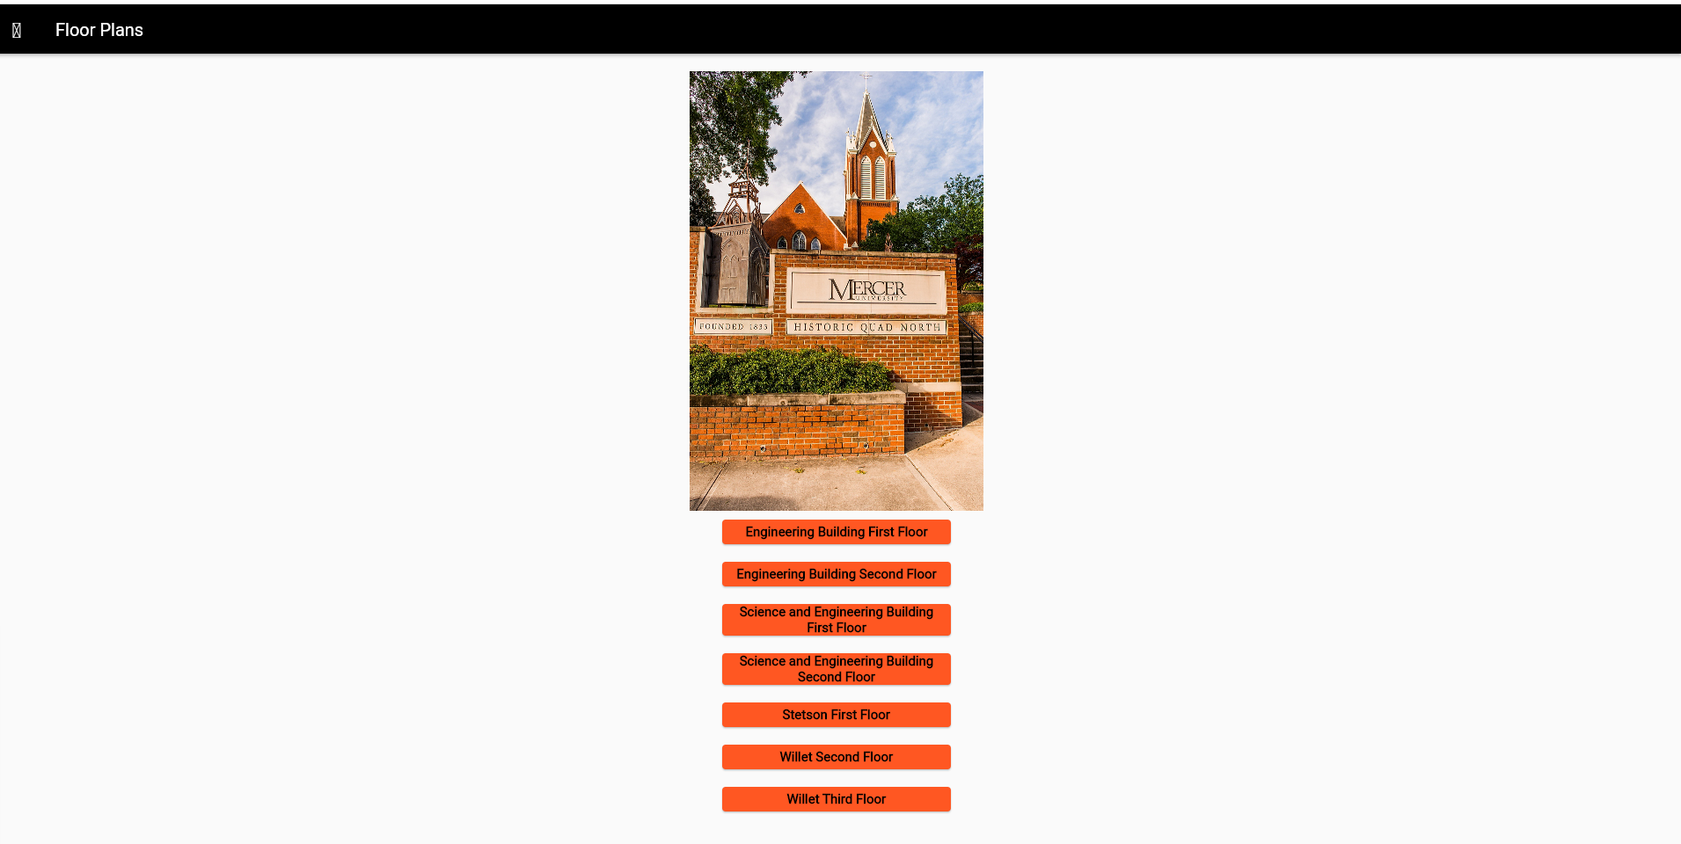
Overall Design
Multiple pages used to convey given documents

Slide 3
Logical Flow
Main page
Contact Page
FIRST Competition Page
About Page
Floor Plans
Lab Tours
Campus Map
EGC First Floor
EGC
EGC Second Floor
SEB
SEB First Floor
Stetson
SEB Second Floor
WSC
Willet Third Floor
Willet Second Floor
Stetson First Floor

Slide 4
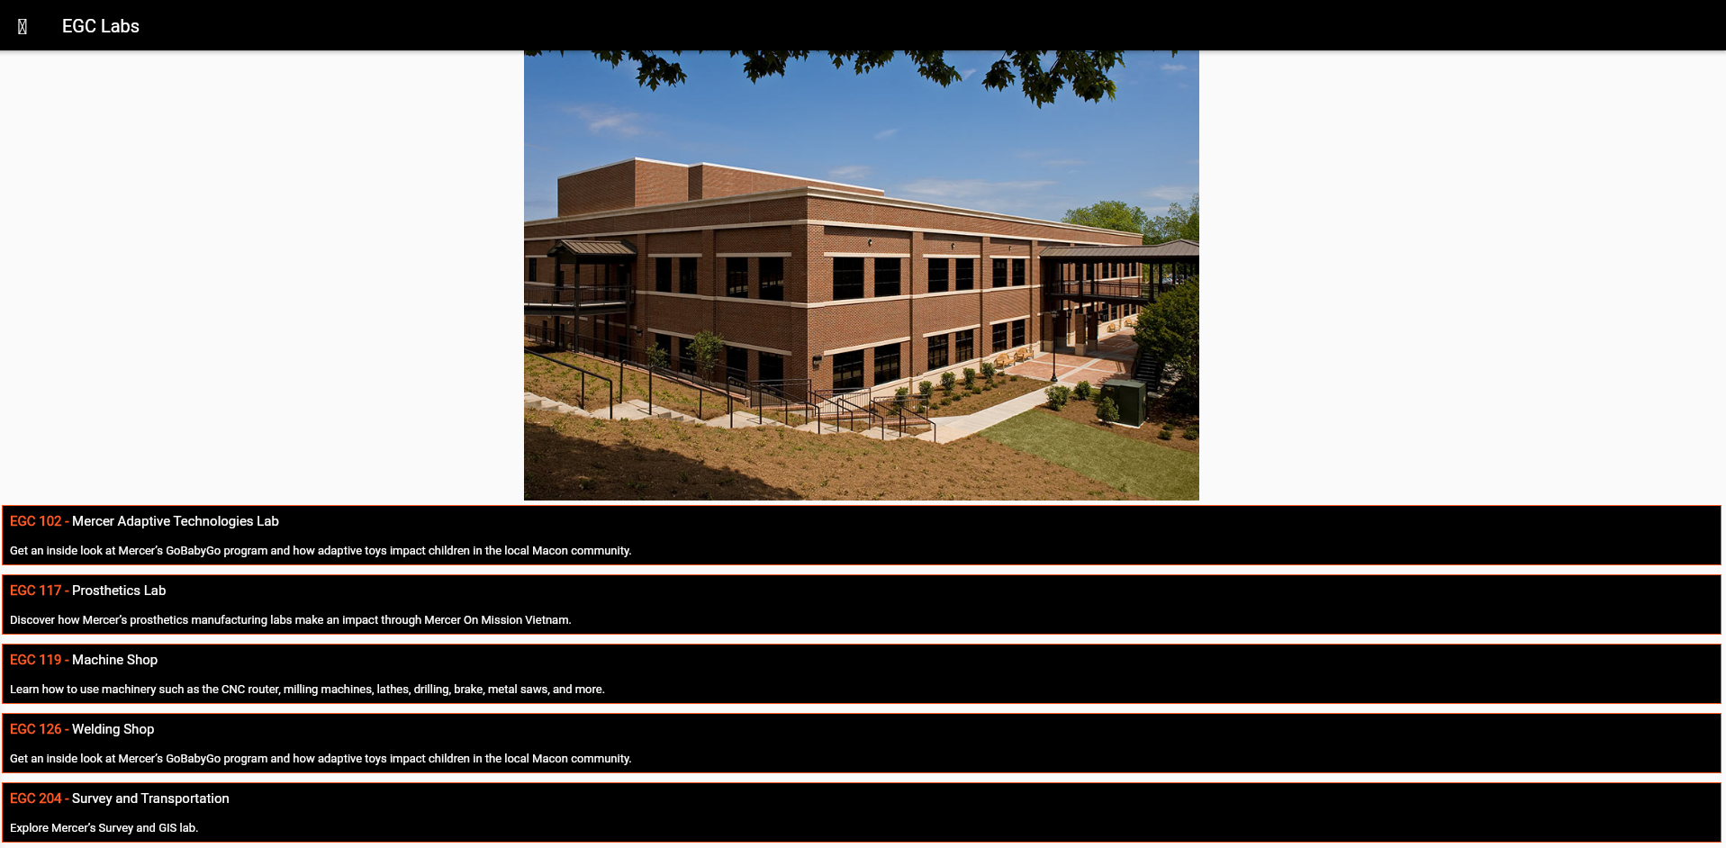
App Activities
Information
URL Links

Slide 5
Contributions
Ethan
Floor Plans
Campus Map
Contacts Page
Sebastian
Lab Tours
About Page
Main Page

Slide 6
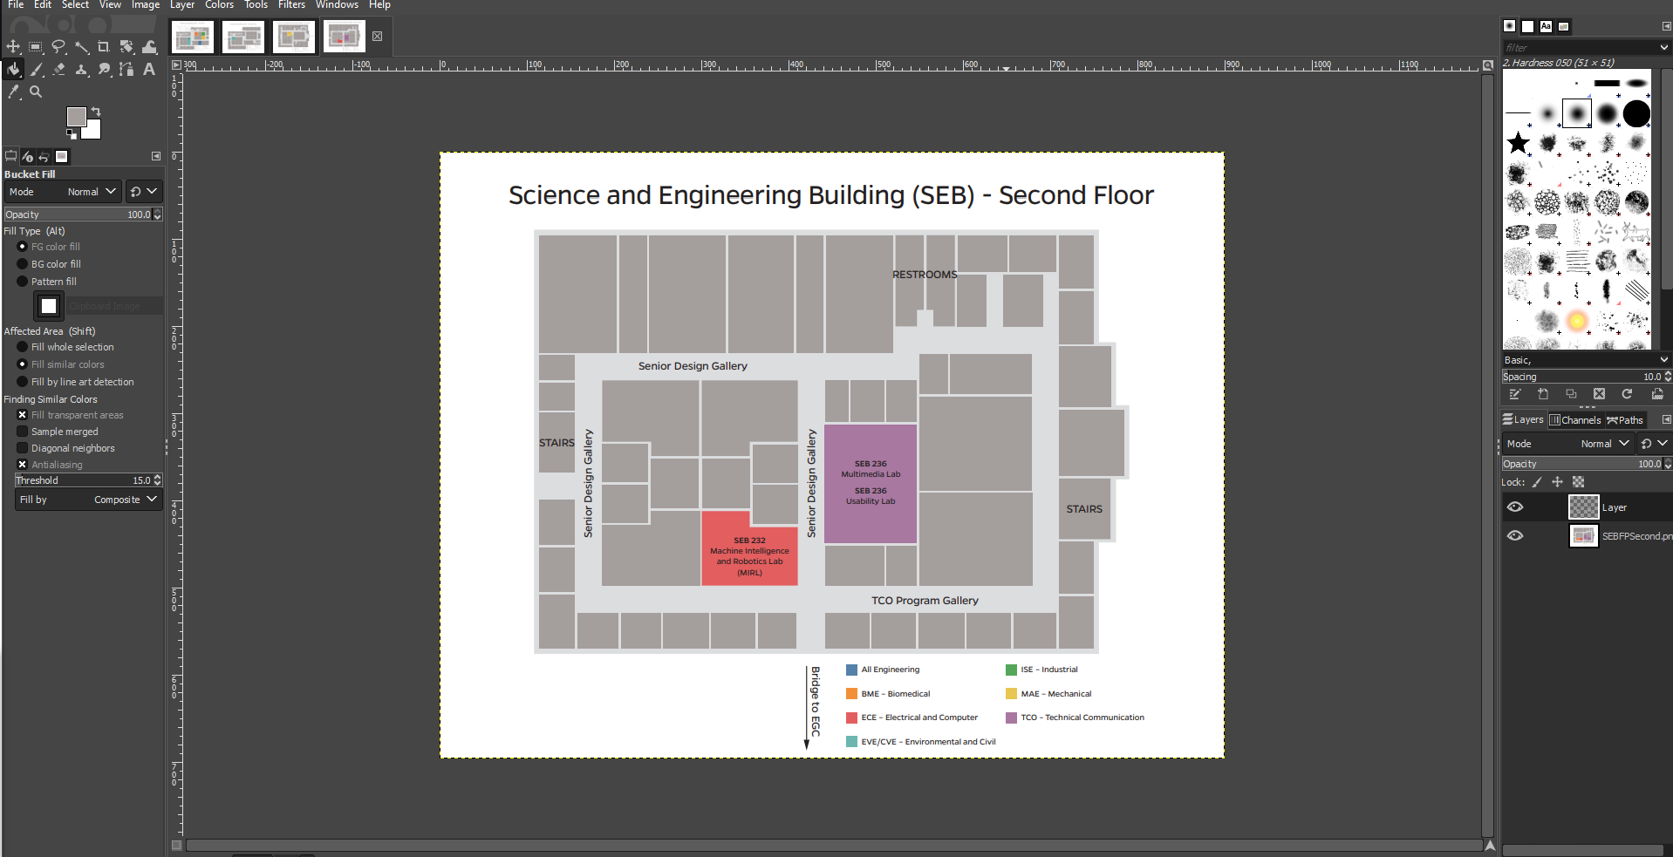
Issues
Getting floor plans/changing floor plans is time consuming

Slide 7
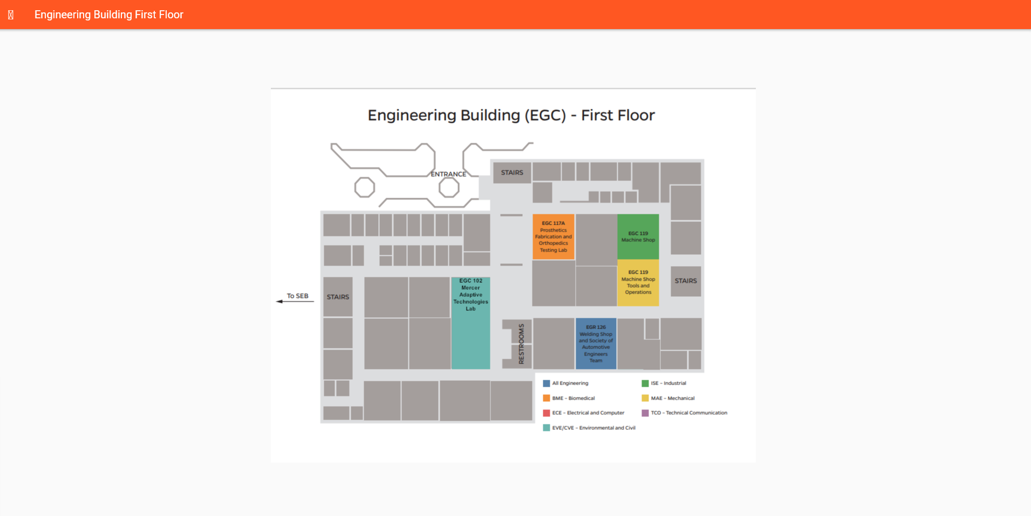
Future Plans
Find a better way to make the floor plans more modifiable

Slide 8
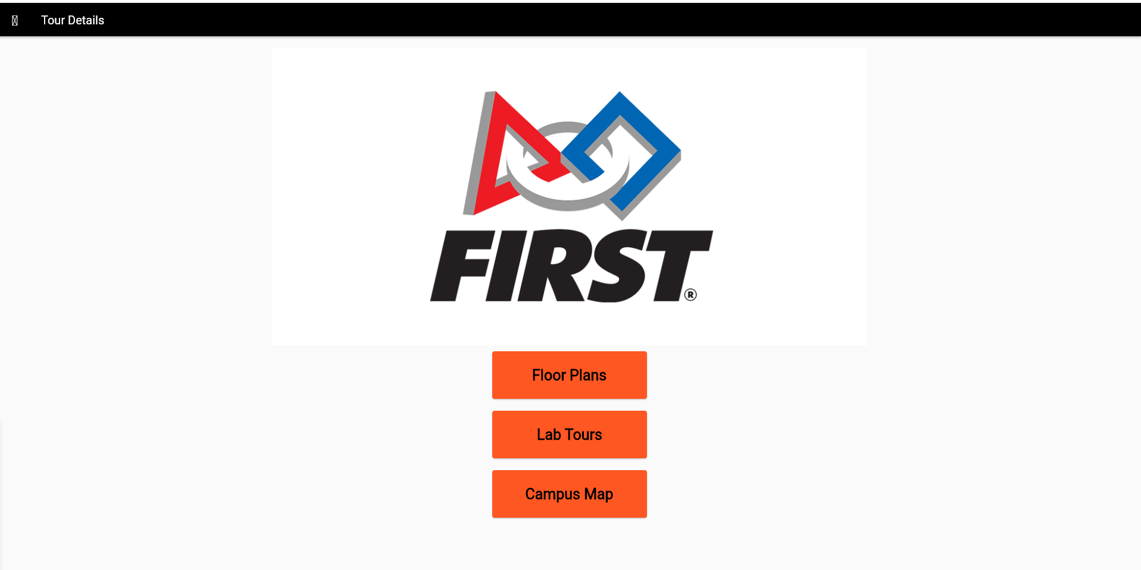
Demo

