Slide 1
COPD PROGRESSION ASSESSMENT USING DEEP LEARNING MODELS
RAHUL G (2127200502035)
SENAJITH S R (2127200502041)
VISHNUVASAN T S (2127200502051)
AD18711 – MINIPROJECT
Viva Voce Examination
Batch No : 17
Name of the Supervisor : Ms. KHANAGHAVALLE G R
Date of Review : 08/11/2023
Domain : DEEP LEARNING

Slide 2
ABSTRACT
India has 18% of the global population and an increasing burden of chronic respiratory diseases. A Pulmonary disease may be caused by infections, smoking tobacco or other forms of air pollution.
According to the world health organization report in 2017 more than 235 million people are suffering from asthma worldwide. In addition, chronic obstructive pulmonary disease (COPD) is expected to be the third leading cause of death by 2030.
Utilize the 12-point body sound recordings found in the "RespiratoryDatabase@TR" dataset for implementation
The process of detection consists of preparing the dataset through preprocessing.
Adding more data to improve generalization and diversity spectrograms, melspectrograms, and chromograms are examples of feature extraction.
Using the robust RESNET50 models.
The model helps determine the severity of COPD by classifying levels of the disease.

Slide 3
BASIC CONCEPTS
COPD
COPD is a progressive lung disease primarily caused by long-term exposure to irritants, including cigarette smoke.
Global prevalence: Over 235 million people have asthma, and COPD is expected to be the third leading cause of death by 2030.
COPD is classified into five stages (COPD0 to COPD4) to assess severity.
It encompasses chronic bronchitis and emphysema, often coexisting.
Management includes lifestyle changes, medication, and personalized healthcare support.

Slide 4
BASIC CONCEPTS
AUDIO SIGNAL PROCESSING
Audio signal processing manipulates and analyzes audio signals, serving roles in music production, speech recognition, telecommunications, and more.
Analog-to-digital conversion (ADC) transforms analog audio into digital format for effective processing and transmission.
Digital signal processing (DSP) techniques include filtering, equalization, compression, and domain transformations for audio signal enhancement.
Music production relies on audio signal processing for mixing, mastering, and real-time effects in recording and live events.
Speech recognition uses audio signal processing to extract speech features, enabling applications in voice-activated systems, transcription, and virtual assistants.

Slide 5
BASIC CONCEPTS
DEEP NEURAL NETWORKS
DNNs are a vital advancement in artificial intelligence and machine learning, mimicking the human brain's architecture.
They consist of numerous layers of interconnected artificial neurons, facilitating their applications in various fields, including reinforcement learning, natural language processing, and image and audio recognition.
DNNs are known for their depth, featuring many hidden layers between input and output layers, making them adept at handling complex tasks.
Their depth enables them to capture intricate and hierarchical patterns in data, making them effective in tasks requiring a high level of abstraction and understanding.
DNNs have transformed multiple domains by providing state-of-the-art solutions in areas like speech recognition, image classification, and game-playing algorithms.

Slide 6
LITERATURE REVIEW
A Roy and U Satija,(2023), A Novel Melspectrogram Snippet Representation Learning Framework For Severity Detection of Chronic Obstructive Pulmonary Diseases, IEEE Transactions on Intrumentation and Measurement, Vol. 72, No. 1, pp. 1-11.
Data collection: Collect a dataset of audio signals from patients with COPD. The dataset should be labeled with the severity of the patient's COPD.
Data preprocessing: Preprocess the audio signals to remove noise and other artifacts. You may also need to normalize the signals.
Feature extraction: Extract features from the audio signals that are relevant to COPD severity classification. Some common features include mel-spectrogram, spectrogram, and chromogram.
Model training: Train a machine learning model to classify the COPD severity of the audio signals. You can use a variety of machine learning models, such as ResNet, YOLO, and support vector machines.
Model evaluation: Evaluate the performance of the trained model on a held-out test set. This will help you to avoid overfitting and ensure that the model generalizes well to new data

Slide 7
LITERATURE REVIEW
L. Pham, H. Phan, R. Palaniappan, A. Mertins and I. McLoughlin (2021), CNN-MoE based framework for classification of respiratory anomalies and lung disease detection, IEEE Journal of Biomedical and Health Informatics, Vol. 25, No. 28, pp. 2938-2947.
Use mel-spectrogram features. Mel-spectrogram features are a well-established representation for audio classification tasks, and they have been shown to be effective for COPD classification in previous studies.
Use a multi-expert ensemble (MoE) architecture. The MoE architecture allows for training a large number of experts in parallel, which can improve the performance of the model.
Use a pre-trained CNN model as a starting point. This can save time and effort, as you will not need to train the model from scratch.
Finetune the CNN model on your dataset. This will help the model to learn the specific features of your data that are relevant to COPD severity classification.
Use cross-validation to evaluate the performance of your model. This will help you to avoid overfitting and ensure that the model generalizes well to new data.

Slide 8
LITERATURE REVIEW
J. Acharya and A. Basu, (2020), Deep Neural Network for Respiratory Sound Classification in Wearable Devices Enabled by Patient Specific Model Tuning, IEEE Transactions on Biomedical Circuits and Systems, Vol. 14, pp. 535-544.
Use a deep neural network architecture. DNNs have been shown to be effective for a variety of classification tasks, including COPD classification.
Use mel-spectrogram features. Mel-spectrogram features are a well-established representation for audio classification tasks, and they have been shown to be effective for COPD classification in previous studies.
Use a patient-specific model tuning approach. This approach involves tuning the hyperparameters of the DNN model to optimize its performance for each individual patient.
Use a wearable device to collect audio signals. Wearable devices are becoming increasingly popular for collecting health data, and they can be used to collect audio signals from patients with COPD in real time. This allows for continuous monitoring of the patient's COPD severity.
Use a cloud-based platform to train and deploy the DNN model.

Slide 9
LITERATURE REVIEW
S. B. Shuvo, S. N. Ali, S. I. Swapnil, T. Hasan and M. I. H. Bhuiyan, (2021), A Lightweight CNN Model for Detecting Respiratory Diseases from Lung Auscultation Sounds using EMD-CWT-based Hybrid Scalogram, IEEE Journal of Biomedical and Health Informatics, Vol. 25, pp. 2595-2603
Use a lightweight CNN architecture. This is important for COPD severity classification on wearable devices, which have limited computational resources.
Use EMD-CWT-based hybrid scalogram features. These features have been shown to be effective for COPD classification in previous studies.
Use a transfer learning approach. This involves training the CNN model on a pre-trained model, such as VGG16 or ResNet50, and then fine-tuning it on your dataset of audio signals from patients with COPD. This can save time and effort, and it can also improve the performance of the model.
Use data augmentation techniques. This will increase the size and diversity of your training dataset, which can help to prevent overfitting.
Evaluate the performance of your model on a held-out test set. This will help you to ensure that the model generalizes well to new data

Slide 10
LITERATURE REVIEW
A. H. Sfayyih, N. Sulaiman and A. H. Sabry, (2023), A review on lung disease recognition by acoustic signal analysis with deep learning networks in springer, Journal of Big Data, Vol. 10, pp. 1-23.
Diverse Features: Use a mix of features, including mel-spectrogram, MFCCs, wavelet, and statistical features to enhance your model's performance.
Multi-Task Learning: Implement a multi-task learning approach. Train your model to classify COPD severity and detect other health issues simultaneously for a more clinically useful model.
Explainable AI: Incorporate explainable AI techniques. Ensure your model's predictions are understandable to clinicians, which is crucial for trust and usability.
Clinical Validation: Test your model in a real clinical environment. Evaluate its performance on new patient audio data to assess how well it works in practice and identify areas for improvement.
Enhanced Model: Work on improving your model's overall performance by exploring diverse features and ensuring it meets the practical needs of clinicians.

Slide 11
ISSUES AND CHALLENGES
Inconsistent data available for each COPD level
Insufficiency of data
Audios were available at different time lengths
Tedious process of spirometry.

Slide 12
PROBLEM STATEMENT
The project is aimed at assessing the progression of COPD severity and conducting multi-class classification of five types based on the level of damage inflicted on the pulmonary organs, ranging from COPD0 (low risk) to COPD4 (high risk), utilizing the RESNET-50 DNN architecture.

Slide 13
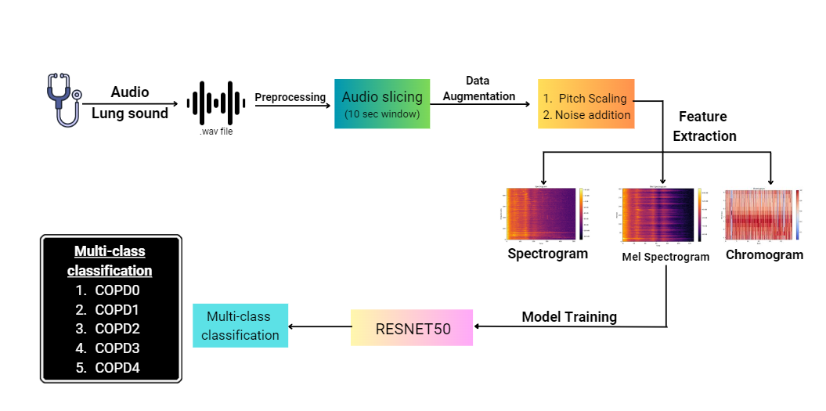
ARCHITECTURE DIAGRAM

Slide 14
SYSTEM REQUIREMENTS AND TOOLS
HARDWARE SPECIFICATIONS
CPU : Intel® Core(TM) i5 CPU @ 1.70GHz 2.40 GHz
RAM : 8 GB
Storage : 16 GB
SOFTWARE SPECIFICATIONS
Operating System : Windows 10
Programming Language : Python
Tools & Frameworks : Tensorflow, Librosa and AudioSegment

Slide 15
MODULES AND ITS DESCRIPTION
The modules are listed below:
1.Preprocessing
2.Data Augmentation
3.Feature Extraction
4.Model Training

Slide 16
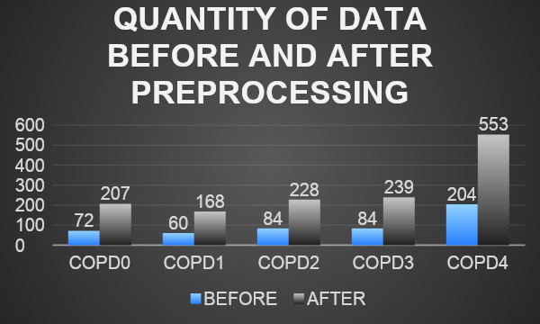
PREPROCESSING
A window length of 10 seconds contains approximately 2 cycles of lung sound signals, making it significant for capturing information for analysis.[1]
The dataset ‘Respiratory database @TR' has an average duration of 17 seconds.
Therefore, each audio is segmented into the maximum number of cycles, each with a size of 10 seconds.

Slide 17
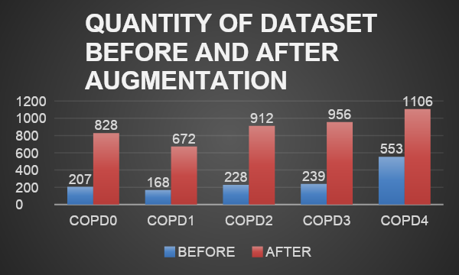
DATA AUGMENTATION
Data augmentation is performed on the audio dataset to overcome data scarcity during model training.
Audio datasets can be populated using techniques such as pitch scaling, noise addition, and time scaling.
1.Pitch scaling
2.Noise addition
3.Time strectching
The Librosa package is used to carry out data augmentation.

Slide 18
FEATURE EXTRACTION
Audio to Visual Transformation:
Audio signals are converted into visual images for easier analysis.
Spectrograms are commonly used for this purpose.
Visual Audio Representations:
Mel spectrogram, spectrogram, and chromogram are visual representations of audio signals.
Each offers unique insights into the audio data.
Neural Network Severity Classification:
Neural networks, often CNNs, are trained to classify audio severity based on these images.
Training involves labeled data for accurate severity assessment in applications like medical diagnostics and voice analysis.

Slide 19
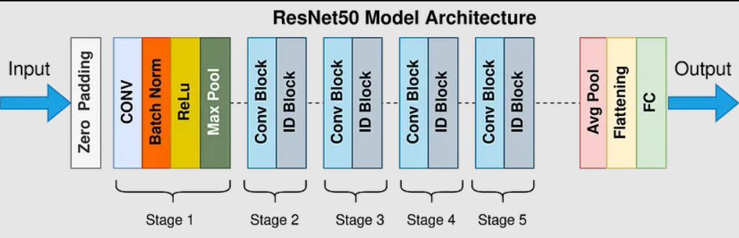
MODEL TRAINING
ResNet-50 is a deep neural network with 50 layers, divided into five stages.Each residual block in ResNet-50 follows a bottleneck design with 1x1 and 3x3 convolutions.
Skip connections (identity shortcuts) connect the output of one block to the input of the next, aiding in training deep networks and mitigating vanishing gradients.
The architecture is efficient due to its bottleneck design and skip connections, balancing accuracy and computation.
ResNet-50 is commonly used for image classification, object detection, and semantic segmentation.
Pretrained ResNet-50 models, trained on ImageNet, are often fine-tuned for various computer vision tasks.

Slide 20
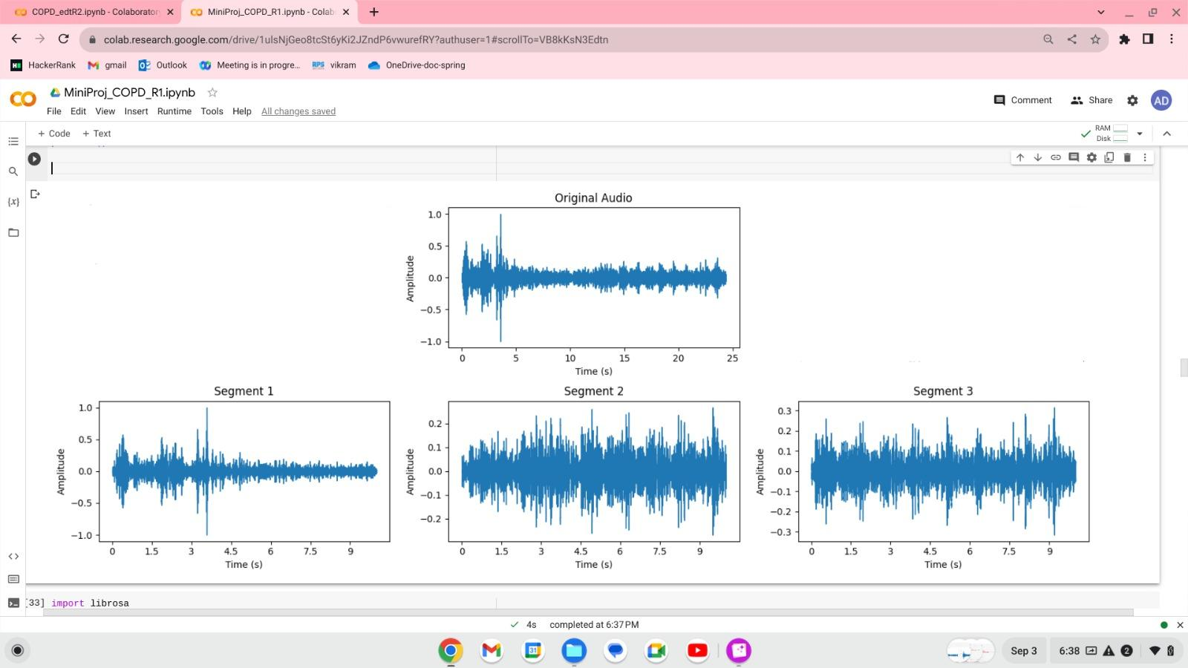
IMPLEMENTATION SCREENSHOTS

Slide 21
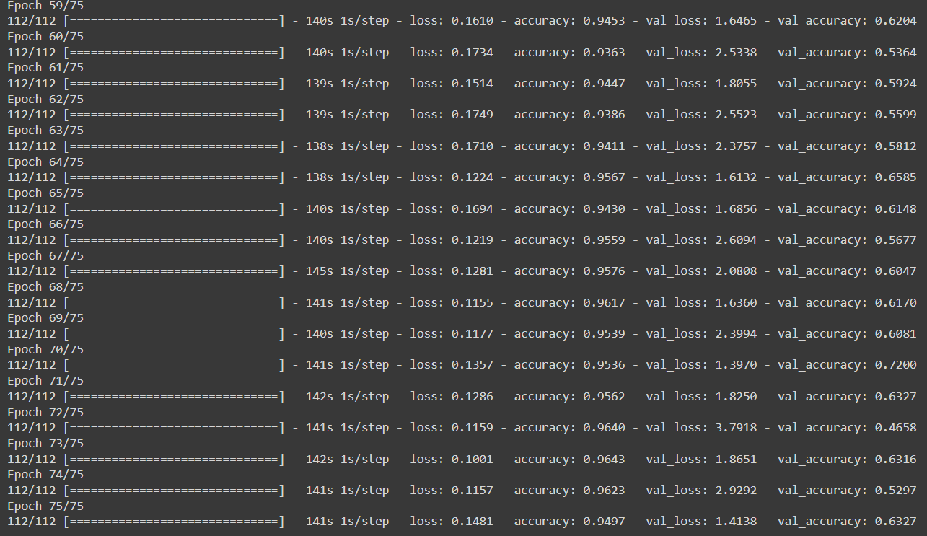
IMPLEMENTATION SCREENSHOTS

Slide 22
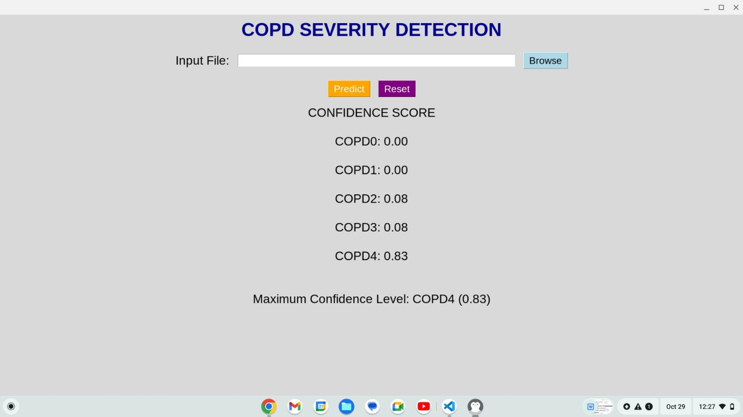
IMPLEMENTATION SCREENSHOTS

Slide 23
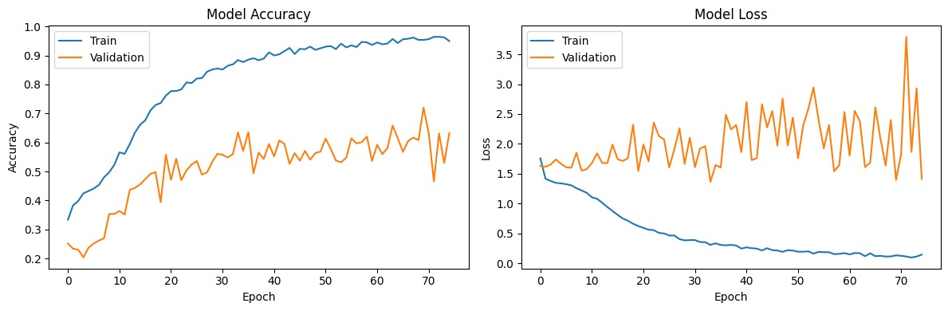
RESNET50 - CLASSIFICATION REPORT

Slide 24
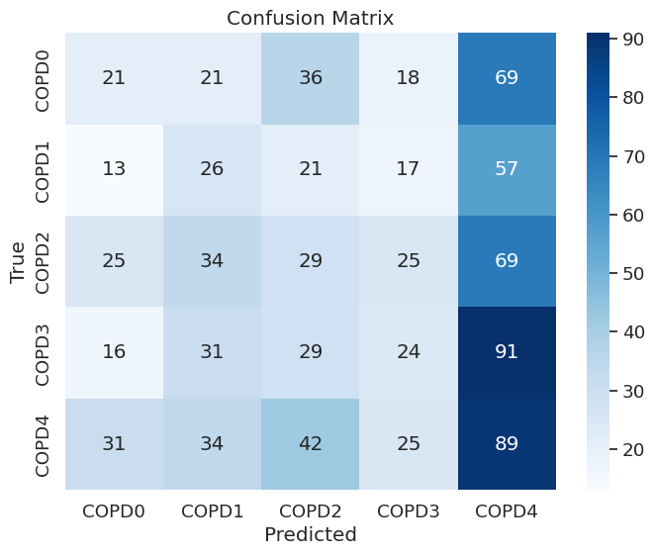
RESNET50 - CONFUSION MATRIX

Slide 25
CONCLUSION
Introduction of melspectrogram snippet framework for COPD classification, utilizing lung sound data and ResNet50 transfer learning.
Framework includes data preprocessing, melspectrogram generation, and ResNet model fine-tuning for enhanced accuracy.
Achieved an impressive accuracy of 94.57% in multi-class classification using the RespiratoryDatabase@TR dataset for lung sound analysis.

Slide 26
REFERENCES
1.)A Roy and U Satija,(2023), A Novel Melspectrogram Snippet Representation Learning Framework For Severity Detection of Chronic Obstructive Pulmonary Diseases, IEEE Transactions on Intrumentation and Measurement, Vol. 72, No. 1, pp. 1-11.
2.)L. Pham, H. Phan, R. Palaniappan, A. Mertins and I. McLoughlin,(2021), CNN-MoE based framework for classification of respiratory anomalies and lung disease detection in IEEE Journal of Biomedical and Health Informatics, Vol. 25, No. 28, pp. 2938-2947.
3.)J. Acharya and A. Basu, (2020), Deep Neural Network for Respiratory Sound Classification in Wearable Devices Enabled by Patient Specific Model Tuning in IEEE Transactions on Biomedical Circuits and Systems, Vol. 14, pp. 535-544.
4.)S. B. Shuvo, S. N. Ali, S. I. Swapnil, T. Hasan and M. I. H. Bhuiyan, (2021), A Lightweight CNN Model for Detecting Respiratory Diseases from Lung Auscultation Sounds using EMD-CWT-based Hybrid Scalogram in IEEE Journal of Biomedical and Health Informatics, Vol. 25,
pp. 2595-2603.
5.)A. H. Sfayyih, N. Sulaiman and A. H. Sabry, (2023), A review on lung disease recognition by acoustic signal analysis with deep learning networks in springer, Journal of Big Data, Vol. 10, pp. 1-23.

