Slide 1
COPD PROGRESSION ASSESSMENT USING DEEP LEARNING MODELS
RAHUL G (2127200502035)
SENAJITH S R (2127200502041)
VISHNUVASAN T S (2127200502051)
AD18711 – MINIPROJECT
Zeroth Review
Batch No : 17
Name of the Supervisor : Ms. KHANAGHAVALLE G R
Date of Review : 24/07/2023
Domain : DEEP LEARNING

Slide 2
PROBLEM STATEMENT
COPD - Chronic Obstructive Pulmonary Disease is the third leading cause of death worldwide, causing 3.23 Million deaths in 2019.
To assess the progression of COPD using Deep Learning Models:
Binary Classification
Multi Class Classification

Slide 3
BASIC CONCEPTS
COPD
Chronic Obstructive Pulmonary Disease
A progressive lung disease characterized by airflow limitation and breathing difficulties
Primary causes includes - smoking, air pollutants and genetic factors.

Slide 4
BASIC CONCEPTS
MELSPECTROGRAM
Mel frequency spectrogram
Represents the short term power spectrum of a signal
Processed to mimic human auditory systems

Slide 5
BASIC CONCEPTS
YAMNET
Sound classification for audio data
Process using audio spectrograms
CNN
Image - CDS
General purpose architecture

Slide 6
LITERATURE SURVEY
CNN-MoE based framework for classification of respiratory anomalies and lung disease detection
CNN-MoE based framework for classification of respiratory anomalies and lung disease detection
A Deep Learning Framework for Predicting COPD Severity Based on Respiratory Sounds
A Novel Convolutional Neural Network Model for COPD Detection Based on Respiratory Sounds

Slide 7
Deep Learning Framework Applied for Predicting Anomaly of Respiratory Sounds
Problem: Respiratory diseases are a major cause of death worldwide. Early diagnosis and intervention are essential for improving patient outcomes. However, traditional methods of diagnosing respiratory diseases, such as auscultation, can be time-consuming and inaccurate.
Methodology: We will use a two-stage deep learning framework. In the first stage, we will extract features from the audio recordings using a convolutional neural network (CNN). In the second stage, we will use a recurrent neural network (RNN) to classify the extracted features into one of the four categories.

Slide 8
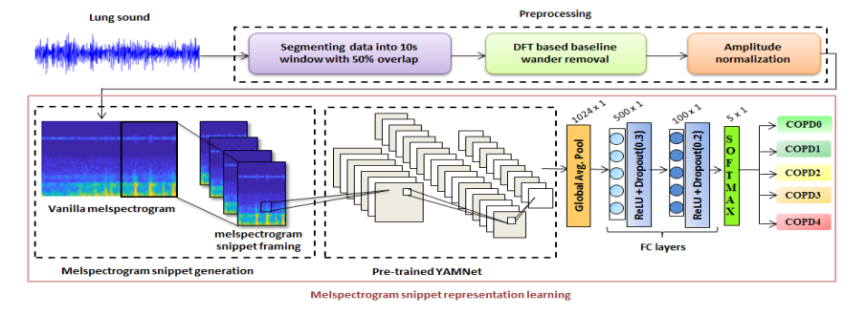

Slide 9
CNN-MoE based framework for classification of respiratory anomalies and lung disease detection
Problem: Respiratory diseases are a major cause of death worldwide. Early diagnosis and intervention are essential for improving patient outcomes. However, traditional methods of diagnosing respiratory diseases, such as auscultation, can be time-consuming and inaccurate.
Methodology: We will use a CNN-MoE based framework. The CNN will extract features from the audio recordings, and the MoE will combine the predictions of multiple CNNs to improve the classification accuracy.

Slide 10
A Deep Learning Framework for Predicting COPD Severity Based on Respiratory Sounds
Problem: Chronic obstructive pulmonary disease (COPD) is a major cause of death worldwide. Early diagnosis and intervention are essential for improving patient outcomes. However, traditional methods of diagnosing COPD, such as spirometry, can be time-consuming and inaccurate.
Methodology: The authors use a deep learning framework that consists of a CNN for feature extraction and a LSTM for classification. The CNN extracts features from the respiratory sounds, and the LSTM classifies the extracted features into one of four categories: mild, moderate, severe, and very severe.

Slide 11
A Novel Convolutional Neural Network Model for COPD Detection Based on Respiratory Sounds
Problem: Chronic obstructive pulmonary disease (COPD) is a major cause of death worldwide. Early diagnosis and intervention are essential for improving patient outcomes. However, traditional methods of diagnosing COPD, such as spirometry, can be time-consuming and inaccurate.
Methodology: The authors propose a CNN model that consists of two convolutional layers, two max-pooling layers, and two fully connected layers. The CNN extracts features from the respiratory sounds, and the fully connected layers classify the extracted features into one of two categories: COPD and non-COPD.

Slide 12
PROPOSED WORK
CNN architecture is used.
The audio signal is captured from lungs.
The audio signal is then converted to melspectrogram graphical images.
The images are fed into CNN for processing.
The architecture will be fine tuned.
The results will be fetched from the CNN

Slide 13
HARDWARE & SOFTWARE REQUIREMENTS
8 GB RAM
11th Gen Intel(R) Core(TM) i5-1115G4 @ 3.00GHz 3.00 GHz
64 bit OS (Linux/Windows/Mac)
Python 3.6 or higher, Pytorch 1.7 or higher
Google Colab

Slide 14
REFERENCES
Deep Learning Framework Applied For Predicting Anomaly of Respiratory Sounds | IEEE Conference Publication
CNN-MoE Based Framework for Classification of Respiratory Anomalies and Lung Disease Detection | IEEE Journals & Magazine
A review on lung disease recognition by acoustic signal analysis with deep learning networks | Journal of Big Data
Evaluation of the impact of COPD severity grading and oxygen saturation on the retinal nerve fiber layer thickness and subfoveal choroidal thickness in COPD patients | The Egyptian Journal of Bronchology
Urban population exposure to air pollution in Europe over the last decades

