Slide 1
COPD PROGRESSION ASSESSMENT USING DEEP LEARNING MODELS
RAHUL G (2127200502035)
SENAJITH S R (2127200502041)
VISHNUVASAN T S (2127200502051)
AD18711 – MINIPROJECT
Second Review
Batch No : 17
Name of the Supervisor : Ms. KHANAGHAVALLE G R
Date of Review : 04/09/2023
Domain : DEEP LEARNING

Slide 2
ABSTRACT
Chronic Obstructive Pulmonary Disease (COPD) presents a significant global health challenge, demanding early detection strategies. Using RespiratoryDatabase@TR dataset, encompassing 12-point body sound recordings is used to assess the progression of COPD severity detection process encompasses preprocessing, data augmentation, feature extraction (spectrogram, melspectrogram, chromogram), and model training with RESNET50, enabling robust multi-class COPD level classification.

Slide 3
BASIC CONCEPTS
COPD
Chronic Obstructive Pulmonary Disease
A progressive lung disease characterized by airflow limitation and breathing difficulties
Primary causes includes - smoking, air pollutants and genetic factors.

Slide 4
BASIC CONCEPTS
SPECTROGRAM
Visual representation of frequency changes over time in lung sounds.
Displays intensity and frequency distribution in respiratory audio signals.
Useful for diagnosing respiratory conditions and abnormalities by analyzing pattern in lung sound spectra
MELSPECTROGRAM
Mel frequency spectrogram
Represents the short term power spectrum of a signal
Processed to mimic human auditory systems

Slide 5
BASIC CONCEPTS
CHROMOGRAM
Application of chromagram to lung sound analysis.
Focuses on representing musical pitch classes in lung sounds.
May assist in identifying specific patterns or characteristics in lung sound pitch, aiding in the diagnosis of respiratory issues.
RESNET-50
Architecture: ResNet-50 is a deep convolutional neural network with 50 layers, capable of extracting complex features from lung sound spectrograms.
Transfer Learning: It's often used with transfer learning, pre-trained on ImageNet, and fine-tuned for lung sound analysis tasks.
Classification: ResNet-50 is valuable for automated lung sound classification, aiding in the diagnosis of respiratory conditions and abnormalities.

Slide 6
LITERATURE SURVEY
A Novel Melspectrogram Snippet Representation Learning Framework For Severity Detection of Chronic Obstructive Pulmonary Diseases
CNN-MoE based framework for classification of respiratory anomalies and lung disease detection
Deep Neural Network for Respiratory Sound Classification in Wearable
A review on lung disease recognition by acoustic signal analysis with deep learning networks
A Lightweight CNN Model for Detecting Respiratory Diseases from Lung Auscultation Sounds using EMD-CWT-based Hybrid Scalogram

Slide 7
A Novel Melspectrogram Snippet Representation Learning Framework For Severity Detection of Chronic Obstructive Pulmonary Diseases
Problem: Chronic obstructive pulmonary disease (COPD) is a major public health concern. Early detection and accurate diagnosis of COPD is crucial for preventing the progression of the disease. Lung sounds can be used to diagnose COPD, but existing methods for lung sound analysis have limited accuracy.
Methodology :Lung sound data is augmented and preprocessed to improve the robustness of the model.Melspectrograms are generated from the lung sound data to extract features that are relevant to COPD severity.A pretrained YAMNet model is fine-tuned on the melspectrogram snippet representations to learn the features that are predictive of COPD severity.

Slide 8
CNN-MoE based framework for classification of respiratory anomalies and lung disease detection
Problem: Respiratory diseases are a major cause of death worldwide. Early diagnosis and intervention are essential for improving patient outcomes. However, traditional methods of diagnosing respiratory diseases, such as auscultation, can be time-consuming and inaccurate.
Methodology: We will use a CNN-MoE based framework. The CNN will extract features from the audio recordings, and the MoE will combine the predictions of multiple CNNs to improve the classification accuracy.

Slide 9
Deep Neural Network for Respiratory Sound Classification in Wearable
Problem: Respiratory diseases are a major cause of death worldwide. Early detection and accurate diagnosis of respiratory diseases is crucial for preventing the progression of the disease. However, traditional methods for respiratory sound classification are not always accurate, especially in wearable devices with limited computational resources.
Methodology: The proposed methodology addresses these challenges by using a deep CNN-RNN model that is trained on a large dataset of respiratory sounds. The model is then fine-tuned with patient-specific data to improve its accuracy. Finally, the model is quantized to reduce its memory footprint for deployment in wearable devices.

Slide 10
A review on lung disease recognition by acoustic signal analysis with deep learning networks
Problem: Lung diseases are a major cause of death worldwide. Early detection and accurate diagnosis of lung diseases is crucial for preventing the progression of the disease. However, traditional methods for lung disease diagnosis, such as chest X-rays and computed tomography (CT) scans, are often expensive and require specialized equipment.
Methodology: Deep learning networks have been shown to be effective for lung disease recognition from acoustic signals. These networks can be trained on large datasets of lung sound recordings to learn the features that are predictive of different lung diseases. Once trained, these networks can be used to classify lung sounds from new patients with high accuracy.

Slide 11
A Lightweight CNN Model for Detecting Respiratory Diseases from Lung Auscultation Sounds using EMD-CWT-based Hybrid Scalogram
Problem: Lung auscultation is a medical procedure that is used to listen to the sounds produced by the lungs. It is a common way to diagnose respiratory diseases, such as asthma, pneumonia, and chronic obstructive pulmonary disease (COPD). However, manual auscultation is time-consuming and can be inaccurate.
Methodology: The method uses a CNN model to learn the features of lung auscultation sounds that are predictive of respiratory diseases. The model is trained on a dataset of lung auscultation sounds from patients with different respiratory diseases. Once trained, the model can be used to classify lung sounds from new patients with high accuracy.

Slide 12
ISSUES AND CHALLENGES
Inconsistent data available for each COPD level
Insufficiency of data
Audios were available at different time lengths
Tedious process of spirometry.

Slide 13
PROBLEM STATEMENT
India has 18% of the global population and an increasing burden of chronic respiratory diseases. A Pulmonary disease may be caused by infections, smoking tobacco or other forms of air pollution.
According to the world health organization report in 2017 more than 235 million people are suffering from asthma worldwide. In addition, chronic obstructive pulmonary disease (COPD) is expected to be the third leading cause of death by 2030.
Our project aims to diagnose the pulmonary diseases with the provided respiratory sounds using latest technologies such as deep learning and digital stethoscope to achieve high accuracy in a safe, cost-effective and non-invasive way

Slide 14
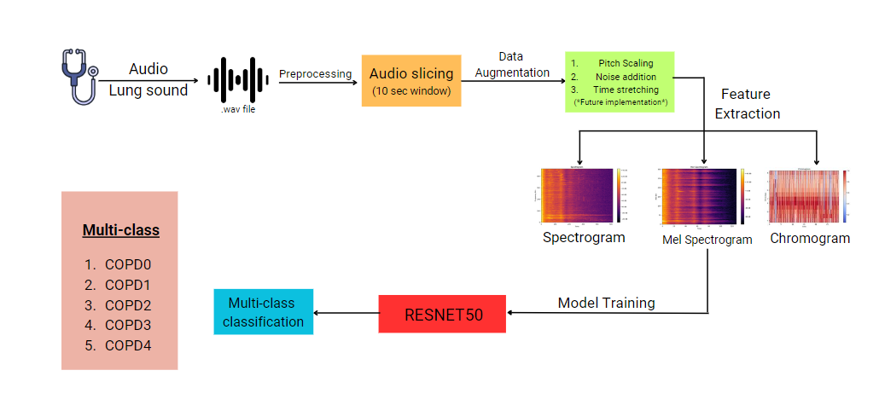
ARCHITECTURE DIAGRAM

Slide 15
MODULES AND ITS DESCRIPTION
The modules are listed below:
1.Preprocessing
2.Data Augumentation
3.Feature Extraction
4.Model Training

Slide 16
System Requirements and Tools
HARDWARE SPECIFICATIONS
CPU : Intel® Core(TM) i5 CPU @ 1.70GHz 2.40 GHz
RAM : 8 GB
Storage : 16 GB
SOFTWARE SPECIFICATIONS
Operating System : Windows 10
Programming Language : Python
Tools & Frameworks : Tensorflow, Librosa and AudioSegment

Slide 17
PREPROCESSING
A window length of 10 seconds contains approximately 2 cycles of lung sound signals, making it significant for capturing information for analysis.[1]
The dataset ‘Respiratory database @TR' has an average duration of 17 seconds.
Therefore, each audio is segmented into the maximum number of cycles, each with a size of 10 seconds.

Slide 18
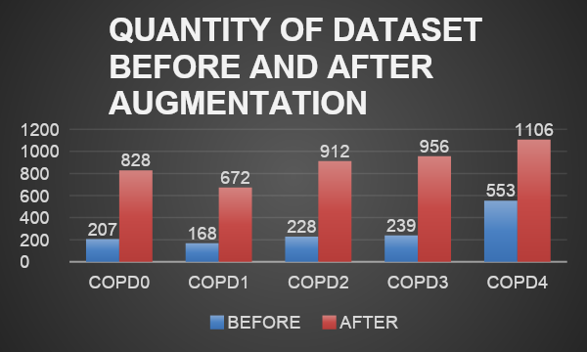
DATA AUGMENTATION
Data augmentation is performed on the audio dataset to overcome data scarcity during model training.
Audio datasets can be populated using techniques such as pitch scaling, noise addition, and time scaling.
1.Pitch scaling
2.Noise addition
3.Time strectching
The Librosa package is used to carry out data augmentation.

Slide 19
FEATURE EXTRACTION
1.The audio signals are transformed into visual images.
2. Mel spectrogram, spectrogram, and chromogram are the different visual representations of audio signal
3. The generated images are grouped and used for training a neural network-based model for severity classification

Slide 20
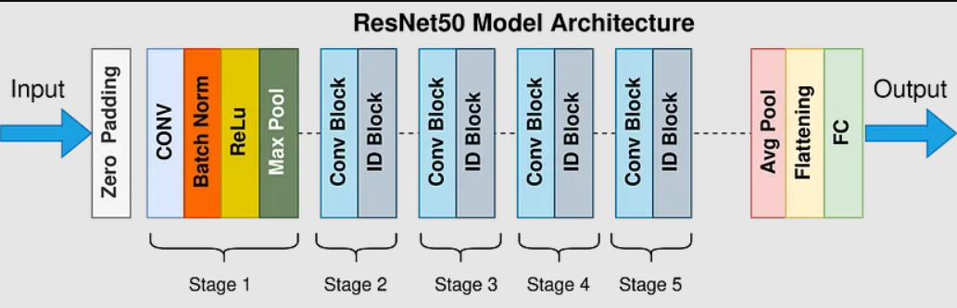
MODEL TRAINING
ResNet-50 is a deep neural network with 50 layers, divided into five stages.Each residual block in ResNet-50 follows a bottleneck design with 1x1 and 3x3 convolutions.
Skip connections (identity shortcuts) connect the output of one block to the input of the next, aiding in training deep networks and mitigating vanishing gradients.
The architecture is efficient due to its bottleneck design and skip connections, balancing accuracy and computation.
ResNet-50 is commonly used for image classification, object detection, and semantic segmentation.
Pretrained ResNet-50 models, trained on ImageNet, are often fine-tuned for various computer vision tasks.

Slide 21
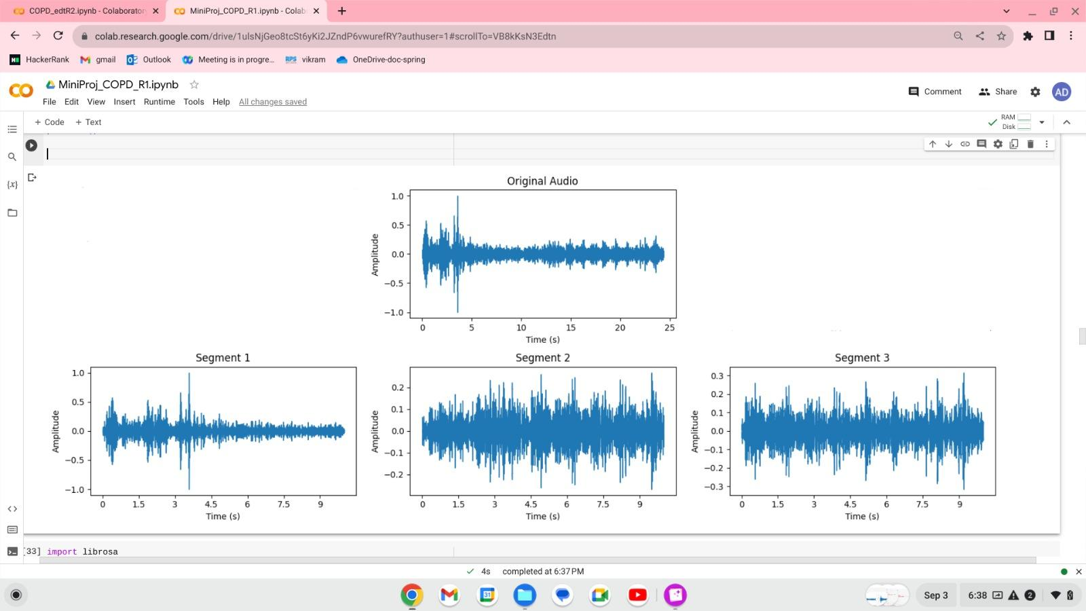
IMPLEMENTATION SCREENSHOTS

Slide 22
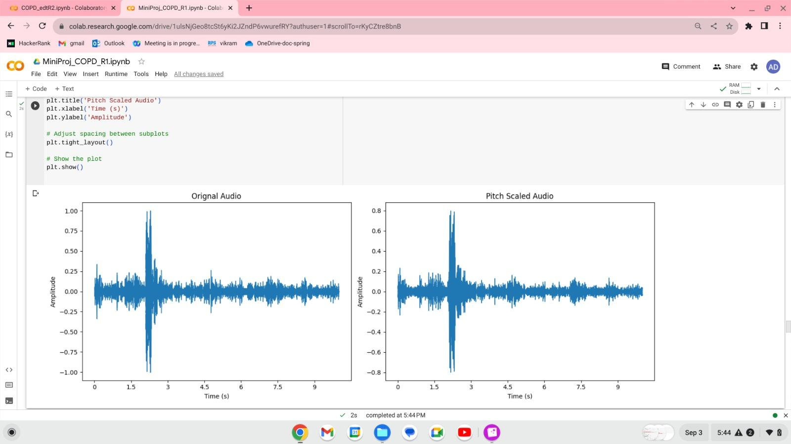
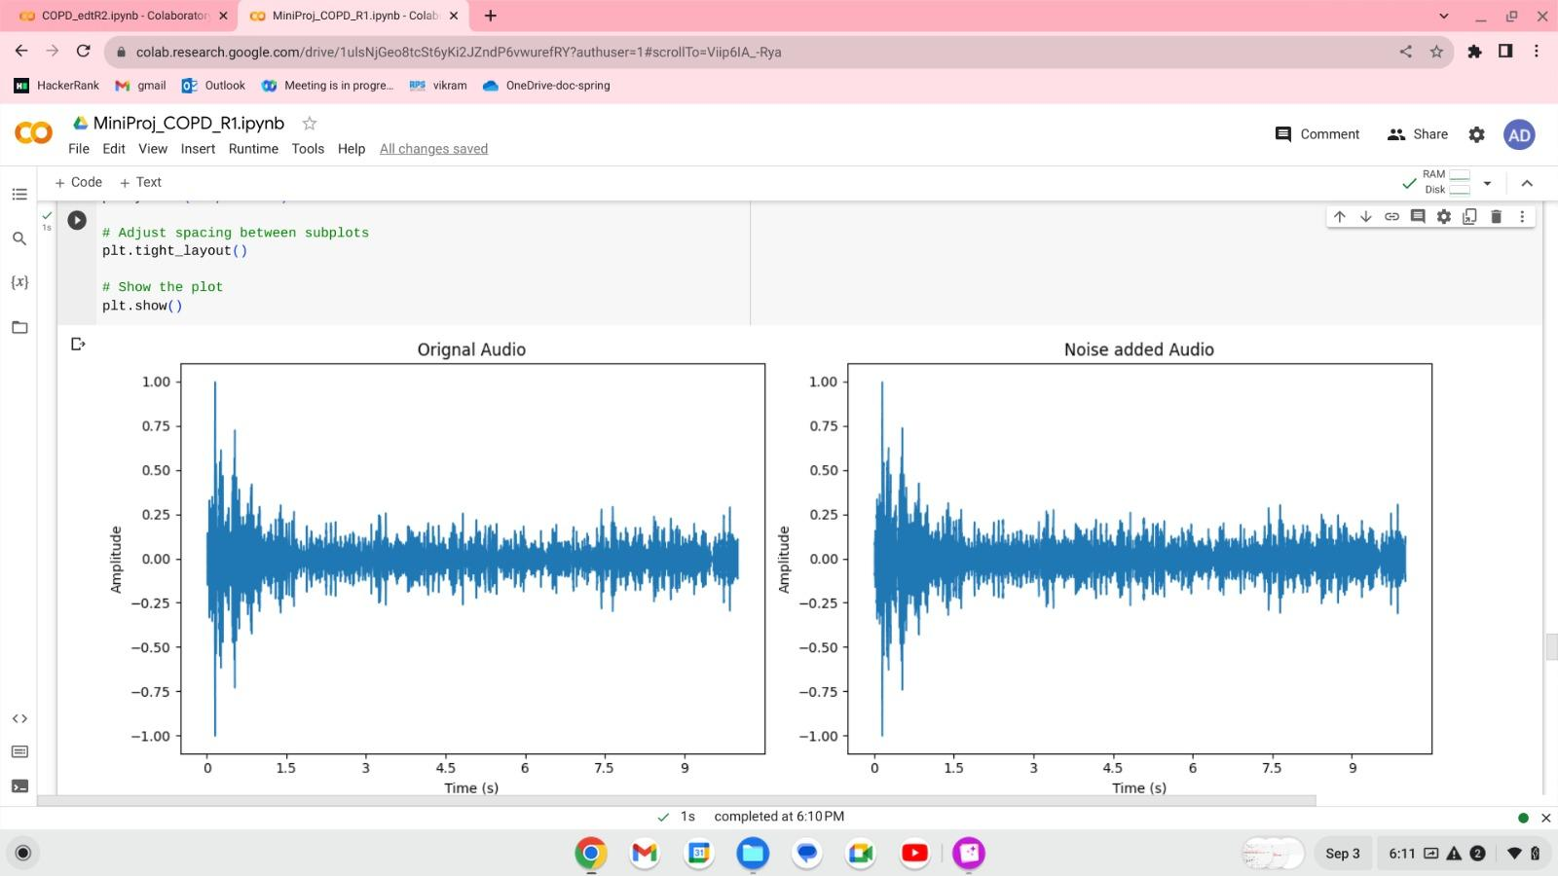
IMPLEMENTATION SCREENSHOTS

Slide 23
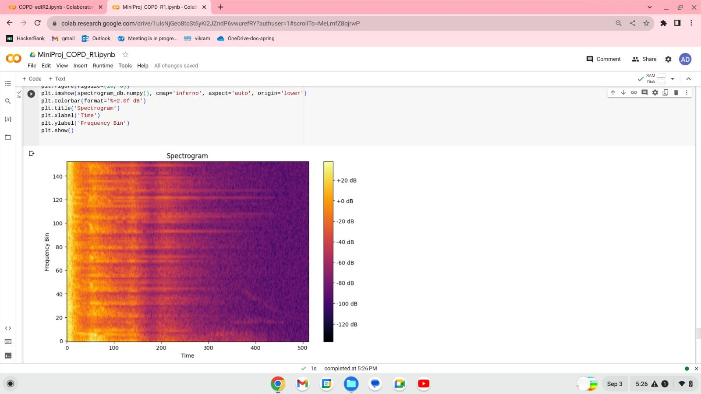
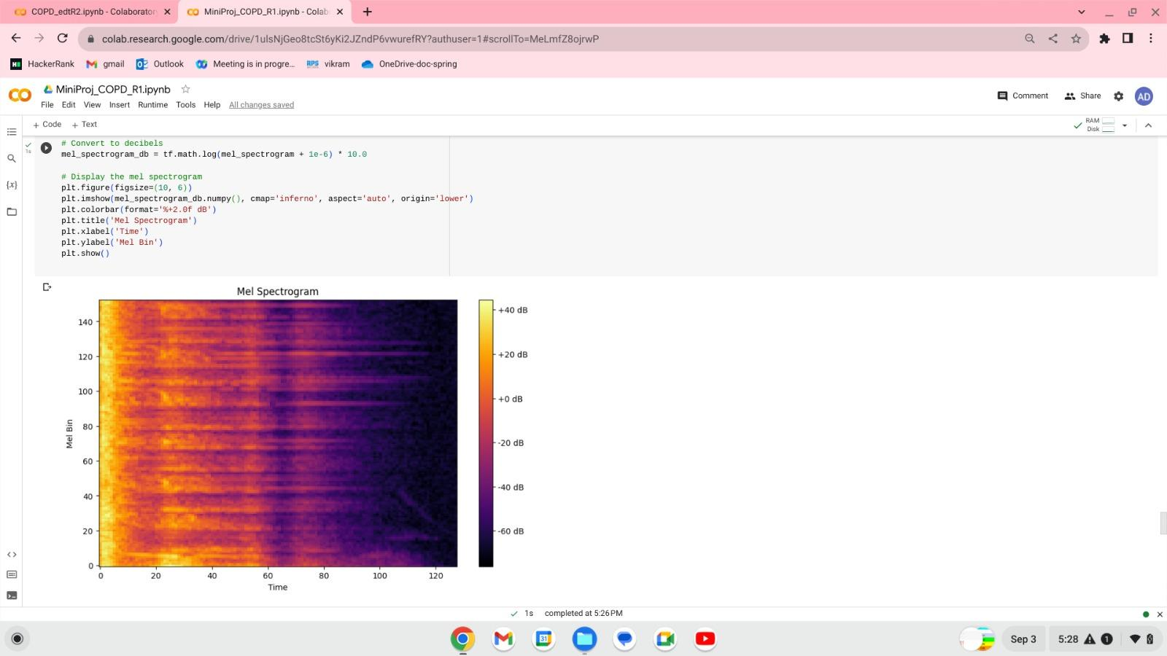
IMPLEMENTATION SCREENSHOTS

Slide 24
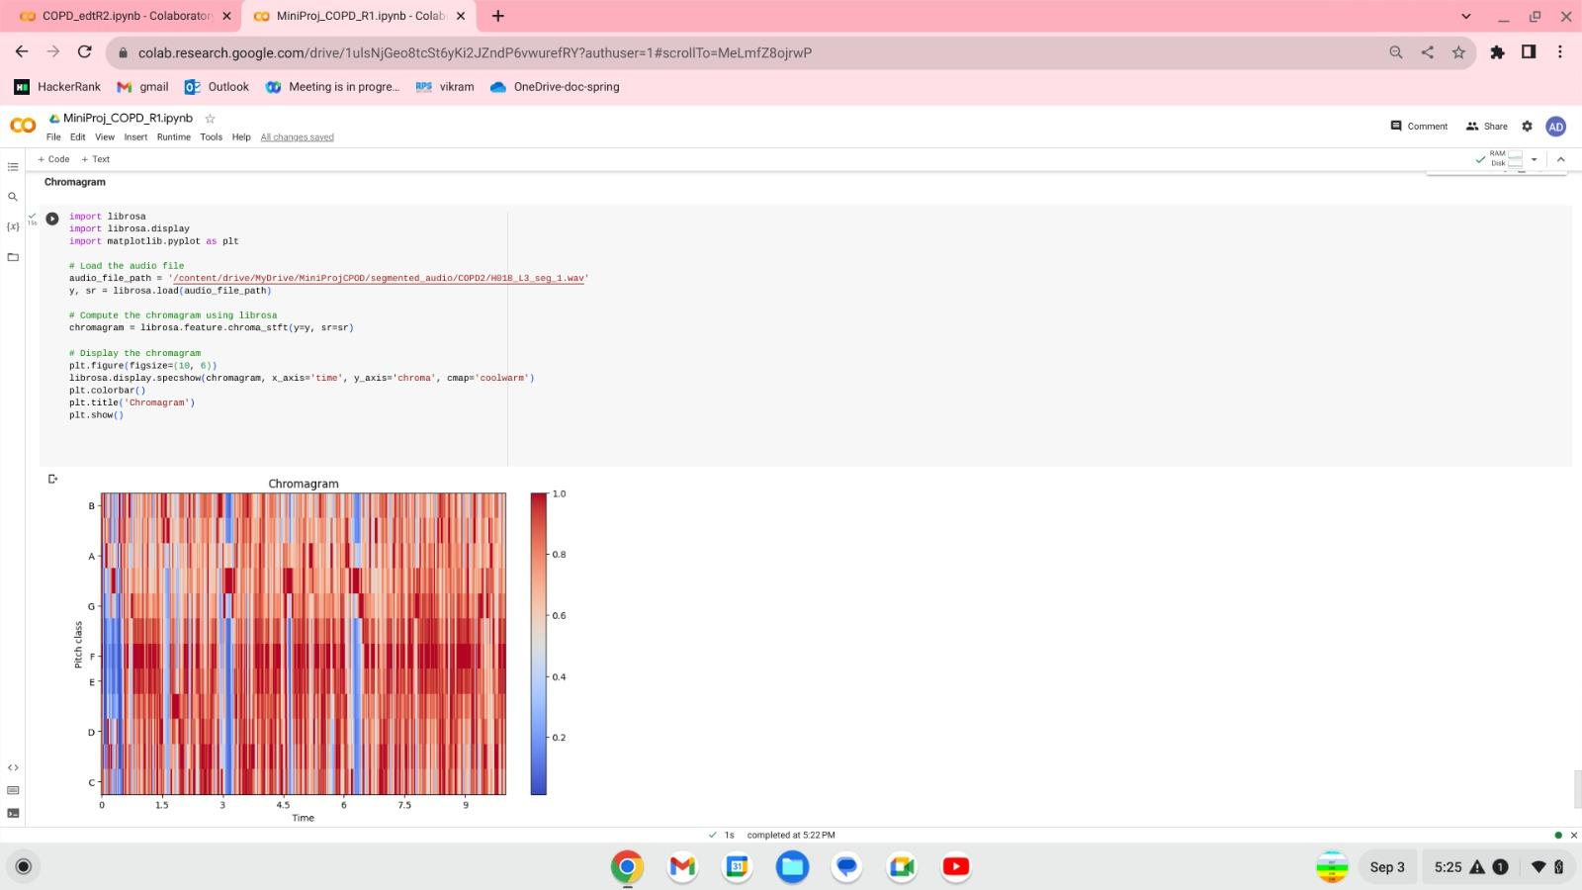
IMPLEMENTATION SCREENSHOTS

Slide 25
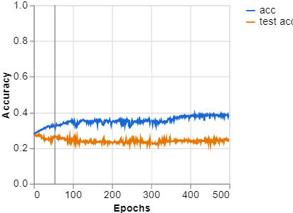
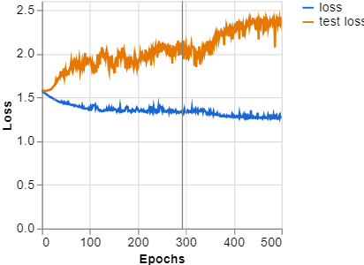
MobileNet

Slide 26
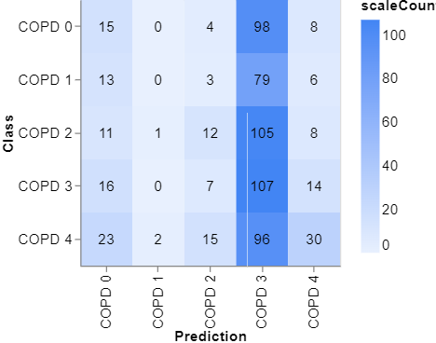
MobileNet
CONFUSION MATRIX

Slide 27
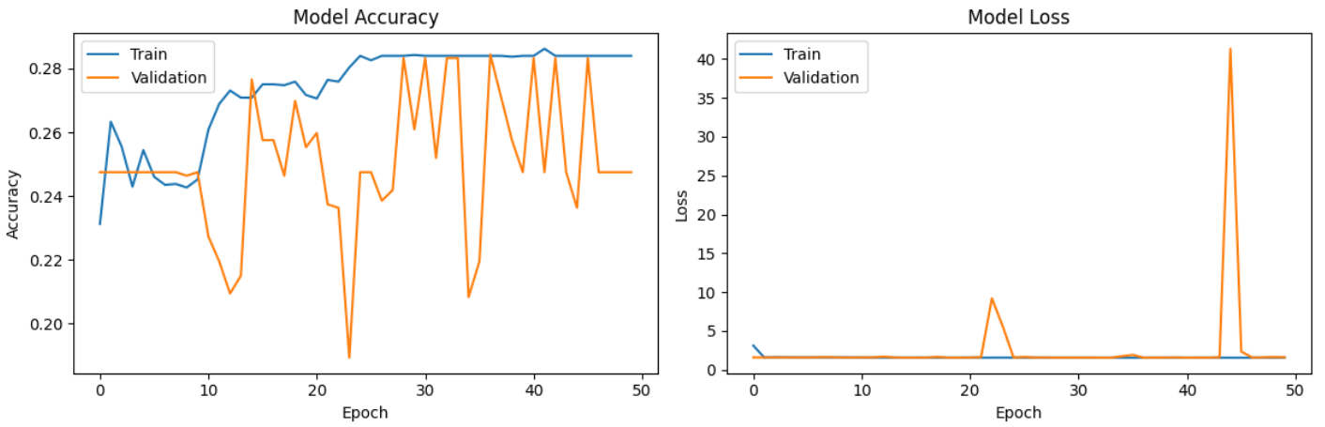
YOLOV8

Slide 28
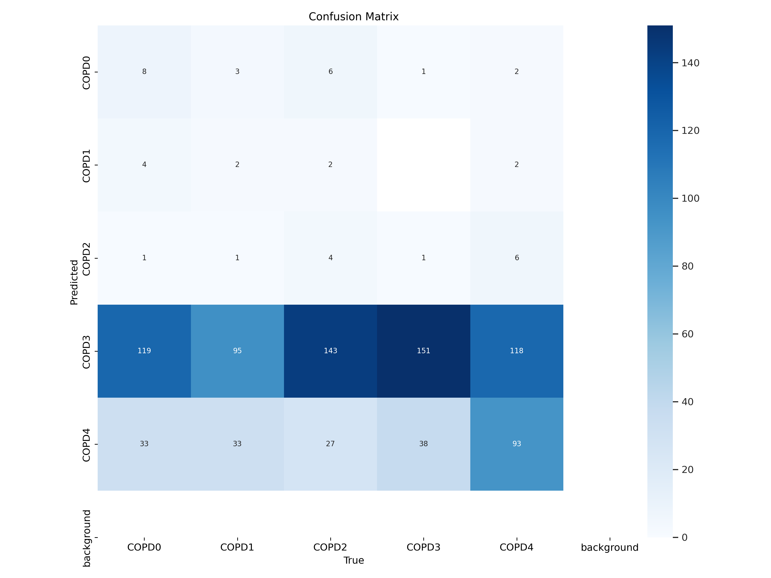
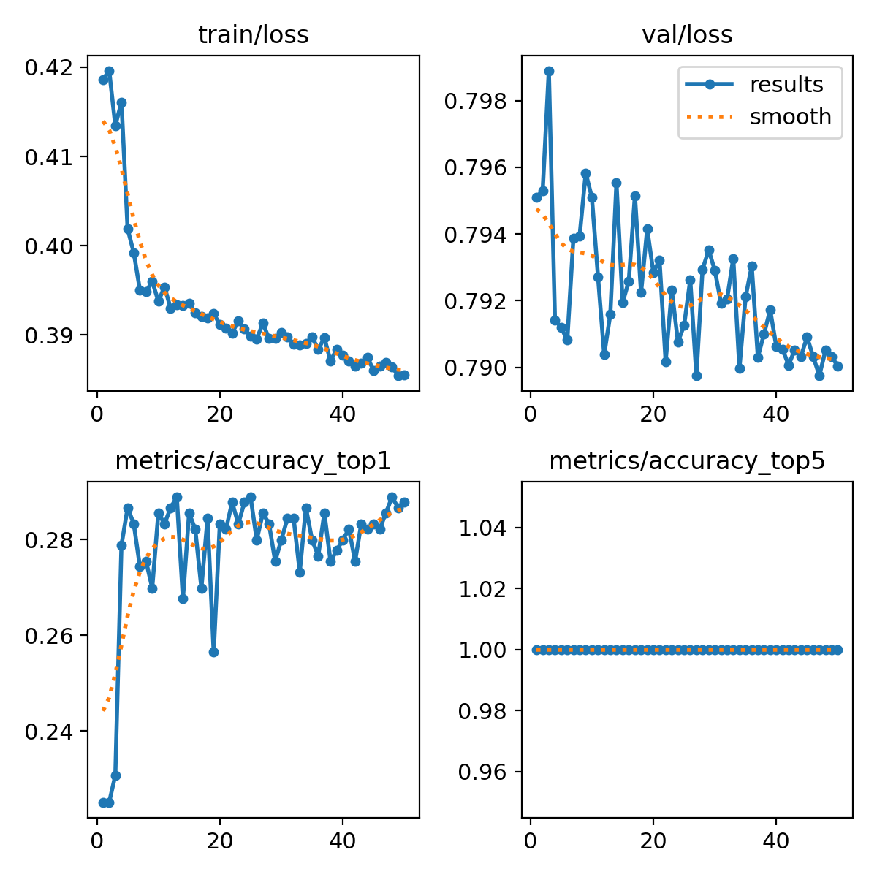
RESNET50

Slide 29
REFERENCES
1.)Roy, Arka; Satija, Udit, ”A Novel Melspectrogram Snippet Representation Learning Framework For Severity Detection of Chronic Obstructive Pulmonary Diseases” in IEEE Transactions on Intrumentation and Measurement(Volume 72),2020
2.)Lam Pham, Huy Phan, Ramaswamy Palaniappan, Alfred Mertins, Ian McLoughlin,”CNN-MoE based framework for classification of respiratory anomalies and lung disease detection”in IEEE ,2021
3.)Jyotibdha Acharya and Arindam,”Deep Neural Network for Respiratory Sound Classification in Wearable Devices Enabled by Patient Specific Model Tuning” in IEEE Transactions on Biomedical Circuits and Systems,volume 14,Issue:3,2020

Slide 30
REFERENCES
4.)Samiul Based Shuvo, Shams Nafisa Ali,Soham Irtiza Swapnil,Taufiq Hasan, and Mohammed Imamul Hassan Bhuiyan ,“A Lightweight CNN Model for Detecting Respiratory Diseases from Lung Auscultation Sounds using EMD-CWT-based Hybrid Scalogram” in IEEE journal of Biomedical and Health Informatics,Volume:25,Issue:7 ,2020
5.)Alyaa Hamel Sfayyih, Nasri Sulaiman and Ahmad H. Sabry,“A review on lung disease recognition by acoustic signal analysis with deep learning networks in Springer”,Journal of big Data,2023

