Slide 1


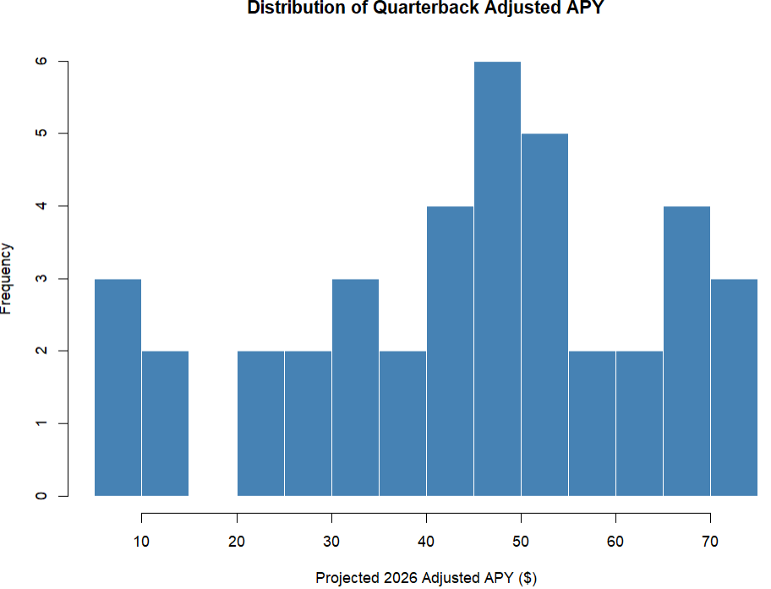
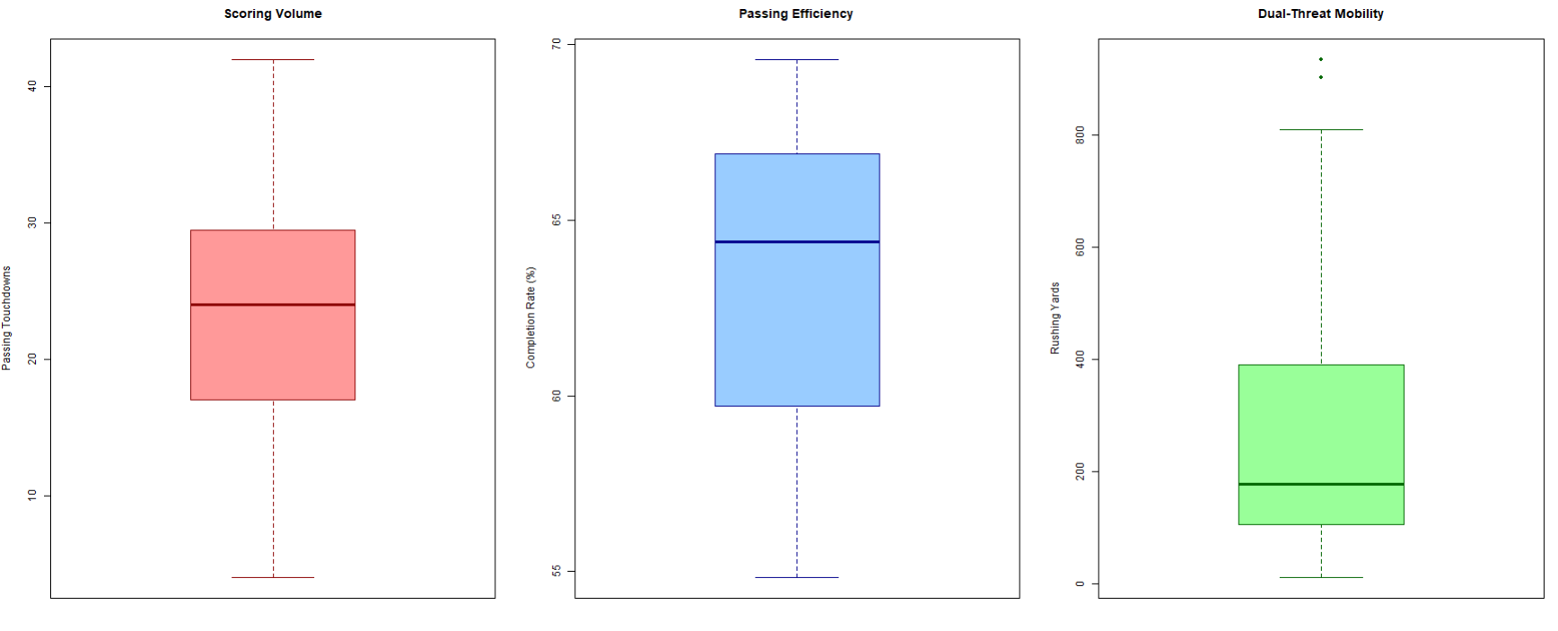
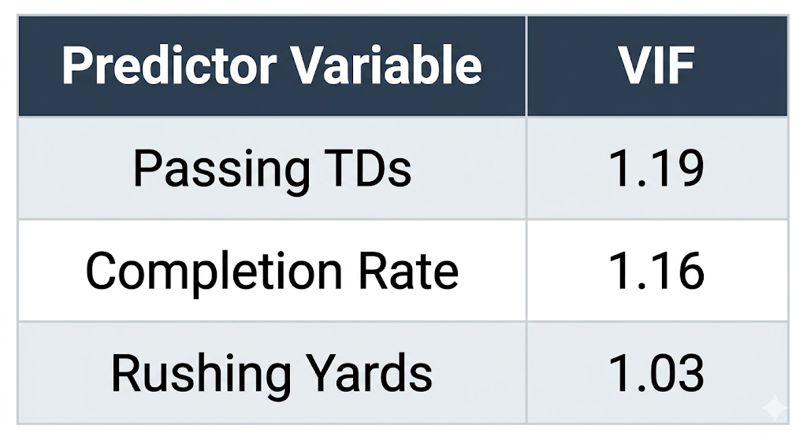
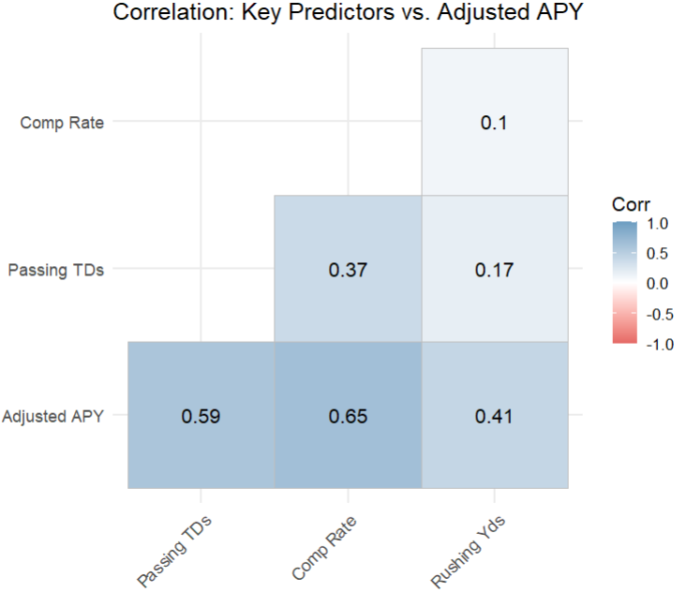
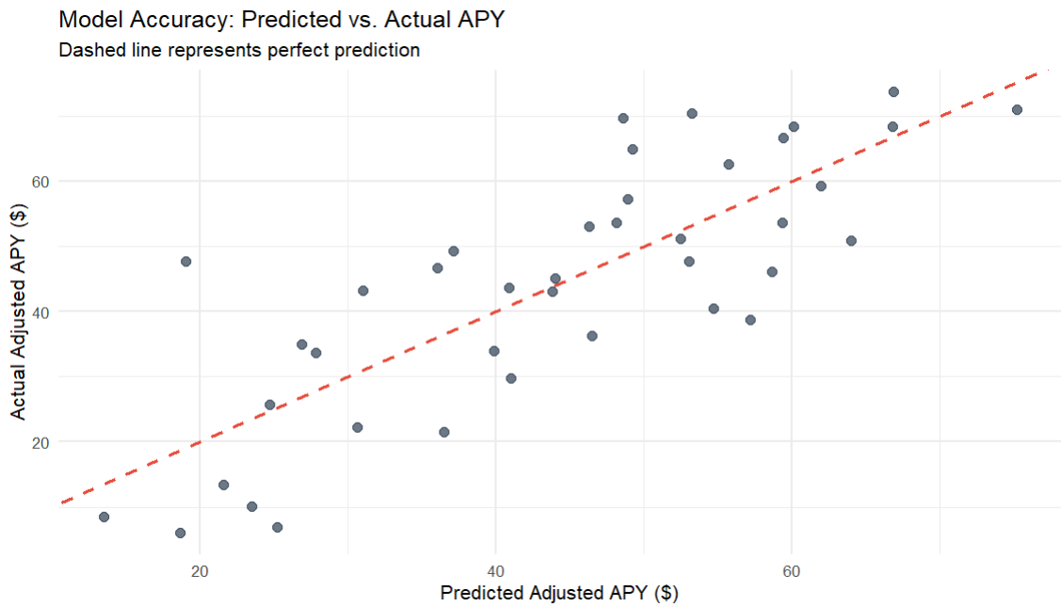

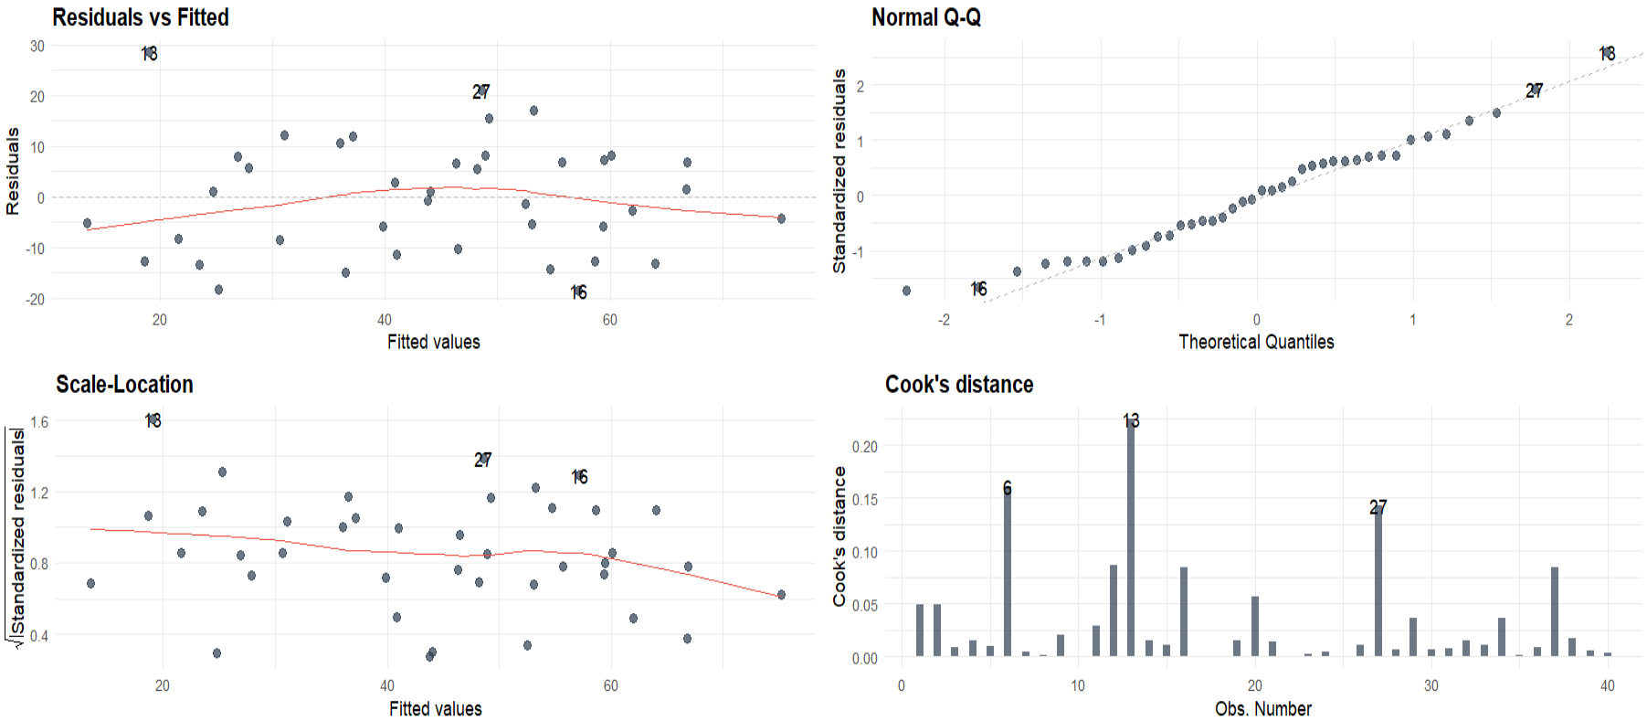
Winning Efficiency: Modeling NFL Point Differential using Play-by-Play Efficiency Metrics
Hussain Sohail and Favour Adekunle
Lauren M. Matheny, PhD, MPH
INTRODUCTION
EDA
RESULTS
Adjusted APY is multi-modal, revealing distinct compensation tiers and a "missing middle" between bridge starters and franchise quarterbacks.
The model successfully explained 65.4% of the variance in inflation-adjusted quarterback salaries (R² = 0.65, F(3,36) = 22.65, p < 0.001), confirming that passing efficiency, scoring volume, and dual-threat mobility are all statistically significant predictors of open-market value.
When holding all other variables constant:
Completion Rate: A 1% increase in completion rate increases expected APY by $2.21 million.
Passing Touchdowns: Each additional passing touchdown adds $703,500 to expected APY.
Rushing Yards: Every additional rushing yard increases expected APY by $22,450.
The metrics driving initial free-market NFL quarterback valuations remained highly debated despite unprecedented financial growth. This study modeled how scoring volume (passing touchdowns), passing efficiency (completion rate), and dual-threat mobility (rushing yards) predicted a quarterback's first non-rookie Average Per Year (APY). By adjusting historical salaries to the projected 2026 salary cap, this research isolated true market value from annual inflation noise, revealing what NFL teams actually prioritised for salary contracts
Rushing yards are heavily right-skewed, highlighting a few elite QBs that are capable of both rushing + passing plays
METHODS
Data was acquired through NFLVerse R Package.
Quarterback Data including:
2011 : 2025 Season (selected due to era of consistent policy and sample size)
All performance statistics and physical attributes. Aggregations applied for parsimony. Example: Completions/Attempts = comp_rate
APY earnings adjusted for inflation by the yearly salary cap for 2026 year
Contracts under $5M were excluded as boundary outliers to eliminate non-market structural noise and preserve model linearity
Model:
Adjusted Model:
DV apy_adj_2026.
The player's first non-rookie contract Average Per Year, adjusted for inflation to the projected 2026 salary cap
Independent Variable 1 passing_tds.
Total passing touchdowns in the season immediately prior to new contract signing
Independent Variable 2 comp_rate.
Passing efficiency, defined by (completions / attempts) * 100).
Independent Variable 3 rushing_yards.
To account for dual threat QBs that use rushing tactics frequently
Due to sample size (n=40), visual diagnostics are outlier-sensitive; (Shapiro-Wilk: p = 0.41) and homoscedasticity (Breusch-Pagan: p = 0.46), help to statistically confirm trends suggested by our visualisations.
FUTURE WORK
Note for Dr Lauren:
If the scope is this project is too small, we can expand it to include RB or WR player category allowing us a sample size of approx. 100+ allowing for use of all concepts covered in class without overfitting and do a short comparison of the parsimonious vs comprehensive model
Fig 1 – Pairwise relationships between Adjusted APY and key QB metrics
Fig 2 – Predicted (x- Axis) vs Actual (y-Axis) contract values
R CODE
Fig 3 - Visual validation of standard model assumptions (linearity, normality, and constant variance).

