Slide 1

AI-BASED MENTAL HEALTH
MONITORING SYSTEM
Combining Machine Learning and NLP to support early mental-health risk awareness
MACHINE LEARNING
NLP
STREAMLIT WEB APP
SUBMITTED BY: RITUSREE BANERJEE
Portfolio / Academic Project • Built with Python, Scikit-learn, NLTK & Streamlit

Slide 2

The Problem
Mental health struggles often go unnoticed until they become severe
1 in 5
60%+
Early
adults experience a mental health
issue every year
never seek treatment due to stigma,
cost, or lack of awareness
self-reflection tools can encourage
timely support-seeking
Our goal: Build an accessible AI tool that combines a structured questionnaire with a user's own words, giving a fuller, more natural picture of mental wellbeing — without replacing professional care.

Slide 3



Our Solution — Three Pillars
A hybrid system that reasons from both structured answers and free-form text
ML Questionnaire
NLP Journal Analysis
Combined Risk Score
15 lifestyle & behavioral questions feed a trained classifier that predicts likelihood of needing treatment.
Users write freely about how they feel; VADER sentiment analysis detects their current mood.
Both signals are merged into one Low / Moderate / High risk indicator for a fuller picture.

Slide 4
The Dataset
A large-scale mental health survey dataset
292,365
Key Features
survey records
Gender, Country, Occupation, Self-employed status
Family history of mental illness
Days spent indoors, Growing stress, Changes in habits
Mental health history, Mood swings, Coping struggles
Work interest, Social weakness / withdrawal
Interview comfort, Awareness of care options
17
features per record
Categorical
survey-style data
Target variable: treatment (Yes / No)

Slide 5
Machine Learning Pipeline
From raw survey data to a deployable trained model
01
02
03
04
05
Clean & Encode
Train / Test Split
Train 3 Models
Evaluate & Compare
Save Best Model
Handle missing values, label-encode all categorical columns
80/20 split, stratified on the target variable
Logistic Regression, Decision Tree, Random Forest
Accuracy, precision/recall, train-vs-test overfit check
Export model + encoders as .pkl for the web app

Slide 6
Model Comparison
Test-set accuracy across three trained classifiers
Best Performer
Decision Tree
76.33%
test accuracy
Training and test accuracy stayed close, showing the model generalizes well rather than overfitting.

Slide 7

NLP Module — Journal Sentiment
Since the dataset has no free text, users' own words add a natural-language signal
5-Level Mood Scale
Highly Negative
VADER Sentiment Analyzer
Negative
A lightweight, rule-based NLTK model scores free text on a compound sentiment scale — no internet call needed at runtime, ideal for a free Streamlit deployment.
Neutral
Example input:
"I am feeling very tired, also feel depressed."
Positive
Detected mood: Highly Negative
Highly Positive

Slide 8
Combined Risk Assessment
Two independent signals merge into a single actionable risk level
Overall Risk
ML Prediction
+
Journal Mood
Yes / No
5-level NLP score
LOW / MODERATE / HIGH
High Risk
ML says Yes AND journal mood is Negative
Moderate Risk
ML says Yes OR journal mood is Negative
Low Risk
Neither signal indicates concern

Slide 9
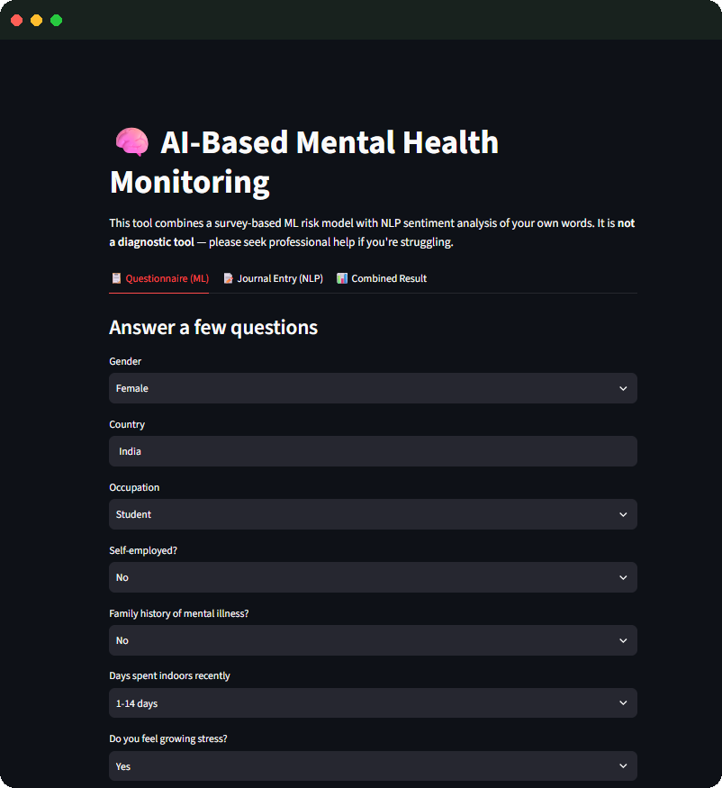
Live App Demo
Step 1 — Answer the Questionnaire
Users answer 15 short lifestyle & behavioral questions — gender, occupation, stress levels, mood swings, coping ability, and more.
Simple dropdown-based UI
Built entirely in Streamlit
Feeds directly into the trained ML model

Slide 10
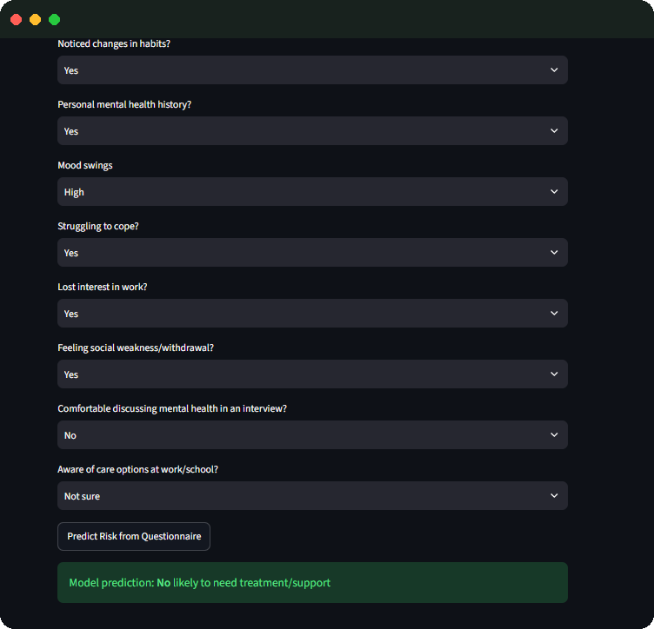
Live App Demo
Step 2 — ML Prediction Result
Once submitted, the trained classifier predicts whether the respondent is likely to need mental health treatment or support.
Model prediction: No likely to need treatment/support

Slide 11
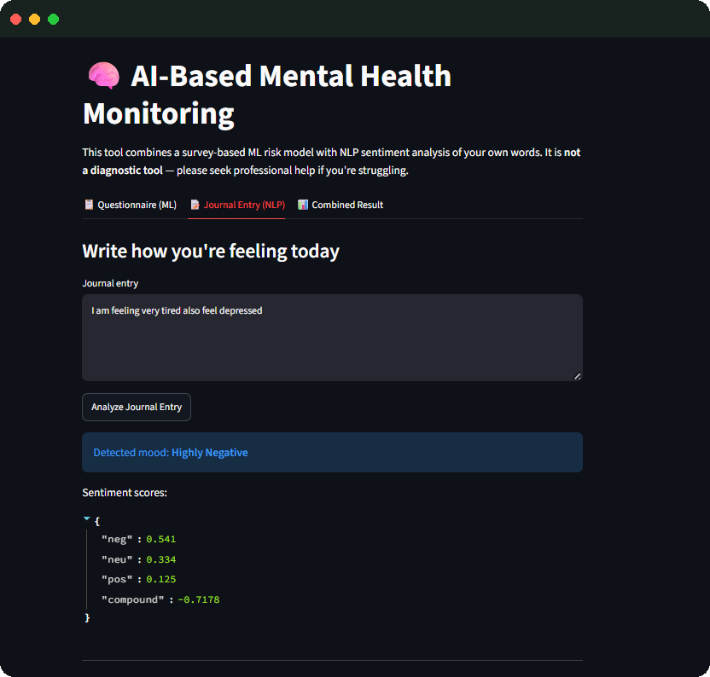
Live App Demo
Step 3 — Journal Entry (NLP)
The user writes freely about how they feel. VADER breaks the text into negative, neutral, and positive components and returns a compound mood score.
"I am feeling very tired, also feel depressed."
Detected mood: Highly Negative

Slide 12
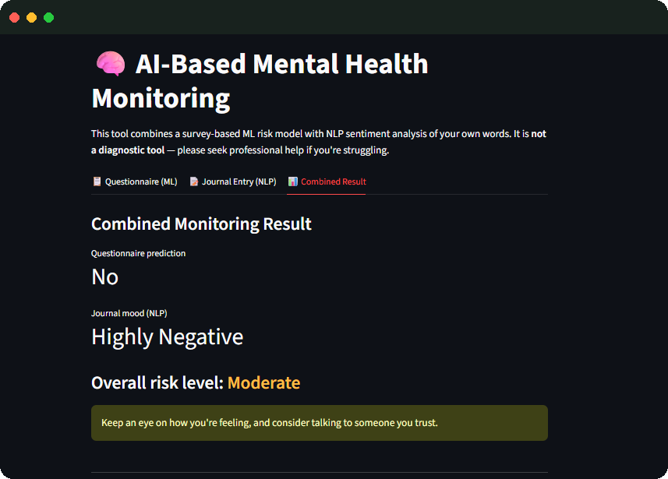
Live App Demo
Step 4 — Combined Risk Result
The questionnaire prediction and journal mood are merged into one overall risk level, with supportive guidance shown to the user.
Overall risk level: Moderate
“Keep an eye on how you're feeling, and consider talking to someone you trust.”

Slide 13





Tech Stack & Deployment
From Colab notebook to a live public web app
Python
Scikit-learn
NLTK / VADER
Streamlit
Core language
ML models
NLP sentiment
Web app UI
Deployment Flow
›
›
›
Google Colab
GitHub
Streamlit Cloud
Live App
Train model, save .pkl files
Host app.py, requirements & model files
Auto-builds & deploys from repo
Public URL, anyone can use it

Slide 14
Future Improvements
Where this project can grow next
Cross-Validation
Deeper NLP
Add k-fold cross-validation for more statistically robust model comparison.
Upgrade to a transformer-based emotion classifier for finer-grained mood detection.
Mood History
Multi-language
Add a dashboard so returning users can track their mood trends over time.
Extend journal sentiment analysis to support multiple languages.

Slide 15

Thank You
AI-Based Mental Health Monitoring System

