Slide 1
General Description of the BMS Unit:
Battery management system (BMS) is a device that monitors and controls each cell in the battery pack by measuring its parameters.
The capacity of the battery pack differs from one cell to another and this increases with number of charging/discharging cycles.
The Li-poly batteries are fully charged at typical cell voltage 4.16 - 4.20 V.
Due to the different capacity this voltage is not reached at the same time for all cells in the pack.
The lower the capacity the sooner this voltage is reached. When charging series connected batteries with single charger, the voltage on some cells might be higher than maximum allowed charging voltage at the end of charging.
Overcharging the cell additionally lowers its capacity and number of charging cycles.
The BMS equalizes cells’ voltage by diverting some of the charging current from higher voltage cells – passive balancing.
The device temperature is measured to protect the circuit from over-heating due to the passive balancing. Battery pack temperature is monitored by Dallas DS18B20 digital temperature sensor/s.
Maximum 8 temperature sensors per Slave unit may be used.
Current is measured by low-side shunt resistor. Battery pack current, temperature and cell’s voltage determine state of charge (SOC).
State of health (SOH) is determined by comparing cell’s current parameters with the parameters of the new battery pack.

Slide 2
DS18B20 Sensor Technical specs:
Usable temperature range: -55 to 125°C (-67°F to +257°F)
9 to 12 bit selectable resolution
Uses 1-Wire interface- requires only one digital pin for communication
Unique 64 bit ID burned into chip
Multiple sensors can share one pin
±0.5°C Accuracy from -10°C to +85°C
Temperature-limit alarm system
Query time is less than 750ms
Usable with 3.0V to 5.5V power/data

Slide 3
SYSTEM SPECIFICATION
Connection | Description
Temperature connector | DALLAS 18B20 temp. sensor pins (pin 2) |  | GND + shield
Temperature connector | DALLAS 18B20 temp. sensor pins (pin 3) |  | 1-wire digital signal
Temperature connector | DALLAS 18B20 temp. sensor pins (pin 1) |  | + 5 V
Current connector | + Shunt (pin 3) |  | Analog signal
Current connector | - Shunt (pin 1 ) |  | Analog signal
Current connector | Shield (pin 2) |  | Analog signal

Slide 4
CELLS ATTACHEMENT
7 | Cell 1 ground | Analog signal
8 | Cell 1 positive | Analog signal
9 | Cell 2 positive | Analog signal
10 | Cell 3 positive | Analog signal
11 | Cell 4 positive | Analog signal
12 | Cell 5 positive | Analog signal
13 | Cell 6 positive | Analog signal
14 | Cell7 positive | Analog signal
15 | Cell 8 positive | Analog signal
16 | Cell 9 positive | Analog signal
17 | Cell 10 positive | Analog signal
18 | Cell 11 positive | Analog signal
19 | Cell 12 positive | Analog signal
20 | Cell 13 positive | Analog signal
21 | Cell 14 positive | Analog signal
22 | Cell 15 positive | Analog signal

Slide 5
Extra Ports
23 | Charger + 12V | Analog voltage
24 | Charger enable | Analog voltage 0-5V
25 | Charger GND | Analog voltage
26 | Internal Relay | -
27 | Internal Relay | -

Slide 6
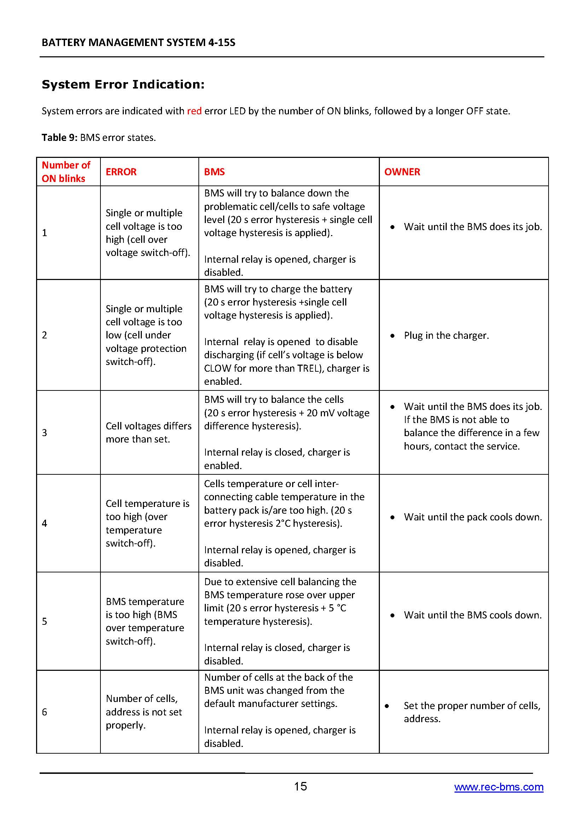

Slide 8
