Slide 1

Website(Real time data)
or
Messaging
(Hourly updates with updating time options )
Camera
(For Image processing)
Water level sensor
Using Ultrasonic sensor
Chemical sensor
Wi-Fi module
ESP8266 - WRL-13678
Raspberry pi
Board
Humidity (DHT 11)
GSM Module
SIM900A
Temperature Sensor (DHT 11)
Relay driver
+
Relay
Motor Pump
Regulated Power
Supply
5V
Fig : - Block Diagram for Agriculture Automation

Slide 2
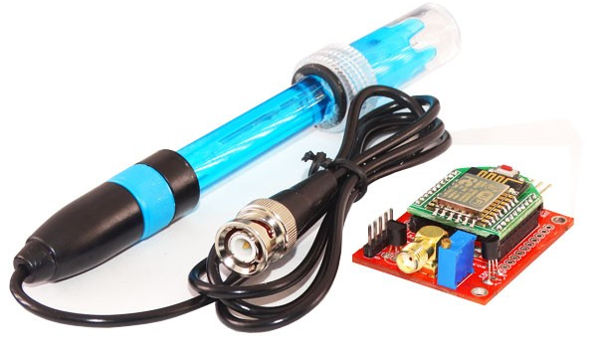
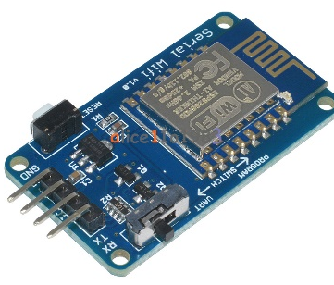
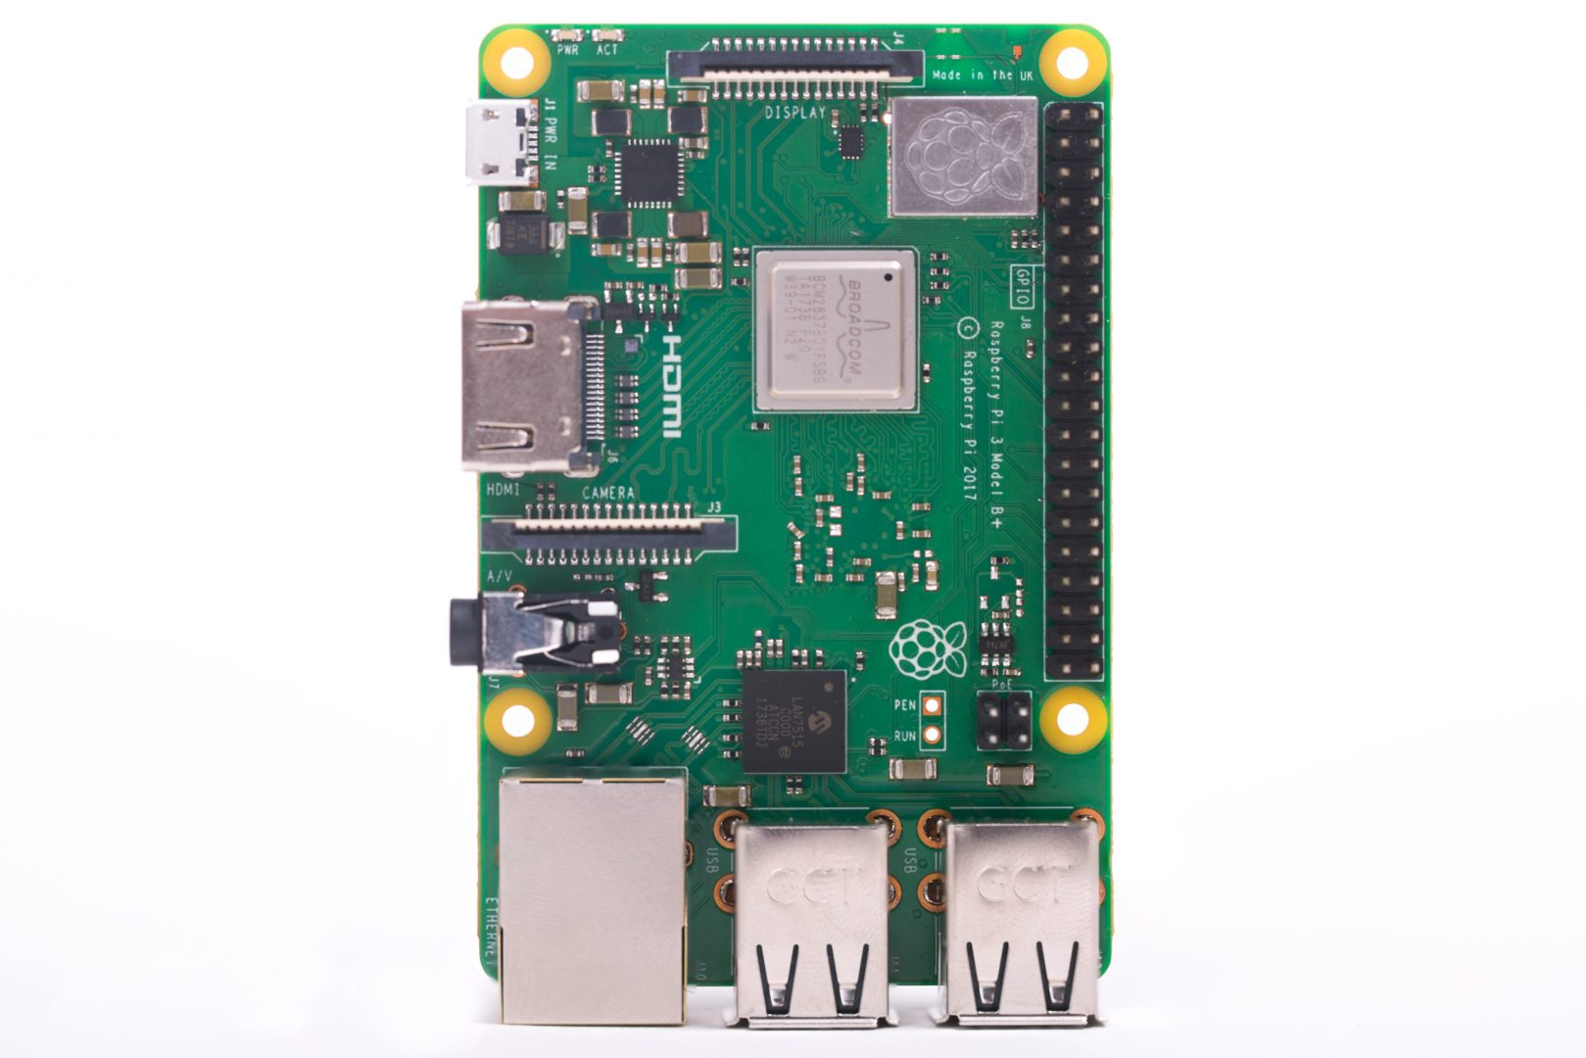
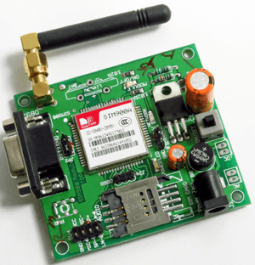
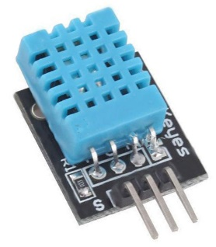
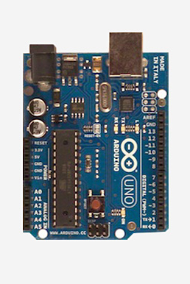
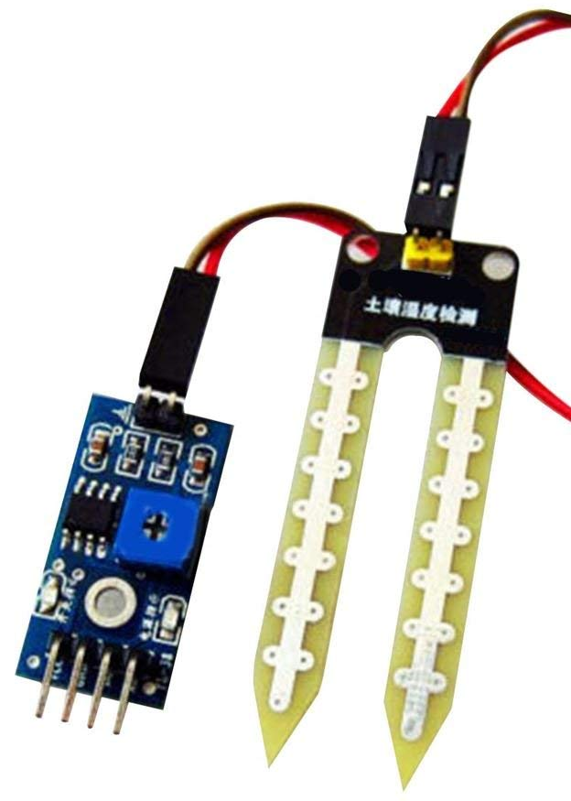
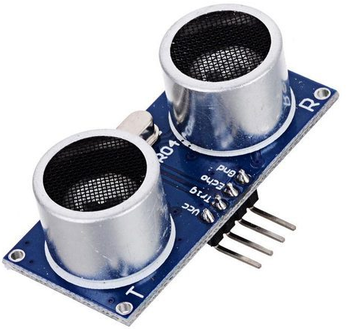
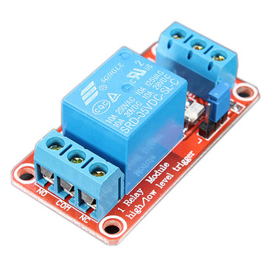
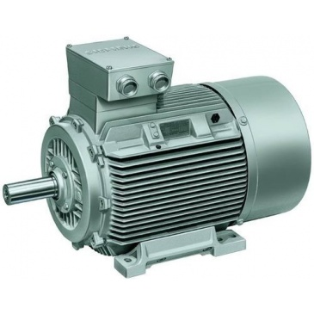
COMPONENTS
REQUIRED
Serial Wifi Module
ESP8266 ESP-12
PH SENSOR MODULE
DHT11 Sensor
Temperature sensor
DHT11 Sensor
Humidity sensor
SIM900A GSM MODEM
MODULE
Raspberry pi Board
Arduino Board
Ultrasonic sensor
For Measuring Water level
Soil Moisture sensor
Relay and Motor

Slide 3
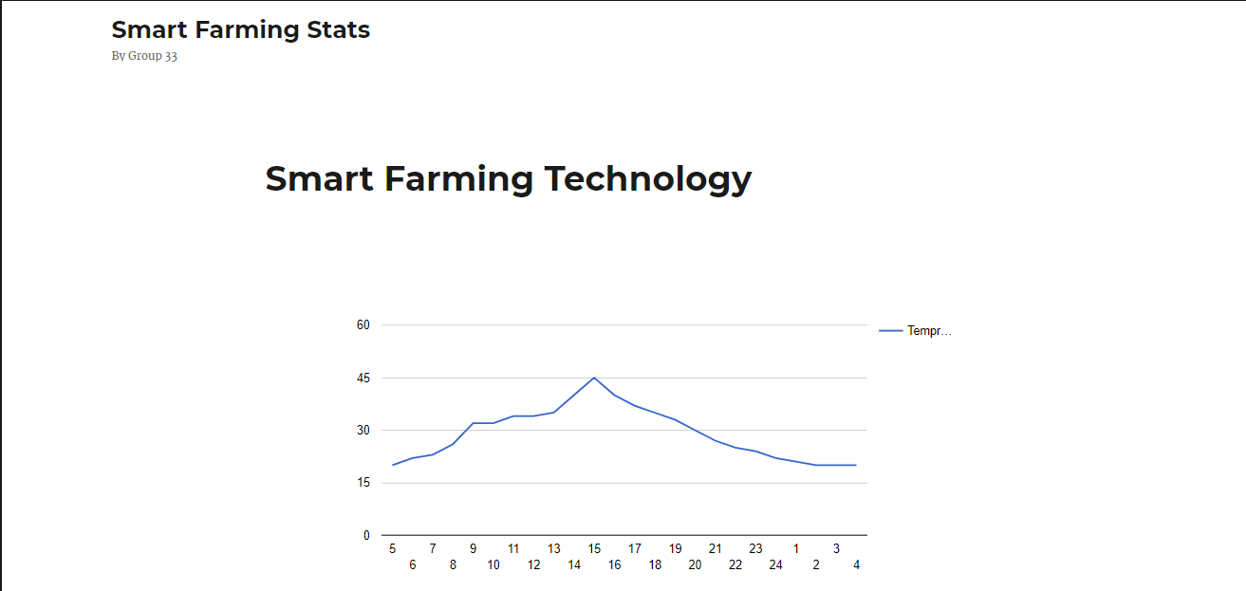
OUPUT WEBSITE

Slide 4
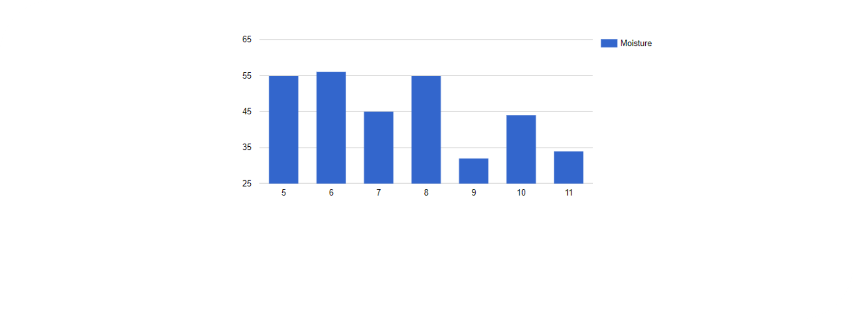


Slide 5
ALGORITHM
START
Type of Signal
ANALOG
DIGITAL
Arduino Uno
Raspberry pi 3
Chemical Sensor
A3 Port
Water Level By Ultrasonic sensor
A1 Port
PH sensor
A0 port
Soil moisture sensor
A4 port
Humidity sensor
(GPIO 2)
Temperature sensor
(GPIO 3)
OUTPUT ON WEBSITE
Is Signal digital
YES
NO
Critical Level?
GSM MODULE
SIM900
SMS on mobile
NO
STOP

