Slide 1

SRES’ SANJIVANI COLLEGE OF ENGINEERING, KOPARGAON 423 603(M.S.)
PROJECT [STAGE-I] PRESENTATION
ON
“DIGITIZATION OF BATTERY MANAGEMENT SYSTEM & CHARGING BY SOLAR PANEL”
Notes:
NOTE:
To change the image on this slide, select the picture and delete it. Then click the Pictures icon in the placeholder to insert your own image.

Slide 2
Content
Slide No.
Project Definition 1
Project Objectives 2
Literature Survey 3
System Overview 4
System Features 5
Hardware Specifications 6
Algorithm 7
References 8

Slide 3
Project Definition
Domain / Field of specialization:
Power Electronics and drives / Battery System Engineering / Control System / IoT.
Project Definition:
The aim of this project is to digitalized the energy storing, dissipating, controlling and converting system (like batteries, Battery Management System and Solar Panel Respectively) by introducing concept of “Internet of Things” (IoT), Cloud Computing and displaying it on display (i.e. on Website / Local monitor LCD display) and make it simple to understand and manageable to the consumer.

Slide 4
Project objectives
To monitor & control each cell in the battery pack by measuring its parameters.
To control and monitor the charge & discharge current going into and out of the battery pack.
To limit the overcharging and undercharging of cells.
To maintain safe operation of the pack.
To Monitor the cells temperature and control the thermal management systems to maintain the pack within a speciﬁed temperature range.
To efficiently convert the solar energy into the electrical one and preserving it.
To make all above objectives simply understandable and controllable by the consumer by introducing concept of “Internet of Things” (IoT), Cloud Computing and displaying it on display (i.e. on Website / Local monitor LCD display) .

Slide 5

Literature survey
A review of completed and ongoing work on the “Battery Management System” and “Solar System” and “Internet of Things” have been taken from published and unpublished works from print and electronic sources. By referring this content we have observed some things that need to be added in the system which are
Digitization of the working of system.
Real time monitoring of the system.
Simplification in understanding and controlling of system for user.
“Battery System Engineering” by Christopher D. Rahn and Chao-Yang Wang, A John Wiley & Sons Publication year 2013.
This book describes the multidisciplinary area of battery system engineering by providing the background, models, solution techniques and system theory that are necessary for development of the advanced battery management system. Anyone who is interested in learning more about advanced battery system will benefit from this book.

Slide 6

Literature survey
By referring this book we got an tremendous amount of knowledge about battery management system. This book contents the designing of battery management system in consideration with the various battery pack parameters.
“SOLAR POWER ENGINEERING: PROCESSES AND SYSTEM” (2nd edition) by Soteris A. Kalogirou, Elsevier publication.
This book gives an introduction to an solar energy , its operation and how to design it. The material presented in this book covers a large variety of technologies for the conversion of solar energy to provide hot water, heating, cooling, drying, desalination and electricity.
from this book we got an information about solar panel system. How the solar panel works, its construction, operation. In addition to that we got an knowledge about different type of solar panel.

Slide 7
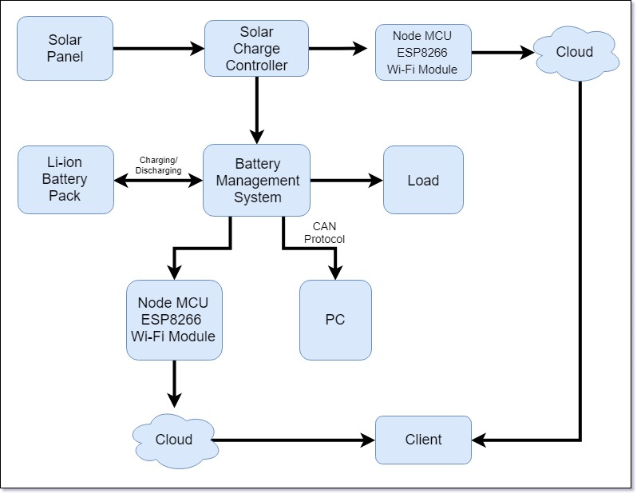
System Overview

Slide 8
System Features
BMS
Robust and small design.
Single cell voltage measurement (0.1 – 5.0 V, resolution 1 mv) .
Single cell - under/over voltage protection.
Single cell internal resistance measurement.
SOC and SOH calculation.
Over temperature protection (up to 8 temperature sensors).
Under temperature charging protection.
Passive cell balancing up to 1.3 A per cell .
Shunt current measurement.
Galvanically isolated user defined multi-purpose digital input/output .
Programmable relay (normally open).
Galvanically isolated rs-485 communication protocol.
CAN communication .
PC user interface for changing the settings and data-logging.
Hibernate switch.

Slide 9
System Features
SOLAR PANELS
Panasonic Module HIT - VBHN325SA16
Efficiency – 19.7%
Temperature Independent.
Having Water Drainage.
SOLAR CHARGE CONTROLLER
NavSemi Energy IMAX40 (48v) MPPT Solar Charge Controller.
Maximization of Solar Energy Harvest.
Higher Power Conversion Efficiency.
Remote Monitoring.
Dual Voltage Operation (12/24V).
Integrated LCD Display.
LED Visual Indications.
High Voltage Protection.

Slide 10
System Features
SOLAR CHARGE CONTROLLER
Panel reversal Protection.
Battery reversal Protection.
Short Circuit Protection.
Open Fuse Protection.

Slide 11
Project Hardware Specifications
BMS
balance start voltage 3.5 V .
balance end voltage 3.6 V.
maximum diverted current per cell up to 1.3 (3.9 Ohm) A.
cell over voltage switch-off 3.8 V.
cell over voltage switch-off hysteresis per cell 0.015 V.
charger end of charge switch-off pack 3.6 V.
cell under voltage protection switch-off 2.2 V.
cell under voltage protection alarm 2.6 V.
cell under voltage protection switch-off timer 4 s.
cells max difference 0.2 V.
BMS maximum pack voltage 62.5 V.
BMS over temperature switch-off 50 °C.
cell over temperature switch-off 60 °.
under temperature charging disable -15 °C.

Slide 12
Project Hardware Specifications
Solar Panel
Rated Power (Pmax)¹ : 325W
Maximum Power Voltage (Vpm) : 57.6V
Maximum Power Current (lpm) : 5.65A
Open Circuit Voltage (Voc) : 69.6V
Short Circuit Current (lsc) : 6.03A
Temperature Coefficient (Pmax): -0. 30%/°C
Temperature Coefficient (Voc) : -0. 174V/°C
Temperature Coefficient (lsc) : 1.82mA/°C
CEC PTS Rating : 301.7W.
Cell Efficiency : 21.76%
Module Efficiency : 19.4%
Watts per Ft.² : 18.0W
Maximum System Voltage : 600V
Weight 40.81 Lbs. (18.5kg)

Slide 13
Project Hardware Specifications
Solar Panel
Dimensions LxWxH 62.6x41.5x1.4 in. (1590x1053x35 mm)
Cable Length +Male/-Female 40.2/40.2 in. (1020/1020 mm)
Cable Size / Type No. 12 AWG / PV Cable
Connector Type2 Multi-Contact® Type IV (MC4™)
Operating Temperature -40°F to 185°F (-40°C to 85°C).
Battery Low Alarm (V) [Yellow LED]: 45.6
Boost cut-off (V): 58.8
Float charge voltage (V): 54.4
Maximum charging current (A): 40
Self-consumption: <1.3 W OTHER
Solar Charge Controller
Maximum Power Handling (Wp): 2000
Maximum Voltage Open Circuit (V): 150

Slide 14
Project Hardware Specifications
Solar Charge Controller
Operating Voltage Range(V): 60-120
Max Short Circuit Current (Isc): 20 A
Typical Battery Voltage (V): 48
Battery Low (V) [Red LED]: 43.2
Battery Low Alarm (V) [Yellow LED]: 45.6
Boost cut-off (V): 58.8
Float charge voltage (V): 54.4
Maximum charging current (A): 40
Self-consumption: <1.3 W OTHER.
Temperature Sensor (DS18B20)
Usable temperature range: -55 to 125°C (-67°F to +257°F).
9 to 12 bit selectable resolution
Uses 1-Wire interface- requires only one digital pin for communication
Unique 64 bit ID burned into chip

Slide 15
Project Hardware Specifications
Temperature Sensor (DS18B20)
Multiple sensors can share one pin
±0.5°C Accuracy from -10°C to +85°C
Temperature-limit alarm system
Query time is less than 750ms
Usable with 3.0V to 5.5V power/data

Slide 16
Add a Slide Title - 3

Slide 17
Thank you…

