Slide 1
TOPIC :-
Types of joints and Workspace

Slide 2
What are Joints…?
A robotic joint provides relative motion between two links of the robot.
Each joint, or axis, provides a certain degree-of-freedom (dof) of motion.
In most of the cases, only one degree-of-freedom is associated with each joint.
Therefore the robot's complexity can be classified according to the total number of degrees-of-freedom they possess.

Slide 3
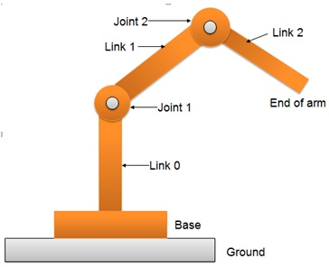
Each joint is connected to two links, an input link and an output link.
Joint provides controlled relative movement between the input link and output link.
A robotic link is the rigid component of the robot manipulator. Most of the robots are mounted upon a stationary base, such as the floor.

Slide 4
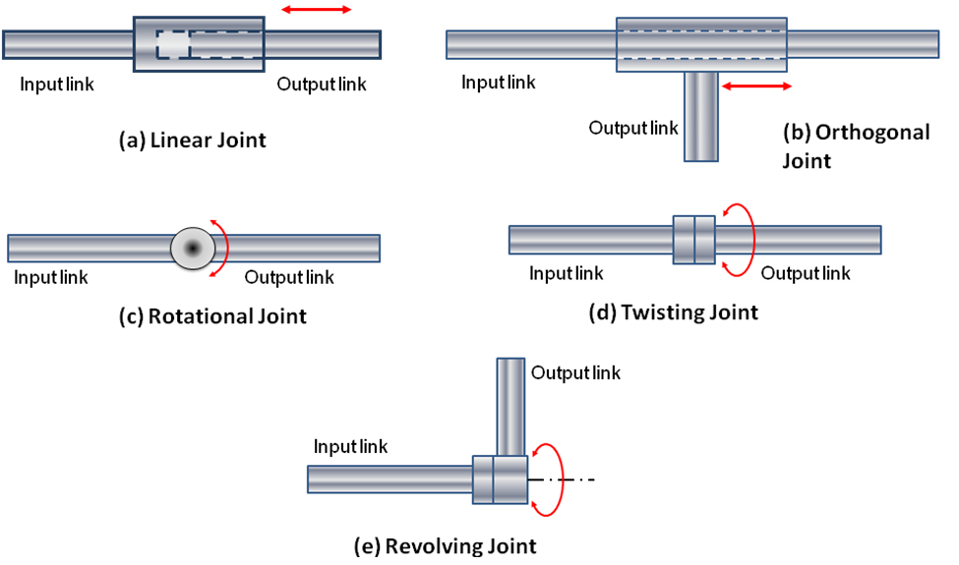
Type of Joints….
Linear joint (type L joint)
The relative movement between the input link and the output link is a translational sliding motion, with the axes of the two links being parallel.
Orthogonal joint (type U joint)
This is also a translational sliding motion, but the input and output links are perpendicular to each other during the move.

Slide 5
Rotational joint (type R joint)
This type provides rotational relative motion, with the axis of rotation perpendicular to the axes of the input and output links.
Twisting joint (type T joint)
This joint also involves rotary motion, but the axis or rotation is parallel to the axes of the two links.
Revolving joint (type V-joint, V from the “v” in revolving)
In this type, axis of input link is parallel to the axis of rotation of the joint. However the axis of the output link is perpendicular to the axis of rotation.

Slide 6
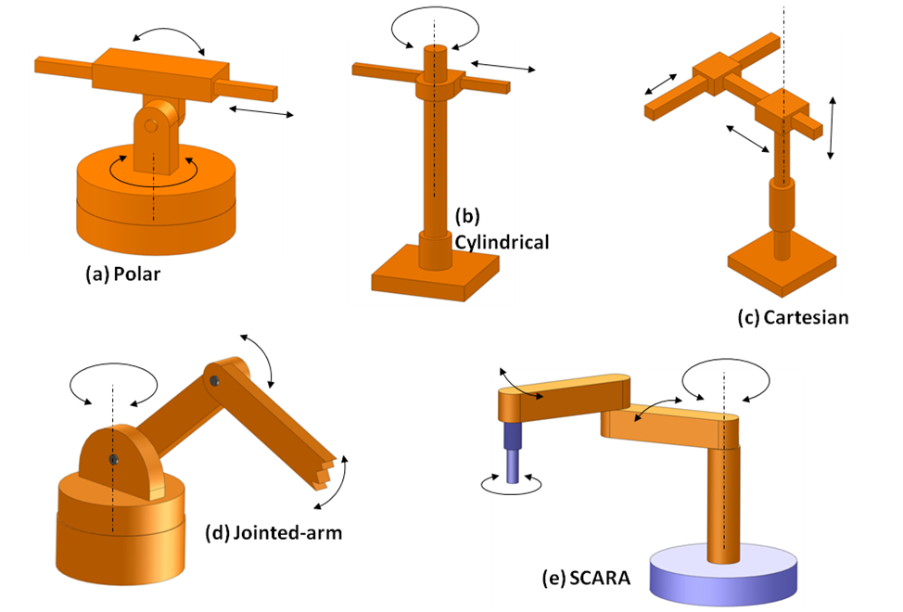
Robot Configuration….

Slide 7
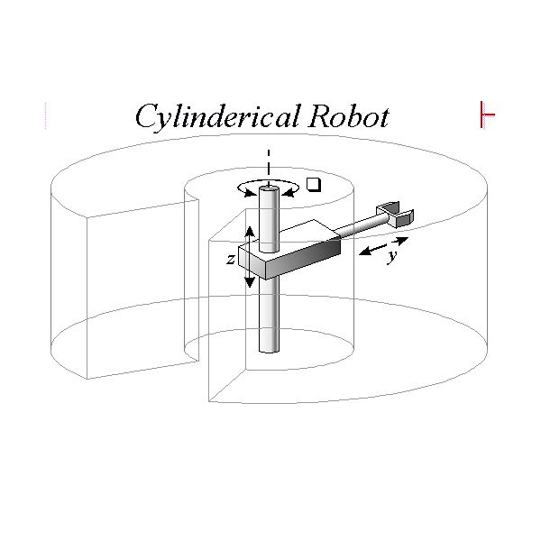
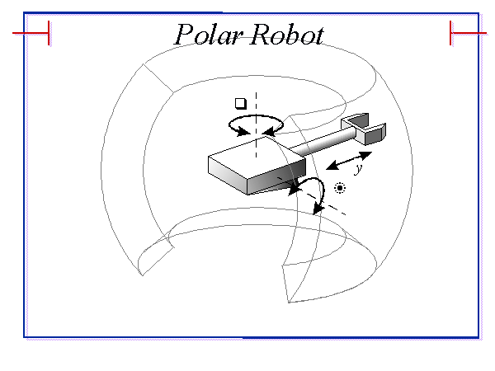
Workspaces of Robots…

Slide 8
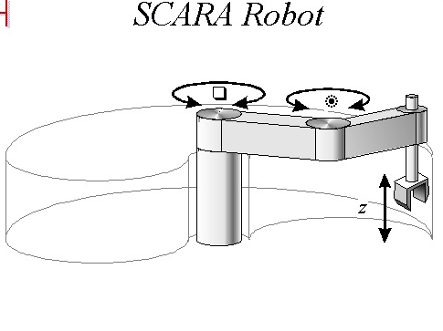
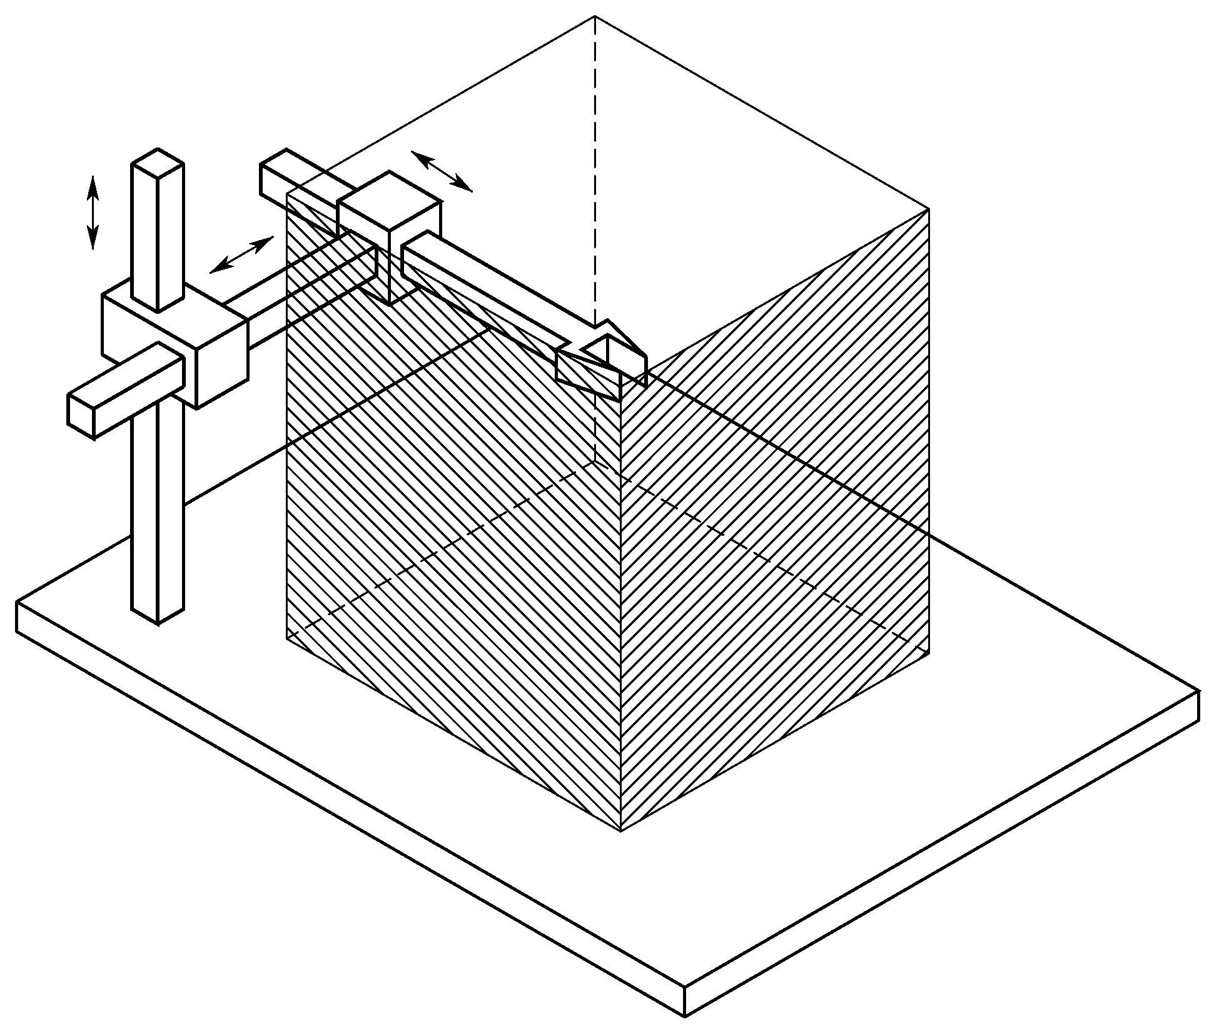
Cartesian Robot

Slide 9
THANK YOU…

