Slide 1
Tabular Q-Learning and Deep Q-Networks on Gymnasium
A controlled comparison on CartPole and a DQN study on LunarLander
Ismael Paredes | Project 01 | November 2026
Notes:
Introduce yourself and the project in one sentence: I compared tabular Q-learning and DQN on CartPole, then studied DQN on LunarLander. Everything is implemented from scratch in Python and PyTorch. (20 seconds)

Slide 2
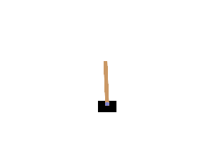
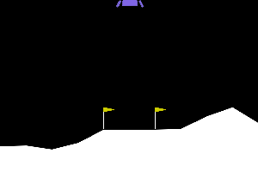
DQN solved both tasks, and the loss decided CartPole
311.0
498.9
72.7
252.9
Best tabular
DQN with MSE loss
DQN with Huber loss
DQN on LunarLander
CartPole, threshold 475. No seed reached it.
CartPole. All 5 seeds above 475.
CartPole. Q-values diverged.
Threshold 200. All 3 seeds above it.
Final return: mean over seeds of 100 greedy episodes after training. Tabular and DQN shared the same steps and exploration schedule.
One episode: return 341
One episode: return 500, first 400 steps shown
One episode: return 283
2
Notes:
Start with the answer. On CartPole, no tabular configuration reached the 475 threshold; the best averaged 311. DQN reached it on all 5 seeds. But the same DQN with a Huber loss failed completely, at 72.7. On LunarLander, the base DQN reached the 200 threshold. The clips show one episode of each trained agent, as an illustration only. The rest of the talk explains why. (1 minute)

Slide 3
Each method fits a different kind of problem
Task | Observations | Actions | Fit
CartPole-v1 | 4 continuous | 2 discrete | Tabular and DQN
LunarLander-v3 | 8 continuous | 4 discrete | DQN (10 bins would give 10^8 states)
Ant (MuJoCo) | 105 continuous | 8 continuous | PPO, SAC, TD3 (11 bins: 214M actions)
Tabular Q-learning
DQN
Uniform bins per dimension
One value per state and action
Bin limits taken from measured data
Two hidden layers of 128 units
Replay buffer and target network
Same training loop as the tabular agent
3
Notes:
The state and action spaces decide what is possible. CartPole has four dimensions, so it can be discretized. LunarLander would need 10 to the 8 states at 10 bins, so only DQN is practical. Ant is continuous with 8 joints: 11 bins per joint gives 214 million actions, so neither method works, and PPO, SAC or TD3 fit better. Both agents run through the same training loop, so the comparison changes only the learner. (1 minute 15)

Slide 4
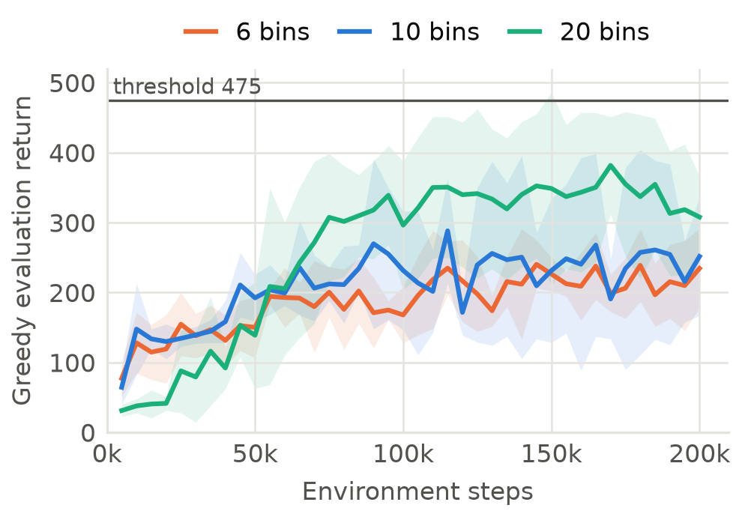
More bins help, but the table fills slowly
Bins | Return | Visited
6 | 235.4 | 39.3%
10 | 253.3 | 17.1%
20 | 311.0 | 2.9%
10, narrow | 310.3 | 11.7%
10, wide | 247.0 | 11.5%
Limits matter as well as bin count
Differences are small against seed variance (65 to 125)
4
Notes:
Every configuration learned, compared with 22.6 for a random policy, but none reached 475 in the final evaluation. 20 bins started later and finished higher: it has 160,000 states, and only 2.9 percent were visited. Narrower velocity limits matched 20 bins with half the resolution; my hypothesis is that they place the bins near balance, where a good policy lives. With 5 seeds, 6 and 10 bins cannot be told apart. (1 minute 15)

Slide 5
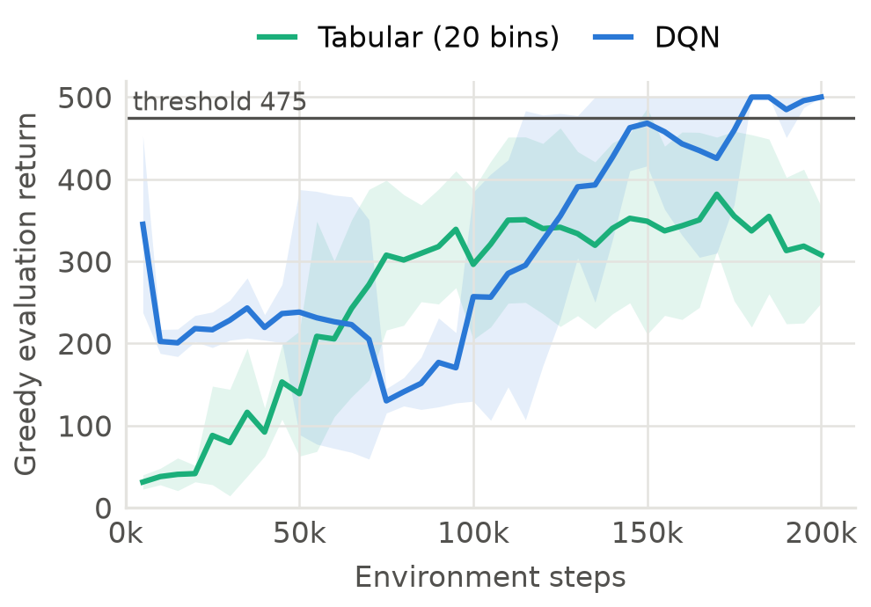
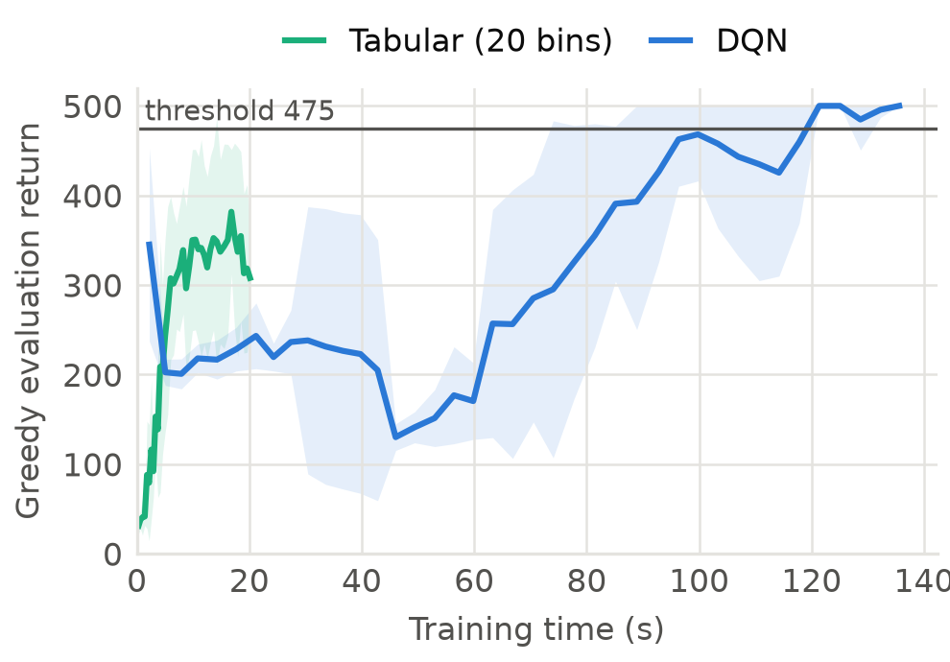
DQN ends higher, but the table is seven times cheaper
Per step: the lead changes twice, then DQN wins
Per second: 20 s for tabular, 136 s for DQN
5
Notes:
On the same steps, the lead changes. DQN is ahead until about 65k steps, tabular until about 125k, then DQN wins clearly. In time the picture is different: a tabular run takes 20 seconds and a DQN run 136. Tabular averaged 300 after 6 seconds; DQN held that level from 78 seconds. A table updates one entry per transition and cannot generalize. A network shares information between similar states and reuses data through replay, at a higher cost per step. (1 minute 15)

Slide 6
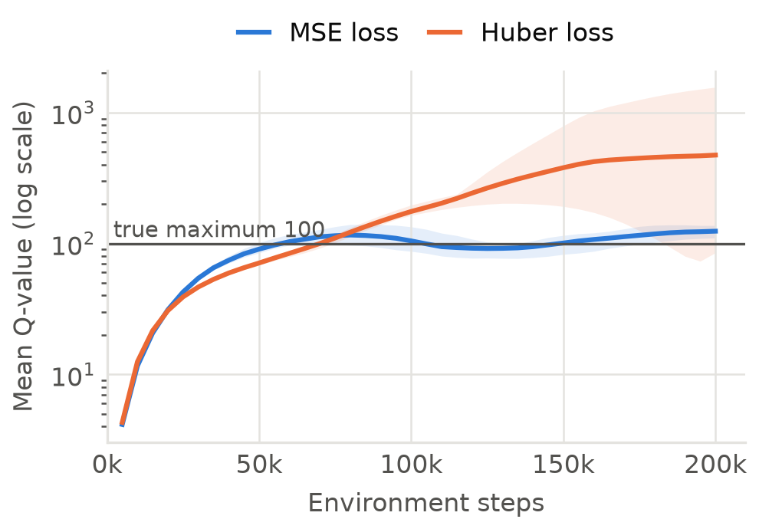
A Huber loss made the Q-values diverge
Symptom
Mean Q peaked at 202 to 1564; the true maximum is 100
Test
Changing only the loss: 72.7 to 498.9
Known Q-values recovered, so not a bug
Hypothesis, not measured
Only terminal transitions pull values down, and Huber caps their gradient
6
Notes:
This was the most useful result. With reward 1 and gamma 0.99, no value can exceed 100. Yet with Huber loss the mean Q peaked between 202 and 1564. First I checked for a bug: the agent recovers known Q-values on a small chain. My first explanation, slow exploration, was wrong: MSE worked with the same schedule. Changing only the loss fixed it. My explanation is that terminal transitions are the only thing pulling values down here, and Huber caps their gradient. That part is a hypothesis I did not measure, and it does not mean Huber is bad in general. (1 minute 30)

Slide 7
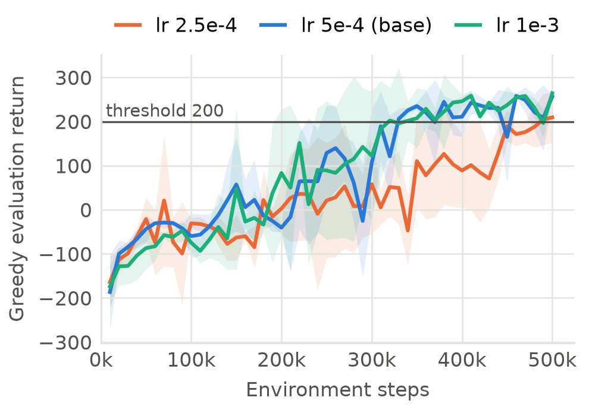
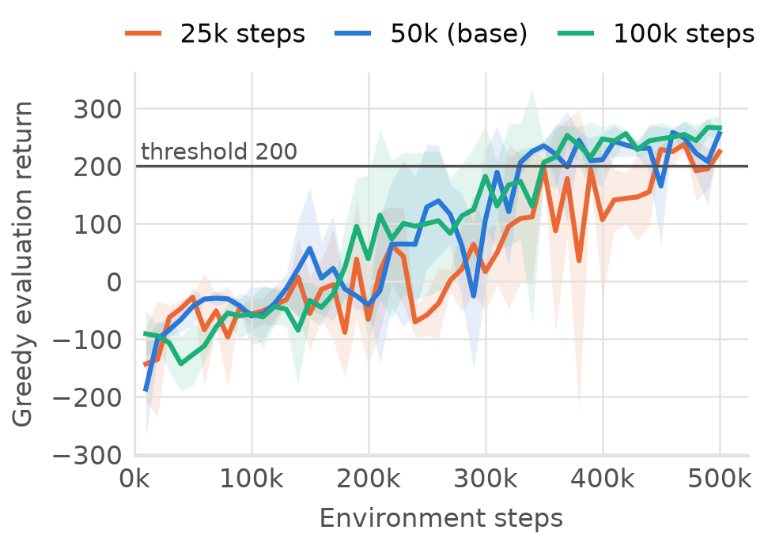
A low learning rate was the only clear weakness
Learning rate: 2.5e-4 gave 175.3, passing on 2 of 3 seeds
Epsilon decay: all three pass, from 224.0 to 258.0
7
Notes:
On LunarLander, the base DQN reached 252.9 on all 3 seeds. I varied one parameter at a time. Halving the learning rate gave 175.3 and missed the threshold on one seed; its final Q-values were much lower, which points to slow learning rather than instability. Doubling it changed little. All three epsilon schedules passed, from 224.0 to 258.0, but with 3 seeds those gaps are within the spread. Learning was slow: mean return stayed near or below zero for most of the first 200k steps. (1 minute 15)

Slide 8
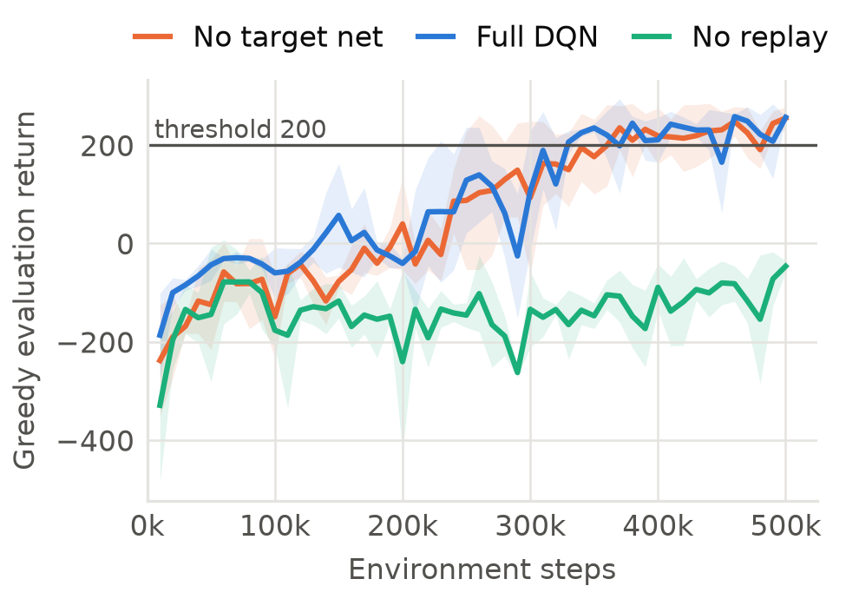
Replay was essential; the target network was not
Configuration | Final return
Full DQN | 252.9
No target network | 234.9
No replay buffer | -34.6
No replay: 0 of 3 seeds pass; correlated data may overwrite earlier learning
No target network: 3 of 3 pass, but later (360k against 250k steps)
3 seeds on one small task, so not a general claim
8
Notes:
This surprised me. Without replay, no seed came near the threshold: the agent only sees its last 64 transitions, which are correlated, and each update can overwrite what it learned about other phases of the landing. Without a target network, all 3 seeds still passed at 234.9, though the median first arrival at 200 was later: 360k against 250k steps. This does not mean target networks are unnecessary in general. It is 3 seeds on a small task. A possible reason is that updates here are small and infrequent, but I did not test that. (1 minute 15)

Slide 9
What this project shows
Takeaways
Limits
Tabular methods are cheap but limited by resolution
DQN goes further, but needs checking: one loss choice decided CartPole
Comparing Q-values with theory exposed the problem
On LunarLander, replay mattered far more than the target network
3 to 5 seeds: small differences are not conclusive
Loss chosen on seeds also reported; tabular not tuned equally
DQN stays unstable; final scores depend on when training stops
AI use: Claude Code helped with code and writing, as disclosed in the paper.
9
Notes:
Three messages. Tabular methods are cheap but limited by resolution. DQN goes further but needs checking: on CartPole one loss choice decided success or failure, and comparing Q-values against the theoretical maximum exposed the problem. On LunarLander, replay mattered far more than the target network. Then state the limits yourself before anyone asks, and mention that AI use is disclosed in the paper. Then close and take questions. (1 minute)

