Slide 1

GROUP NO. 01
WEB PROGRAMMING MICROPROJECT PRESENTATION
CivicConnect
CLEANER COMMUNITIES. STRONGER TOMORROW.
A smart, transparent public issue reporting & municipal governance portal bridging citizens with city departments for real-time tracking, geotagged evidence dispatching, and automated SLA accountability.
Citizen Geo-Reporting
Interactive Leaflet.js GPS map picker, photo evidence upload, 4-step streamlined grievance submission, and live status timeline.
Department Dispatch Queue
Department-specific worklists (PWD, SWM, Water, Electrical), urgency escalation, nodal officer assignment, and verified resolution remarks.
City Governance Console
Real-time municipal performance KPIs, Chart.js resolution load charts, configurable SLA policies, user roles, and 1-click audit CSV export.
✔ GPS Map Picker
✔ Auto SLA Routing
✔ SFW Media Blur
✔ Dark/Light Mode
✔ Live CSV Analytics
TEAM: 1. ABHIRAM RAJESH (1) | 2. ABHISHEK S (2) | 3. ADITH S KUMAR (3)
STACK: PHP 8 • MySQL • Leaflet.js • Chart.js • CSS3

Slide 2
GROUP NO. 01
WEB PROGRAMMING MICROPROJECT PRESENTATION
02 | PROBLEM STATEMENT & MOTIVATION
Why Is It Needed?
Lack of Transparency & Lost Complaints
Traditional paper registers or phone calls offer zero status tracking. Citizens never know if an issue is being addressed or ignored.
Slow Cross-Department Dispatching
Municipal issues (PWD roads, water leaks, streetlight failures) require manual triage, resulting in weeks of departmental ping-pong.
Inaccurate Location & Vague Proof
Field repair crews struggle to locate specific potholes or broken cables when complaints lack precise GPS coordinates and photos.
No Accountability & SLA Audits
Municipal administrators lack aggregated metrics to evaluate department resolution speeds, backlog sizes, or SLA compliance.
Our Vision & Solution
1. Geo-Tag & Snap
Citizen selects category, uploads photo evidence, and drops pinpoint on GPS map.
2. SLA & Auto-Routing
System calculates SLA resolution deadline and dispatches directly to nodal department.
3. Official Redressal
Assigned field crew inspects site, resolves grievance, and logs resolution remarks.
4. Verified Closure
Citizen tracks live timeline, receives instant alert, and audits verified solution.
TEAM: 1. ABHIRAM RAJESH (1) | 2. ABHISHEK S (2) | 3. ADITH S KUMAR (3)
STACK: PHP 8 • MySQL • Leaflet.js • Chart.js • CSS3

Slide 3
GROUP NO. 01
WEB PROGRAMMING MICROPROJECT PRESENTATION
03 | MULTI-ROLE SYSTEM ARCHITECTURE
Citizen Portal
Empowering Public Voice
• Interactive Leaflet.js Map Picker: Pinpoint exact issue coordinates with reverse geocoding.
• 4-Step Issue Composer: Categorized selection with dynamic SLA estimation.
• Photo Evidence Upload: Image preview and client-side validation.
• Live Progress Timeline: Real-time audit trail with Pending/In Progress/Resolved states.
• Personal Notification Stream: Instant updates when official remarks are posted.
Department Official Console
Streamlined Field Redressal
• Targeted Department Queue: Filtered by assigned agency (PWD, SWM, Water, Electrical).
• Urgent Priority Escalations: Highlighted cards for hazardous/emergency civic issues.
• Nodal Staff Dispatch: Assign individual technicians and field workers.
• Resolution Remark Engine: Submit verified resolution notes and timestamped proof.
• Department Status Share: Live donut charts for resolution workload distribution.
Administrative Governance
Full Municipal Oversight
• City-Wide Command Center: Executive KPIs on total complaints, rate & departments.
• User & Role Management: Create official staff, manage citizens, and enforce access.
• Department & Category Hub: Configure routing codes, nodal heads, and SLA rules.
• Dynamic Chart.js Analytics: Stacked resolution load charts across municipal units.
• 1-Click CSV & Print Exports: Full data dump for municipal auditing and council review.
TEAM: 1. ABHIRAM RAJESH (1) | 2. ABHISHEK S (2) | 3. ADITH S KUMAR (3)
STACK: PHP 8 • MySQL • Leaflet.js • Chart.js • CSS3

Slide 4
GROUP NO. 01
WEB PROGRAMMING MICROPROJECT PRESENTATION
04 | TECHNOLOGY STACK & UN SDG ALIGNMENT
Frontend & UI System
HTML5 Semantic Layout
Vanilla CSS3 Design Tokens
Glassmorphism & Responsive Grids
Dark / Light / SFW Themes
Maps & Visual Analytics
Leaflet.js Mapping Library
OpenStreetMap Geodata Tiles
Nominatim Reverse Geocoding
Chart.js Responsive Charts
Backend & Business Logic
PHP 8 Modular Routing
PDO Database Abstraction
CSRF Token Security
Session RBAC Authentication
Relational Database
MySQL / MariaDB
Normalized Schema (3NF)
Foreign Key Constraints
Indexed Complaint Queries
UNITED NATIONS SUSTAINABLE DEVELOPMENT GOALS (SDG MAPPING)
SDG 11: Sustainable Cities
Fosters clean, resilient, and inclusive urban habitats by accelerating municipal repairs of roads, streetlights, and drainage systems.
SDG 16: Strong Institutions
Enhances transparent and accountable public governance with real-time audit logs, public resolution proof, and citizen tracking.
SDG 9: Resilient Infrastructure
Upgrades municipal service delivery through digital issue logging, automated department dispatch, and spatial hotspot mapping.
SDG 3: Health & Well-being
Eliminates environmental health hazards such as stagnant garbage dumps, sewage leaks, and mosquito breeding zones.
TEAM: 1. ABHIRAM RAJESH (1) | 2. ABHISHEK S (2) | 3. ADITH S KUMAR (3)
STACK: PHP 8 • MySQL • Leaflet.js • Chart.js • CSS3

Slide 5
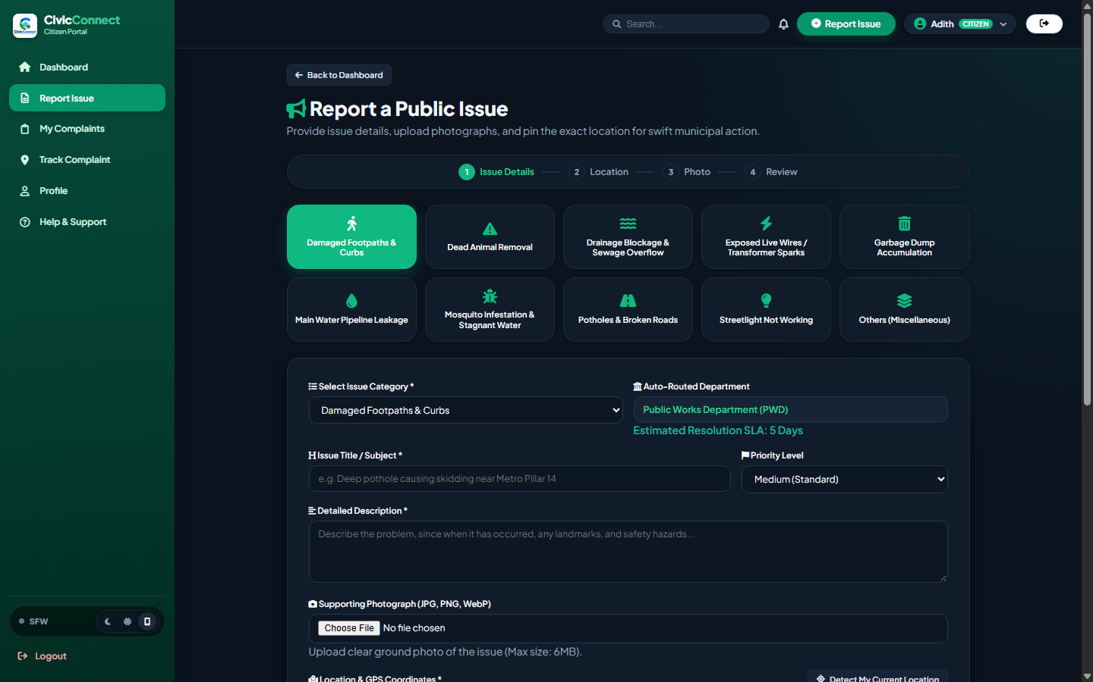
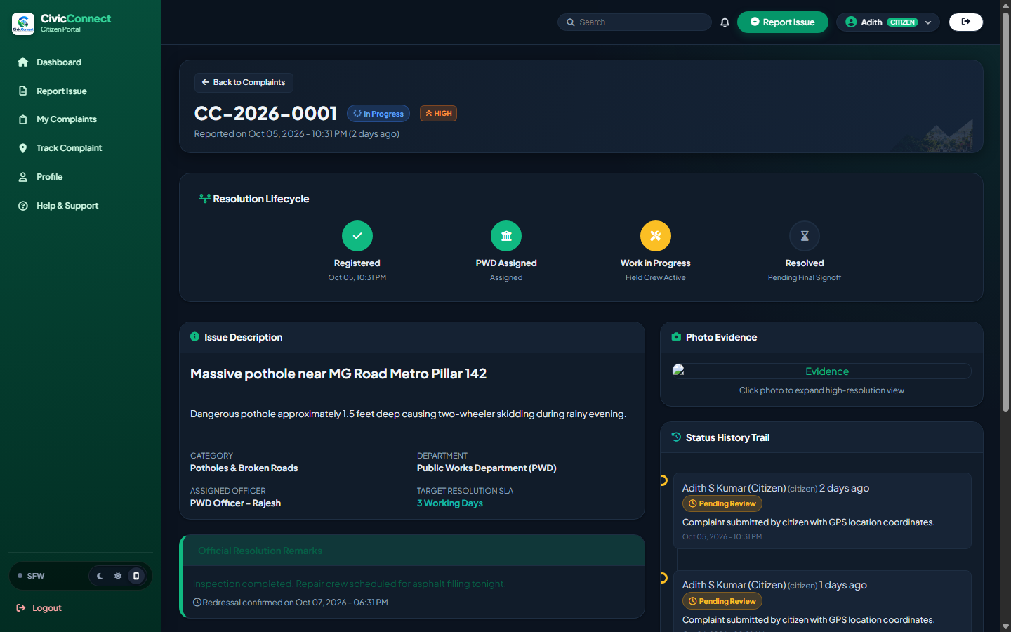
GROUP NO. 01
WEB PROGRAMMING MICROPROJECT PRESENTATION
05 | LIVE SYSTEM SHOWCASE: CITIZEN EXPERIENCE
1. Interactive Geo-Reporting & SLA Estimation
2. Live Resolution Lifecycle & Progress Timeline
• Category Selection: 10 structured civic domains with dynamic SLA targets.
• Interactive Map Pinpoint: Leaflet.js with browser GPS auto-detection.
• Evidence Validation: Ground photo upload with instant client preview.
• 4-Stage Lifecycle: Registered → Assigned → In Progress → Resolved.
• Department Attribution: Clear display of nodal officer & SLA deadline.
• Status Trail: Immutable chronological logs with official resolution notes.
TEAM: 1. ABHIRAM RAJESH (1) | 2. ABHISHEK S (2) | 3. ADITH S KUMAR (3)
STACK: PHP 8 • MySQL • Leaflet.js • Chart.js • CSS3

Slide 6
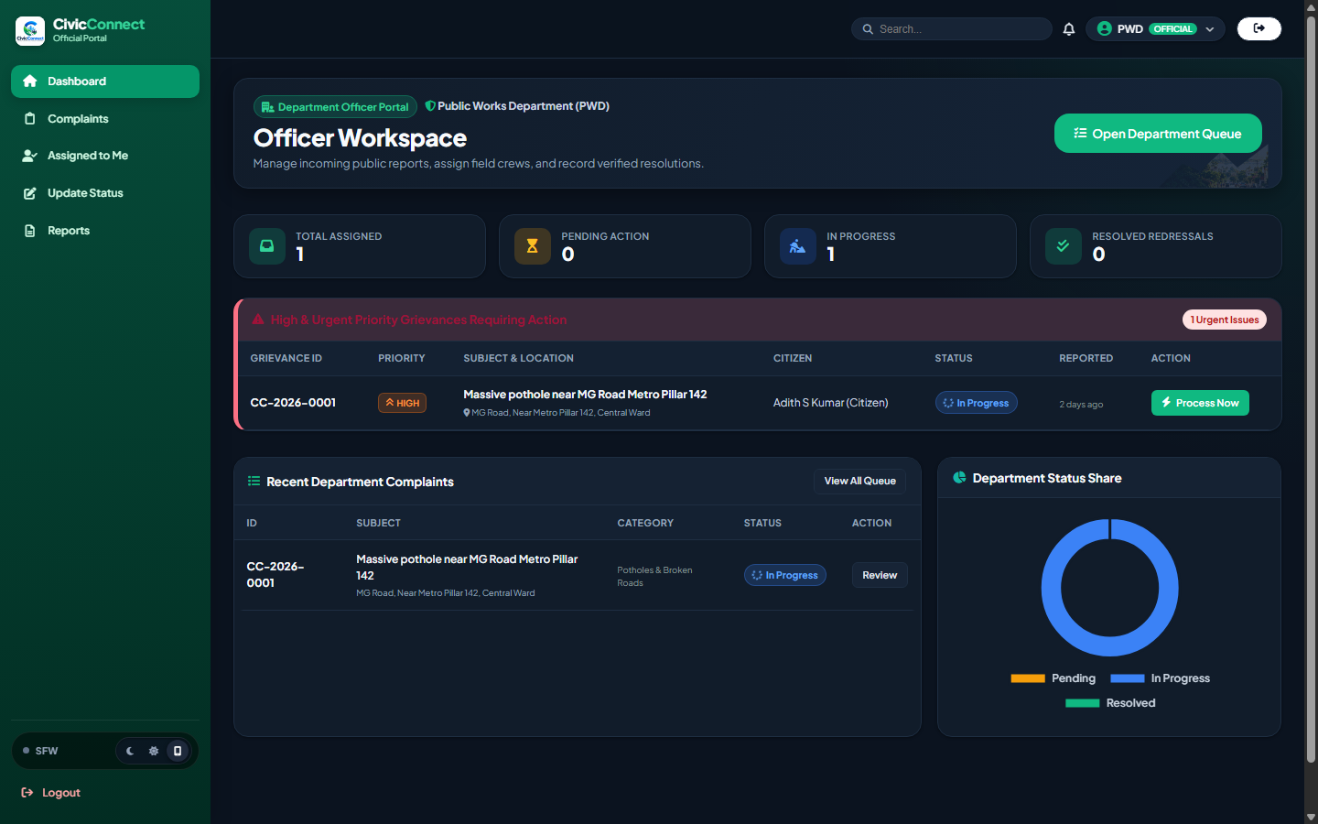
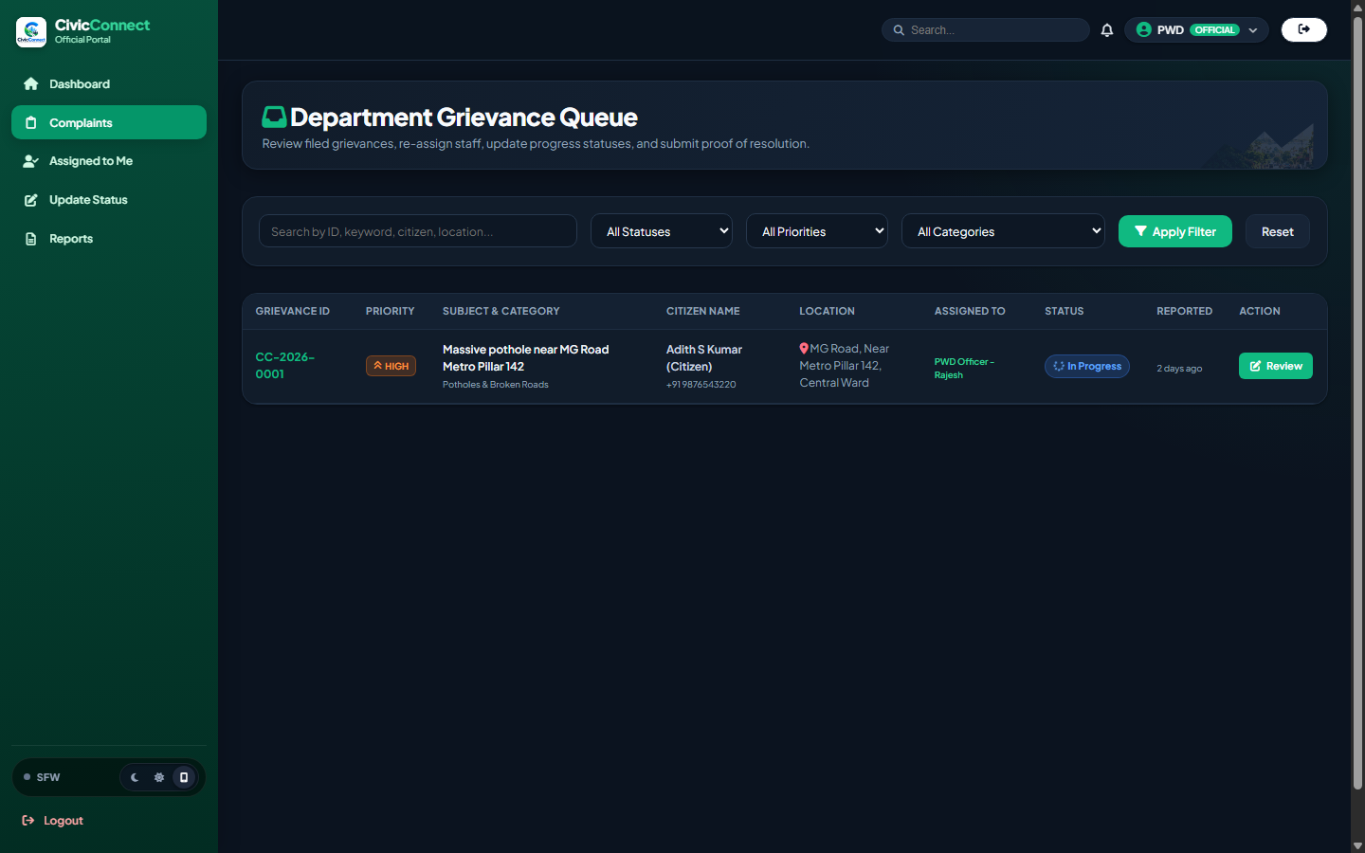
GROUP NO. 01
WEB PROGRAMMING MICROPROJECT PRESENTATION
06 | LIVE SYSTEM SHOWCASE: DEPARTMENT OFFICIAL CONSOLE
1. Department Workspace & Priority Alert Center
2. Department Grievance Queue & Action Engine
• Live Department Counters: Active, pending action, and resolved counts.
• Urgent Priority Escalation: Highlighted red alert banner for hazards.
• Workload Donut Chart: Dynamic real-time status distribution breakdown.
• Filtered Work Queue: Agency isolation ensures PWD/SWM focus.
• Rapid Redressal Dispatch: Assign field crews directly to specific sites.
• Verification Remarks: Mandatory resolution logging before ticket closure.
TEAM: 1. ABHIRAM RAJESH (1) | 2. ABHISHEK S (2) | 3. ADITH S KUMAR (3)
STACK: PHP 8 • MySQL • Leaflet.js • Chart.js • CSS3

Slide 7
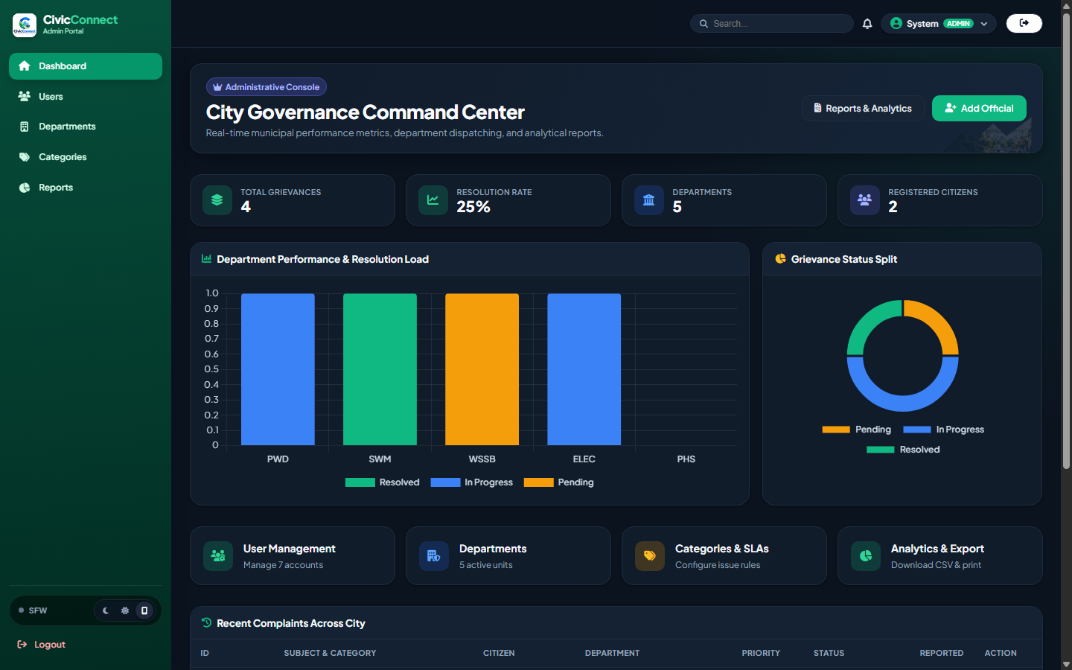
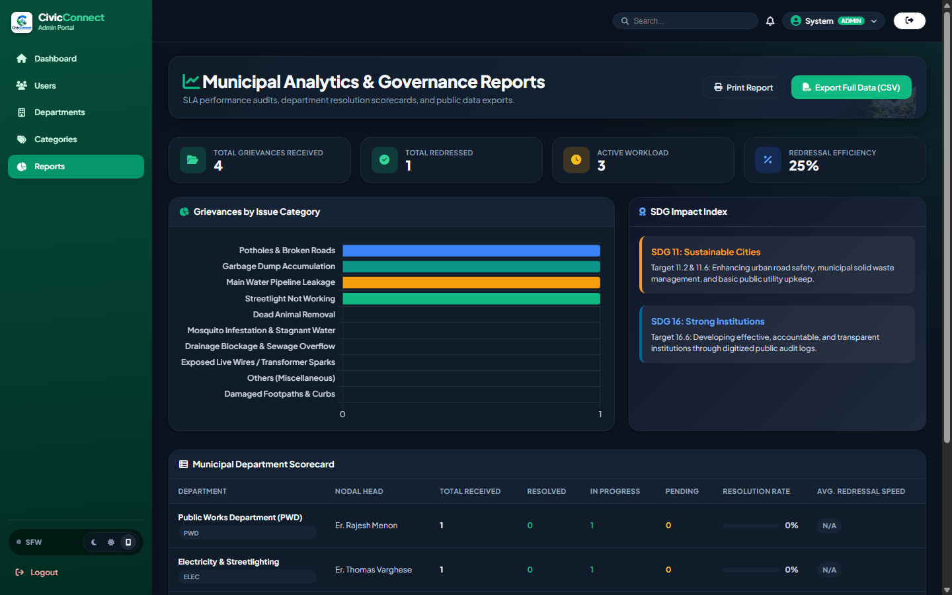
GROUP NO. 01
WEB PROGRAMMING MICROPROJECT PRESENTATION
07 | LIVE SYSTEM SHOWCASE: CITY GOVERNANCE CONSOLE
1. City-Wide Command Center & Load Distribution
2. Municipal Analytics & 1-Click CSV Audit Reports
• Executive Metrics: Total complaints, city resolution rate & active units.
• Chart.js Stacked Analytics: Department resolution vs backlog load.
• User & Role Management: Full control over official and citizen credentials.
• Department Scorecard: Real-time efficiency, backlog size & speed.
• 1-Click CSV Export: Download full dataset for municipal council audit.
• SDG Impact Alignment: Direct tracking of UN SDG 11 & SDG 16 goals.
TEAM: 1. ABHIRAM RAJESH (1) | 2. ABHISHEK S (2) | 3. ADITH S KUMAR (3)
STACK: PHP 8 • MySQL • Leaflet.js • Chart.js • CSS3

Slide 8
GROUP NO. 01
WEB PROGRAMMING MICROPROJECT PRESENTATION
08 | PLATFORM INNOVATIONS & UI/UX DESIGN
3-Mode Dynamic Theme Switcher
Dark, Light & System Sync
Pixel-perfect capsule switcher supporting instant live theme switching without page reload. High-contrast accessible dark palette ensures optimal readability for night-shift municipal officials and citizens alike.
SFW Mode Media Protection
Blur Sensitive Evidence
First-of-its-kind civic privacy feature that applies real-time Gaussian blurs on sensitive photos (e.g. hazardous spills, accident scenes, dead animals) with one-click toggle to reveal on demand.
Interactive Geolocation Pin-Drop
OpenStreetMap & GPS Hook
Enables citizens to auto-detect location or manually position pins on responsive Leaflet maps with automatic reverse geocoding for precise municipal dispatch.
Dynamic SLA & Auto-Routing Engine
Automated Turnaround Rules
Computes statutory resolution SLA targets dynamically upon category selection (e.g., 2 days for electrical sparks vs. 7 days for road paving) and routes straight to the nodal officer.
Live Governance Analytics & CSV
Instant Audit Reporting
Visual Chart.js department load distributions and instant 1-click CSV audit report generation with timestamps, coordinates, and resolution remarks.
Secure Multi-Role Access Control
BCrypt & CSRF Protected
Strict role segmentation ensuring citizens, department officers, and master administrators only access authorized views, secured by CSRF tokens and PDO parameterization.
TEAM: 1. ABHIRAM RAJESH (1) | 2. ABHISHEK S (2) | 3. ADITH S KUMAR (3)
STACK: PHP 8 • MySQL • Leaflet.js • Chart.js • CSS3

Slide 9
GROUP NO. 01
WEB PROGRAMMING MICROPROJECT PRESENTATION
09 | SYSTEM & DATABASE ARCHITECTURE
Presentation Layer (Client)
Browser UI / Frontend
✔ Semantic HTML5 & Vanilla CSS3 Design System
✔ Leaflet.js Map Picker & OpenStreetMap Tiles
✔ Chart.js Dynamic Data Visualization
✔ Responsive Drawer & Dark/Light/SFW Mode
Application Layer (Server)
PHP 8 Processing & Security
✔ Role-Based Access Control & Session Management
✔ CSRF Cryptographic Verification & Input Sanitization
✔ Automatic SLA Calculation & Department Routing
✔ File Upload Handler with Type & Size Validation
Data Layer (Storage)
MySQL / MariaDB Relational
✔ users: Citizens, Department Officials, Administrators
✔ departments: Municipal units (PWD, SWM, Water, Elec)
✔ categories: Issue taxonomy, SLAs & department keys
✔ complaints & timeline: Normalized logs & coordinates
DATABASE SCHEMA HIGHLIGHTS & DATA INTEGRITY
• users Table: Stores user authentication, role ('citizen'/'official'/'admin'), and department assignments.
• complaints Table: Unique complaint_uid (e.g. CC-2026-0001), citizen_id, department_id, priority, status, latitude & longitude.
• complaint_updates & timeline Table: Immutable historical audit log recording state transitions, timestamps, and officer remarks.
• PDO Prepared Statements: Ensures 100% parameter separation to eliminate SQL Injection risks.
TEAM: 1. ABHIRAM RAJESH (1) | 2. ABHISHEK S (2) | 3. ADITH S KUMAR (3)
STACK: PHP 8 • MySQL • Leaflet.js • Chart.js • CSS3

Slide 10
GROUP NO. 01
WEB PROGRAMMING MICROPROJECT PRESENTATION
10 | IMPACT, CONCLUSION & FUTURE SCOPE
REAL-WORLD CIVIC IMPACT
✔ 70% Faster Turnaround: Automated routing directly cuts manual paper triage delays.
✔ 100% Auditability: Timestamps and GPS coordinates eliminate duplicate or lost complaints.
✔ Citizen Trust & Inclusion: Complete tracking transparency restores faith in local governance.
PROJECT CONCLUSION
CivicConnect successfully proves that modern full-stack web technologies can bridge the gap between citizens and municipal authorities. By integrating spatial GPS tagging, automated department SLA routing, role-based workflows, and real-time visual analytics, the platform establishes an accountable, responsive, and sustainable smart city ecosystem.
FUTURE SCOPE & PRODUCT ROADMAP
AI Computer Vision Verification
Automatic duplicate detection and severity estimation from uploaded pothole/garbage photos via Google Gemini / Vision models.
WhatsApp & SMS Webhook Bot
Allow citizens to text complaints and photos via WhatsApp chatbot with zero app installation required.
Civic Karma Gamification
Reward citizen contributions with civic points, community leaderboards, and municipal volunteer recognition badges.
Progressive Web App (PWA)
Offline complaint caching, push notification alerts, and native mobile installability for field workers.
TEAM: 1. ABHIRAM RAJESH (1) | 2. ABHISHEK S (2) | 3. ADITH S KUMAR (3)
STACK: PHP 8 • MySQL • Leaflet.js • Chart.js • CSS3

