Slide 1
Employee Management System
Java
https://github.com/Ciprian1922/Code_Works/tree/main/P3/Employee_Management_System
Popa Ioan-Ciprian

Slide 2
Motivation
Easy to use employee management system with interactive GUI working on a database :D

Slide 3
01
For each onstructor
02
Functionality test
EmployeeManagementGUI
testValidateEmployeeInputValid
testValidateEmployeeInputInvalidId
testValidateEmployeeInputInvalidName
testAddEmployee
Test cases

Slide 4
Chat for multiple users
This uses threads to allow multiple instances for each person that takes part of the chat
Threads

Slide 5
MySql Workbench
MySql Connector
Using this platform I created the users and the tables that are being used in the project
Added the JAR file in the src project in order to create the connection with the program
Database

Slide 6
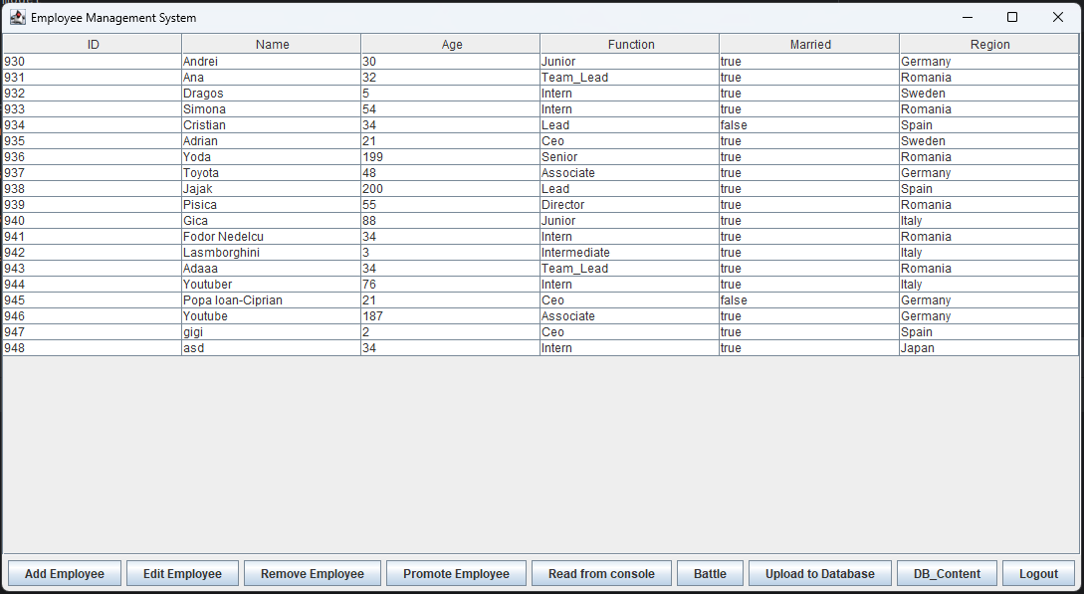
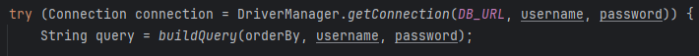
Database content
Multiple conections for multiple instances
Connection

Slide 7
Add / Remove employees
Simple adding / removing operations can be done before uploading the data into the database
Change emp details
After changing data about the employees you can upload it to the database using users that have acces to uploading
Updating data

Slide 8
“angajat” user
This user is having the permission to see all the employees from the database and it can modify them (it has delete permissions)
“averageman” user
This user has restricted acces to the database, it can only load the employees that have Region Romania (only angajat has all privileges) and it cannot upload changes into the database
User roles

Slide 9
Every single input is verified, so there is no place where sql injection can take place.
Validate input data

Slide 10
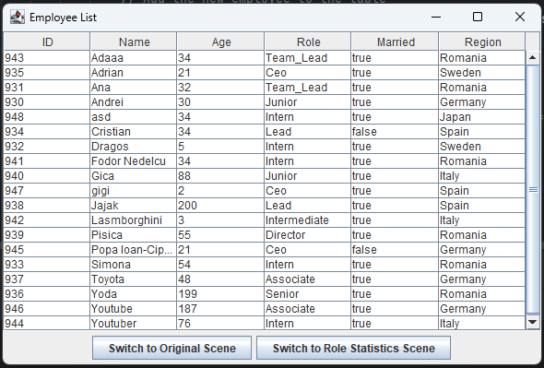
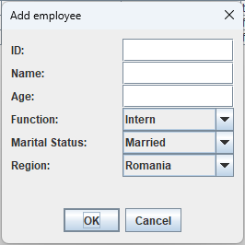
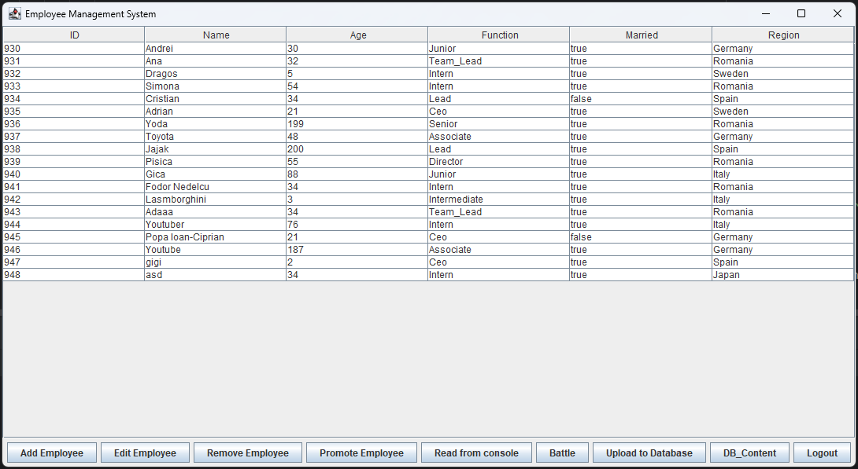
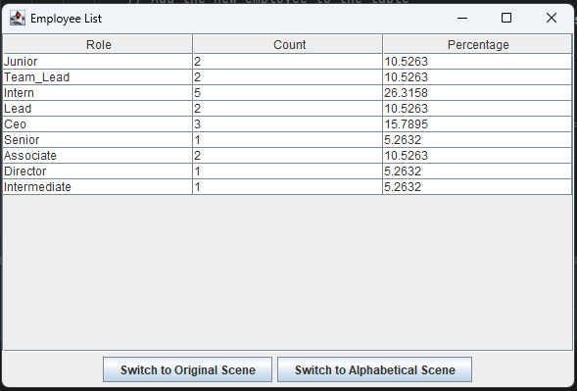
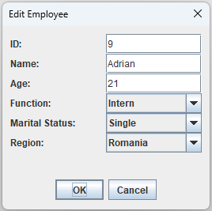
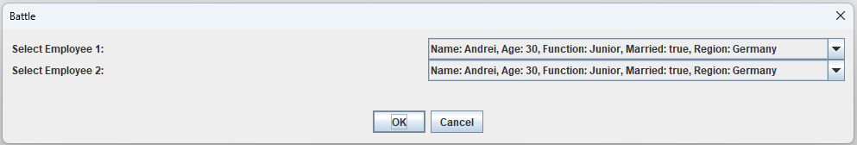
Scenes

Slide 11
END OF
PRESENTATION
Thank you for paying attention!

