Slide 1
Input Feedback GUI for Bank Management System
Efficient Management of Accounts and Transactions using GUI
Popa Ioan-Ciprian

Slide 2
The Problem
Manual banking processes are time-consuming and error-prone
Lack of centralized logs for client transactions
Difficulty in generating clear and concise reports

Slide 3
Proposed Solutions
Implement a real-time GUI Feedback for account and transaction management
Log all client and account activities systematically
Generate detailed, structured reports for audits and reviews

Slide 4
Features of the System
Add and manage clients and accounts
Perform deposits and transfers with real-time balance updates
Generate operation history reports automatically

Slide 5
Example: Adding and Managing Accounts
1. Add a client
2. Create an account with an initial deposit
3. Get real-time Feedback while using the operations
4. Log updates with account number and balance

Slide 6
Example: Performing Transfers
1. Specify source and destination clients/accounts – get real-time feedback
2. Enter transfer amount
3. Log before and after balances for both accounts

Slide 7
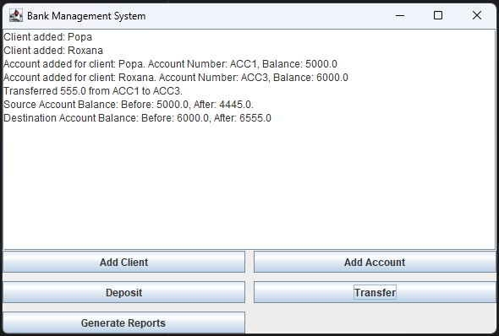
Main GUI

Slide 8
Summary
Simplifies bank operations with a user-friendly GUI
Ensures accurate logging of all activities
Provides actionable insights through structured reports

Slide 9
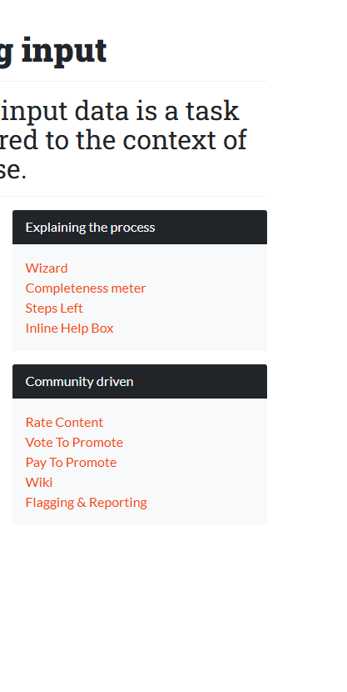
Thank you! That is what I have to do! Getting input

