Slide 1
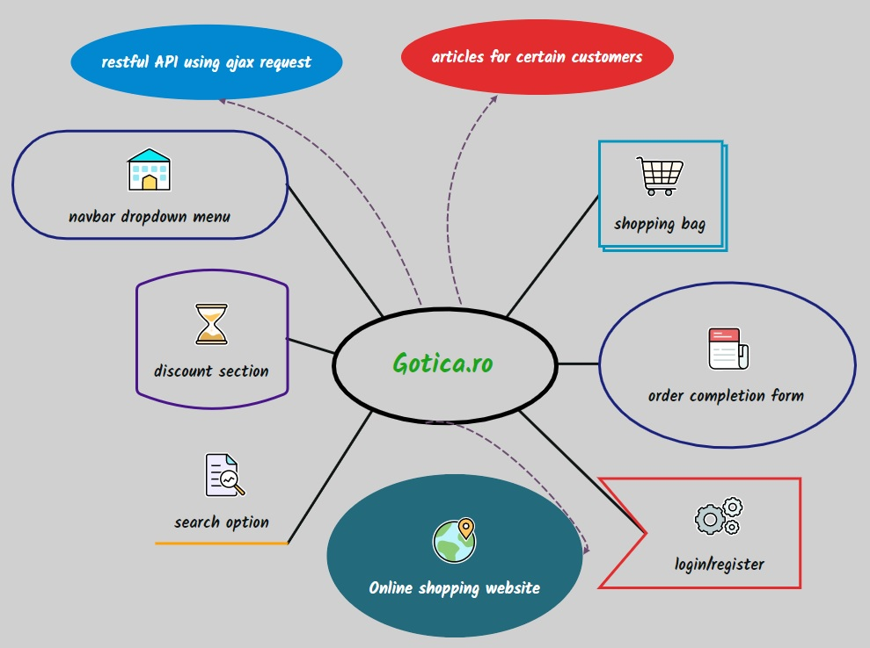

Slide 2
Test approach
Smoke test
Test scope
Test data
Results
Test environment setup
Exploratory testing
Testing tools
Test design techniques

Slide 3











Slide 4
Testing types covered
Functional testing
Smoke testing
Non-functional testing
Exploratory testing
UI testing Login form
Compatibility testing
Exploratory testing
Security testing
Ip register
Clear cookies
Cross-browser testing
Order form
Login

Slide 5

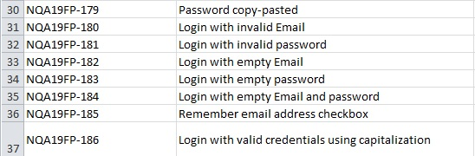
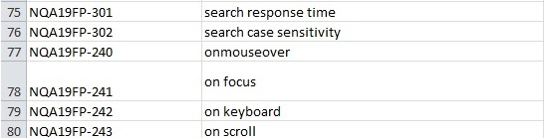
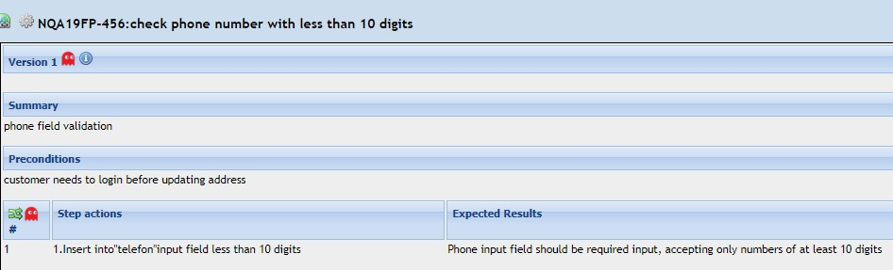

Slide 6
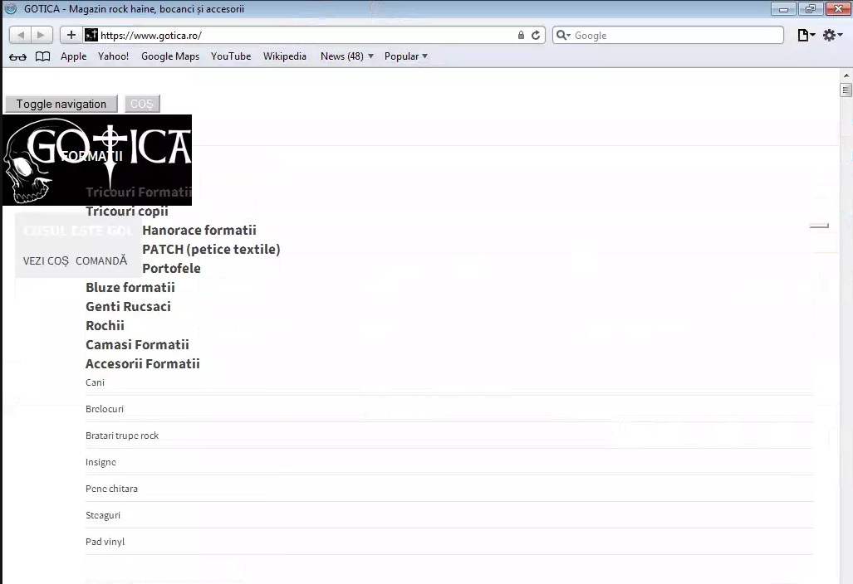
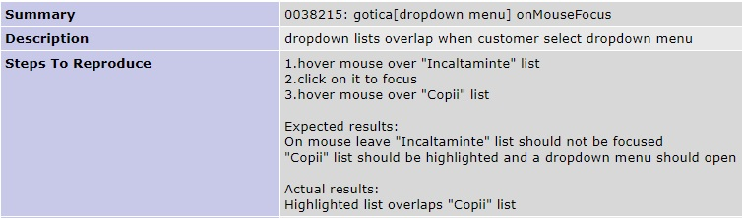
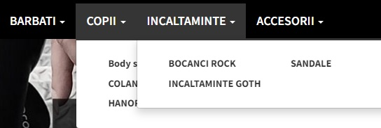
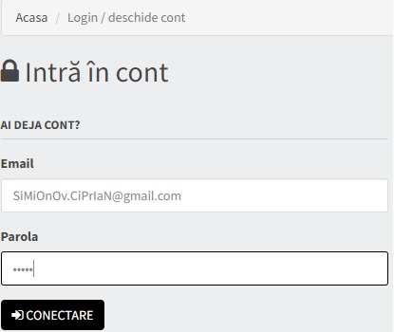
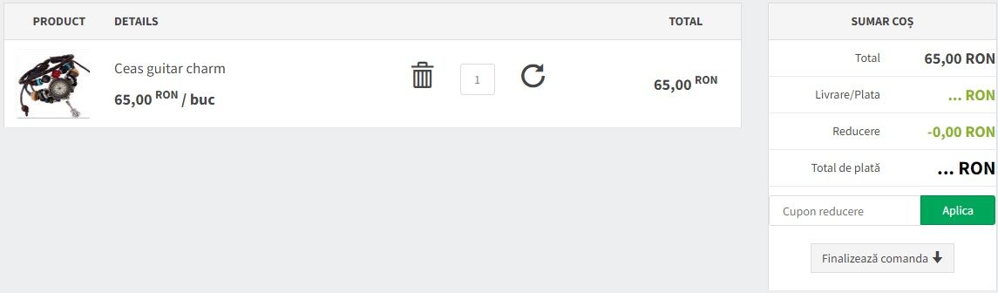

Slide 7
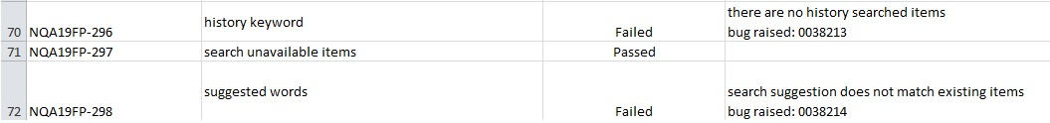
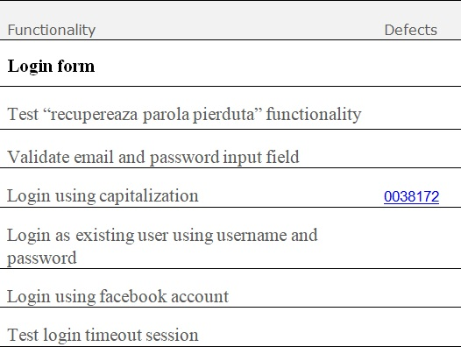
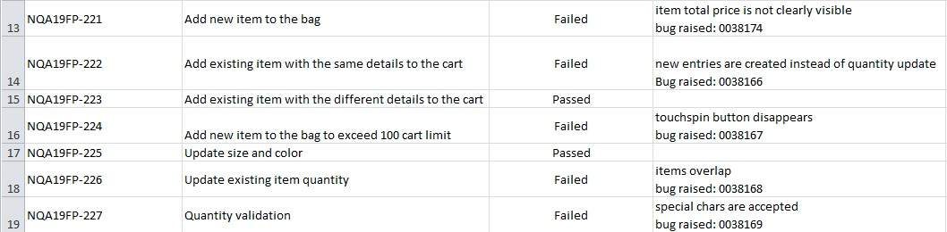

Slide 8

Test report
Submitted for testing during 07.02.2022-25.02.2022
Windows 10 home edition vs 12H1 using Mozilla Firefox vs 65, vs 88, vs 97.0.1,
Chrome vs 81.01.318, vs 98.0.4758.102, vs 70.01.485, vs 98.0.4758.101 ,
Internet Explorer vs 10, 11 and Safari vs 4, 5.1
Linux Ubuntu 20.04.3 LTS using Mozilla firefox as default browser
Android vs 7.0 Nougat, 6.0 Marshmallow, Android 10/ wp6 build
Total testing period: 75h
Testing total: 68 Pass 53 Failed 2 Blocked 1 Not Run
Following Exploratory test session 3 bugs were found
Compatibility testing, cross-browser testing and connectivity testing were run on different environments.
All in all, the application has raised security issues and there are concerns about new release.

Slide 9
Lessons learnt
even if not all testing types or techniques were used, it was a highly practical course
Being well organized helps a lot in goal achievement
Passion
In order to succeed requires positive point of view
Knowledge sharing by using communication skills in a proactive way

