Slide 1
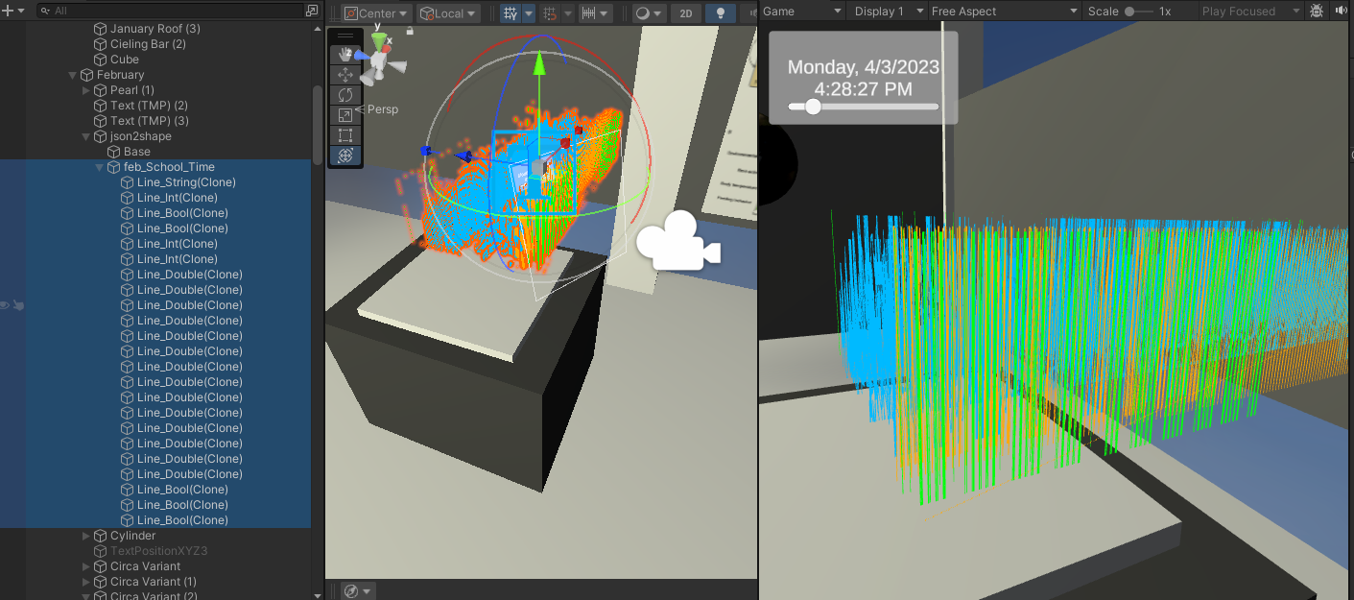

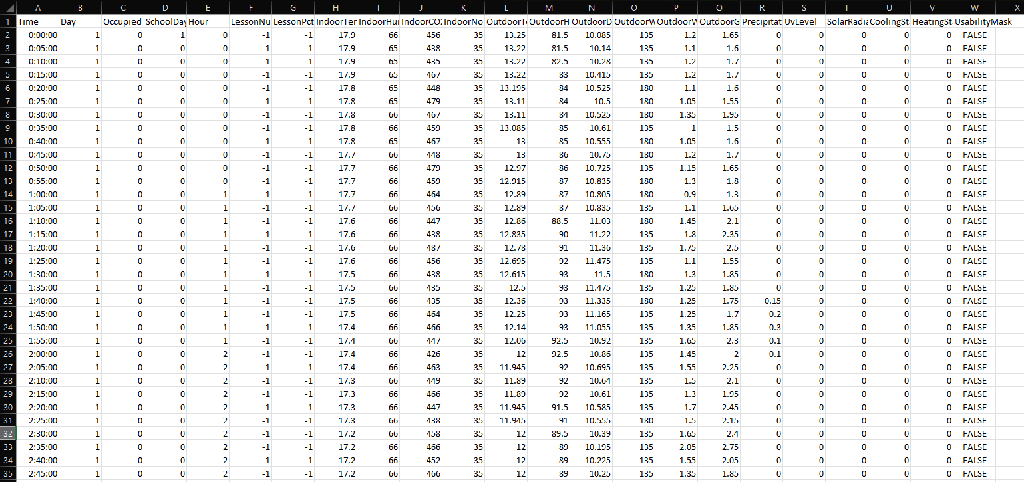
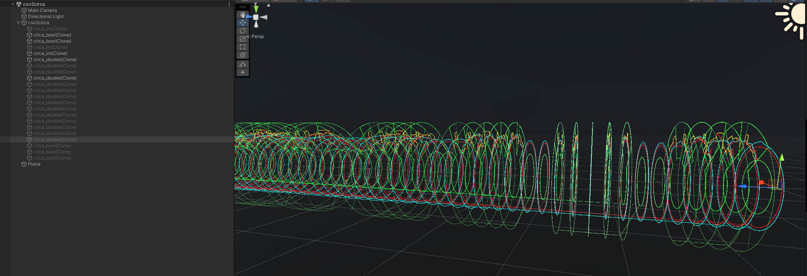

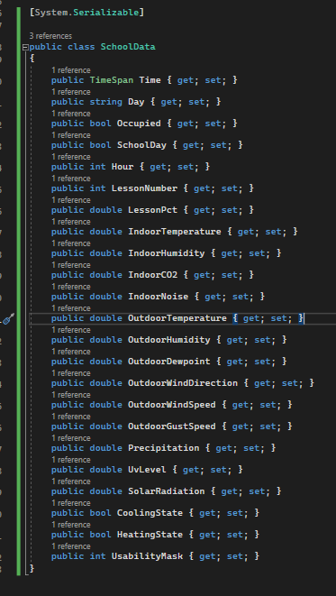
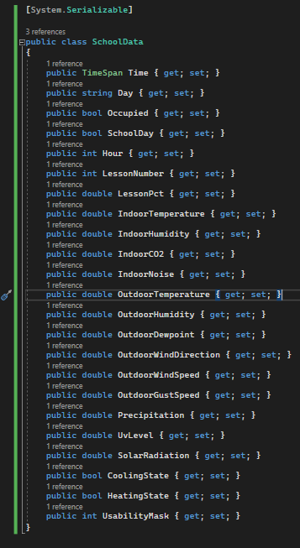
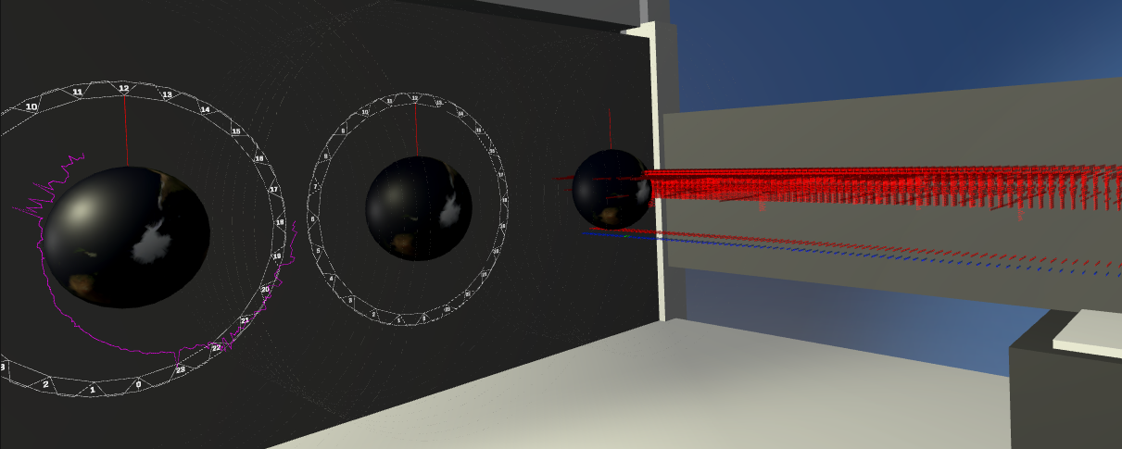
csv2circa
@EarthAdam
In Unity

Slide 2


Agenda
Review Outline
Look at the Data
Build Reader
Build Model
Build LineRenderers

Slide 3



Outline: Adding Scripts to GameObjects
Game Object
(LineRenderer)
Game Object
(LineRenderer)
boolean
boolean
Readers, Models, and LineRenderers
Game Object
(LineRenderer)
Game Object
(LineRenderer)
School Data Model
int
Game Object
int
Health Data Model
Game Object
(LineRenderer)
Game Object
(LineRenderer)
Reader
csv
json
txt
Energy System Data Model
float
double
Game Object
(LineRenderer)
string

Slide 4
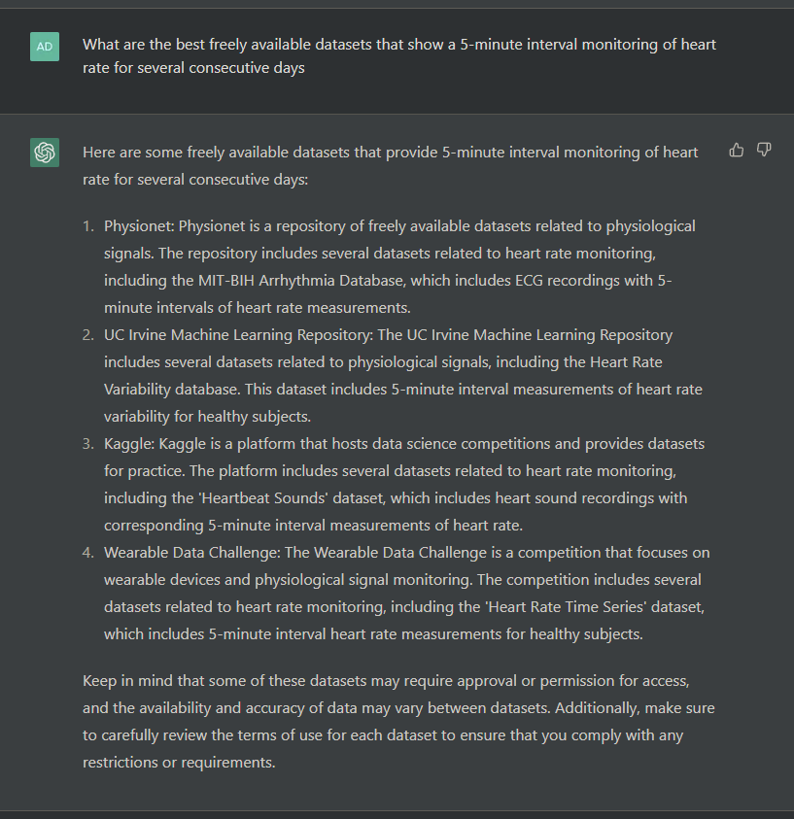
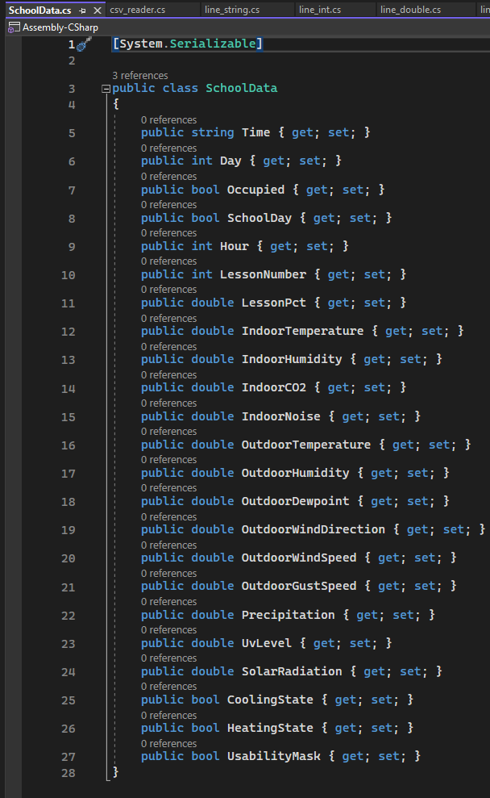
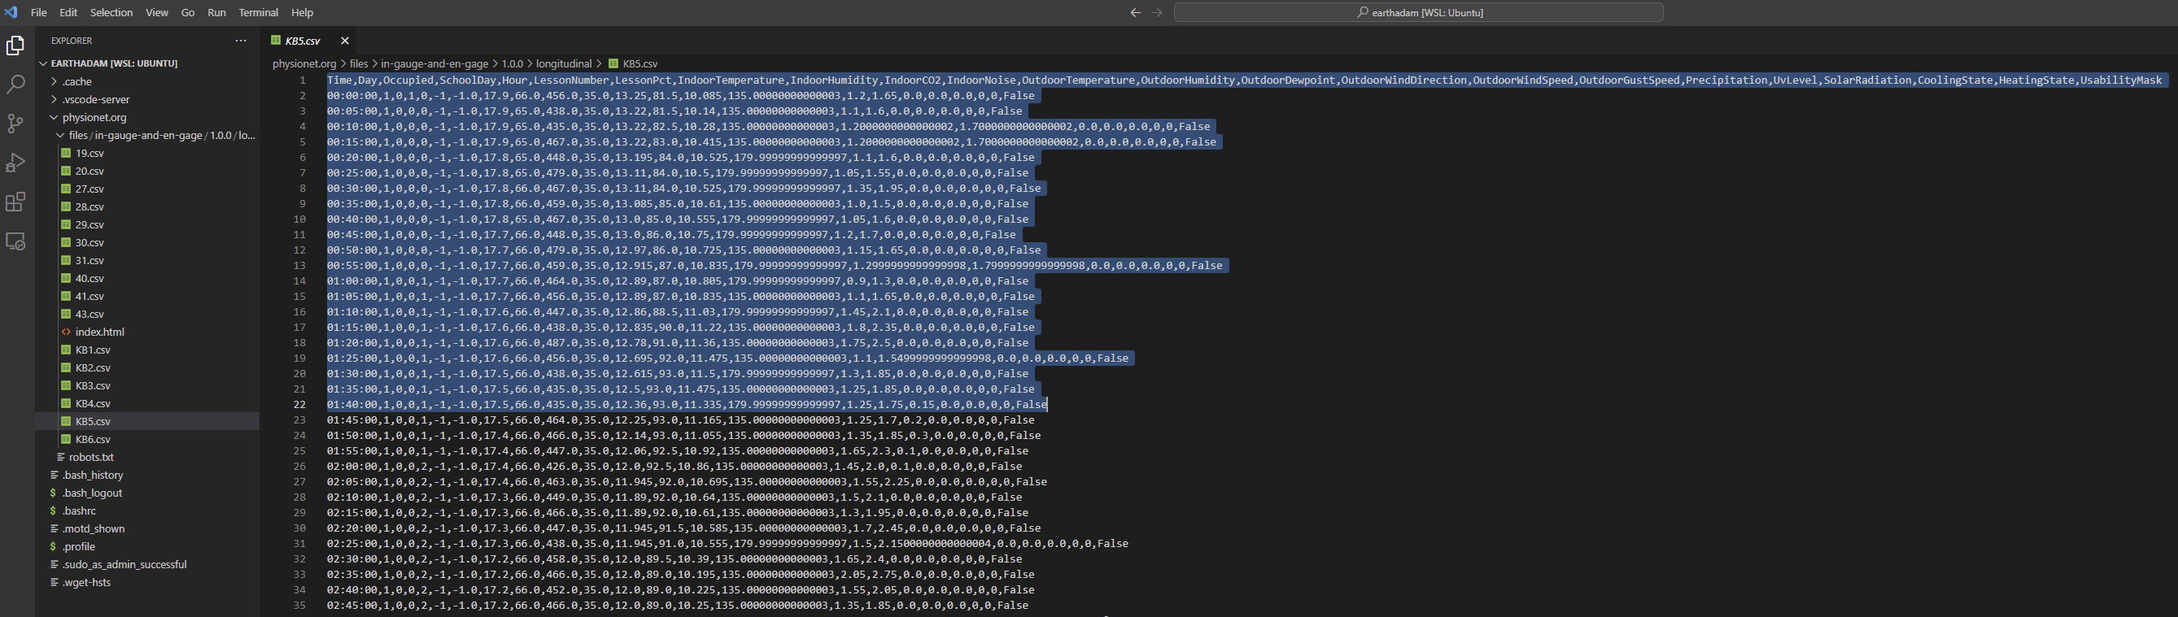


The Data
Link: https://physionet.org/content/in-gauge-and-en-gage/1.0.0/
Occupied
Lesson Number
In Temp
In NO

Slide 5
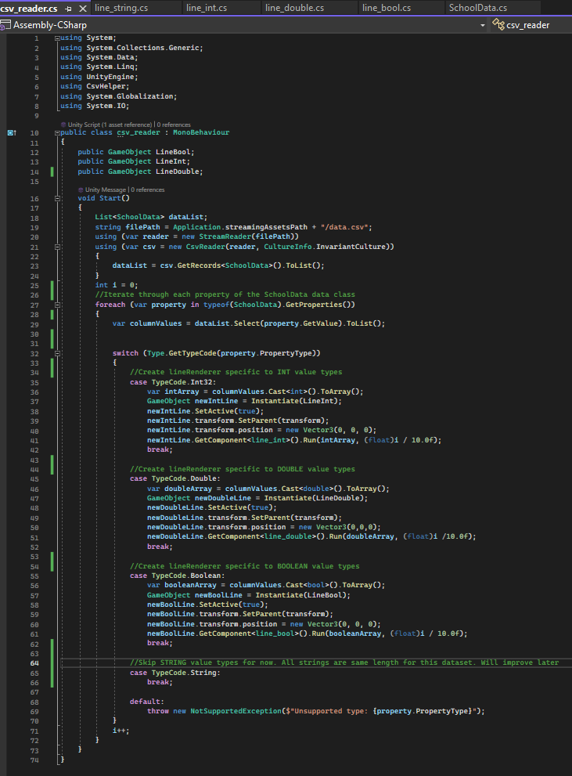
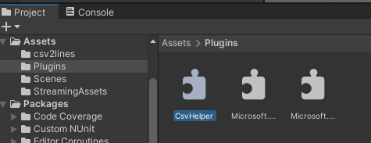
Reader
Game Object
Reader
csv
json
txt
NOTE: Requires CsvHelper.dll and associated dependencies
(Included in “Plugins” folder)
To Be Fixed Soon

Slide 6
Model
To Be Fixed Soon
School Data Model
Health Data Model
Energy System Data Model

Slide 7
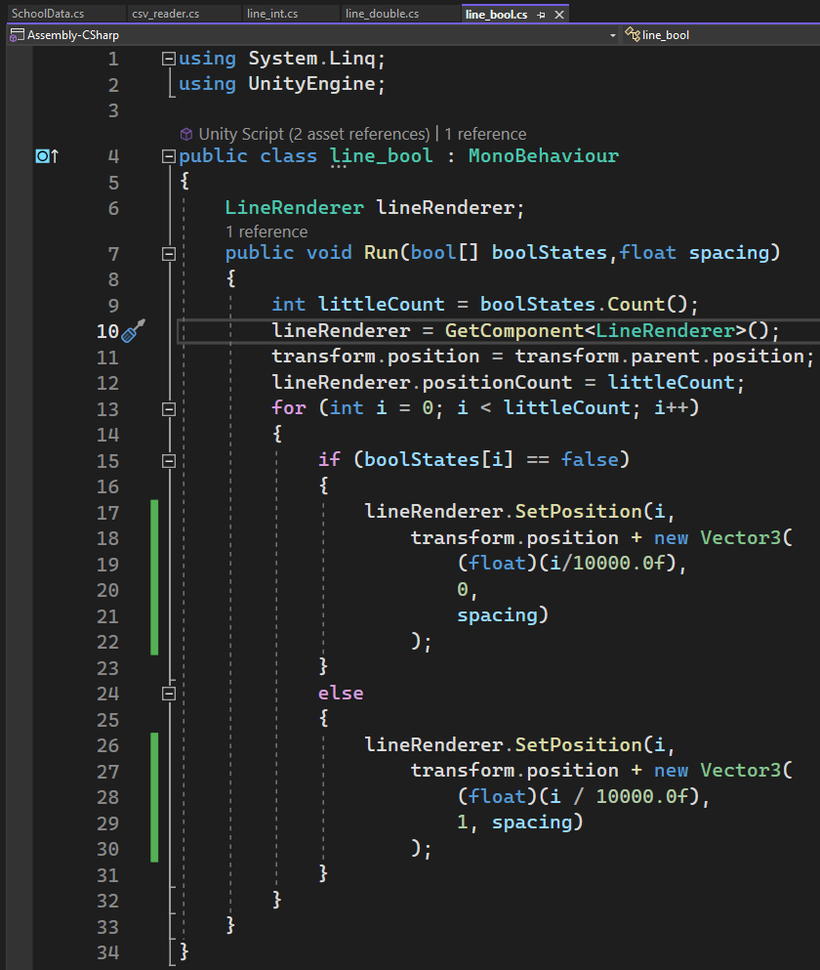
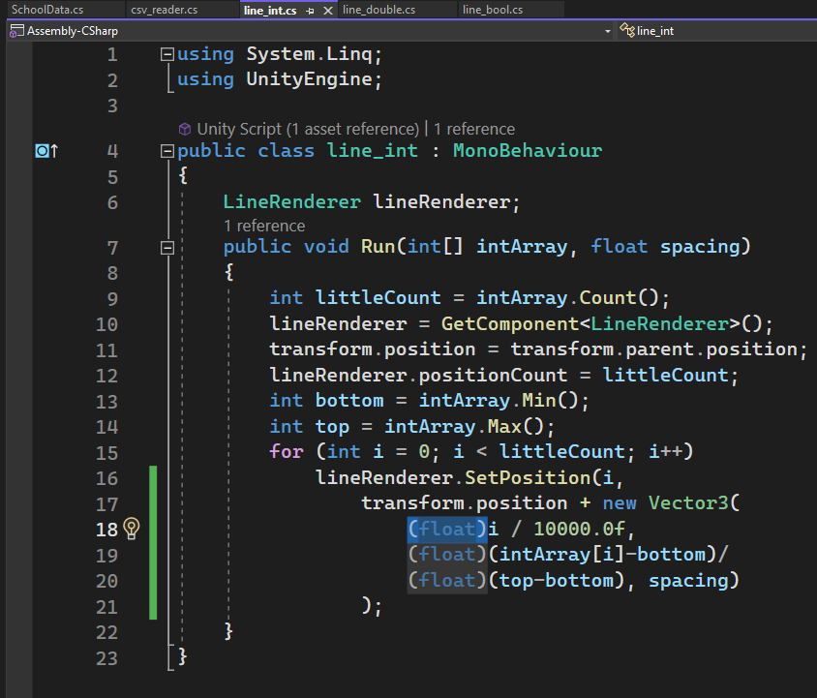
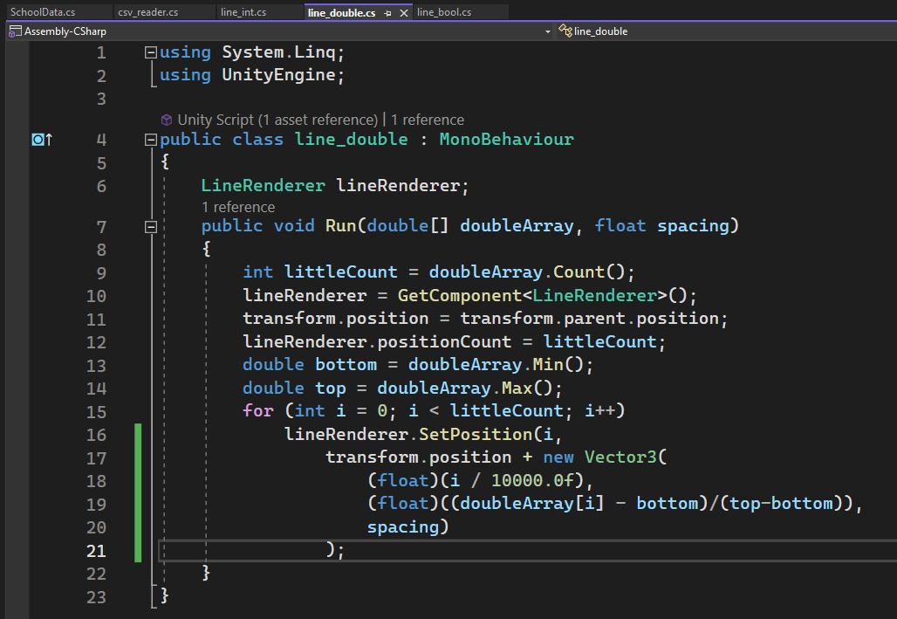
LineRenderers
Game Object
(LineRenderer)
boolean
Game Object
(LineRenderer)
int
To Be Fixed Soon
Game Object
(LineRenderer)
double

Slide 8
csv2circa
Game Object
(LineRenderer)
Game Object
(LineRenderer)
boolean
boolean
Game Object
(LineRenderer)
Game Object
(LineRenderer)
School Data Model
int
Game Object
int
Health Data Model
Game Object
(LineRenderer)
Game Object
(LineRenderer)
Reader
csv
json
txt
Energy System Data Model
float
double
Game Object
(LineRenderer)
string
20XX
8

