Slide 1
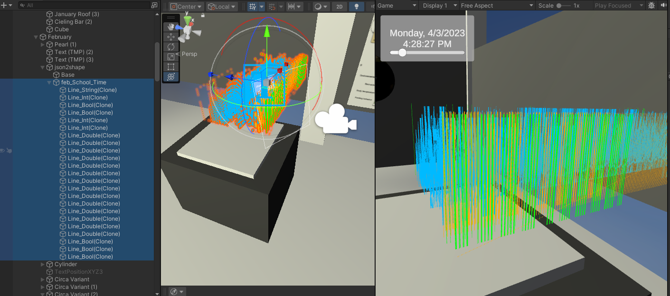

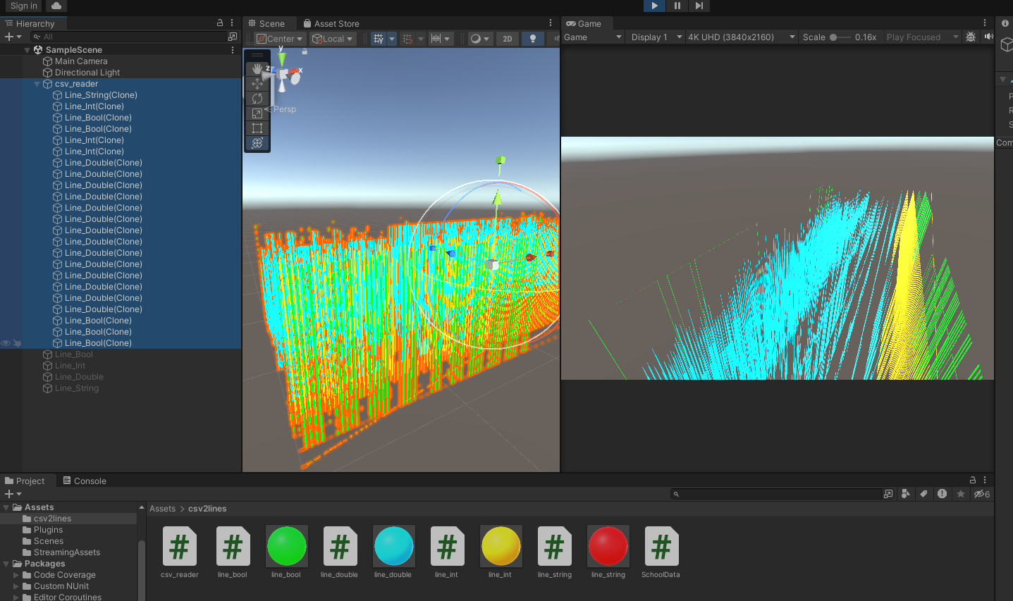
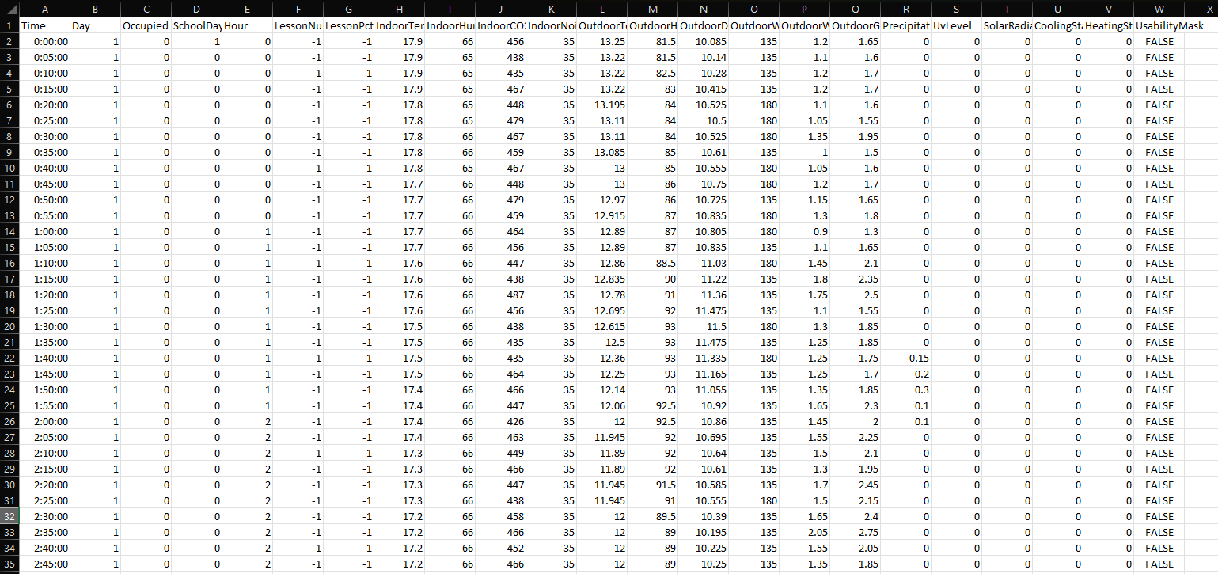
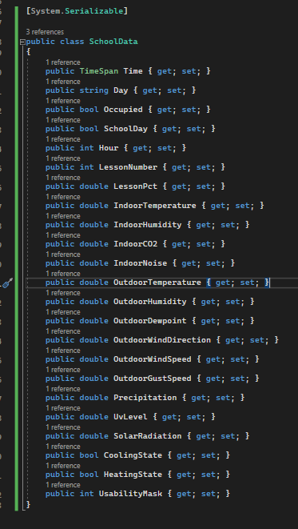
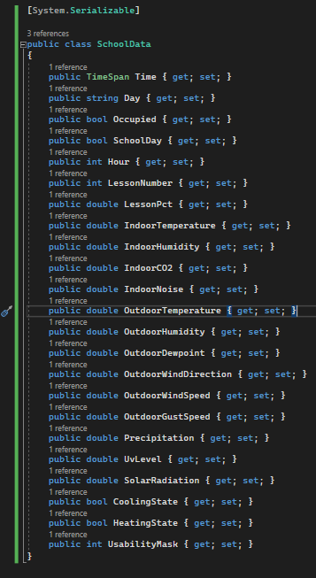
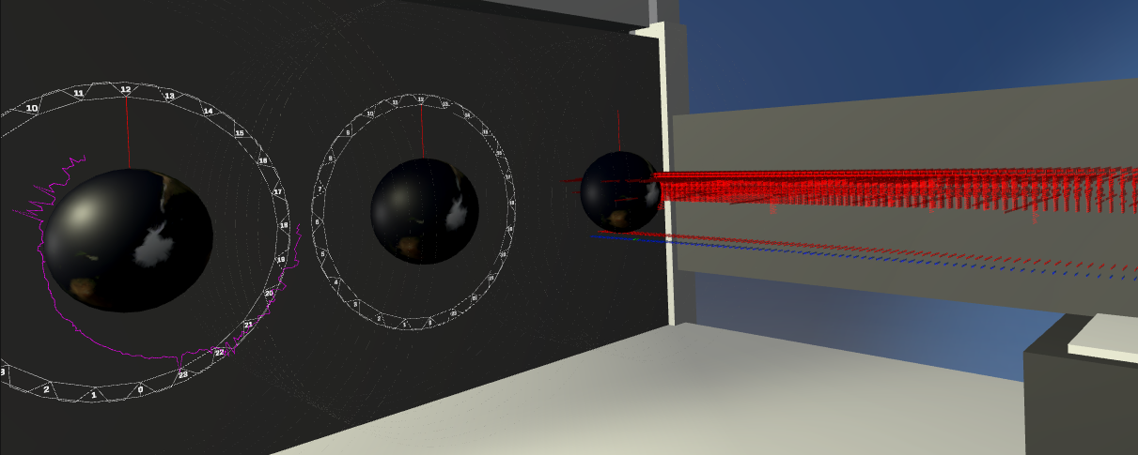
csv2lines
In Unity

Slide 2


Agenda
Review Outline
Look at the Data
Build Reader
Build Model
Build LineRenderers

Slide 3



Outline: Adding Scripts to GameObjects
Game Object
(LineRenderer)
boolean
Readers, Models, and LineRenderers
Game Object
(LineRenderer)
Game Object
School Data Model
int
Health Data Model
Game Object
(LineRenderer)
Reader
csv
json
txt
Energy System Data Model
float
Game Object
(LineRenderer)
string

Slide 4
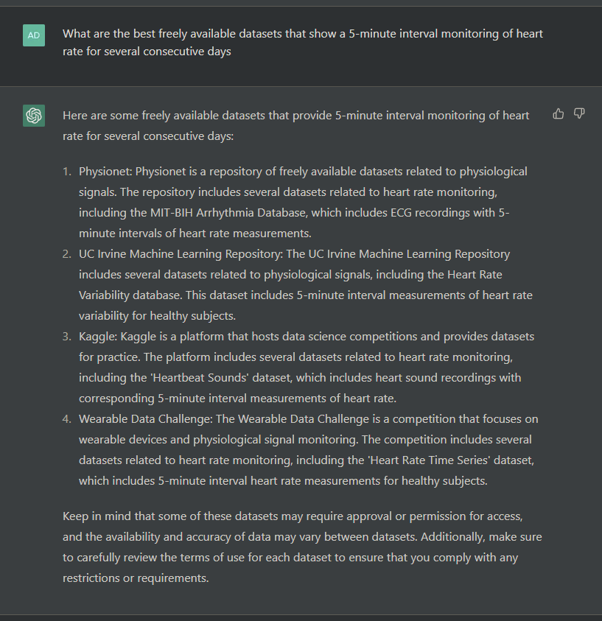
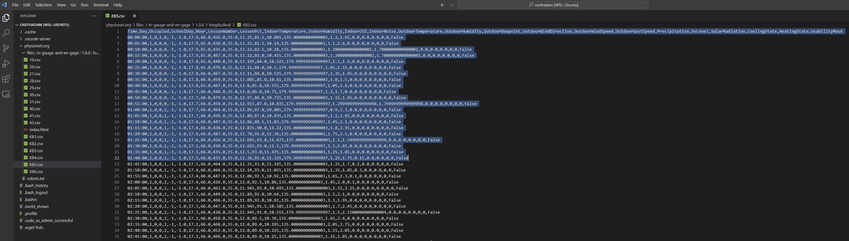

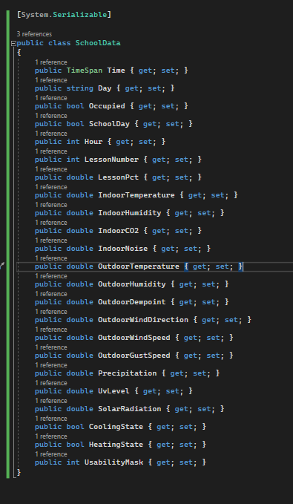

The Data
Link: https://physionet.org/content/in-gauge-and-en-gage/1.0.0/

Slide 5
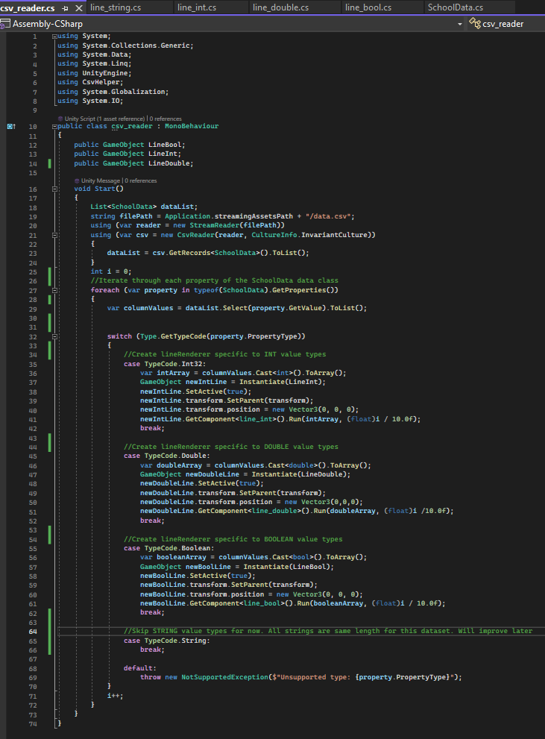
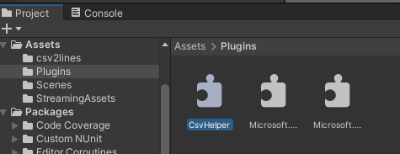
Reader
Game Object
Reader
csv
json
txt
NOTE: Requires CsvHelper.dll and associated dependencies
(Included in “Plugins” folder)

Slide 6
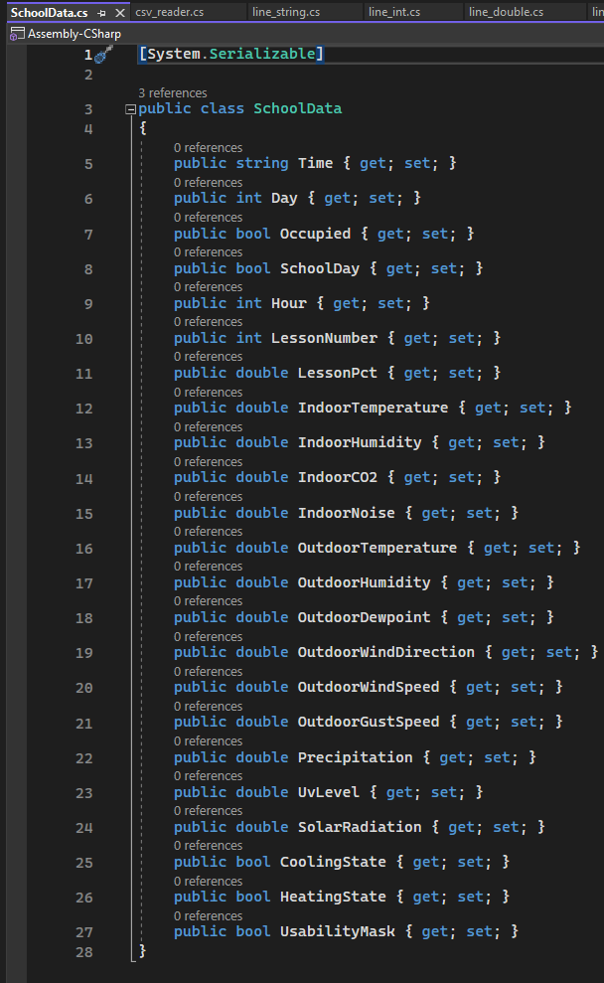
Model
School Data Model
Health Data Model
Energy System Data Model

Slide 7
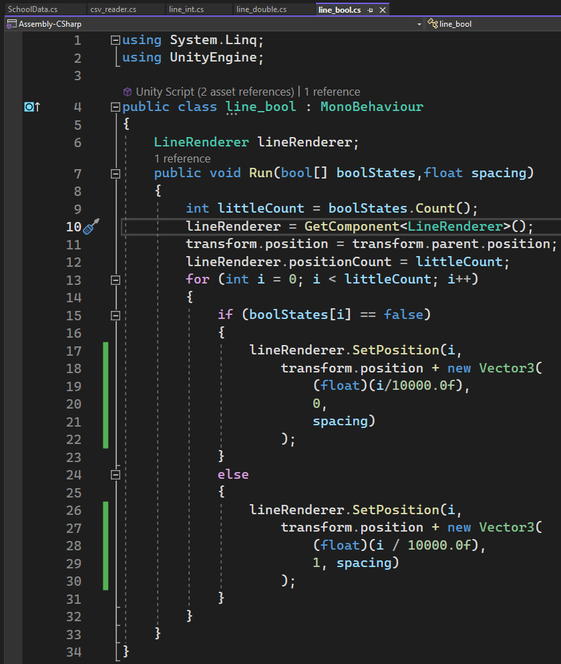
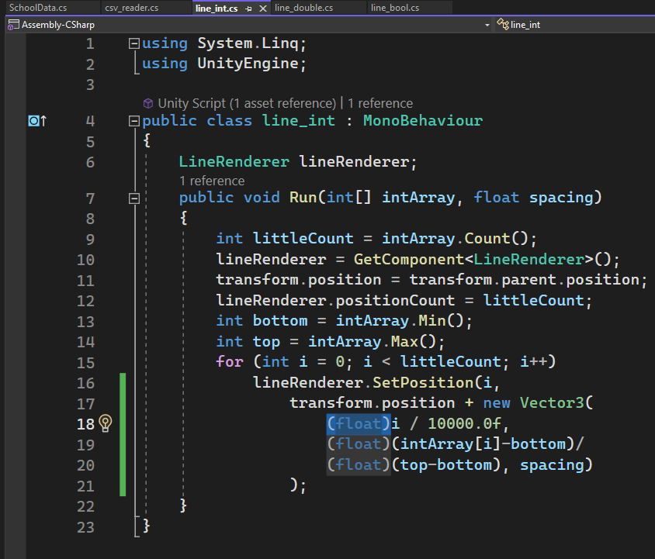
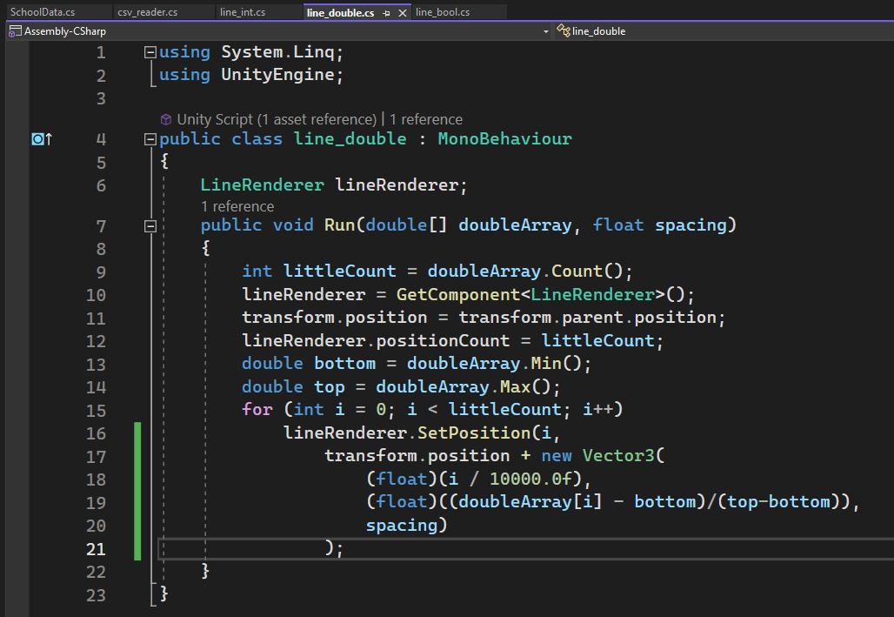
LineRenderers
Game Object
(LineRenderer)
boolean
Game Object
(LineRenderer)
int
Game Object
(LineRenderer)
double

