Slide 1
Continuous Intravenous Infusion
Lecture 2
3rd/June/2012

Slide 2
“Practical” steady-state concentration
Practical ss conc. would be reached when the Cp of a drug represents 95% or greater (95% - 99%) of the true Cp_{ss}.
According to the previous calculation
Time to reach 95% of the ss = 4.32 t_{1/2} .
We can use the practical Cp_{ss} to achieve a therapeutic drug effect.
t = ln (1 - f_{ss}) × t_{1/2}
-0.693
Notes:
The intravenous loading dose permits us to attain the desired cp at time 0 and the concomitant constant infusion allows us to maintain this concentration.

Slide 3
Instantaneous and continuous steady-state
If rapid drug effect is required, such as in emergency situations, then immediate achievement of therapeutic drug conc. will be required .
How to achieve instantaneous and continuous ss?
This may be obtained by giving:
Loading IV bolus dose + IV infusion at the same time
Notes:
The intravenous loading dose permits us to attain the desired cp at time 0 and the concomitant constant infusion allows us to maintain this concentration.

Slide 4
Equations
Cp_{tot} = Cp from IV bolus + Cp from infusion
Following IV bolus dose:
Cp_{t} = Cp₀e^{-kt}
Following IV constant infusion:
Cp_{t} = Q × (1-e^{-kt})
VK
The total plasma concentration at time t will be:
Cp_{tot} = Cp₀e^{-kt} + Q × (1-e^{-kt})
VK
Cp_{tot} = D_{L(iv)} × e^{-kt} + Q × (1-e^{-kt})
V VK

Slide 5
By rearrangement:
Cp_{tot} = Q - Q e^{-kt} + D_{L(iv)} × e^{-kt}
VK VK V
What D_{L} we want?
We need a D_{L} that attains Cp_{ss},,,,
Cp_{ss} = D_{L(iv)} /V ,,,,D_{L(iv)} = Cp_{ss} × V
From previous equation Cp_{ss} × V = Q/K
Substitution of D_{L(iv)} = Q/K in equation (a) gives:
Cp_{tot} = Q
VK and this is the same equation for
Cp_{ss} = Q (then Cp at any time will be equivalent to Cp_{ss})
VK
…. (a)
Notes:
Then to calculate the loading dose you need to know the infusion rate and elimination half life or the volume of distribution and Cpss.

Slide 6
This indicates that the plasma concentration at any time (Cp_{t}) attained after administration of a drug as IV bolus dose (D_{L(iv)}) followed immediately by IV infusion will be equal to the Cp_{ss}.
Cp_{t} (IV bolus + IV infusion) = Cp_{ss}
Notes:
Then to calculate the loading dose you need to know the infusion rate and elimination half life or the volume of distribution and Cpss.

Slide 7
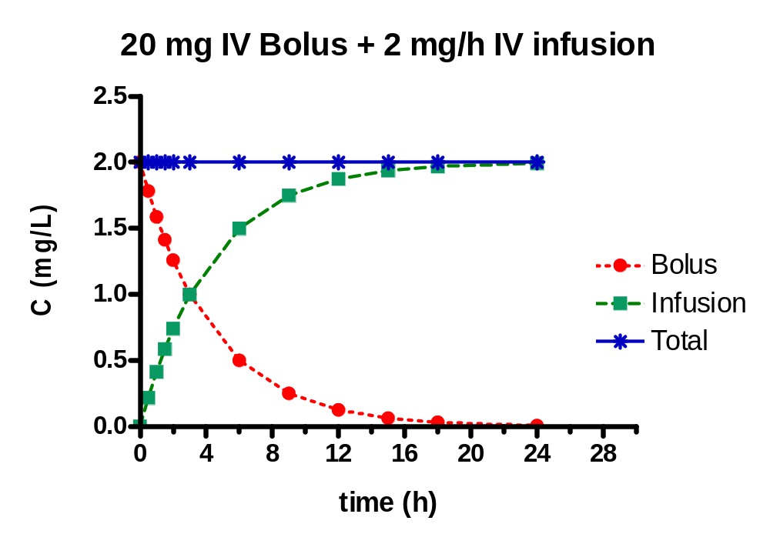
Theoretical Cp Vs time profile following the administration of a drug as IV bolus dose (D_{L}) followed by IV infusion.
Desired (Cp_{ss})
Bolus dose = 20 mg
Q = 2 mg/h
k = 0.1 hr⁻¹
V = 10 L
D_{L} = Cp_{ss} × V
Q = Cp_{ss} × V × K
Notes:
Then to calculate the loading dose you need to know the infusion rate and elimination half life or the volume of distribution and Cpss.

Slide 8
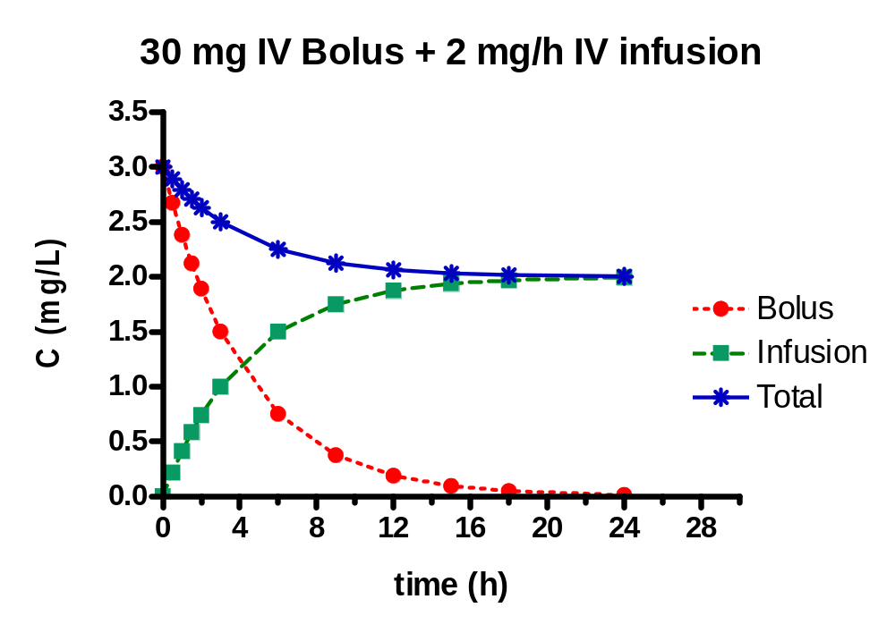
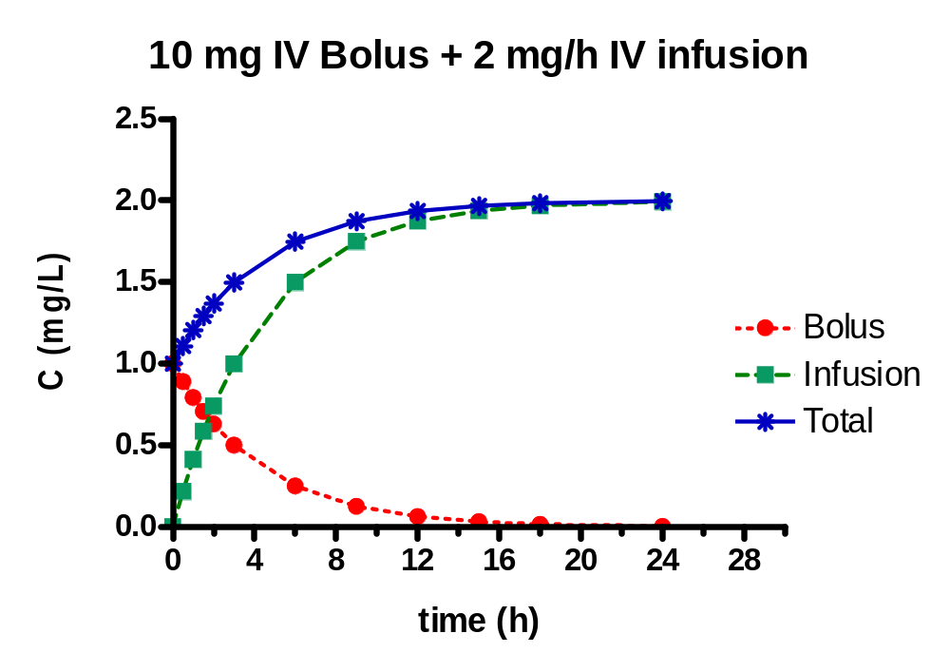
Changing the D_{L}
Bolus dose = 30 mg
Q = 2 mg/h
k = 0.1 h⁻¹
V = 10 L
Bolus dose = 10 mg
Q = 2 mg/h
k = 0.1 hr⁻¹
V = 10 L
Notes:
Then to calculate the loading dose you need to know the infusion rate and elimination half life or the volume of distribution and Cpss.

Slide 9
Generally, adjustment of the D_{L} is neither necessary nor required.
Adjustment of the D_{L} is necessary when the volume of distribution changes. (in some abnormalities).
Adjustment of the Q is required For renally impaired subject:
* The elimination of the drug will be slower →
the elimination rate constant (K) will be smaller.
* Then the infusion rate required to maintain the
Cp_{ss} should also be smaller according to the
elimination process.
Notes:
In summary, the adjustment in infusion rate is always necessary and required is there is a change in systematic clearance; however, adjustment in D_{L} is necessary only if there is a change in the volume of distribution.

Slide 10
Example:
A physician wants to administer an anesthetic agent by IV infusion to achieve a constant plasma concentration of 4 mcg/mL. The elimination rate constant of the drug is 0.1 hr^{– 1}, and the volume of distribution (one compartment) is 20 L. Recommend an IV loading dose and IV infusion rate to immediately achieve and then maintain the plasma concentration at 4mcg/ mL.
Answers
D_{L} = 80 mg
Q = 8 mg/hr
Notes:
Then to calculate the loading dose you need to know the infusion rate and elimination half life or the volume of distribution and Cpss.

Slide 11
Wagner’s method for rapid attainment of steady-state
Another method can be used to attain a SS rapidly (but not instantaneously).
Wagner’s method uses tow different infusion rates (Q₁ and Q₂), there is no IV bolus dose.
This method has tow stages:
1. the drug is infused first at a higher infusion rate Q₁ for a time equal to t_{1/2}.
2. at t = t_{1/2}, the infusion rate is changed to a second (slower) rate (Q₂) which control the SS concentration.

Slide 12
Cp_{t} = Q₁(1-e^{-kt}) ……………… (1)
VK
Q₁ = Cp_{t} × VK
(1-e^{-kt})
Where t is the time at which the first infusion rate (Q₁) is changed to the second infusion rate (Q₂), which determines and controls the SS plasma concentration.
Cp_{ss} = Q₂ ………………… (2)
VK
Q₂ = Cp_{ss} × VK

Slide 13
Q₁ = Cp_{t} × VK × 1
Q₂ (1-e^{-kt}) × Cp_{ss} ×VK
Q₁ = 1
Q₂ = (1-e^{-kt})
However, since K = 0.693/t_{1/2}, and e^{-0.693} = 0.5 then:
Q₁ = 2 × Q₂

Slide 14
Some important comments on Wagner’s method of using two infusion rates.
The ratio of Q₁/Q₂ will always be equal to 2 if the time at which the first infusion rate is equal to t1/2.
If the drug is administered by choosing two infusion rates, the ratio of the two infusion rates will determine the time at which the desired plasma concentration is attained.
The greater the ratio the sooner is the attainment of the desired plasma concentration.

Slide 15
Sampling blood following cessation of infusion
The setup for monitoring elimination of drug from plasma following the discontinuation of a constant rate i.v. infusion:
dX = -K(X)_{tֿ}
dt _{tֿ}
Where tֿ is the time following the cessation of infusion.

Slide 16
once the infusion is stopped, there is no drug entering the blood and the drug present in the blood follows a mono-exponential decline that is identical to that seen for an i.v. bolus injection.
(X)_{tֿ} = (X)_{T} e^{-kt}ֿ
T = time at which the infusion was stopped.
Or: (Cp)_{tֿ} = (Cp)_{T} e^{-kt}ֿ
The amount of drug (or conc.) at the time of cessation will depend on Q as well as the time of cessation of infusion.

Slide 17
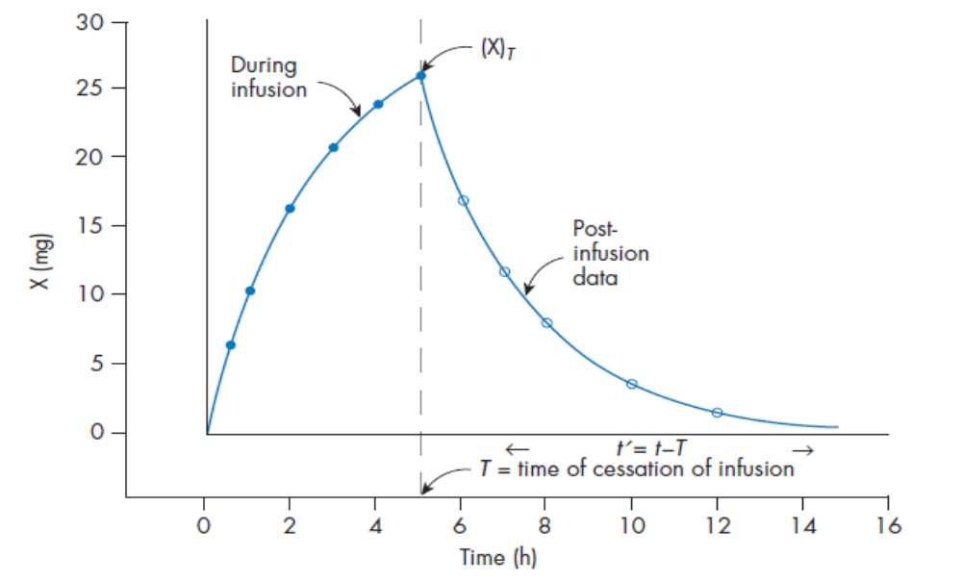
A typical profile of the amount of drug in blood Vs time following the administration of a drug by an i.v. infusion, showing amounts of drug in blood before and after cessation of the infusion.

Slide 18
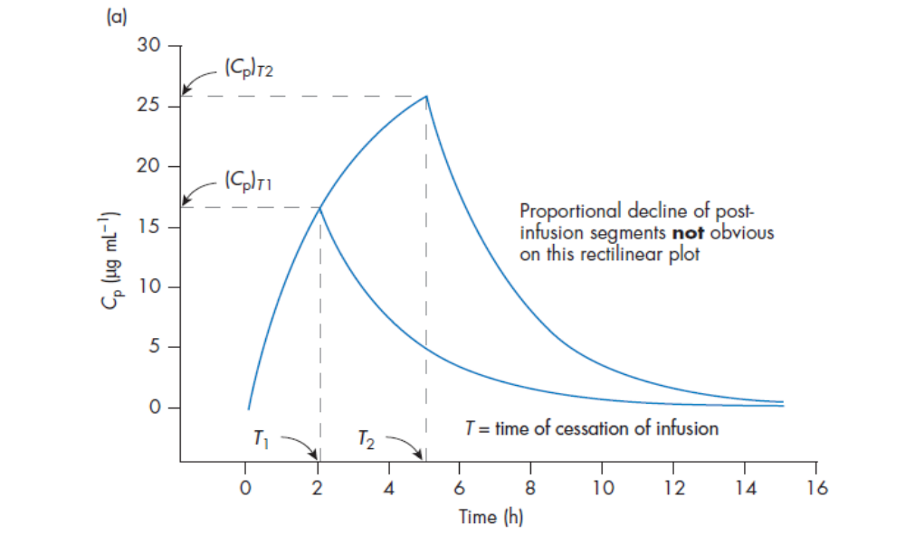
Use of post-infusion plasma data to obtain t_{1/2}, and K

Slide 19
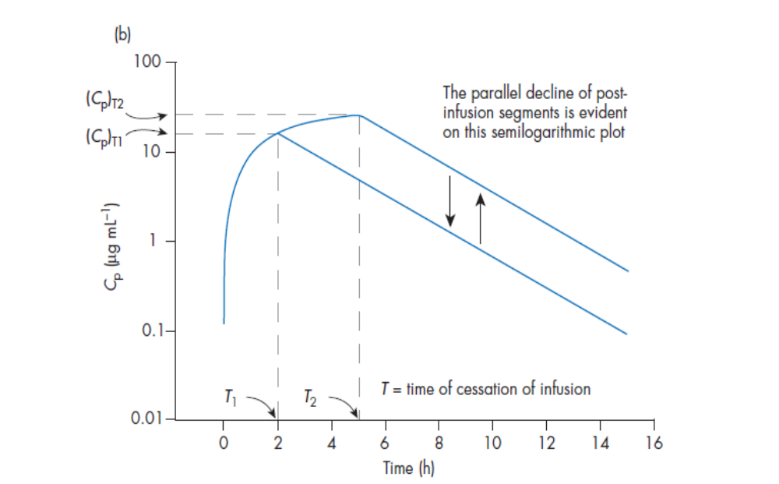
Use of post-infusion plasma data to obtain t_{1/2}, and K

Slide 20
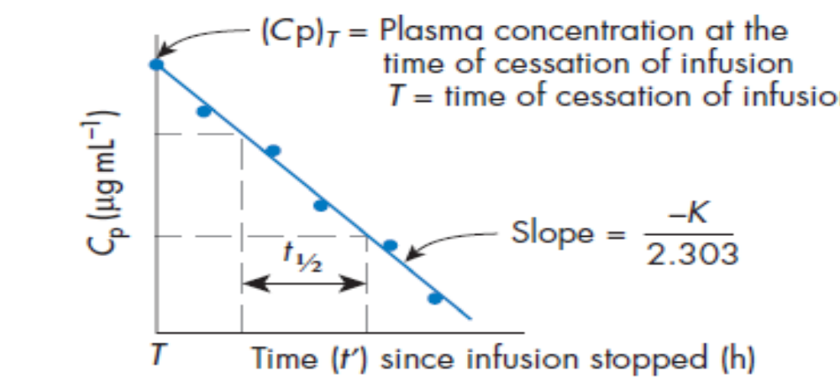
Use of post-infusion plasma data to obtain t_{1/2}, and K
The elimination half life and the elimination rate constant can be determined by employing methods described in i.v single dose
Cp Vs time profile following the cessation of infusion (i.e. post-infusion).

Slide 21
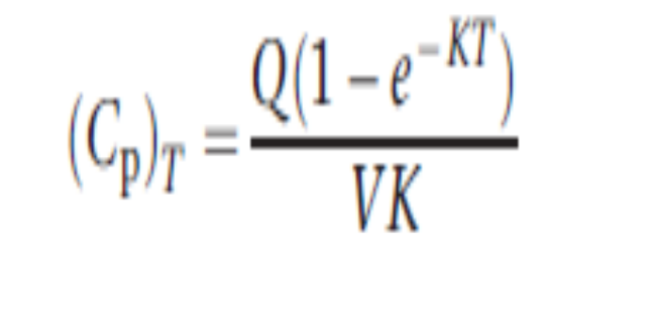
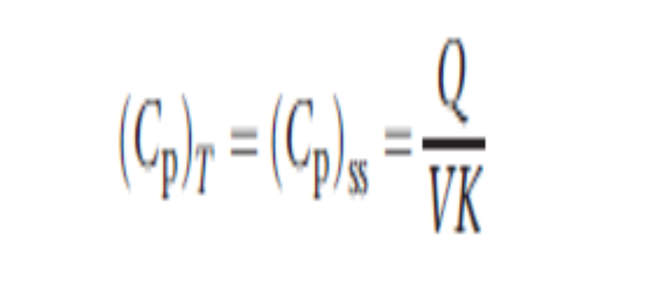
In general, if there is no loading dose:
However, when T approaches infinity:

Slide 22
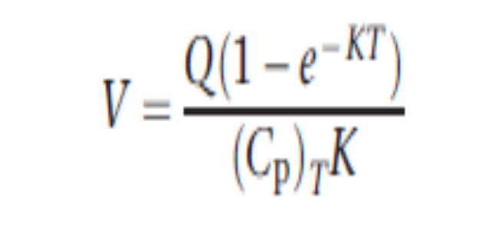

Method for obtaining the volume of distribution
Rearrangement of this equation gives

Slide 23
Example 1:
The followings are plasma concentration during and after the infusion period when a drug was infused at a constant rate (40 mgh⁻¹) for 12 h.
determine t_{1/2}, K and V_{d}.

Slide 24
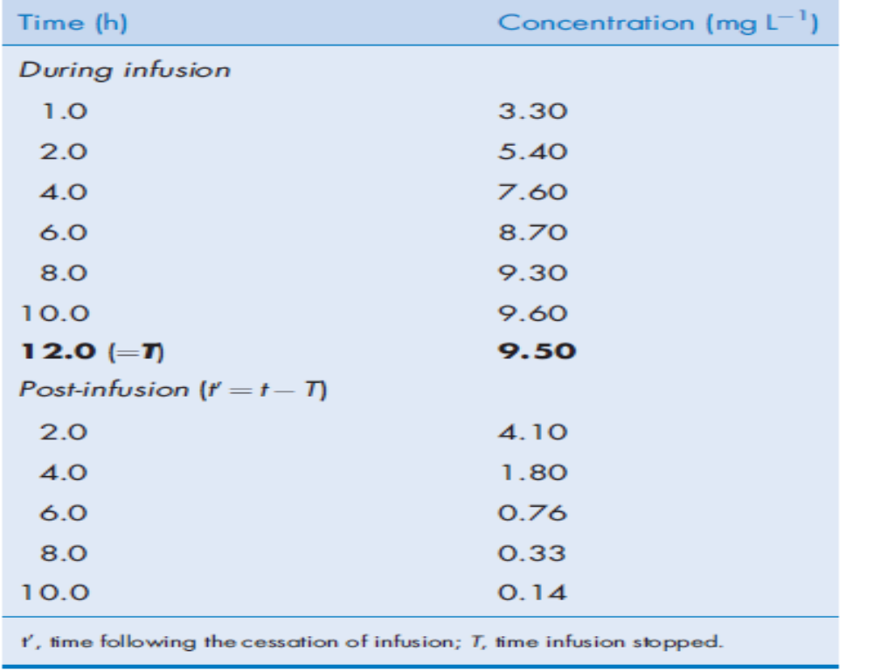

Slide 25
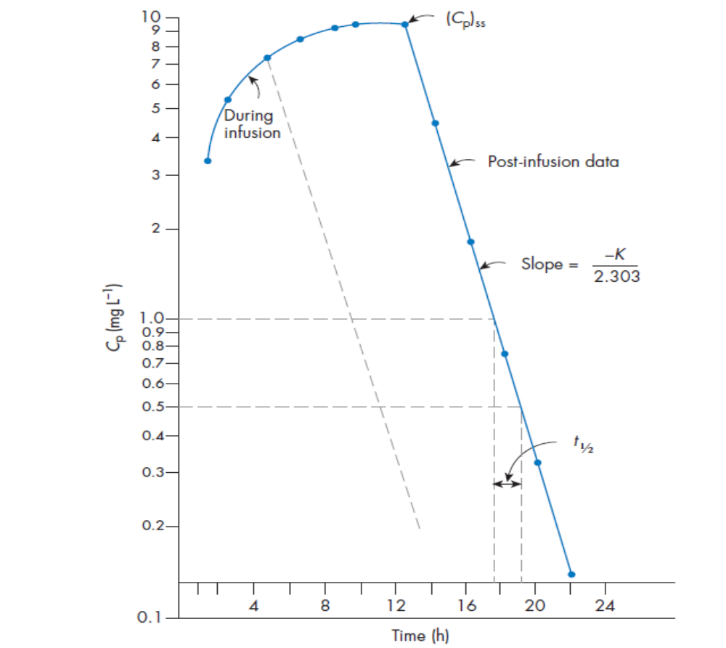

Slide 26
From the graph t_{1/2} = 1.7 h
K = 0.693/t_{1/2}
K = 0.407 h⁻¹
To compute Vd
the true steady-state plasma concentration is 9.6mg/L This assumption can be justified by the fact that the time of cessation of the infusion, 12 h in this example, is substantially more than 11.3 h (6.65 t_{1/2} of the drug). Therefore,

Slide 27
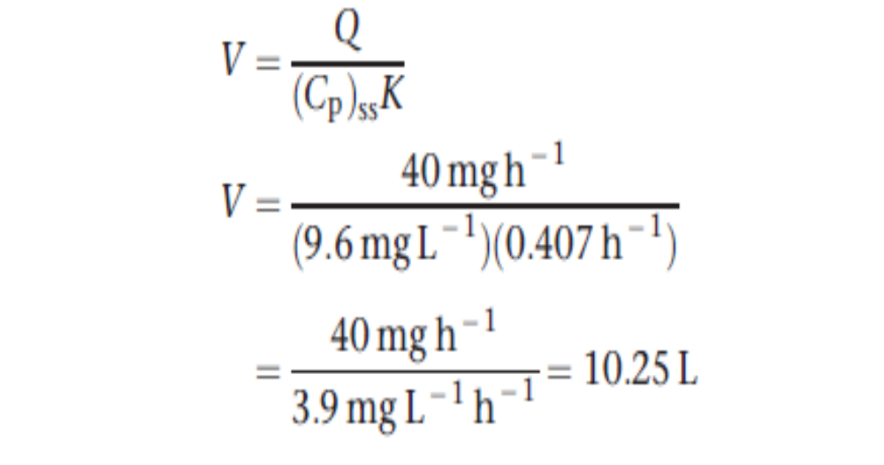

Slide 28
Example 2:
A patient was receiving an antiarrhythmic drug as a constant rate iv infusion of 24mg/hr. After 3 days, the drug infusion was terminated, and three plasma samples were obtained.
Time after the end of infusion (hr) | Conc. Mg/L
1 | 3.3
3 | 2.2
6 | 1.2

Slide 29
Calculate the CL_{tot} and V_{d} of this drug in this patient.
The patient experienced irregular heart rhythm again, and the physician wanted to restart this antiarrhythmic drug. He wanted the pharmacist to recommend an IV loading dose and a constant IV infusion that should achieve a steady-state of 10 mg/L.

Slide 30
Answer:
The Cp_{ss} and the t_{1/2} or (K_{e}) can be estimated from the plot of the drug plasma conc. obtained after termination of the infusion versus time on a semi-log scale.
Time zero represents the time when the infusion was terminated, so the y-intercept will be equal to Cp_{ss}.

Slide 31
Cp_{ss} = 4 mg/L
5
4
3
O
Cp (mg/L)
t_{1/2}
O
2
3.5 hr
O
1
0
1
2
3
4
5
6
Time after the end of IV infusion

Slide 32
1. Calculation of CL_{tot} and V_{d}
From the graph:
Cp_{ss} = 4mg/L
Cp_{ss} = Q/CL_{tot}.
CL_{tot} = Q = 24 mg/hr = 6 L/hr
Cp_{ss} 4 mg/L
To calculate V_{d}: → from the graph:
t_{1/2} = 3.5 hr. Then K_{e} = 0.198 hr⁻¹.
V_{d} = CL_{tot}/Ke
V_{d} = 6 L/hr = 30.3 L
0.198 hr⁻¹

Slide 33
2.
The recommended IV loading dose:
D_{L} = Cp_{ss} x V_{d}
= 10 mg/L x 30.3 L
= 303 mg
The recommended constant rate IV infusion:
Q = Cp_{ss} x CL_{tot}
= 10 mg/L x 6 L/hr
= 60 mg/hr

Slide 34
The recommendation is 303 mg administered as IV bolus dose followed immediately by 60 mg/hr as a constant-rate IV infusion. This regimen should achieve a steady-state concentration of 10 mg/L.

Slide 35
Problem:
A procainamide plasma concentration of 6 µg mL⁻¹ is required to be reached and maintained by employing Wagner’s method. So two infusion rates must be calculated. The elimination half-life of procaine amide is 3 h and the apparent volume of distribution is 2000 mL kg⁻¹ body weight. The systemic clearance is equal to 462 mL kg⁻¹ h⁻¹. If we wish to reach ss after one t1/2 and then maintain the Cp at 6 µg mL⁻¹, determine the two infusion rates involved.
Answer:
Q2 = 2.77 mg kg⁻¹ h⁻¹
Q1 = 5.54 mg kg⁻¹ h⁻¹

