Slide 1
Introduction To Cryptography
Patrick Kellogg
patrickkellogg@gmail.com
http://www.patrickkellogg.com/kryptos

Slide 2
AS A TEENAGER, I LOVED “CRYPTOGRAMS”, DO YOU REMEMBER THOSE?
YD Y IBBRYLBH, S ZACBT “FHVWIALHYJD”, TA VAO HBJBJNBH IKADX?

Slide 3
AS A TEENAGER, I LOVED “CRYPTOGRAMS”, DO YOU REMEMBER THOSE?
How do you solve a cryptogram?
There are 105 legal two-letter words in Scrabble… but only 26 are commonly used
Either “A” or “I”
YD Y IBBRYLBH, S ZACBT “FHVWIALHYJD”, TA VAO HBJBJNBH IKADX?
Try a substitution and see if it works!
“B” is probably “E”, the most frequently used letter in the English language

Slide 4
Letter frequency
The most common letters in the English language are: e t a o i n s r h l d c u m f p g w y b v k x j q z
Word frequency
Try the most frequent two-letter words (or three, or four!) of, to, in, it, is, be, as, at, so, we, he, by, or, on, do, if, me, my, up, an, go, no, us, am
AS A IEERALBH, S ZACET “FHVWIALHAJS”, TA VAO HEJEJNEH IKASX?
Trial and error: do a substitution and see if it works

Slide 5
Historically, military ciphers made it much harder by:
Removing all spaces between words
Introducing random letters or “noise”
Creating a “code” (more about this later)
YDYZIBBRYZLBHSZACZBTFZHVWIA
LHYZZJDTAVAOHBJBJZNBHIKADZX

Slide 6
More ways to solve a cryptogram
Guess a “crib”
A crib is a word that might be in the message. For example, during WWII, British cryptanalysts guessed that many messages started with the phrase KEINEBESONDERENEREIGNISSE: no special occurrences, nothing to report. This is a “known-plaintext attack” (KPA)

Slide 7
More ways to solve a cryptogram
Do a more complex frequency analysis
Don’t just look at just the frequency of all letters (etaoin...) but also the frequency of the most common FIRST letters of each word T O A W B C D S F M R H I Y E G L N P U J K) or the frequency of the most common FINAL letters (E S T D N R Y F L O G H A K M P U W)
Create a custom frequency dictionary based on examples from the “corpus” (body of work) you are studying
Count up the letters in any decrypted message you have any use those frequencies instead

Slide 8
Ciphers aren’t Codes!
Many people use these words interchangeably, but they are actually quite different
Cryptograms are and example of a “cipher” where each letter is replaced using an algorithm
To create a code, replace important words or phrases (like “factory” or “stormy weather”) with innocuous words like “banana”. That way, the recurring words can’t be used as a crib (for example “BOMB THE BANANA AT DAWN”)
Often, codes and ciphers are used together. First, the secret message is coded using word or phrase substitution. Then, a cipher replaces each letter

Slide 9
Pros and Cons of Codes
Pro: Codes are theoretically uncrackable
For example “Buffalo buffalo buffalo buffalo” could mean “bomb the factory at dawn” if that’s what the codebook says. You HAVE to have the codebook to unencrypt the message
Con: Codes require a book to be distributed that is filled with a lookup chart of all the codewords and what they really mean. This can be difficult, especially since the codebook should be changed regularly for everyone in case the code was cracked

Slide 10
Distribution of Codes and Ciphers
If codes can be uncrackable, why not use them instead of ciphers?
Answer: if even a single codebook is intercepted, security is broken. So, there is often no way to know if your code is secure
To me, this is main driving force for the history of cryptography. How do you keep information out of the hands of the enemy, while making sure that all your friends understand?

Slide 11

The History of Cryptography
The first recorded cipher is the “Caesar cipher” (or “shift cipher”), reportedly used by Julius Caesar to protect military information
To do this cipher, just shift each letter forward or backward in the alphabet
THISISATEST
“ROT23” rotating forward 23 letters (i.e. back 3)
QEFPFPXQBPQ

Slide 12
More on the Caesar Cipher
The most famous Caesar Cipher is made by shifting the alphabet forward half-way by 13 letters. Often called “ROT13”, this technique is nice because a second ROT13 will decrypt the message back again
However, Caesar ciphers are VERY easy to break, since any computer only needs 25 tries to cycle through all shifts of the alphabet. Some people have even taught themselves to read ROT13 messages still encrypted!

Slide 13
One-time Pads
To make a substitution cipher uncrackable, you can specify the shift of each letter in the message. For example, if given the message is:
OEHDP… and the shift is [5, 10, 25, 1, 4, …] then you
shift the first letter (O) ahead 5 places to get (T)
and shift the second (E) ahead 10 places to get (O)
to find the start of the message is “TO…”
For complete security, publish a new “pad” for every message. However, this method will have this same distribution problem as code book did earlier where pads will get stolen and need to be replaced securely

Slide 14
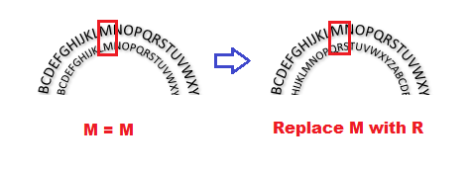
Cipher Disks
In 1467, an Italian named Leon Battista Alberti came up with idea of creating a little metal disk that would rotate change the letter substitutions
These were still used during US Civil War by both sides
In 1934, the chocolate malt drink “Ovaltine” famously gave out a “secret decoder pin” to children who listened to their radio programs

Slide 15
Vigenère Cipher
Actually not invented by Blaise de Vigenère due to a bad translation. Instead, has its roots in a 1553 book by Giovan Battista Bellaso
A great compromise between a one-time pad and an easy-to-crack ROT13 is a Vigenère cipher
To create a Vigenère cipher, come up with a plaintext message you’d like to encrypt, and a keyword

Slide 16
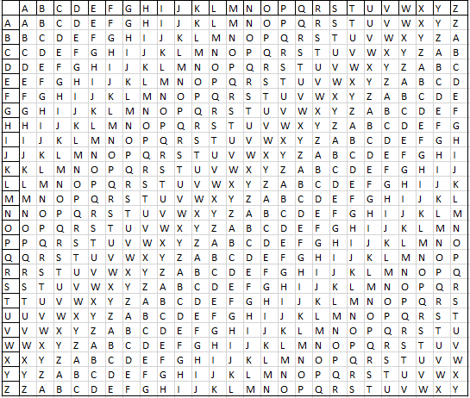
How To Create a Vigenère
First write out a table (or “tabula recta”)

Slide 17
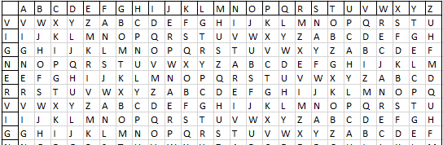
How To Create a Vigenère
Take the keyword (for example “Vigenère”) and remove the duplicate “e” letters and repeat it over and over to get “VIGNERVIGNERVIGNERVIGNER”

Slide 18
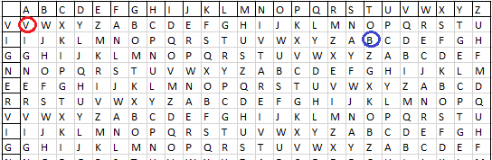
How To Use a Vigenère
Take the first letter of the plaintext message to be encoded (like “A” in “ATTACKATDAWN”) and substitute the corresponding keyword letter (“V”)
For the next letter of the message (“T”), use the lookup on next keyword line (the one starting with “IJKL” line) to get the encrypted letter “B”
Keep going until the entire plaintext message is encrypted

Slide 19
Vigenère Tips and Tricks
It helps to have as long a keyword as possible
Which leads to the problem… if you know the length of the keyword is 6 (“VIGNER”), then you know every sixth letter is going to use the same encryption alphabet, and that helps to decipher it
The “Enigma engine” that was used (and cracked!) during WWII was a form of substitution cipher using electrical wheels that spun around to create intricate set of encryption alphabets

Slide 20
Transposition Ciphers
The Caesar and Vigenère ciphers earlier were known as “substitution ciphers” because they replace each letter in the plaintext message with a different letter
Another method of encrypting a message is to mix up the order of all the letters. This is known as a “transposition cipher”

Slide 21

Rail Fence Cipher
This is a quick way to mix up the letters in the plaintext message. For example, using the phrase “THISISAQUICKWAYTOMIX”
Write out the plaintext up and down over 3 rows
Then, write it out by rows to get TIUWOHSSQIKATMXIACYI

Slide 22
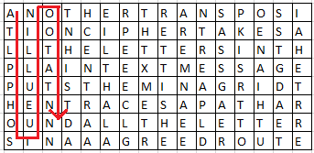
Route Cipher
Another transposition cipher takes all the letters in the plaintext message, puts them into a grid, and traces a path around all the letters in an agreed route
This becomes ATLPPHOSIUEULLINOOTATN…
Or, you could use a different route, like a spiral

Slide 23
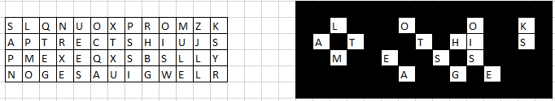
Other Transposition Methods
There are an infinite number of ways to rearrange the letters in a message. For example, there is something called “Myszkowski transposition” that alters the order of the columns. Or, you can use a “grille” which is a piece of paper with holes cut in it.

Slide 24
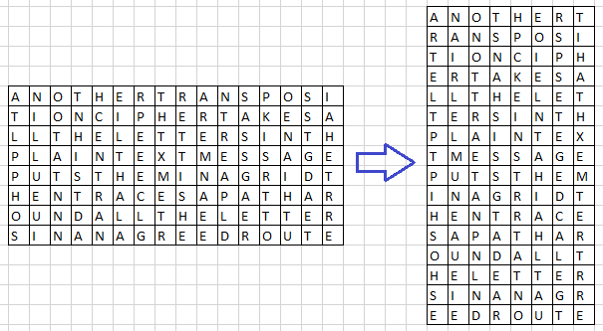
Row-column Transposition
Take a message with a certain number of columns and rows. For example, our earlier message was “8-by-16” 8 rows by 16 columns
Turn it into something else
(like “16-by-8”)

Slide 25
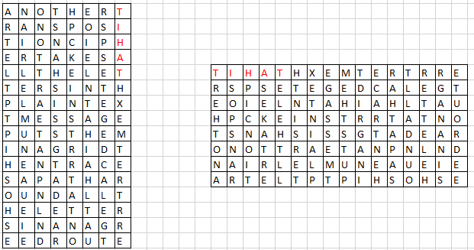
Double row-column transposition
Then keep going! As long as the receiver knows the method used to mix up the letters, you could even do a rotation

Slide 26
Case Study: Kyptos
In fact, this method of doing a row-column transposition PLUS a rotation PLUS another row-column transposition AND a Vigenère encryption is all used by an actual unsolved mystery called “Kryptos”
In the next set of slides, we will look at Kryptos and look into possible methods of solving it!

