Slide 1
CS-310 Operating Systems Final Project
Multi-threaded HTTP Client-Server
A Game of Rock Paper Scissors
Presentation by: Jerrin C. Redmon

Slide 2
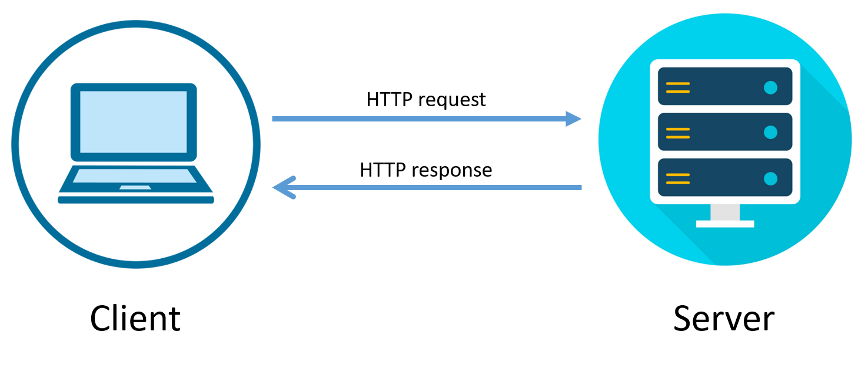
What does it do?
The program hosts a multi-threaded server of a game of rock paper scissors using basic HTTP requests and responses. It is broken into two part:
The Server which host the game
The client that connects to the game

Slide 3
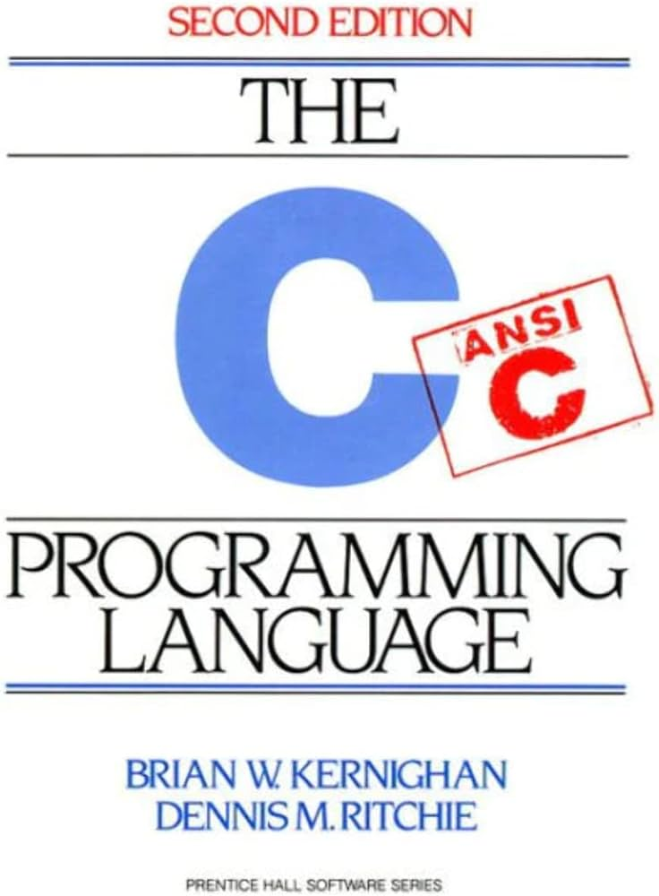
Tools used and why
Linux based Operating System
Provided a unique multi-threaded process unlike Windows
C Programming Language
Allows direct access/control over the operating system

Slide 4
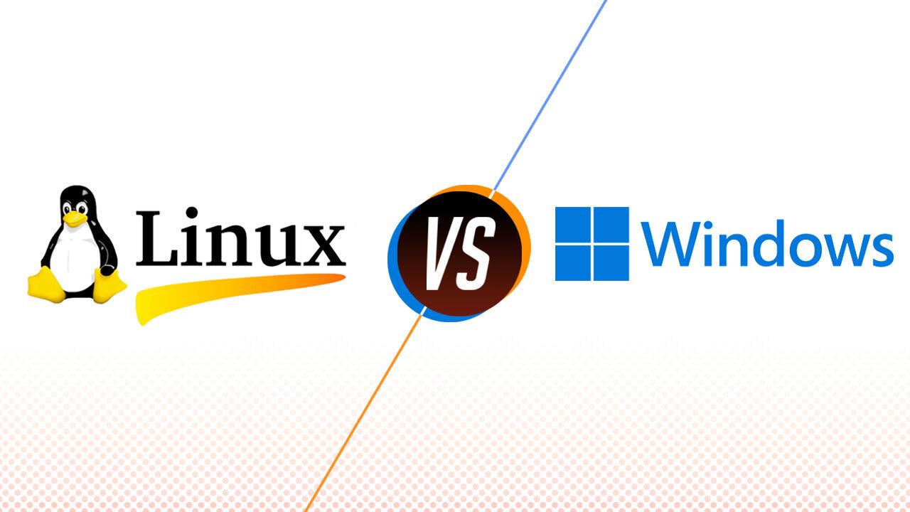
Windows vs Linux Threads
Window
Creates Threads are each tied to their own unique process
Linux
Does not have Threads,and instead are treated as processes with 100% of memory being shared between them.

Slide 5
Sources Used
https://linux.die.net/man/
Linux Man Pages
https://en.wikipedia.org/wiki/HTTP
HTTP
https://developer.mozilla.org/en-US/docs/Web/HTTP/Methods/PUT
Mozilla developer web docs

Slide 6
How does it all work?
CODE REVIEW!

