Slide 1
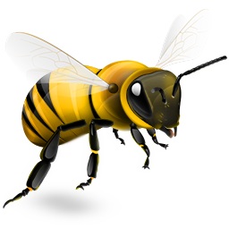
Beekeeper
A game about bees

