Slide 1
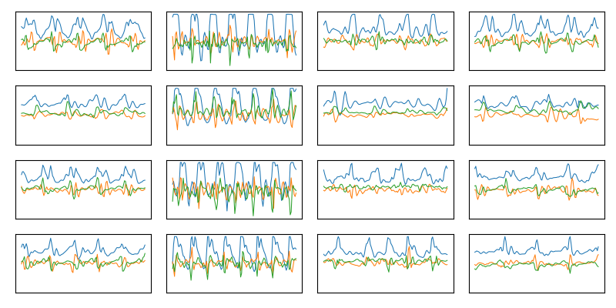
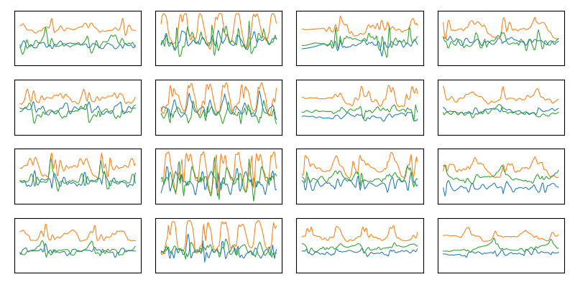




Train-Test Split
Source
Labeled
Used to train GAN and baseline
$$X_{src}$$
Unlabeled
Used to generate synthetic data
$$X_{map}$$
Target
~80%
$$X_{trg}$$
Labeled
Used for evaluation
Balanced between classes
~20%
$$X_{test}$$

Slide 2



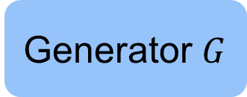
Synthetic Generation
$$X_{map}$$
$$y_{wal}$$
Generator $G$
$$X_{wal}$$

Slide 3


Synthetic Generation
$$X_{map}$$
$$y_{run}$$
Generator $G$
$$X_{run}$$

Slide 4
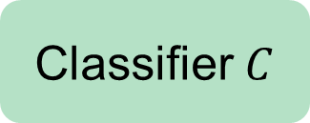

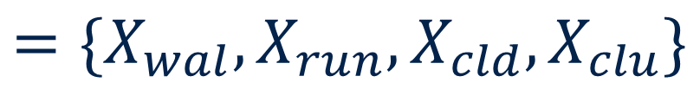

Our Method
$$X_{syn}$$
$$=\{X_{wal},X_{run}, X_{cld}, X_{clu}\}$$
train
Classifier $C$
test
$$X_{test}$$

Slide 5
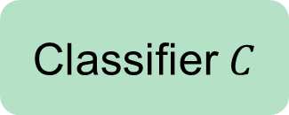


Baseline
$$X_{src}$$
train
Classifier $C$
test
$$X_{test}$$

Slide 6




Deep Coral
$$X_{src}$$
$$X_{map}$$
correlation alignment
train
Classifier $C$
test
$$X_{test}$$

Slide 7
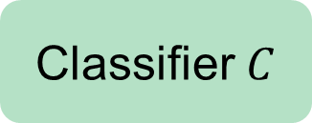



Domain-adversarial Neural Network (DANN)
$$X_{src}$$
$$X_{map}$$
adversarial alignment
train
Classifier $C$
test
$$X_{test}$$

Slide 8
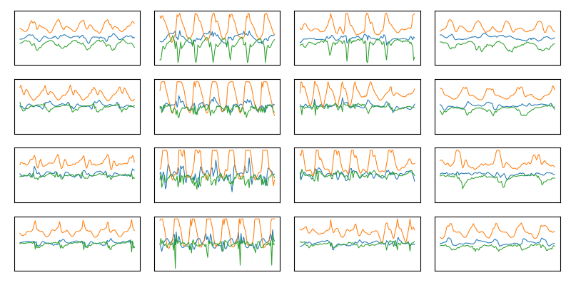
Datasets
Realworld: 12k obs, 15 sub
Mobiact: 11k obs, 61 sub
Pamap2: 1.5k obs, 6 sub

Slide 9
Results
 | BASE | BASE+ | CORAL | CORAL+ | DANN | DANN+ | SYN
Mobiact – Pamap | .45 | .56 | .59 | .55 | .66 | .46 | .44
Mobiact – Realworld | .60 | .57 | .62 | .60 | .59 | .61 | .56
Pamap – Mobiact | .47 | .40 | .59 | .45 | .57 | .52 | .48
Pamap – Realworld | .33 | .36 | .50 | .42 | .47 | .53 | .58
Realworld – Mobiact | .27 | .50 | .48 | .59 | .37 | .59 | .54
Realworld – Pamap | .24 | .66 | .44 | .75 | .55 | .88 | .79
Average | .39 | .51 | .54 | .56 | .53 | .60 | .57

Slide 10
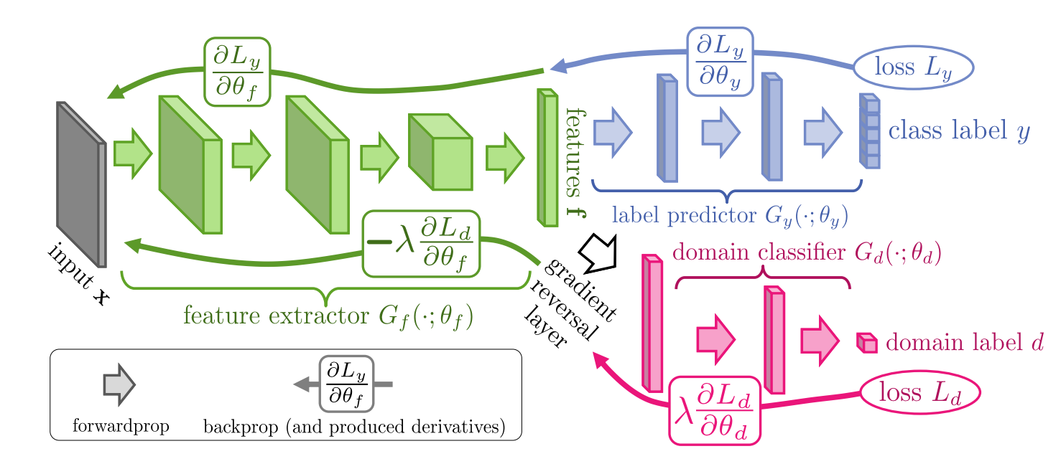
Domain-adversarial Neural Network (DANN)

