Slide 1
Data augmentation con rotazioni
Nuova orientation loss
Test con rotazione preliminare
Walking inclusa nella classificazione
Nuovo train-test split
Risultati aggiornati
Competitors
Deep CORAL

Slide 2
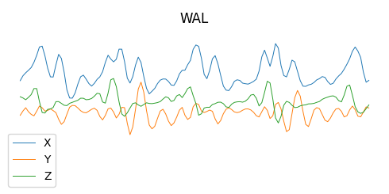
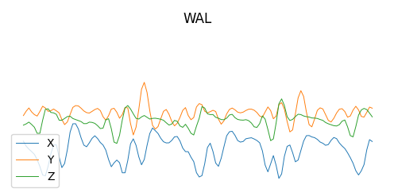
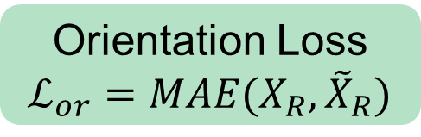
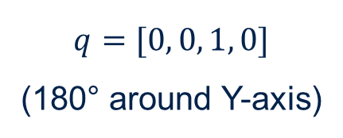



Orientation Loss
+
$$q=[0, 0, 1, 0]$$
(180° around Y-axis)
$$X$$
No rotation network
Invarianza rispetto all’orientamento del dataset source
Orientation Loss $ℒ_{or}=MAE(X_{R},{\tilde{X}}_{R})$
Generator G
$$X_{R}$$
$${\tilde{X}}_{R}$$

Slide 3
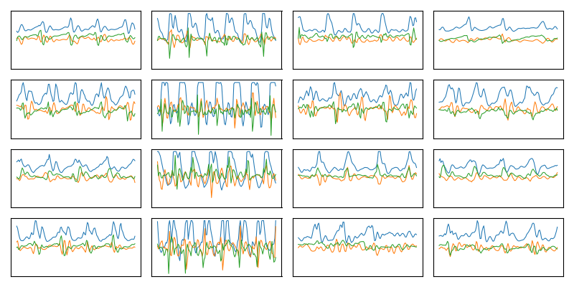
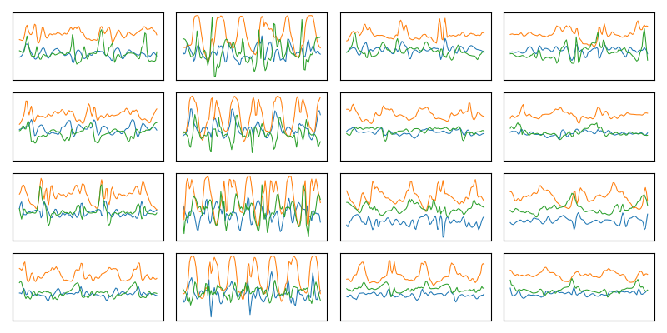
Pre-rotation?
Walking
Running
Down
Up
Walking
Running
Down
Up
Source
Target

Slide 4
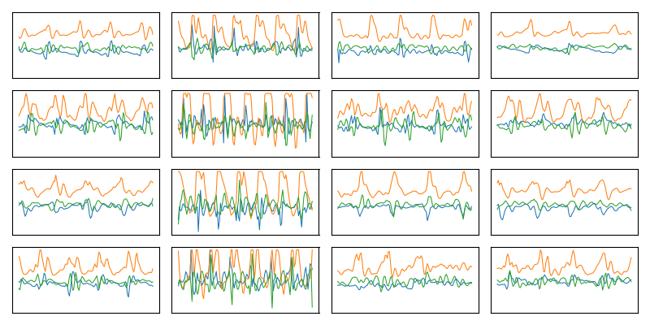
Pre-rotation?
Walking
Running
Down
Up
Walking
Running
Down
Up
Source (rotated)
Target

Slide 5
Results
Baseline | Baseline Augmented | Our Method | Upper Bound
0.51 | 0.74 | 0.79 | 0.90
Baseline Rotated | Our Method Rotated
0.67 | 0.72

Slide 6
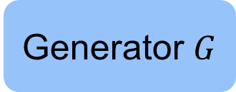

Train-Test Split
Walking
Running
Down
Up
$$X_{src}$$
train
Generator $G$
Source
Walking
Running
Down
Up
Target

Slide 7


Train-Test Split
Walking
Running
Down
Up
$$X_{src}$$
train
Generator $G$
Source
Walking
Running
Down
Up
Target
$$X_{test}$$
0.8
0.2

Slide 8
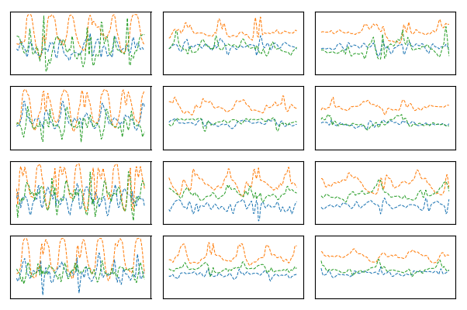

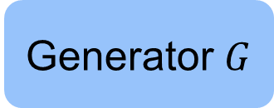
Train-Test Split
Running
Down
Up
Generator $G$
Walking
Running
Down
Up
Target
$$X_{test}$$
0.8
0.2

Slide 9

Train-Test Split
Walking
Running
Down
Up
Target
$$X_{syn}$$
0.8

Slide 10


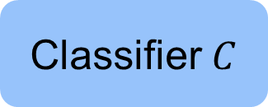













Baseline
Augmented
Upper Bound
Baseline
Our Method
$$X_{src}$$
$$X_{src}$$
$$X_{syn}$$
$$X_{test}$$
train with rotations
train with CV
train
train
Classifier $C$
Classifier $C$
Classifier $C$
Classifier $C$
test
test
test
test
$$X_{test}$$
$$X_{test}$$
$$X_{test}$$
$$X_{test}$$
$$Acc=0.39$$
$$Acc=0.53$$
$$Acc=0.70$$
$$Acc=0.92$$

Slide 11
Results
Without Walking
Baseline | Baseline Augmented | Our Method | Upper Bound
0.51 | 0.74 | 0.79 | 0.90
With Walking
Baseline | Baseline Augmented | Our Method | Upper Bound
0.39 | 0.53 | 0.70 | 0.92

Slide 12





Deep CORAL
$$X_{train}$$
$$X_{test}$$
(unlabeled)
train
Classifier $C$
CORAL
test
$$X_{test}$$
$$Acc=0.44$$

Slide 13

Deep CORAL
$$X_{train}$$
$$X_{test}$$
(unlabeled)
train
Classifier $C$
CORAL
with rotations
test
$$X_{test}$$
$$Acc=0.56$$

Slide 14
Results
Baseline | Baseline Augmented | Our Method | Upper Bound
0.39 | 0.53 | 0.70 | 0.92
CORAL | CORAL Augmented
0.44 | 0.56

Slide 15
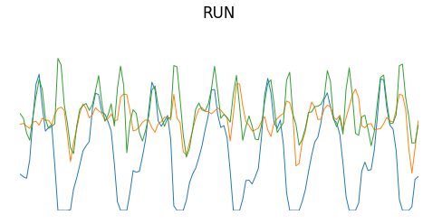
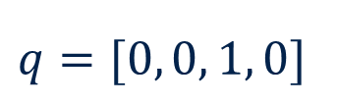
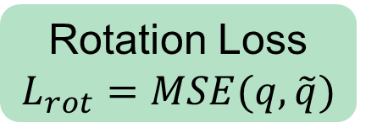
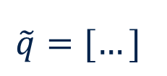
Old Orientation Loss
+
$$q=[0, 0, 1, 0]$$
$$\tilde{q}=[…]$$
Rotation Loss $L_{rot}=MSE(q, \tilde{q})$
Rotation Network R
Generator G

