Slide 1
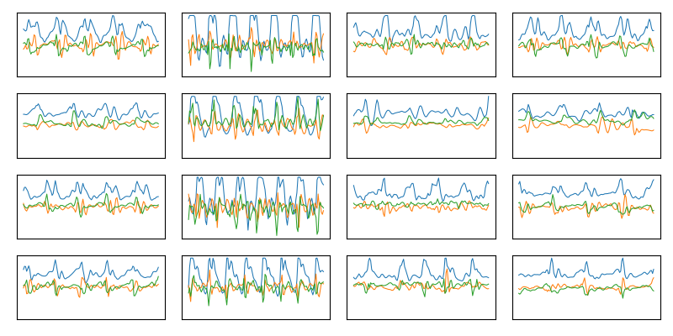
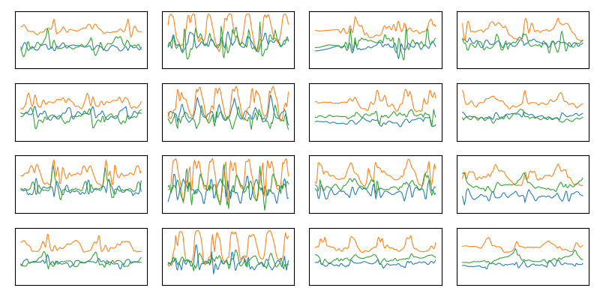
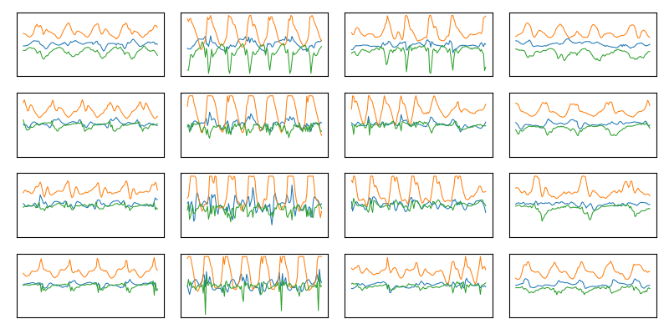
Datasets
Realworld (RW): 12k obs, 15 sub
Mobiact (MA): 11k obs, 61 sub
Pamap2 (PA): 1.5k obs, 6 sub

Slide 2




Train-Test Split
Source
Train GAN
Train baseline
$$X_{src}$$
Target
Unlabeled
Map to all classes
$$X_{map}$$
~80%
$$X_{trg}$$
~20%
Labeled
Used for evaluation
$$X_{test}$$

