Slide 1
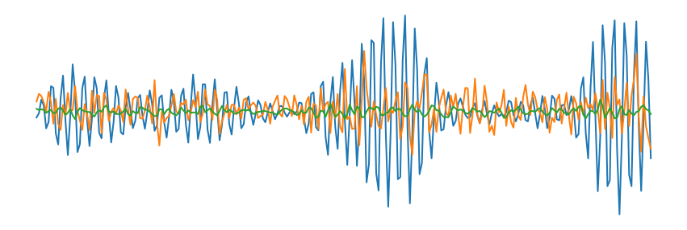
Classifier
ConvBlock1
ConvBlock:
Conv1D
BatchNorm
ReLU
MaxPool
Feature Extractor
ConvBlock2
ConvBlock3
MLP
ConvBlock4
d

Slide 2
TSTR Score

Slide 3
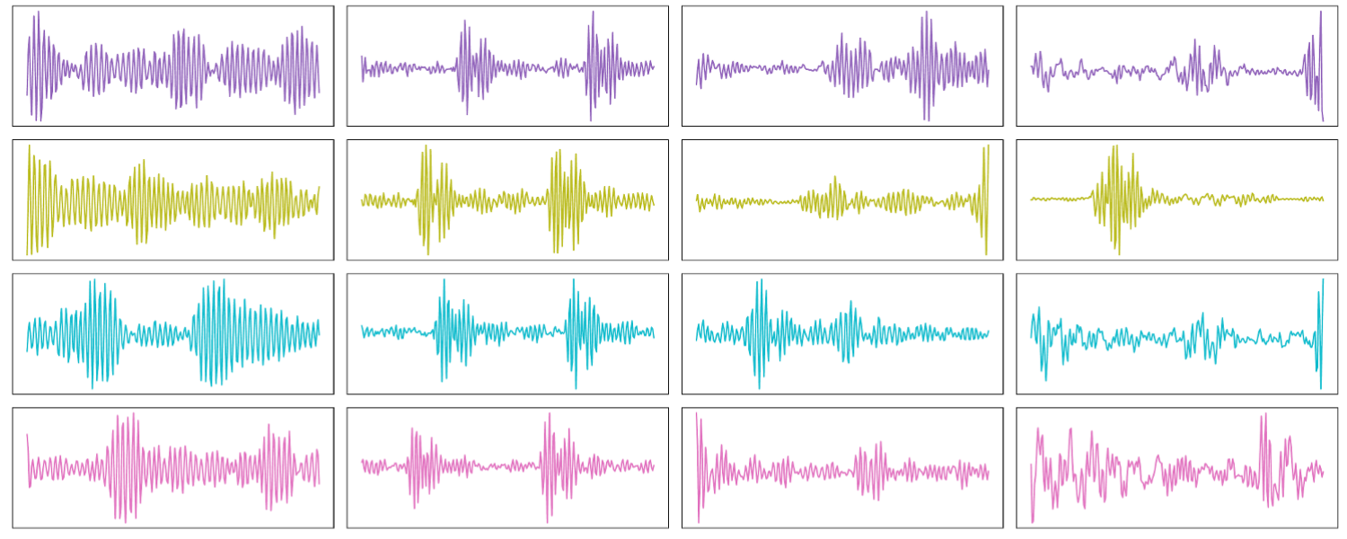


TSTR Score Dp
Train
Source
Target
Classifier $C_{K}$
Accuracy
$${d∈𝒟}_{p}$$
Dp

Slide 4
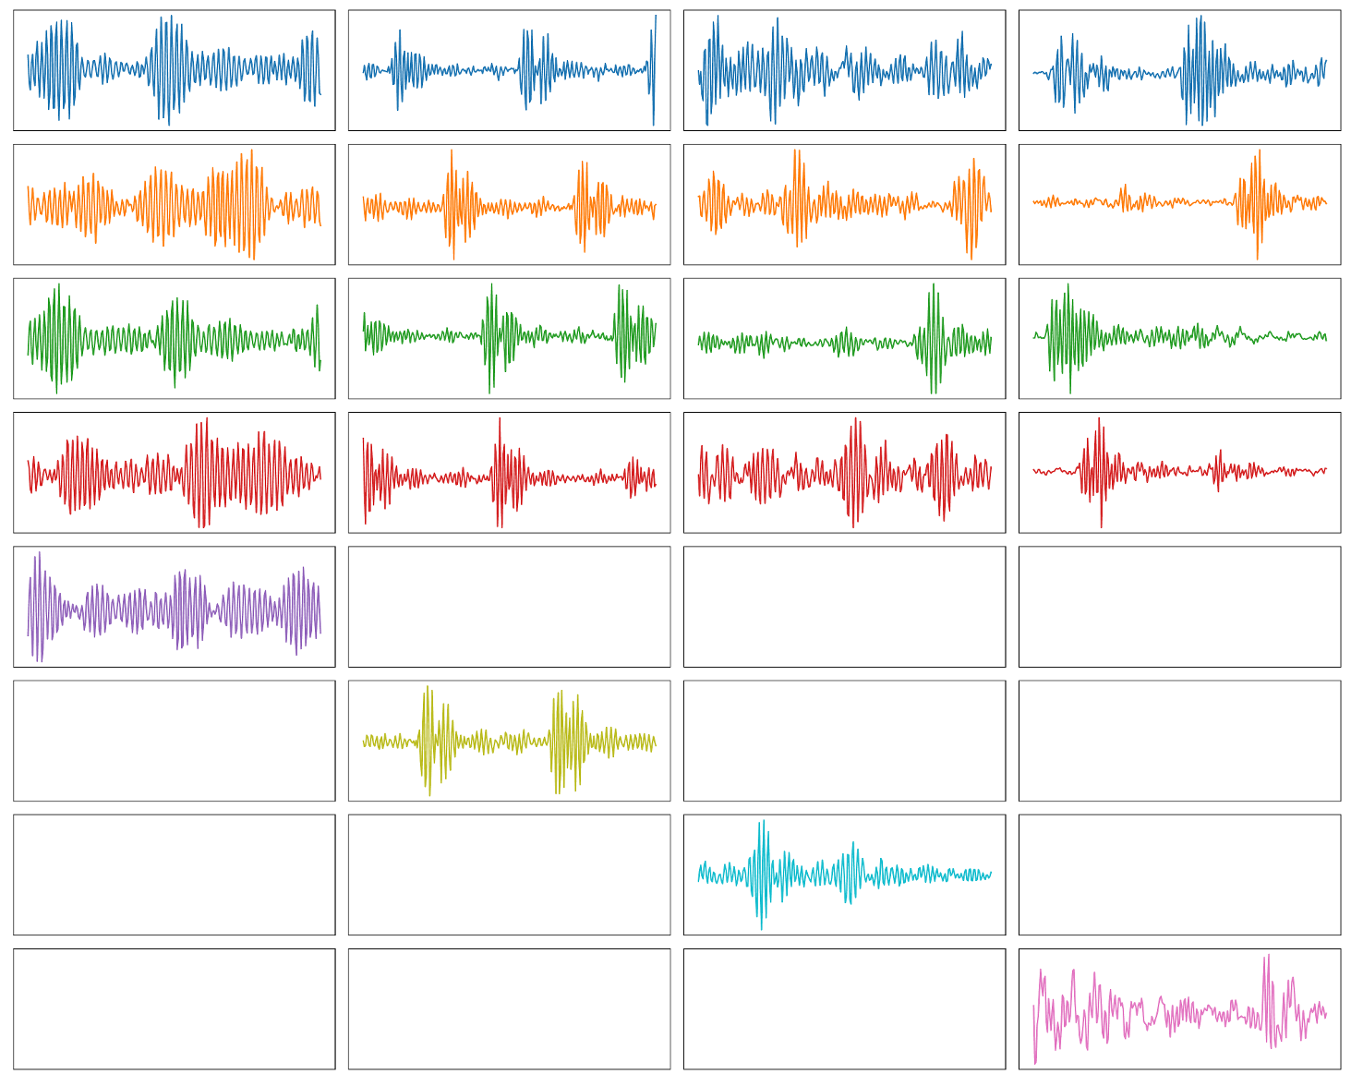



TSTR Score Df
Source
Target
$$𝒟_{f}$$
Train
Source
Target
Classifier $C_{K}$
Accuracy
$${d∈𝒟}_{p}$$
Df

Slide 5
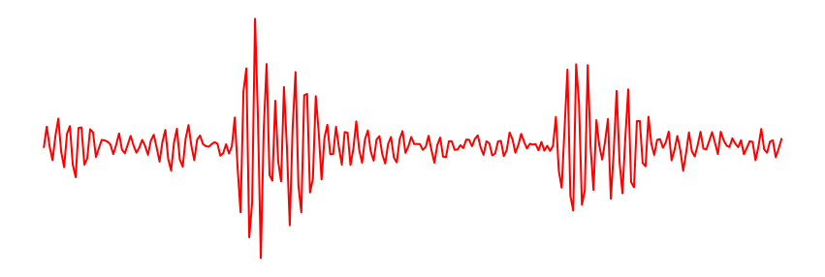
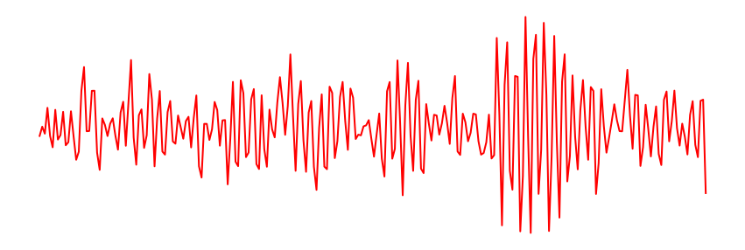
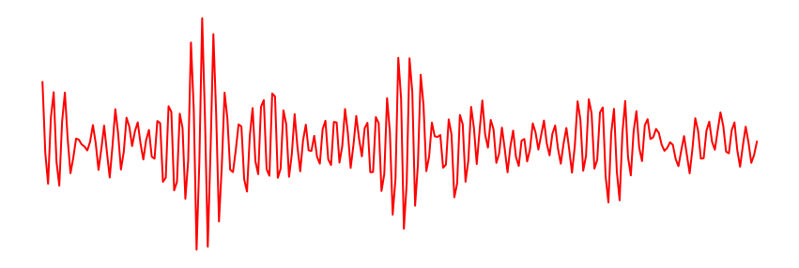

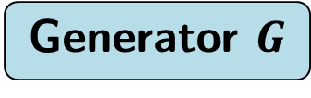

TSTR Score Syn
Target
Generator $G$
Train
Source
Target
Classifier $C_{K}$
Accuracy
$${d∈𝒟}_{p}$$
Syn

Slide 6




TSTR Score Df-Syn
Source
Target
$$𝒟_{f}$$
Train
Target
Fine Tune
$$G$$
Source
Target
$${d∈𝒟}_{p}$$
Classifier $C_{K}$
Accuracy
Df-Syn

Slide 7
FS Score

Slide 8
FS Score Dp
Train
Source
Target
Classifier $C_{K}$
Accuracy
$${d∈𝒟}_{p}$$
Dp

Slide 9


FS Score Dpfs
Source
Target
$${d∈𝒟}_{p}$$
Train
Source
Target
Classifier $C_{K}$
Accuracy
$${d∈𝒟}_{p}$$
Dpfs

Slide 10




FS Score Df-Dpfs
Source
Target
$$𝒟_{f}$$
Train
Source
Target
Fine Tune
$${d∈𝒟}_{p}$$
Source
Target
Classifier $C_{K}$
Accuracy
$${d∈𝒟}_{p}$$
Df-Dpfs

Slide 11
FS Score Df-Syn
Source
Target
$$𝒟_{f}$$
Train
Target
Fine Tune
$$G$$
Source
Target
$${d∈𝒟}_{p}$$
Classifier $C_{K}$
Accuracy
Df-Syn

Slide 12




FS Score Syn-Dpfs
Target
$$G$$
Train
Source
Target
Fine Tune
$${d∈𝒟}_{p}$$
Source
Target
Classifier $C_{K}$
Accuracy
$${d∈𝒟}_{p}$$
Syn-Dpfs

Slide 13





FS Score Df-Syn-Dpfs
Source
Target
$$𝒟_{f}$$
Train
Target
Fine Tune 1
$$G$$
Source
Target
Fine Tune 2
$${d∈𝒟}_{p}$$
Source
Target
Classifier $C_{K}$
Accuracy
$${d∈𝒟}_{p}$$
Df-Syn-Dpfs

