Slide 1
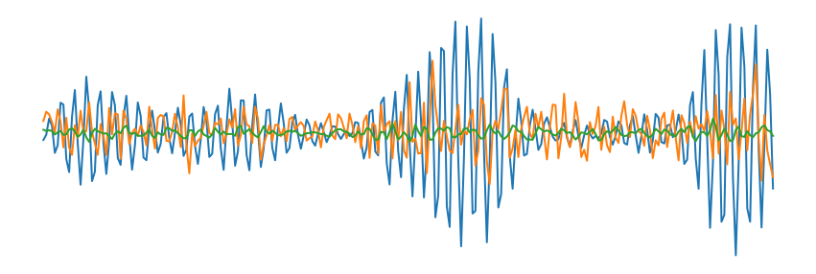
Classifier
ConvBlock1
ConvBlock:
Conv1D
BatchNorm
ReLU
MaxPool
Feature Extractor
ConvBlock2
ConvBlock3
MLP
ConvBlock4
d

Slide 2
TSTR Score

Slide 3
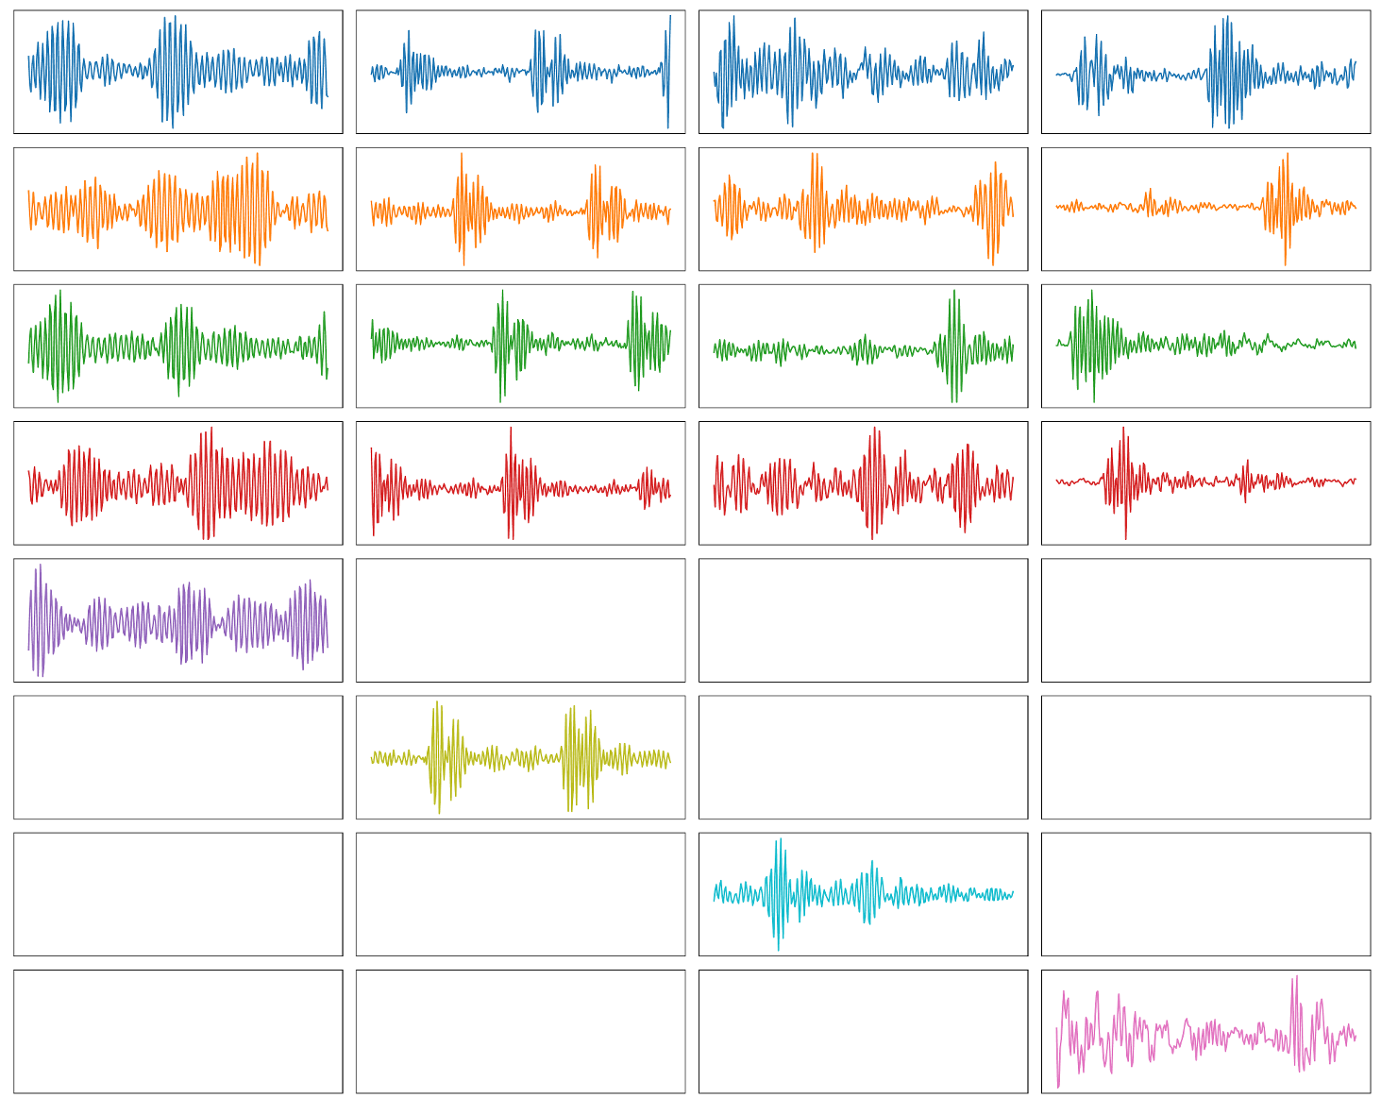
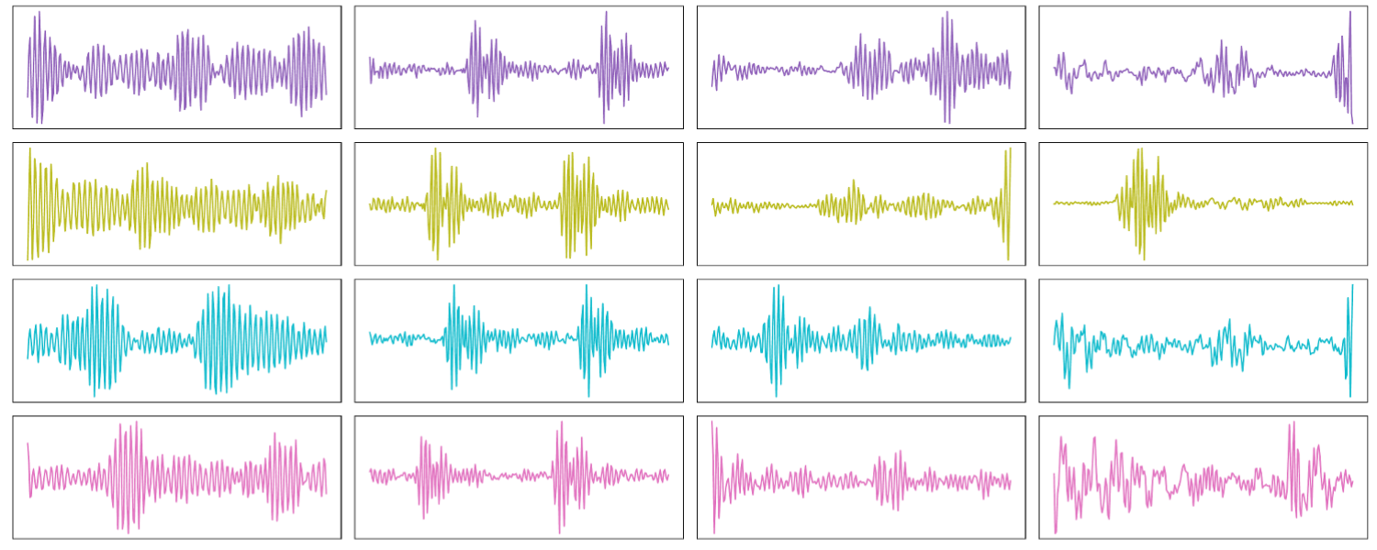



TSTR Score Df
Source
Target
$$𝒟_{f}$$
Train
Source
Target
Classifier $C_{K}$
Accuracy
$${d∈𝒟}_{p}$$
Df
RealWorld | 0.86
CWRU | 0.36

Slide 4
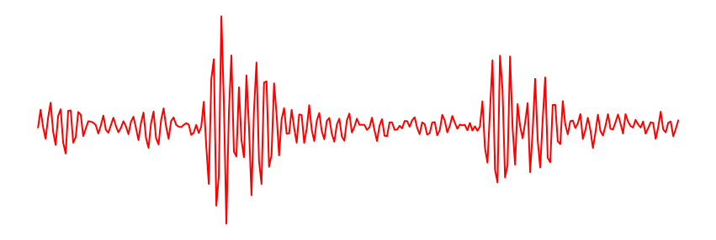
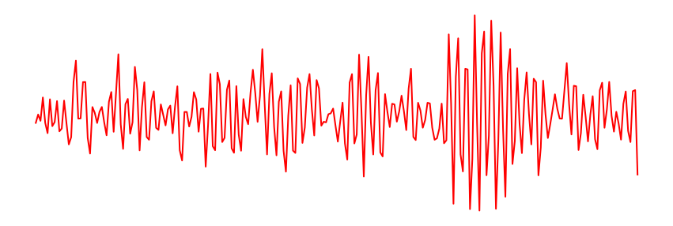
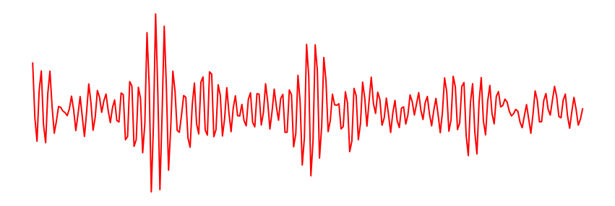

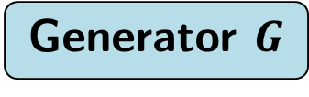

TSTR Score Syn
Target
Generator $G$
Train
Source
Target
Classifier $C_{K}$
Accuracy
$${d∈𝒟}_{p}$$
Syn
 |  |  | Joint
RealWorld |  |  | 0.88
CWRU |  |  | 0.37

Slide 5




TSTR Score Df-Syn
Source
Target
 | Lat | Ref | Joint
RealWorld | 0.89 | 0.88 | 0.9
CWRU | 0.31 | 0.3 | 0.3
$$𝒟_{f}$$
Train
Target
Fine Tune
$$G$$
Source
Target
$${d∈𝒟}_{p}$$
Classifier $C_{K}$
Accuracy
Df-Syn

Slide 6


TSTR Score Dp
Train
Source
Target
Classifier $C_{K}$
Accuracy
$${d∈𝒟}_{p}$$
Dp
RealWorld | 0.97
CWRU | 1.0

Slide 7
TSTR Score Results
 | Df | Syn | Df-Syn | Dp
RealWorld | 0.86 | 0.9 | 0.9 | 0.97
CWRU | 0.36 | 0.42 | 0.31 | 1.0

Slide 8
FS Score

Slide 9
FS Score Df
Source
Target
$$𝒟_{f}$$
Train
Source
Target
Classifier $C_{K}$
Accuracy
$${d∈𝒟}_{p}$$
Df
RealWorld | 0.86
CWRU | 0.36

Slide 10


FS Score Dpfs
Source
Target
$${d∈𝒟}_{p}$$
Train
Source
Target
Classifier $C_{K}$
Accuracy
$${d∈𝒟}_{p}$$
Dpfs
RealWorld | 0.49
CWRU | 0.27

Slide 11




FS Score Df-Dpfs
Source
Target
RealWorld | 0.94
CWRU | 0.4
$$𝒟_{f}$$
Train
Source
Target
Fine Tune
$${d∈𝒟}_{p}$$
Source
Target
Classifier $C_{K}$
Accuracy
$${d∈𝒟}_{p}$$
Df-Dpfs

Slide 12
FS Score Df+Dpfs
Source
Target
RealWorld | 0.92
CWRU | 0.62
$$𝒟_{f}$$
Train
Source
Target
Train
$${d∈𝒟}_{p}$$
Source
Target
Classifier $C_{K}$
Accuracy
$${d∈𝒟}_{p}$$
Df-Dpfs

Slide 13
FS Score Syn
Target
Generator $G$
Train
Source
Target
Classifier $C_{K}$
Accuracy
$${d∈𝒟}_{p}$$
Syn
 |  |  | Joint
RealWorld |  |  | 0.91
CWRU |  |  | 0.65

Slide 14
FS Score Df-Syn
Source
Target
 |  |  | Joint
RealWorld |  |  | 0.92
CWRU |  |  | 0.54
$$𝒟_{f}$$
Train
Target
Fine Tune
$$G$$
Source
Target
$${d∈𝒟}_{p}$$
Classifier $C_{K}$
Accuracy
Df-Syn

Slide 15
FS Score Df+Syn
Source
Target
 |  |  | Joint
RealWorld |  |  | 0.92
CWRU |  |  | 0.72
$$𝒟_{f}$$
Train
Target
Train
$$G$$
Source
Target
$${d∈𝒟}_{p}$$
Classifier $C_{K}$
Accuracy
Df-Syn

Slide 16




FS Score Syn-Dpfs
 |  |  | Joint
RealWorld |  |  | 0.94
CWRU |  |  | 0.78
Target
$$G$$
Train
Source
Target
Fine Tune
$${d∈𝒟}_{p}$$
Source
Target
Classifier $C_{K}$
Accuracy
$${d∈𝒟}_{p}$$
Syn-Dpfs

Slide 17





FS Score Df-Syn-Dpfs
Source
Target
 |  |  | Joint
RealWorld |  |  | 0.94
CWRU |  |  | 0.67
$$𝒟_{f}$$
Train
Target
Fine Tune 1
$$G$$
Source
Target
Fine Tune 2
$${d∈𝒟}_{p}$$
Source
Target
Classifier $C_{K}$
Accuracy
$${d∈𝒟}_{p}$$
Df-Syn-Dpfs

Slide 18
FS Score Dp
Train
Source
Target
Classifier $C_{K}$
Accuracy
$${d∈𝒟}_{p}$$
Dp
RealWorld | 0.97
CWRU | 1.0

Slide 19
FS Score Results
 | Df | Dpfs | Df-Dpfs | Syn | Df-Syn | Syn-Dpfs | Df-Syn-Dpfs | Dp
RealWorld | 0.86 | 0.49 | 0.94 | 0.91 | 0.92 | 0.94 | 0.94 | 0.97
CWRU | 0.36 | 0.27 | 0.4 | 0.65 | 0.54 | 0.78 | 0.67 | 1.0

