Slide 1
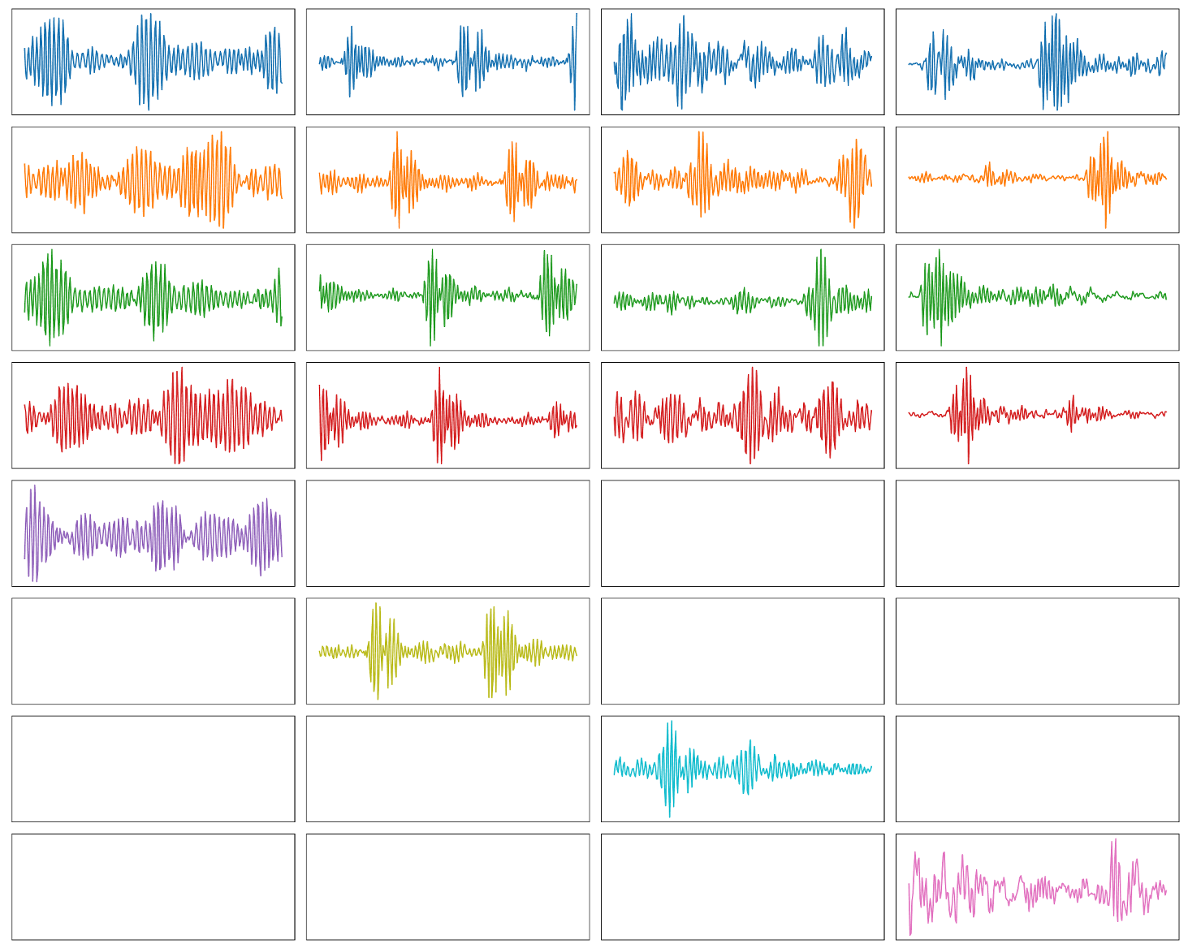




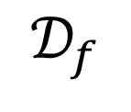

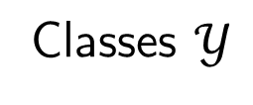
Scenario
Classes $𝒴$
$$𝒟_{f}$$
Training
$$𝒟_{p}$$
Fine Tuning

Slide 2
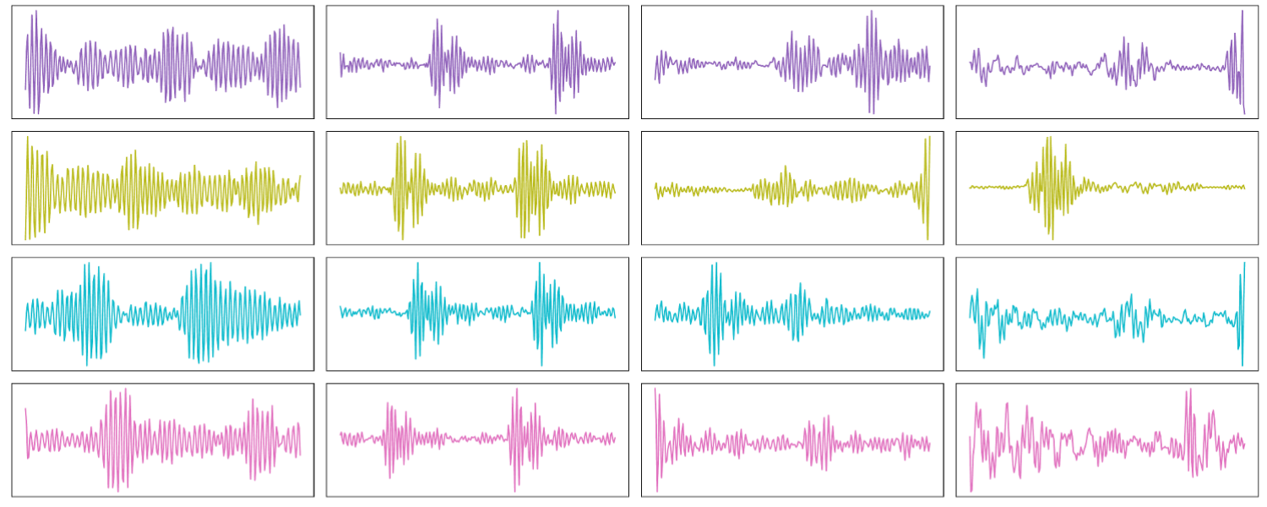



TSTR Score
Source $y_{s}$
Target $𝒴_{t}$
$${d∈𝒟}_{p}$$
Goal: Build a classifier to distinguish between classes in $𝒴_{t}$

Slide 3
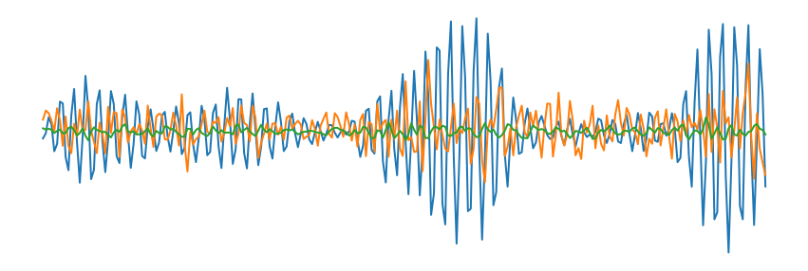
Classifier
ConvBlock1
ConvBlock:
Conv1D
BatchNorm
ReLU
MaxPool
Feature Extractor
ConvBlock2
ConvBlock3
MLP
ConvBlock4
c

Slide 4








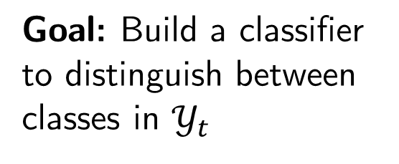
TSTR Score: Lower Bound
Goal: Build a classifier to distinguish between classes in $𝒴_{t}$
Source $y_{s}$
Target $𝒴_{t}$
$${d∈𝒟}_{p}$$
Target $𝒴_{t}$
Source $y_{s}$
Target $𝒴_{t}$
$$𝒟_{f}$$
$${d∈𝒟}_{p}$$

Slide 5










TSTR Score: Lower Bound
Source $y_{s}$
Target $𝒴_{t}$
 | Lower Bound
RealWorld | 0.94
CWRU | 0.40
$$𝒟_{f}$$
Train
Source $y_{s}$
Target $𝒴_{t}$
Fine Tune
$${d∈𝒟}_{p}$$
Source $y_{s}$
Target $𝒴_{t}$
Classifier $C_{K}$
Accuracy
$${d∈𝒟}_{p}$$
LB

Slide 6



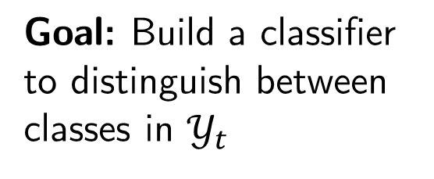




TSTR Score: Upper Bound
Goal: Build a classifier to distinguish between classes in $𝒴_{t}$
Source $y_{s}$
Target $𝒴_{t}$
$${d∈𝒟}_{p}$$
Train (CV)
Source $y_{s}$
Target $𝒴_{t}$
Classifier $C_{K}$
Accuracy
$${d∈𝒟}_{p}$$
UB
 | Upper Bound
RealWorld | 0.97
CWRU | 1.00

Slide 7
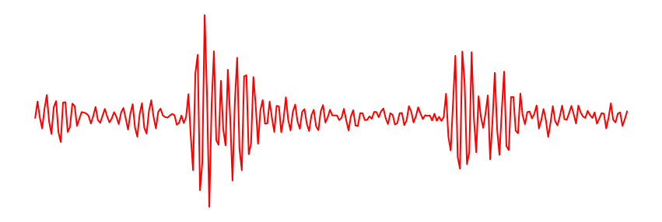
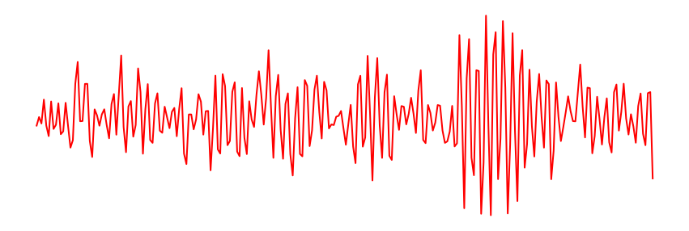
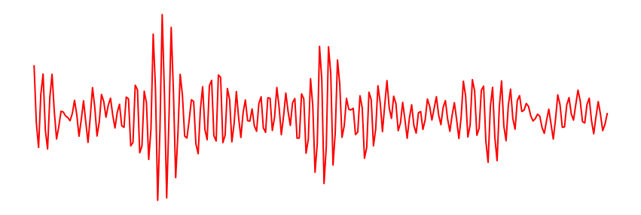

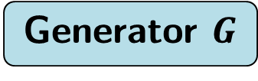



TSTR Score
Goal: Build a classifier to distinguish between classes in $𝒴_{t}$
Source $y_{s}$
Target $𝒴_{t}$
$${d∈𝒟}_{p}$$
Target $𝒴_{t}$
Generator $G$
Source $y_{s}$
Target $𝒴_{t}$
$${d∈𝒟}_{p}$$

Slide 8









TSTR Score
 | TSTR
RealWorld | 0.94
CWRU | 0.78
Target $𝒴_{t}$
$$G$$
Train
Source $y_{s}$
Target $𝒴_{t}$
Fine Tune
$${d∈𝒟}_{p}$$
Source $y_{s}$
Target $𝒴_{t}$
Classifier $C_{K}$
Accuracy
$${d∈𝒟}_{p}$$
TSTR

Slide 9
Results
 | LB | TSTR | UB
RealWorld | 0.94 | 0.94 | 0.97
CWRU | 0.40 | 0.78 | 1.00
Improve with:
HP tuning
Better few shot techniques
Better fine tuning
Improve with:
Better GAN fine tuning
HP tuning

