Slide 1
Da StarGAN v2 a v1

Slide 2
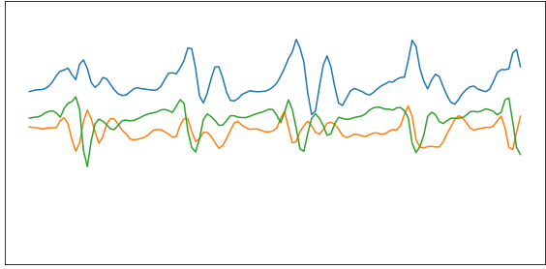
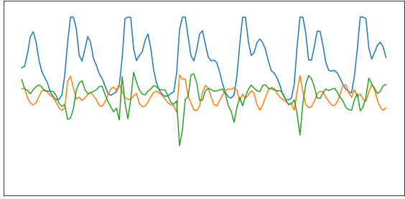
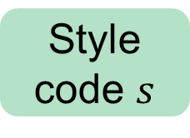
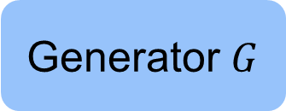
Da StarGAN v2 a v1
Walking
Rappresenta lo “stile” che vogliamo trasmettere alla time series durante il mapping da una classe a un’altra
Style code $s$
Generator $G$
Running

Slide 3


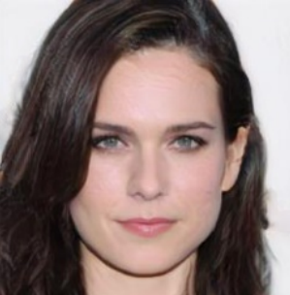
Da StarGAN v2 a v1
Rappresenta lo “stile” che vogliamo trasmettere alla time series durante il mapping da una classe a un’altra
Style code $s$
Generator $G$

Slide 4


Da StarGAN v2 a v1
Walking
Style code $s$
??
Generator $G$
Running

Slide 5
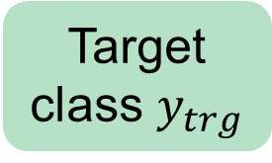
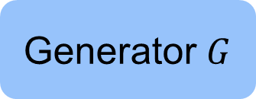
Da StarGAN v2 a v1
Walking
Target class $y_{trg}$
Lo style code non aveva un significato concreto per le time series
Framework semplificato (no mapping network e style encoder)
Tempo di training e dimensione dei checkpoint ridotti
Performance uguali
Generator $G$
Running

Slide 6

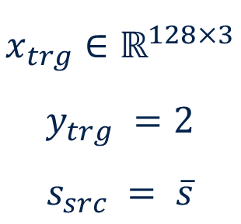
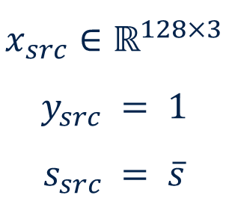
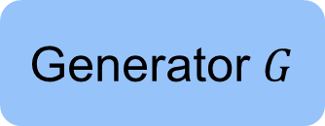
Walking
$$x_{src}∈ℝ^{128×3}$$
$$y_{src} = 1$$
$$s_{src} = \overline{s}$$
Target class $y_{trg}$
Generator $G$
$$x_{trg}∈ℝ^{128×3}$$
$$y_{trg} =2$$
$$s_{src} = \overline{s}$$
Running

Slide 7
Training

Slide 8
Training
Durante il training ripetiamo iterativamente tre step principali:
Process batch
Train auxiliary networks
Train generator

Slide 9
Training
Durante il training ripetiamo iterativamente tre step principali:
Process batch
Sample batch
Apply rotation
Train auxiliary networks
Train discriminator
Train classifier
Train subject network
Train generator
Source-to-target class
Target-to-source class
Source-to-source class

Slide 10
Step 1: Process batch

Slide 11
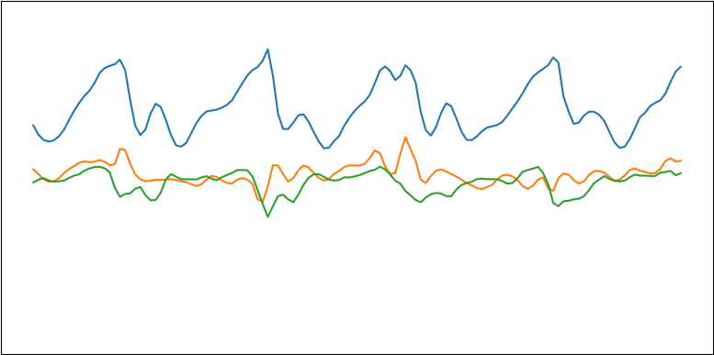
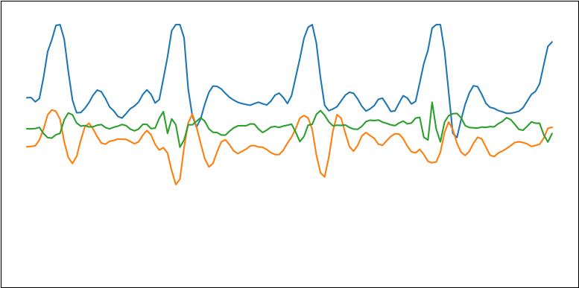
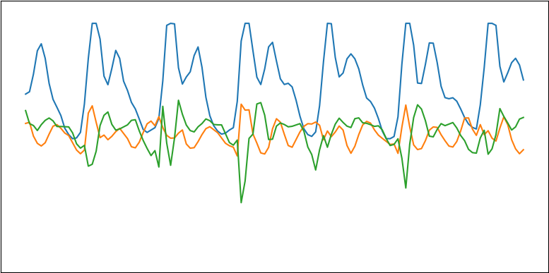
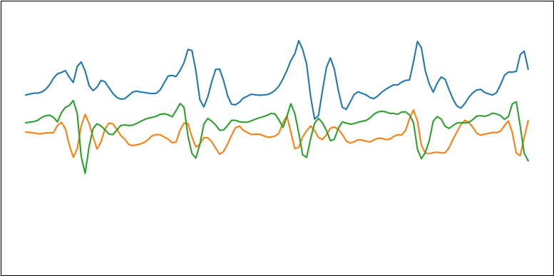
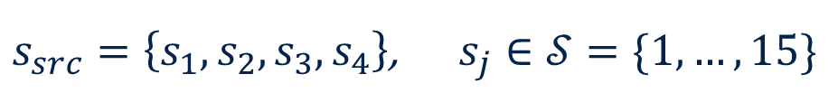
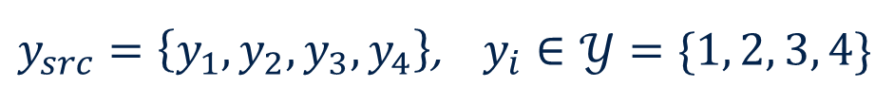
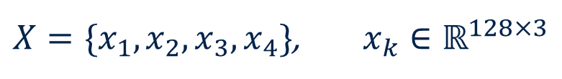
Step 1: Process batch
Step 1.1: Sample batch
Campioniamo 4 (batch size) time series, appartenenti a classi e soggetti randomici
$X=\{x_{1}, x_{2},x_{3},x_{4}\}$, $x_{k}∈ℝ^{128×3}$
$y_{src}=\left\{y_{1},y_{2},y_{3},y_{4}\right\}$, $y_{i}∈𝒴=\{1, 2, 3, 4\}$
$s_{src}=\left\{s_{1},s_{2},s_{3}, s_{4}\right\}$, $s_{j}∈𝒮=\{1, …, 15\}$

Slide 12




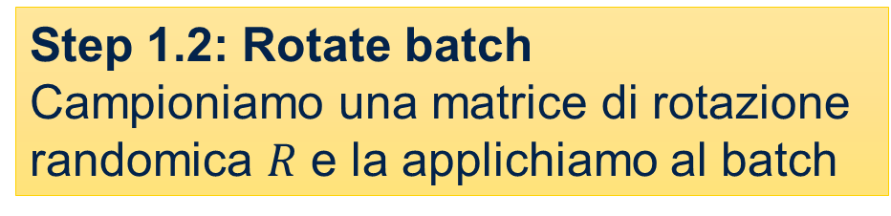



Step 1: Process batch
Step 1.2: Rotate batch
Campioniamo una matrice di rotazione randomica $R$ e la applichiamo al batch
$$X$$
$$X_{R}=XR$$
$$R$$
$$y_{src}$$
$$y_{src}$$
$$s_{src}$$
$$s_{src}$$

Slide 13
Step 2: Train auxiliary networks

Slide 14
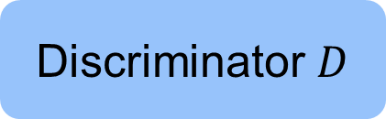


Step 2: Train auxiliary networks
$$X$$
Step 2.1: Train discriminator
Addestriamo il discriminatore a riconoscere time series reali
Discriminator $D$
$$D\left(X\right)=ℙ\left(X real\right)$$

Slide 15




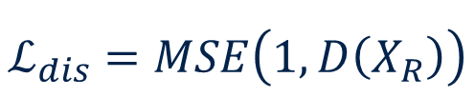


Step 2: Train auxiliary networks
Step 2.1: Train discriminator
Addestriamo il discriminator a riconoscere time series reali
$$X_{R}$$
$$D$$
$$y_{src}$$
$$D\left(X_{R}\right)=ℙ\left(X_{R} real\right)$$
$$s_{src}$$
$$ℒ$$
$$ℒ_{dis}=MSE\left(1, D\left(X_{R}\right)\right)$$
Addestriamo il discriminatore a minimizzare questo termine

Slide 16
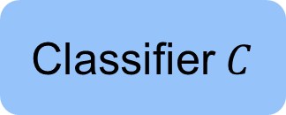
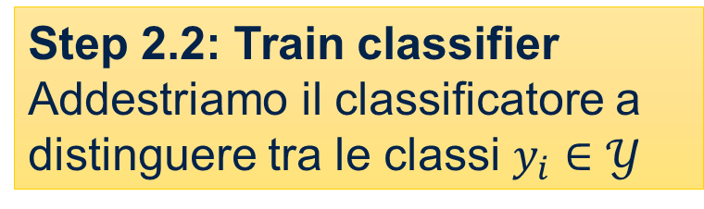


Step 2: Train auxiliary networks
$$X$$
Step 2.2: Train classifier
Addestriamo il classificatore a distinguere tra le classi $y_{i}∈𝒴$
Classifier $C$
$$C\left(X\right)={\left\{ℙ\left(X∈y_{i}\right)\right\}}_{i=1}^{4}$$

Slide 17



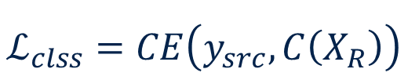


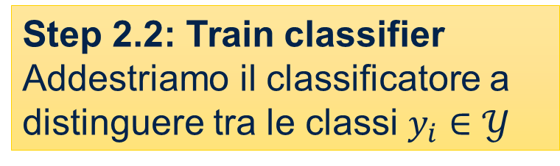

Step 2: Train auxiliary networks
Step 2.2: Train classifier
Addestriamo il classificatore a distinguere tra le classi $y_{i}∈𝒴$
$$X_{R}$$
$$C$$
$$y_{src}$$
$$C\left(X_{R}\right)={\left\{ℙ\left(X_{R}∈y_{i}\right)\right\}}_{i=1}^{4}$$
$$s_{src}$$
$$ℒ$$
$$ℒ_{clss}=CE\left(y_{src}, C\left(X_{R}\right)\right)$$
Addestriamo il classificatore a minimizzare questo termine

Slide 18
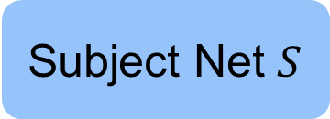
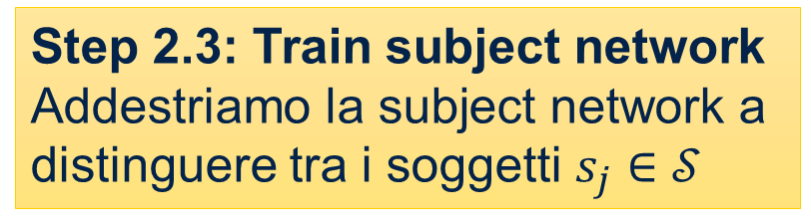
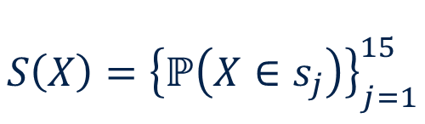

Step 2: Train auxiliary networks
$$X$$
Step 2.3: Train subject network
Addestriamo la subject network a distinguere tra i soggetti $s_{j}∈𝒮$
Subject Net $S$
$$S\left(X\right)={\left\{ℙ\left(X∈s_{j}\right)\right\}}_{j=1}^{15}$$

Slide 19
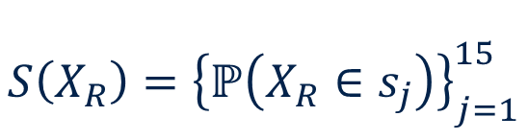
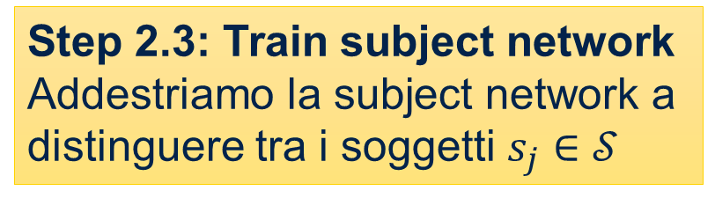

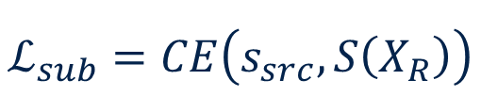

Step 2: Train auxiliary networks
Step 2.3: Train subject network
Addestriamo la subject network a distinguere tra i soggetti $s_{j}∈𝒮$
$$X_{R}$$
$$S$$
$$S\left(X_{R}\right)={\left\{ℙ\left(X_{R}∈s_{j}\right)\right\}}_{j=1}^{15}$$
$$y_{src}$$
$$s_{src}$$
$$ℒ$$
$$ℒ_{sub}=CE\left(s_{src}, S\left(X_{R}\right)\right)$$
Addestriamo la subject network a minimizzare questo termine

Slide 20
Step 3: Train generator

Slide 21


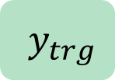

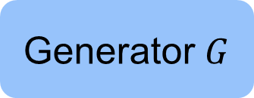
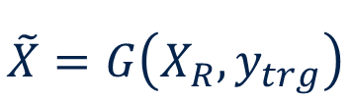



Step 3: Train generator
$$X_{R}$$
$$y_{src}$$
Campioniamo $y_{trg}$
$$s_{src}$$
$y_{trg}$
Generator $G$
Step 3.1: Source-to-target class
Mappiamo il batch di time series dalle classi source alle classi target
$$\tilde{X}=G\left(X_{R}, y_{trg}\right)$$
$$y_{trg}$$
$$s_{src}$$

Slide 22


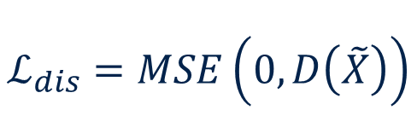



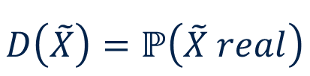

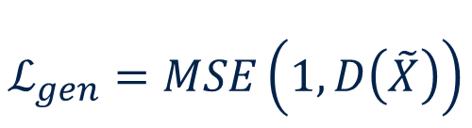
Step 3: Train generator
Step 3.1: Source-to-target class
Mappiamo il batch di time series dalle classi source alle classi target e addestriamo il generatore utilizzando le reti ausiliarie
$$\tilde{X}$$
$$D$$
$$y_{trg}$$
$$D\left(\tilde{X}\right)=ℙ\left(\tilde{X} real\right)$$
$$s_{src}$$
$$ℒ$$
$$ℒ_{dis}=MSE\left(0, D\left(\tilde{X}\right)\right)$$
Addestriamo il discriminatore e il generatore a minimizzare questi termini
$$\tilde{X}=G\left(X_{R}, y_{trg}\right)$$
$$ℒ_{gen}=MSE\left(1, D\left(\tilde{X}\right)\right)$$

Slide 23



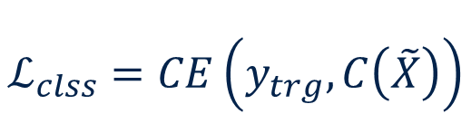

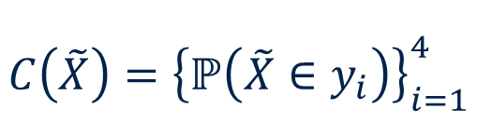

Step 3: Train generator
Step 3.1: Source-to-target class
Mappiamo il batch di time series dalle classi source alle classi target e addestriamo il generatore utilizzando le reti ausiliarie
$$\tilde{X}$$
$$C$$
$$C\left(\tilde{X}\right)={\left\{ℙ\left(\tilde{X}∈y_{i}\right)\right\}}_{i=1}^{4}$$
$$y_{trg}$$
$$s_{src}$$
$$ℒ$$
$$ℒ_{clss}=CE\left(y_{trg}, C\left(\tilde{X}\right)\right)$$
$$\tilde{X}=G\left(X_{R}, y_{trg}\right)$$
Addestriamo il generatore a minimizzare questo termine

Slide 24
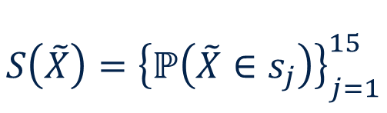

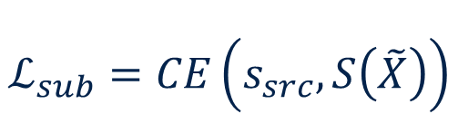

Step 3: Train generator
Step 3.1: Source-to-target class
Mappiamo il batch di time series dalle classi source alle classi target e addestriamo il generatore utilizzando le reti ausiliarie
$$\tilde{X}$$
$$S$$
$$S\left(\tilde{X}\right)={\left\{ℙ\left(\tilde{X}∈s_{j}\right)\right\}}_{j=1}^{15}$$
$$y_{trg}$$
$$s_{src}$$
$$ℒ$$
$$ℒ_{sub}=CE\left(s_{src}, S\left(\tilde{X}\right)\right)$$
$$\tilde{X}=G\left(X_{R}, y_{trg}\right)$$
Addestriamo il generatore a minimizzare questo termine

Slide 25

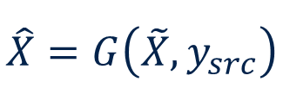
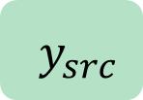


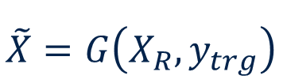

Step 3: Train generator
$$\tilde{X}=G\left(X_{R}, y_{trg}\right)$$
$$y_{trg}$$
$$s_{src}$$
$y_{src}$
Step 3.2: Target-to-source class
Mappiamo le time series generate dalle classi target alle classi source
Generator $G$
$$\hat{X}=G\left(\tilde{X}, y_{src}\right)$$
$$y_{src}$$
$$s_{src}$$

Slide 26



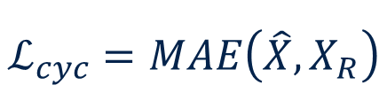




Step 3: Train generator
Step 3.2: Target-to-source class
Mappiamo le time series generate dalle classi target alle classi source e addestriamo il generatore a ricostruire le time series originali
$$\hat{X}$$
$$X_{R}$$
$$y_{src}$$
$$y_{src}$$
$$s_{src}$$
$$s_{src}$$
$$ℒ_{cyc}=MAE\left(\hat{X}, X_{R}\right)$$
$$\hat{X}=G\left(\tilde{X}, y_{src}\right)=G\left(G\left(X_{R}, y_{trg}\right), y_{src}\right)$$

Slide 27



Step 3: Train generator
$$X_{R}$$
$$y_{src}$$
$$s_{src}$$
$y_{src}$
Step 3.3: Source-to-source class
Mappiamo il batch di time series dalle classi source alle stesse classi source
Generator $G$
$$\check{X}=G\left(X_{R}, y_{src}\right)$$
$$y_{src}$$
$$s_{src}$$

Slide 28


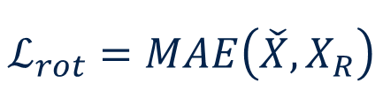
Step 3: Train generator
Step 3.3: Source-to-source class
Mappiamo il batch di time series dalle classi source alle stesse classi source e addestriamo il generatore a mantenere l’orientamento originale
$$\check{X}$$
$$X_{R}$$
$$y_{src}$$
$$y_{src}$$
$$s_{src}$$
$$s_{src}$$
$$ℒ_{rot}=MAE\left(\check{X}, X_{R}\right)$$
$$\check{X}=G\left(X_{R}, y_{src}\right)$$

Slide 29
Network architecture

Slide 30
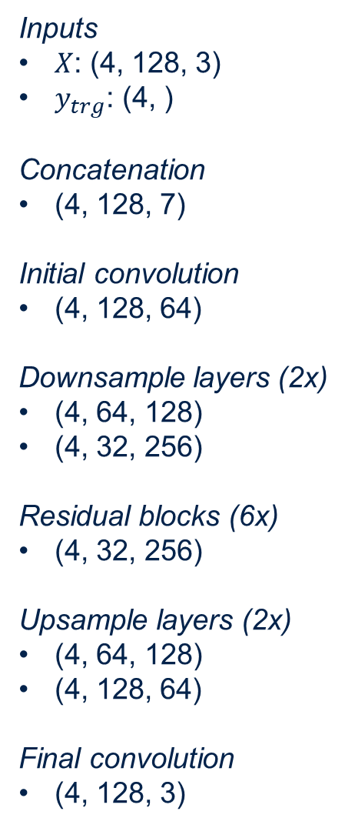

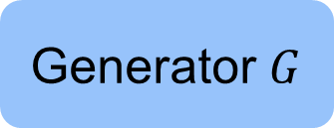
Network architecture
Inputs
$X$: (4, 128, 3)
$y_{trg}$: (4, )
Concatenation
(4, 128, 7)
Initial convolution
(4, 128, 64)
Downsample layers (2x)
(4, 64, 128)
(4, 32, 256)
Residual blocks (6x)
(4, 32, 256)
Upsample layers (2x)
(4, 64, 128)
(4, 128, 64)
Final convolution
(4, 128, 3)
$y_{trg}$
Generator $G$

Slide 31
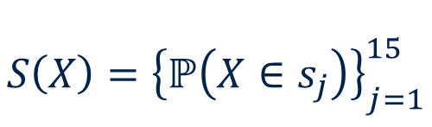
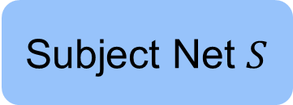




Network architecture
Discriminator $D$
Classifier $C$
Subject Net $S$
$$S\left(X\right)={\left\{ℙ\left(X∈s_{j}\right)\right\}}_{j=1}^{15}$$
$$D\left(X\right)=ℙ\left(X real\right)$$
$$C\left(X\right)={\left\{ℙ\left(X∈y_{i}\right)\right\}}_{i=1}^{4}$$

Slide 32


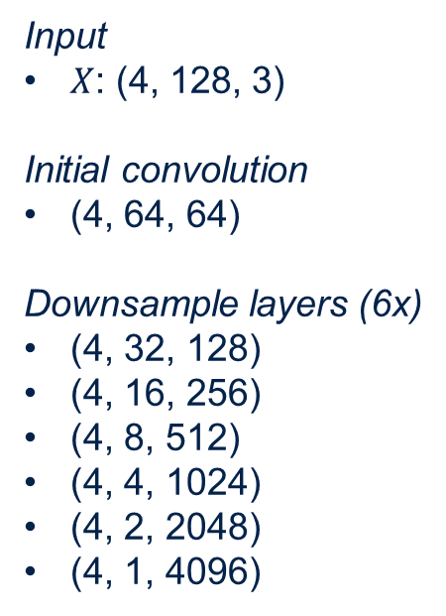


Network architecture
Input
$X$: (4, 128, 3)
Initial convolution
(4, 64, 64)
Downsample layers (6x)
(4, 32, 128)
(4, 16, 256)
(4, 8, 512)
(4, 4, 1024)
(4, 2, 2048)
(4, 1, 4096)
Feature Extractor $E$
Discriminator $D$
Classifier $C$
Subject Net $S$
$$S\left(X\right)={\left\{ℙ\left(X∈s_{j}\right)\right\}}_{j=1}^{15}$$
$$D\left(X\right)=ℙ\left(X real\right)$$
$$C\left(X\right)={\left\{ℙ\left(X∈y_{i}\right)\right\}}_{i=1}^{4}$$

