Slide 1
Meeting agenda
11.00 stefano (struttura generale del codice)
11.30 silvio (strong coupling)
12.00 emanuele (sse)
12.30 jacopo (fluttuazioni energie)
13.00 gabriel (interfaccia con octopus)
13.30-15.00 pranzo (o colazione)
15.00-17.30 discussione su stile di programmazione e input

Slide 2
Expected goals for today
Intro on the structure of the codes
Update on on-going implementation
Provide written materials for helping future developments (i.e., our slides!)
Decide on common coding policies
Decide how to (and who...) adapt the code so far to such policies
Fix a deadline for an open source release?

Slide 3
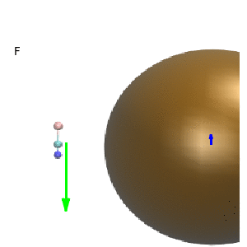

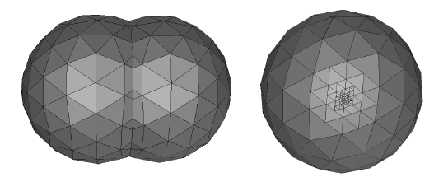

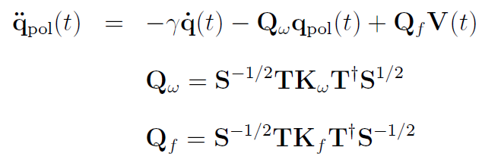



One-slide resume’ (!)
TDSE:
q_{pol},_{i}
EOM for polarization charges:
For K and T matrices, we need to diagonalize:
A: diagonal matrix of tessera areas
Pipolo&Corni

Slide 4

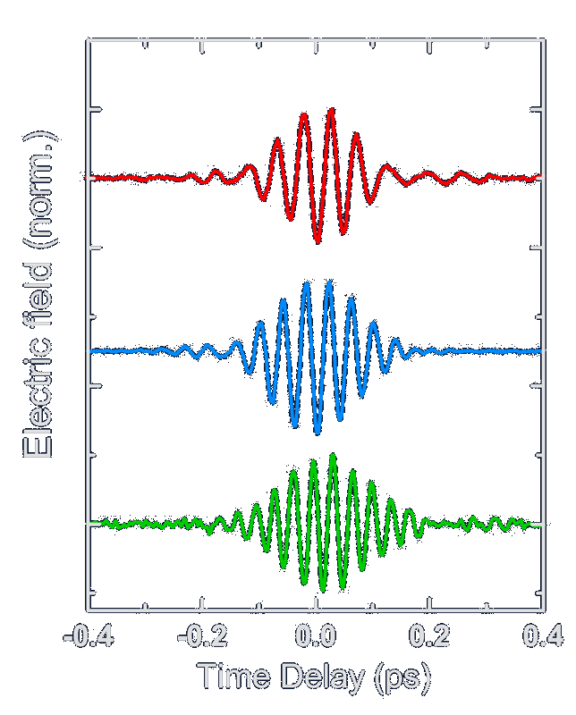
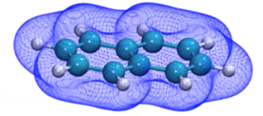
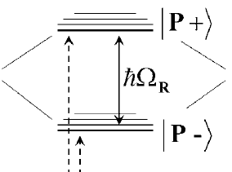
Develop dedicated software
RT-TDDFT codes
(Octopus, GPAW, NWchem...)
Non-adiabatic nuclei codes
(PIXAID, Newton-X, Ant...)
TDPlas
Implement TD-BEM
Enable plasmons in QM codes
Input for quantum plasmons
NEW
External module
Diagonalize
WaveT
TD post-Hartree Fock
TD hybrid plasmon-molecule sim.
Include dephasing and relaxation
NEW
Self-standing
executable
Post-HF codes
(GAMESS, Dalton, Gaussian...)
open source, freely distributed, accessible to non-specialists

Slide 5

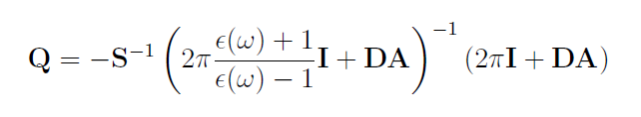
Current status of master
https://github.com/stefano-corni/WaveT
  4 different mains
    WaveT (main.f90)
      propagate TDSE and TDStochasticSE
      “hard-coded” interface with TDPlas modules for NP and solvent
    TDPlas (main_tdplas.f90)
      Just create PCM matrices
    Freq (main_freq.f90)
      solve charges in frequency domain (useful for comparisons)
    Spectra (main_spectra.f90)
      Fourier-transform dipole trace to absorption spectra

Slide 6
Current status of master
https://github.com/stefano-corni/WaveT
10 modules:
  readio_medium.f90: i/o for NP and solvent, medium global variables
  pedra_friends.f90: build the tessellation on NP and solvent cavities with GEPOL algorithm
  BEM_medium.f90: build the D and S matrix, diagonalize
  scf.f90: scf optimizes molecule state close to NP
  td_contmed.f90: solve the charge EOM
  readio.f90: i/o for TDSE (and TDSSE?), all global variables
  propagate.f90: solve TDSE and TDSSE
  dissipation.f90: supporting routines for TDSSE
  random.f90: random number generation routines, external
  spectra.f90: post-processing to calculate spectra (main_spectra.f90)

Slide 7
QM_coupling.f90: a few routines for strong coupling
cav_types.f90: derived types for PCM cavity data (perhaps join to pedra_friends.f90?)

Slide 8
Current status of master
https://github.com/stefano-corni/WaveT
10 modules:
  readio_medium.f90: i/o for NP and solvent, medium global variables
  pedra_friends.f90: build the tessellation on NP and solvent cavities with GEPOL algorithm
  BEM_medium.f90: build the D and S matrix, diagonalize
  scf.f90: scf optimizes molecule state close to NP
  td_contmed.f90: solve the charge EOM
  readio.f90: i/o for TDSE (and TDSSE?), all global variables
  propagate.f90: solve TDSE and TDSSE
  dissipation.f90: supporting routines for TDSSE
  random.f90: random number generation routines, external
  spectra.f90: post-processing to calculate spectra (main_spectra.f90)
T
D
P
l
a
s
W
a
v
e
T

Slide 9
Separation WaveT vs TDPLAS
√ Subroutines are properly distributed between modules
X main.f90 calls both from WaveT and from TDPlas
X input is still a single file
X no plumed-like self installing feature for TDPlas
....?

Slide 10
Variables determining the internal workflow
character*3 often starting with F (eg, Fbem), plus a few logicals, plus a few integer (to be standardized!)
mdm: vac, NanoP or solvent
Ffld: shape of the light pulse (gaussian, pi, etc.)
rad: radiative damping (experimental)
dis (logical): if it is TDSSE
qjump (logical): quantum jump alghoritm for TDSSE
tdis,nr_typ,imar(integer): TDSSE options
ernd (logical): random energy fluctuations
nmodes (integer): number of modes for strong coupling (0 no strong coupling)
mdm_init_prop: initial condition for q (SCF or sudden excitation)
Fchr: reference for q (zero, equilibrated to GS, read from outside)
Fint: Onsager (mu*E) vs PCM (q*V) coupling
Fprop: kind of EOM (for E alone, ief, iefd, cosmo, ecc., see JPC A 2014)
Feps: Debye/Drude-Lorentz dielectric constant
Fbem: read PCM matrixes and tesselation or write them and stop
Fcav: build tesselation / read from previous run / read from GMSH code
Fdeb: debug options
Floc: include local field effect / do not include them

Slide 11
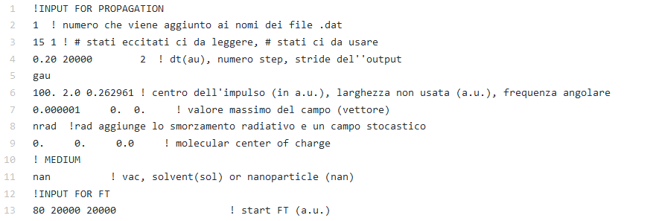
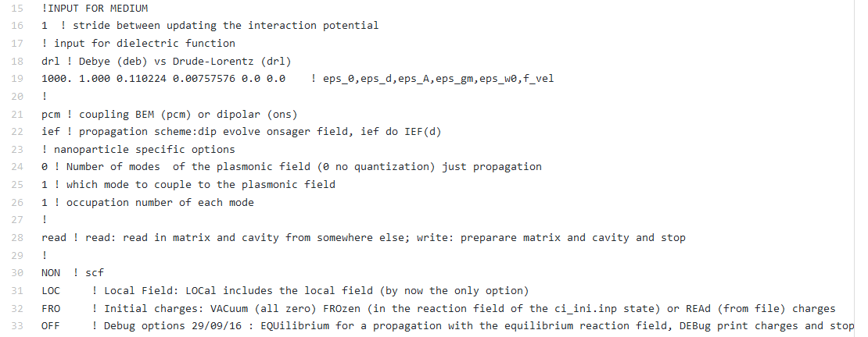
Input

Slide 12
Discussion

Slide 13
Separation WaveT vs TDPLAS
√ Subroutines are properly distributed between modules
X main.f90 calls both from WaveT and from TDPlas
X input is still a single file
X no plumed-like self installing feature for TDPlas
....?

Slide 14
Variable policies
move global variables from readio to global_variable? (and similar for _medium)
use module (or, if needed, global) variables to have short routine calls
make the variable scope as small as possible (i.e., no need to put as a global variables if the needed scope is a module).
Read variables inside the module by calling proper reading routines from general input reading
to determine workflow, do to use logical but character variables (now 3 characters)
use meaningful names, deallocate an old and allocate a new variable rather than reusing the same variable for different things

Slide 15
Subroutine & modules
Do not define new modules unless there is a clear need for an independent “working space”
Try to put routines where they belong (typically: if you need to pass a lot of variables, it does not belong)

Slide 16
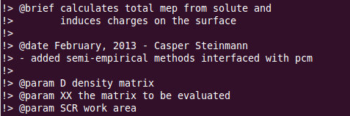
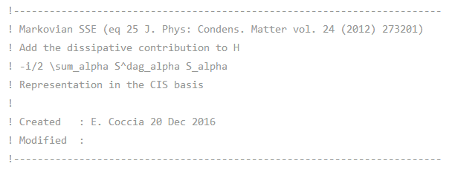
Comments
Each subroutine should have a header section like:
just a documentation-friendly version of:
identify yourself in the comments (initials, name)

Slide 17
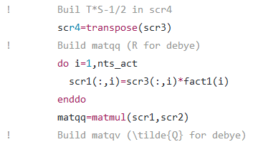
Comments
Please add comments that refer to the original papers, using similar nomenclature in comments

Slide 18
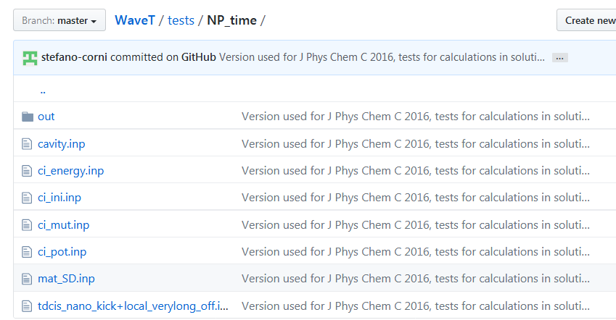
Tests
Each new implementation requires one or more tests/examples to be added
should be a sub-directory of tests/ (eg, tests/example1)
example1 should contain all and only the input files, plus perhaps a readme
example1 should contain a subdirectory out with example results

Slide 19
To Do
Split WaveT and TDPlas. STEFANO 3
Create two subdirectories for the two codes GABRIEL 4
Create src and bin subdirectory GABRIEL 4
Input format namelist EMANUELE 1
Harmonize workflow variables: char*5, name is F_.....SILVIO 2
Derived types: use then when reasonable
Change tessera..x, ...y in array
Add comments at the beginning of each subroutine, in doxygen format EVERYBODY
Adapt and check tests for solvent
Add missing tests (if any)
Add module math_util.f90
Add subroutine init_NOMEMODULO to initialize, & finalize_NOMEMODULO
Pass variable values inside modules by fetching routines (instead of reading input directly): get_NOMEVARIABILE
No automatic arrays (use allocatable)

Slide 20
Anything else?

